Slide 1
CrowSoft Technologies

Slide 2
Purpose Online Business Intelligence to analyze building suitability and running costs.
Customer facing on-line system to analyse Building data
Customer will enter building information
upload files or images
Analysis features
Review similar building within a given price range
Display costs associated to each building
Maintenance projects associated to any special features
Requirement
The analysis system should be clean and simple.
simplified graphics.
administrator has access to edit detailed information
Once a client enters details it should not be able to be changed by the client.

Slide 3





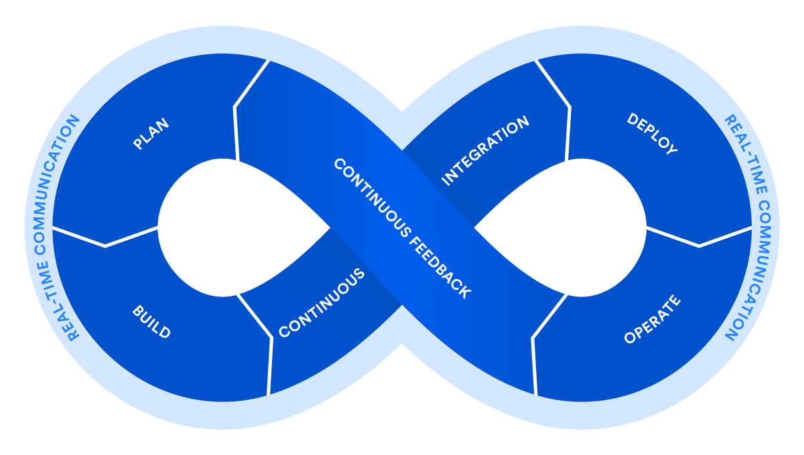










Technologies & DevOps Process
Requirements & Planning
Configuration Management
Continuous Integration & Deploy
Deployment
Environments
Collaboration
Operate & Monitor
Build
Automated Testing
Wrk
Performce Tests

Slide 4
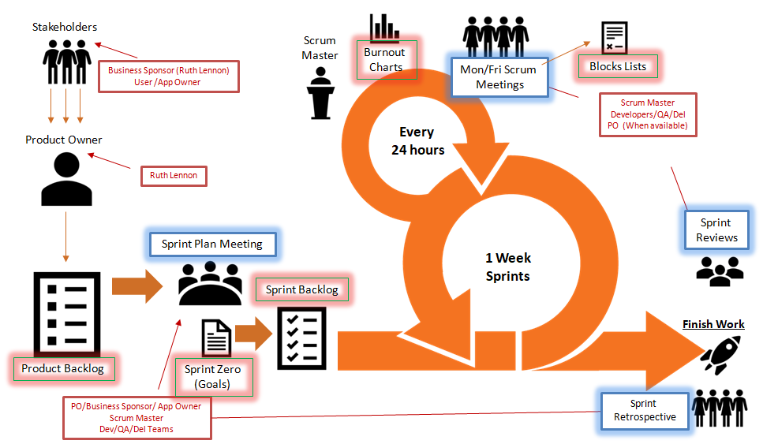
Agile Process

Slide 5



Progress to date Development Environment
To Be Implemented
Jenkins Server
Dev Server
Planning
Collaboration
Wrk
Performance Tests
Build Tools
Jenkins
Java
Open SSH
Putty

Slide 6
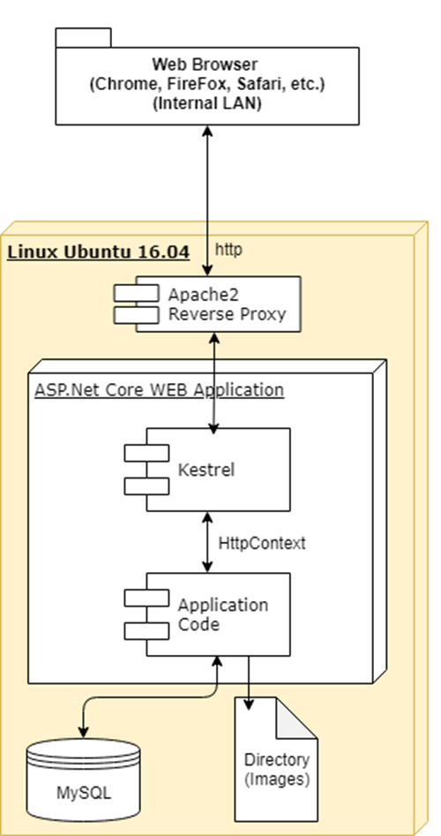
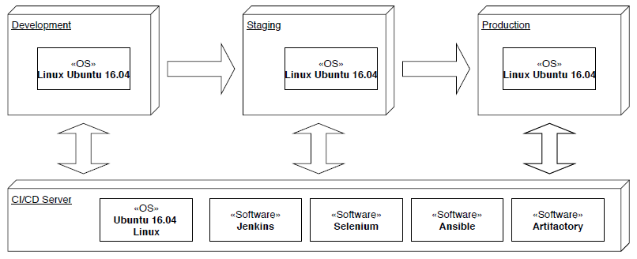
Software Stack
Infrastructure

Slide 7


Code Repository
GitHub
https://github.com/rlennon/CrowSoft

Slide 8
Security

Slide 9



Requirements & Planning
Configuration Management
Continuous Integration & Deploy
Deployment
Environments
Collaboration
Operate & Monitor
Build
Automated Testing
Wrk
Performance Tests

