Slide 1
PI Hole – Local DNS for Adblocking
By: Richard Lentz

Slide 2
Dynamic Host Configuration Protocol (DHCP)
Each computer on a local network needs a unique valid IP address for the given network
This can be done in 2 ways
Each IP address can be set manually
Or DHCP can be used to dynamically assign a unique IP address
DHCP also provides the computer with additional network information
DHCP provides the default gateway or router IP for the network
The router allows for communication external to the local network
DHCP also provides the IP of a Domain Name Server (DNS) to use
The DNS server allows for hostname to IP address resolution

Slide 3
DNS Intro
Name Resolution
Process of attaining a valid IP address based on the host or domain name of a computer
Example:
Domain Name: www.msn.com
Associated IP: 204.79.197.203
In the past each host/domain name was stored in a local file
For example the /etc/hosts file
Difficult to manage & update

Slide 4
DNS Naming Convention
Domain names are the unique friendly name used to access a server without needing to remember the IP address
Domain Name Example: cis4325-server.ccec.unf.edu
Domain names are analyzed from right to left with each domain delimited by a period .
Breaking down the example above
The Top-Level domain is edu
The Second-Level domain is unf
The Subdomain is ccec
Any number of additional subdomains can exist
The Hostname is cis4325-server

Slide 5
URLs & Domains
Uniform Resource Locators (URLs) are used to request information from a remote server
Format:
‘protocol’://‘server_IP_or_domain_name’/Path/to/File/on/server.php
Example:
https://v.firebog.net/hosts/lists.php
URLs normally contain a domain name which must be resolved to an IP address
For the example above the domain name is “v.firebog.net”
v is the hostname
.firebog is the second-level domain
.net is the top-level domain

Slide 6
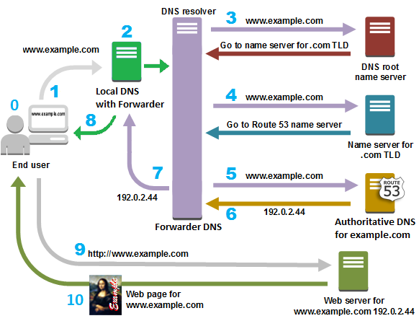
DNS Protocol Overview
https://aws.amazon.com/route53/what-is-dns/

Slide 7
Organizations that Control the Internet
Internet Corporation for Assigned Names and Numbers (ICANN)
Maintains the coordinates of the Internet, from IP address to web address
Manages & maintains the Root DNS Name Servers keeping track of all Top-Level Domains
Internet Assigned Numbers Authority (IANA)
Department of ICANN responsible for allocating IPv4 and IPv6 addresses including the root DNS servers
The root level domain servers keep track of all top-level domain servers
Top-level domain examples would be .com, .edu, .net, etc
Top-Level Domain servers keep track of all authoritative DNS servers for the given domain
For example, the top-level domain .com is managed by VeriSign Global Registry Services
Authoritative Domain Servers are the DNS servers that contain the hostname to IP resolution information
These servers must be registered with the domain’s Top-Level server

Slide 8
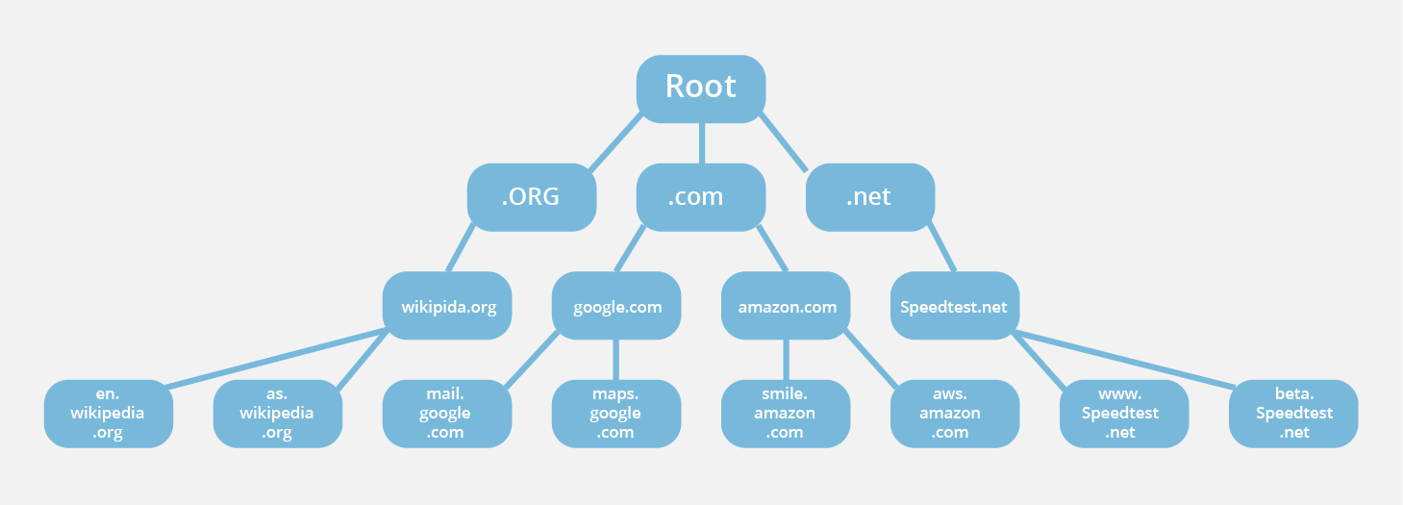
DNS Hierarchy Overview

Slide 9
PI Hole – Local DNS Sinkhole
The PI Hole software is designed to be a local DNS server that allows for blocking specific domains
Blocking certain domains will also block ads hosted by that domain
Be careful not to block a domain that is hosting more than ads since it may block more content than just ads
It comes with a web interface that allows to easily determine what sites are currently being blocked as well as domains that are not blocked
This interface also allows for easily adding new list of domains to block

Slide 10
PI Hole Install
https://github.com/rlentz1236/PI-Hole-Tutorial/tree/main

