Slide 1
Effect of measurement error on sparse PCA
Tilburg & Eindhoven University
Donghyeok Lee

Slide 2
Contents
1. Motivation
- why sparse PCA : drawbacks of PCA
- why measurement error
- why sPCA-rSVD
2. PCA vs sPCA-rSVD
3. Effect of measurement error on sPCA-rSVD
- Homogeneous
- Heterogeneous
4. Conclusion & Limitations
Notes:
Here is the contents of my presentation.
I will firstly talk about why I choose sparse PCA and measurement error as my research question.
There are many sparse PCA methods. Then I will also talk about why I choose spca-rsvd among many different sparse pca methods.
In the second chapter, I will present the comparison of performance between pca and spca-rsvd.
And in the next chapter, effect of measurement error on spca-rsvd in both cases : homogeneous and heterogeneous is discussed.
Finally, conclusion and limitations in my study.

Slide 3
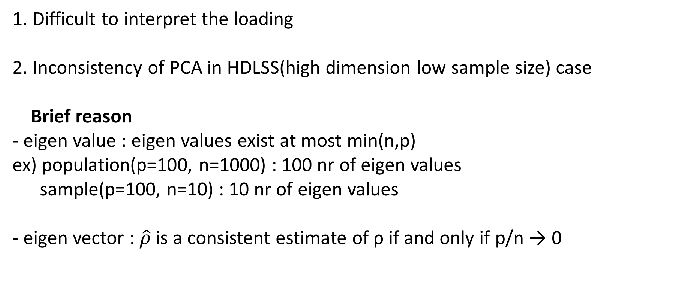
Drawbacks of PCA
1. Difficult to interpret the loading
2. Inconsistency of PCA in HDLSS(high dimension low sample size) case
Brief reason
- eigen value : eigen values exist at most min(n,p)
ex) population(p=100, n=1000) : 100 nr of eigen values
sample(p=100, n=10) : 10 nr of eigen values
- eigen vector : $\hat{ρ}$is a consistent estimate of ρ if and only if p/n → 0
Notes:
There are the two main drawbacks of PCA, which are difficult interpretability and inconsistency of PCA in HDLSS case.
Since PCA component is a linear combination of every variable, it is difficult to interpret the loading of a variable.
And there is inconsistency issue when the number of variable is much larger than the sample size.
Eigen values can exist at most min(n,p), for example, population data with the size 100 can have 100 nr of eigen values, while the sample with the size 10 can have only 10.
So, in case of sample only 10 nr of principal component have to explain the variance of the data. That’s why the eigne values from the sample tend to be bigger than the eigen values from population.
In case of eigen vector, numerous articles mathematically proved that the sample eigen vector is only consistent when the sample size is enough.

Slide 4
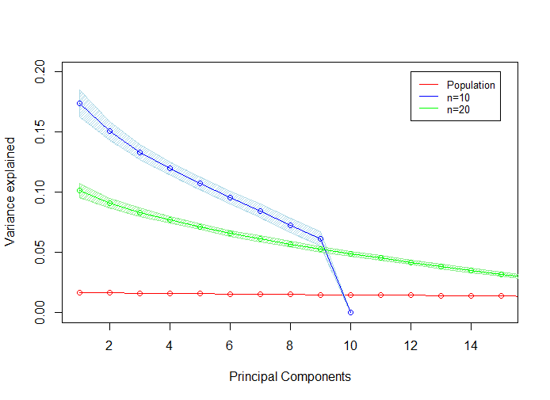
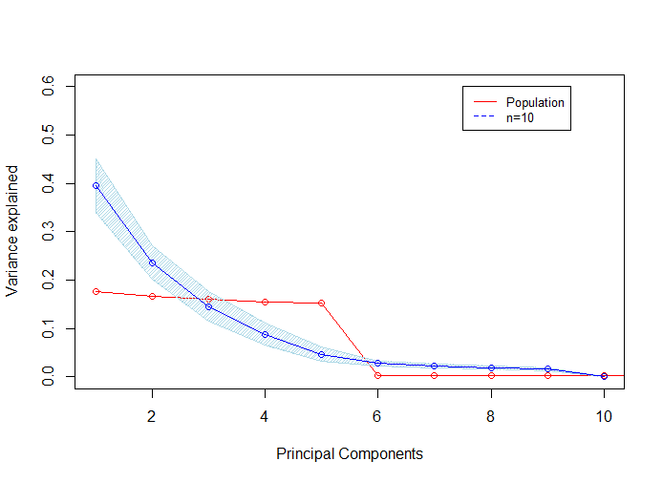
Inconsistency in the eigen value
Figure 1 and 2 : The expected PEV (proportion of explained variance)
Notes:
These two plots show the PEV(proportion of explained variance) from population and sample.
The PEV from the population is expressed as red line.
The point represents the expected PEV and the shaded area indicated the standard error of PEV.
The left plot is based on random noise data and the right plot is based on the sparse loading structure data.
In both cases, the PEV of the first few principal components tend to be bigger than populational PEV.

Slide 5
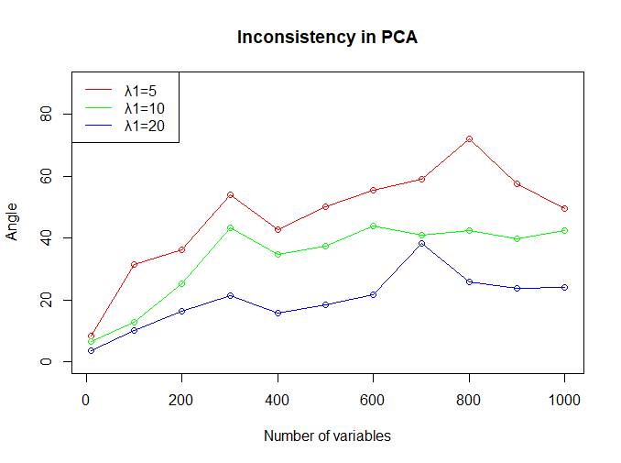
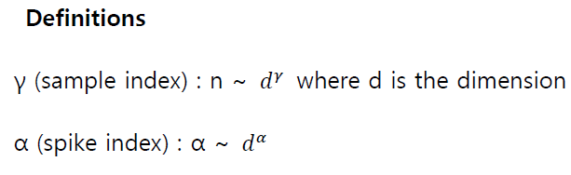
Inconsistency in the eigen vector
According to Dan Shen et al,
the consistency of PCA is related to the two factors : sample index and spike index.
Figure 3 : Angle between the truth and the first eigen vector when the sample size is fixed as 10.
Data : the single component spike covariance data
Notes:
According to Dan shen and other authors,
The consistency of PCA depends on the two factors: sample index and spike index.
Here are the definitions.
Simply, comparing to the nr of variables, sample index indicates how big the sample size is and the spike index indicates how big the eigen value is.
Referring their article, the conclusion is that the sample index and spike index are proportional to consistency.
The right plot shows the angle between the truth and the first sample eigen vector.
In this plot, the sample size is fixed as 10 and the nr of variable is increased, while the data structure remains same.
Data structure is the single component spike covariance data which means that the first eigen value is some specific value and other remaining eigen values are set to be 1.
From this plot, we can see that the angle increases as the nr of variables increases or the first eigen value decreases.

Slide 6
Motivation
- drawbacks of PCA : solution is sparse PCA!
- why measurement error
- why sPCA-rSVD
Guerra Urzola et al : sPCA-rSVD has the best performance according to the four criteria:
The squared relative error (SRE) of the model parameters
The misidentification rate (MR) of zero versus the nonzero status of the sparse coefficients
The proportion of explained variance (PEV)
The cosine similarity.
Notes:
Until now we discussed about drawbacks of PCA. To deal with these drawbacks, many sparse pca methods are proposed.
High dimensional data are measured by many different measures, therefore, there must be measurement error. However, there has been little attention on effect of measurement error on sparse pca.
According to Guerra Urzola and other authors, spca-rsvd has the best performance for the sparse loading according to the four criteria.

Slide 7
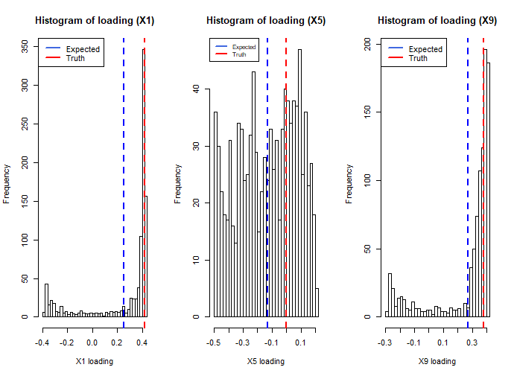
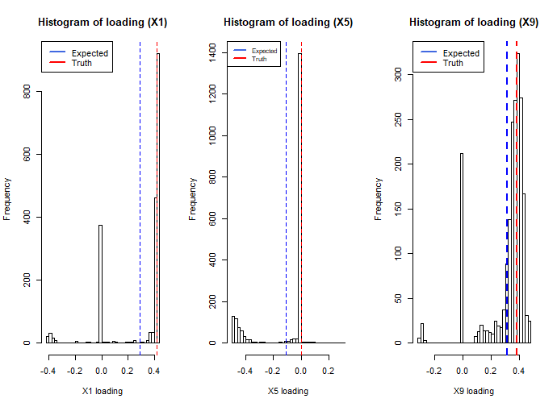
2. PCA vs sPCA-rSVD : histogram of loadings
Data generation
the sparse component loadings structure data where sparsity=40%, p=10, n=10000, VAF=100%, PEV of the first PC=0.67.
PCA sPCA-rSVD
Notes:
Now let’s compare the performance of PCA to spca-rsvd.
I created the sparse loading data with these conditions;
From this population data, I took the sample of size 5 a 1000 times, estimates eigen vectors and create the histogram of loadings.
As you can see, not only the expected loading is different from the truth, but also there are the two problems: flipped sign problem and non-zero problem.
Flipped sign problem is that the variable with the true large loading might have the opposite sign of the loading like this
And non-zero problem is that the variable with the true zero loading might have the large loading like this.
From the right plot, we can see that the flipped sign problem or non-zero problem occur much less in spca-rsvd.

Slide 8
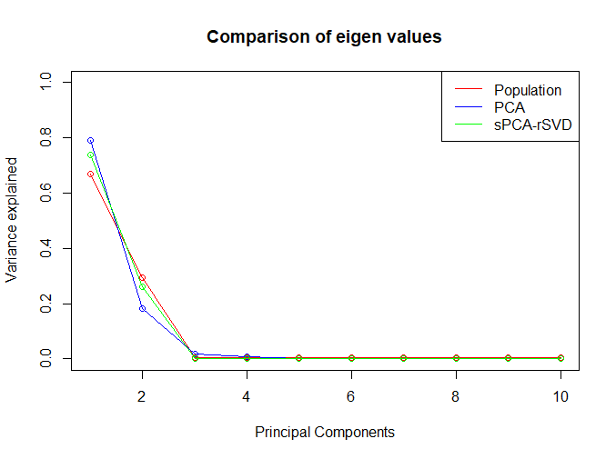
2. PCA vs sPCA-rSVD : PEV
Figure 4 : Comparison of the expected PEV between PCA and sPCA-rSVD
Notes:
This is the comparison of the expected PEV between PCA and spca-rsvd.
The red represents the PEV from the population and we can see that the PEV of spca-rsvd is more close to populational PEV than PCA.

Slide 9
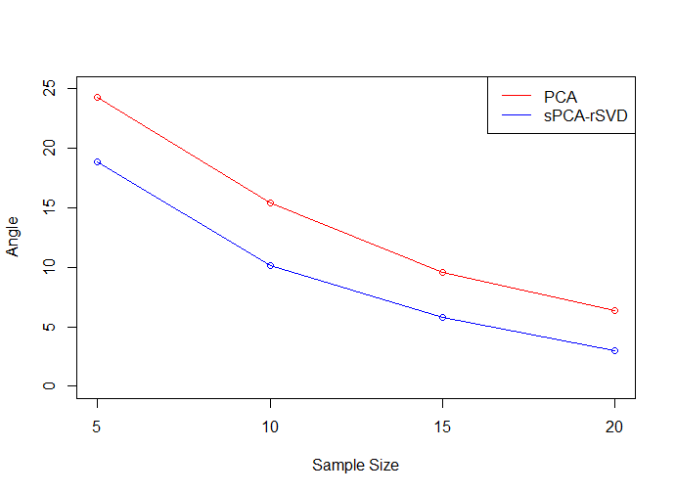
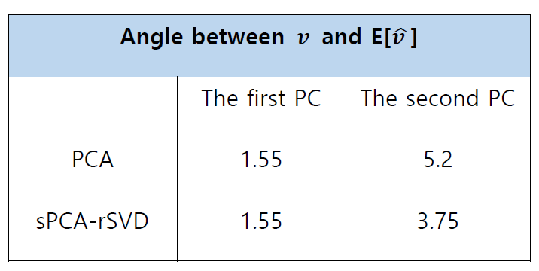
2. PCA vs sPCA-rSVD : angle
Table 1 : Angle between the truth and expected eigen vector
Figure 5 : Median angle per sample size
Notes:
The left table shows the angle between the true eigen vector and the expected eigen vector.
The true PEV of the first principal component is 0.68 when we generate data.
Spike index is large enough, so the eigen vector from PCA is quite consistent even in HDLSS case.
The right plot shows the median angle from 1000 angles per sample size.
Median angles of PCA are larger than median angles of spca-rsvd, regardless of sample size.
So, spca-rsvd estimates the eigen vecor better than PCA when there is sparsity in loadings.

Slide 10
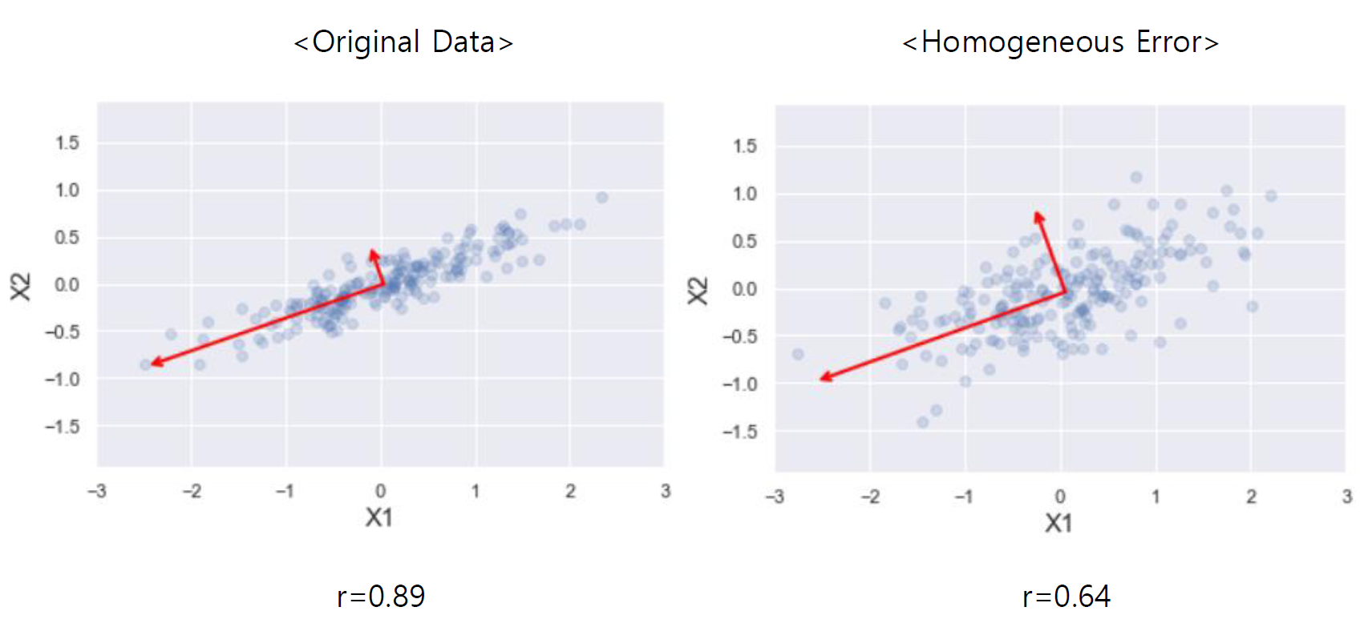
3. Effect of measurement error on sPCA-rSVD
Figure 6 : Correlation dilution by homogeneous error
Notes:
Now, let’s see how measurement error affects the performance of spca-rsvd.
In the left plot, it is original data. And the red arrow represents the size of eigen value.
In the right plot, it is data with homogeneous error.
When there is homogeneous error, the data structure remains same since the variance of each variable increases equally by error.
so, there is no change in estimating the eigen vector.
But if there is error, correlation dilution occurs. The pearson correlation becomes smaller from 0.89 to 0.64.
And the correlation dilution makes the data more spherical. So the difference between the first and second eigen value becomes smaller, which results in the decrease of PEV of the first principal component.

Slide 11
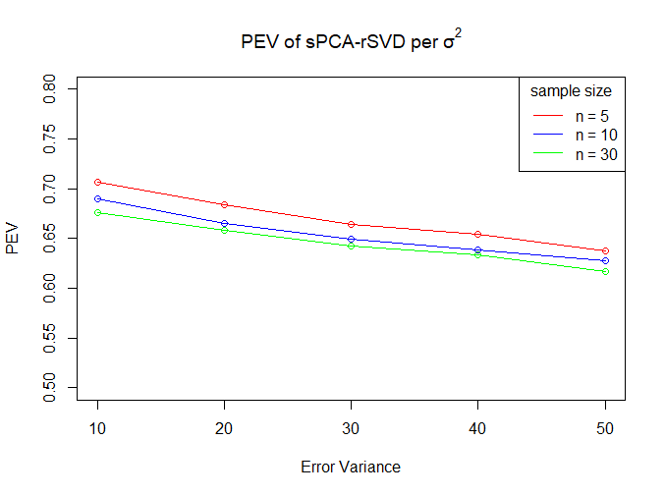
PEV of the first principal component
Figure 7 : The effect of the homogeneous error on the expected PEV of the first PC
Notes:
From this plot, we can see the decrease of the PEV of the first principal component regardless of sample size.

Slide 12
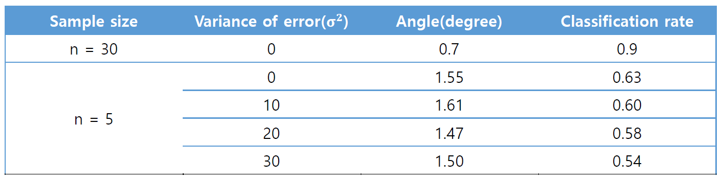
Angle and classification rate
Table 2 : Change of the angle and the classification rate per the variance of error
Notes:
When there is homogeneous error, the data structure remains same, so the angle between the true and the expected eigen vector also remains same.
The classification rate refers to the rate that spca-rsvd correctly identify a variable with the true zero loading.
But the classification rate decreases as the error variance increases. The reason is the increased standard error.

Slide 13
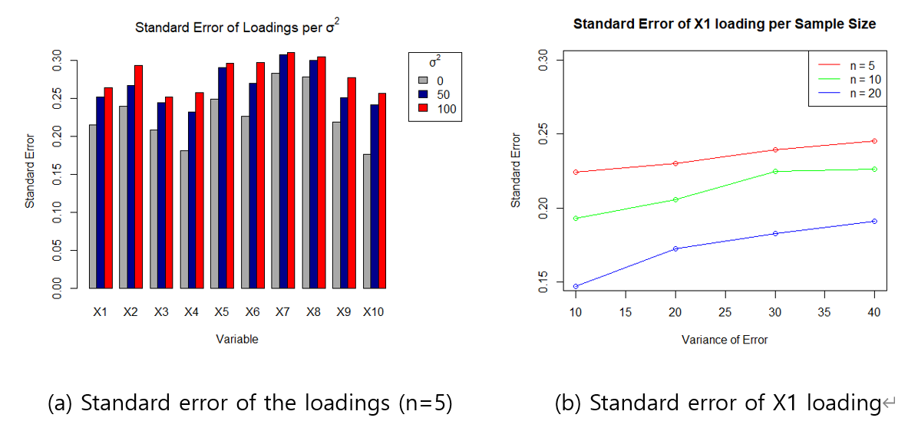
Standard error
Homogeneous error
Correlation dilution
More spherical data
Standard error increases
Lower classification rate
Notes:
Plot (a) shows the standard error of the loadings per the error variance and plot (b) shows the standard error of X1 loading per sample size and per error variance.
From plot (a), we can see that homogeneous error increase the standard error of the loading of every variable
And from plot (b), the standard error of the loading depends on the sample size and the error variance.

Slide 14
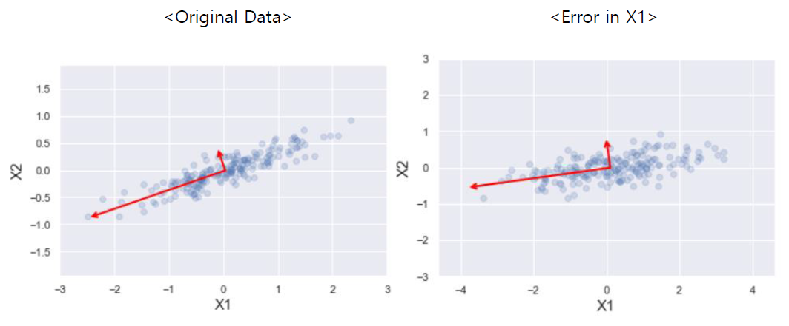
3. Effect of measurement error on sPCA-rSVD
Heterogeneous error
Figure 8 : Effect of heterogeneous error (error in X1)
Notes:
Now let’s discuss about heterogeneous error.
The left plot shows the original data and the right plot shows the data with error only in X1.
When error is in X1, the variance of X1 increases, therefore, the first eigen vector moves towards X1 axis.
And due to correlation dilution by error, the data becomes more spherical,
so the difference between the first and the second eigen value decreases, which results in lower PEV of the first component.

Slide 15
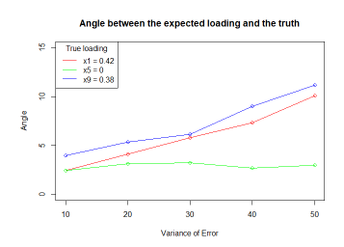
Angle under heterogeneous error
Figure 9 : Change of the angle between first eigen vector and the truth when error is in one variable.
Red line : error in X1
Green line : error in X5
Blue line : error in X9
Insensitiveness : Less change when error is in a variable with the true zero loading.
Notes:
This figure shows the change of the angle when error is in one variable.
Red line is when error is in x1, green line is error in x5, and blue line is error in x9.
As you can see, the angle increases except when error is in X5, which is a variable with the true zero loading.
So, the loading is insensitive to error when error is in a variable with the true zero loading because that variable has little association with the first eigen vector.

Slide 16
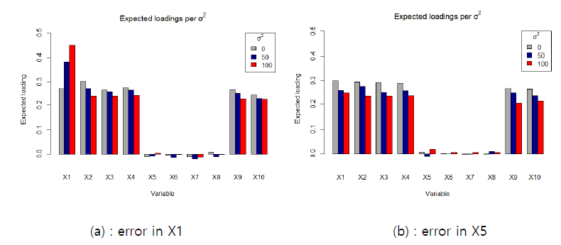
Expected loading
Figure 10 : Change of the expected loading when error is in X1 and X5.
Notes:
These plots show the change of expected loading when error is in X1 or X5.
When you increase the variance of error in X1, the expected loading of X1 increases a lot, while other variables tend to be smaller since the first eigen vector moves towards X1-axis.
In case of X5, we can find the insensitiveness. The expected loading of X5 does not change that much.

Slide 17
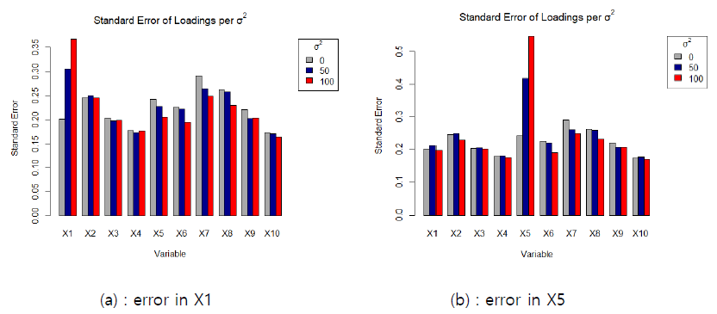
Standard error
Notes:
When error is in X1, the standard error of X1 loading increases as the correlation between X1 and other variables decreases.
But the standard error of loadings of other variables does not change that much.
This phenomenon also holds for when error is in X5, which is the true zero loading.

Slide 18
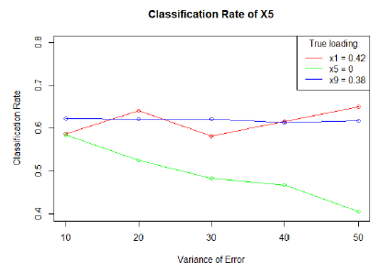
Classification rate
Figure 11 : Change of the classification rate of X5 when error is in one variable (X5 has the true zero loading.)
Result
The classification rate of X5 decreases only when error is in X5 because error in other variables does not increase the standard error of X5’s loading.
Notes:
This plot shows the change of the classification rate of X5 when error is in one variable. X1 or x5 or x9.
Classification of X5 decrease only when error is in X5 because error in other variable does not increase the standard error of X5.

Slide 19
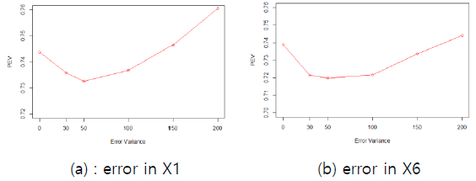
PEV of the first principal component
● As the variance of error increases,
the PEV decreases until some point, and then starts to increase.
● When error is in X1 -> correlation dilution -> more spherical -> lower PEV
● When error is in X6 -> directly increases the variance explained by other PCs -> lower PEV of the first PC.
Figure 12 : Change of the PEV when error is in a variable.
The true loading of X1 and X6 are 0.42 and 0, respectively.
Notes:
This plot shows the change of the PEV when error is in one variable. The true loading of X1 and X6 are 0.42 and 0, respectively.
In both cases, as the variance of error increases, the PEV decreases until some point, and then start to increases.
When error is in X1, correlation dilution makes the data more spherical, which results in lower PEV. But if you keep increasing the variance of error, the X1-axis becomes the first eigen vector and eventually PEV also increases.

Slide 20
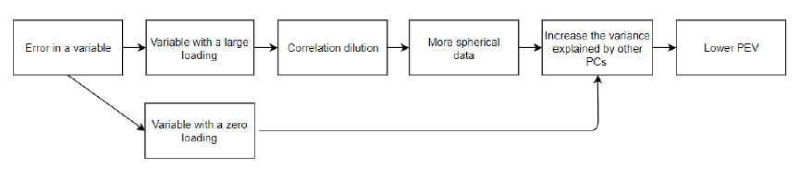
PEV of the first principal component
PEV of the first principal component decreases at some point as follows.
Notes:
This mechanism can be summarized as follows.
In both cases, error in a variable with a large loading and a zero loading, it increase the variance explained by other PCs, which results in lower PEV.

Slide 21
4. Conclusion and limitations
Closing remarks
1. Why sparse PCA?
- Drawbacks of PCA : difficult interpretability and inconsistency
2. Effect of measurement error regarding the angle, the PEV, the standard error and the classification rate.
Homogeneous error
Heterogeneous error
Notes:
Until now I talked about why sparse PCA is better than PCA regarding the drawbacks of PC, which are difficult interpretability and inconsistency in HDLSS case.
Then, we discussed the effect of measurement error on spca-rsvd regarding the angle, PEV, standard error and classification rate in both situations: homogeneous error and heterogeneous error.

Slide 22
4. Conclusion and limitations
Limitations
Only the first component is addressed.
2. The simulation experiment is conducted only on one dataset.
- Lack of examination on various factors such as the sparsity or the spike index
3. Unrealistic assumption that the sparsity of the loadings is known.
- Need to further investigate how measurement error affects the performance of techniques to determine the sparsity of the loadings, such as ad hoc approach or K-fold cross validation

Slide 23

End of Effect of measurement error on sparse PCA
Any question?

