Slide 1
Deep Dives & Deep Stops
Why we are here, where we are going
Bringing Dive Physics, Physiology, and Practice into Focus
A closer look at the recreational dive mantra: you can ascend anytime from anywhere
Exploring the Deep Stop Discussion
Some Practical Guidance on deep diving with a 7mm wetsuit
Gas tissue terms and definitions
NAUI Master Scuba Diver Candidate Presentation
Addendum
Dive Gas Laws

Slide 2
Why This Matters
Beyond AGE, most recreational dive DCS incidents are neurological (spinal cord, brain).
Majority incidents occur after diver has spent time beyond 80 ft.
Key diver questions:
Does adding a deep stop reduce bubble risk?
Is it safe to dive to 100 ft in a 7mm wetsuit

Slide 3
Decompression Basics Refresher
Henry’s Law: gas dissolves under pressure.
Fast vs. slow tissues: on-gassing/off-gassing rates differ.
Supersaturation = bubble risk.

Slide 4
Confusion vs Clarity
What is the official dive agency guidance on the 12-15 ft safety stop?
PADI
Do it unless the dive is shallow/easy
Required below 100 ft or if NDL is hit
SDI
Do it whenever you can, it’s part of the ascent,
Formally, it’s ‘recommended’.
NAUI
Do it whenever you can, it’s part of the ascent,
Formally, it’s ‘recommended’.

Slide 5
The Myth of No-Decompression Ascent
No-Decompression Limit (NDL) ≠ Free Ascent Safety.
Gas loading at 80–100 ft stresses fast tissues.
Rapid ascent may trigger bubble growth and DCS symptoms.
Gas consumption at depth shortens available reaction time.
Even the emergency ascent must be slow, controlled, and deliberate.

Slide 6
A Few Definitions
Stress: high gas tension approaching or exceeding safe gradients relative to ambient pressure, e.g., the tissue is challenged by a high level of dissolved inert gas. The higher the tissue tension, the less margin remains before supersaturation occurs on ascent
Tension: or gas tension is the partial pressure of a dissolved gas in a tissue or fluid. It may be more convenient to think of tension as how “compressed” or “packed” the gas molecules are in that tissue. Tension is expressed in ATA (atmospheres absolute), the same units as ambient pressure. On ascent, if tissue tension > ambient pressure, the tissue is supersaturated → risk of gas coming out of solution (bubble formation).
Supersaturated: A tissue is supersaturated when its gas tension (dissolved gas pressure) is greater than the surrounding ambient pressure, e.g., the tissue is holding more dissolved gas than the current pressure should allow.
Gradient: is defined as the difference between tissue gas tension and ambient pressure, e.g., Tissue Gas tension less the Ambient pressure

Slide 7
A Recap
Stress (informal use): tissues carrying high gas load, reducing margin before gradient gets risky.
Tension: the dissolved gas pressure inside tissues.
Supersaturation: condition when tension > ambient.
Gradient: the magnitude of that difference.

Slide 8

Silent Bubbles & Neurological Risk
Microbubbles form even inside NDL dive limits.
Neurological tissues (spinal cord, brain) especially vulnerable.
Bubbles can grow during ascent, not depth (re: gradient).
Mitigation:
Slow, controlled ascent rate (<30 ft/min).
Brief pause near half depth (optional, brief, and only if gas permits).
Extended the 3 min safety stop to 5+ min at 12-15 ft.

Slide 9
The Deep Stop Argument
Likely not needed for recreational dives.
There is no empirical physiological data that suggests the recreational, non-technical, no-deco dive benefit from a stop at 60 feet after a brief stay at 120 feet.
Watch the NDL time on your dive computer
If you don’t have a dive computer, get one
If your NDL time has ticked down to single digits, then consider a deep stop
Otherwise, consider a slower than normal ascent and a longer safety stop at 12-15 feet
What does physics and physiology tell us?

Slide 10
Why Deep Stops Came About
Originated in technical/military dives, where divers spent long bottom times, accumulating significant load in slower tissues.
Idea: stop deeper to control bubble growth in fast tissues before surfacing.
Fast tissues coming from time at 130 feet are likely supersaturated at 60 ft, but slow tissues are likely still on-gassing
Evidence: Some studies (e.g., Marroni, Bennett, DAN Europe) showed fewer venous bubbles with deep stops — but these were decompression dives, not recreational no-stop dives.

Slide 11
Recreational Deep Dives Are Different
Bottom time is short: with a single tank, divers don’t stay long enough at 100+ ft to load any but the slowest tissues heavily.
Fast tissues dominate: these tissues can be managed effectively by a deliberate, slower ascent rate (≤30 ft/min, ideally 20–25 ft/min in last 60 ft).
Gas supply is limited: better used for extending the shallow stop than for pausing deep..

Slide 12
A Deep Dive into Deep Dive Theory

Slide 13
Recreational Bottom Time
Using modified rule of thirds (3000 PSI AL80, ~77ft³ or 2190L)
800 PSI to get to the bottom (584L air)
800 PSI available at the bottom (584L air)
800 PSI to get back to surface (584L air)
600 PSI reserve (438L air)
Respiratory Minute Volume or RMV
Average Recreational Diver : 16-18 L/min (or 25 L/min at 15 ft)
Nervous, anxious, or working diver : 25-26 L/ min (or 36 L/min at 15 ft)
Bottom time at 100 feet / 30m / 4ATA
Average Recreational Diver : 68 L/min or 11 minutes
Nervous, anxious, or working diver : 105 L/min or 7½ minutes

Slide 14
Dive Profile Tissue Loading
Two fast-tissue analysis
4 min and 8 min half-time
Depth (meters) | Period End | Time (min) | Tension 8-min HT (ATA) | Tension 4-min HT (ATA)
0 (0 ft) | T0 (0 min) | 0 | 1 | 1
↓ | T1 (5 min) | 5 | 1.565 | 1.993
30 (98.4 ft) | T2 (16 min) | 16 | 3.061 | 3.702
↑ | T3 (24 min) | 24 | 2.82 | 2.755
4.5 (15 ft) | T4 (29 min) | 29 | 2.338 | 1.999

Slide 15
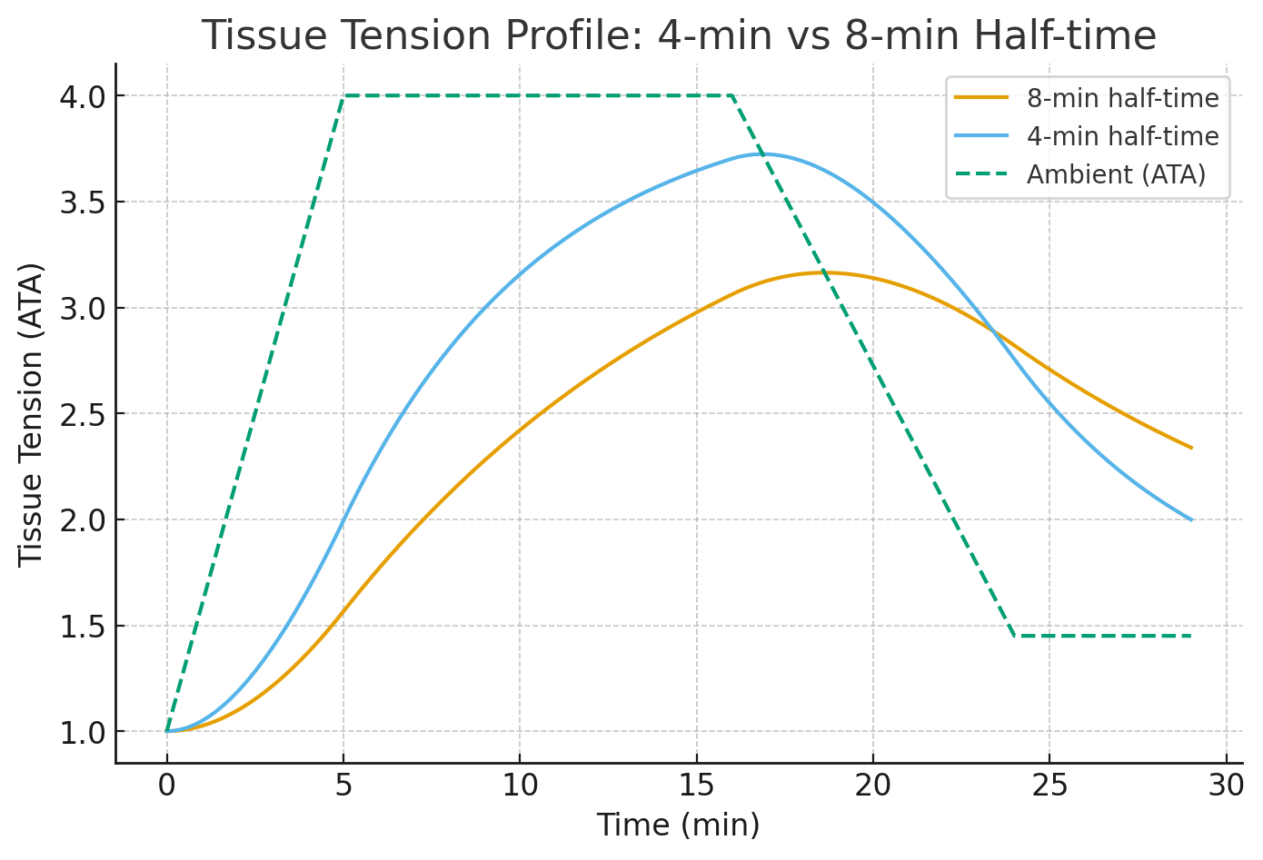
Dive Profile Tissue Loading

Slide 16
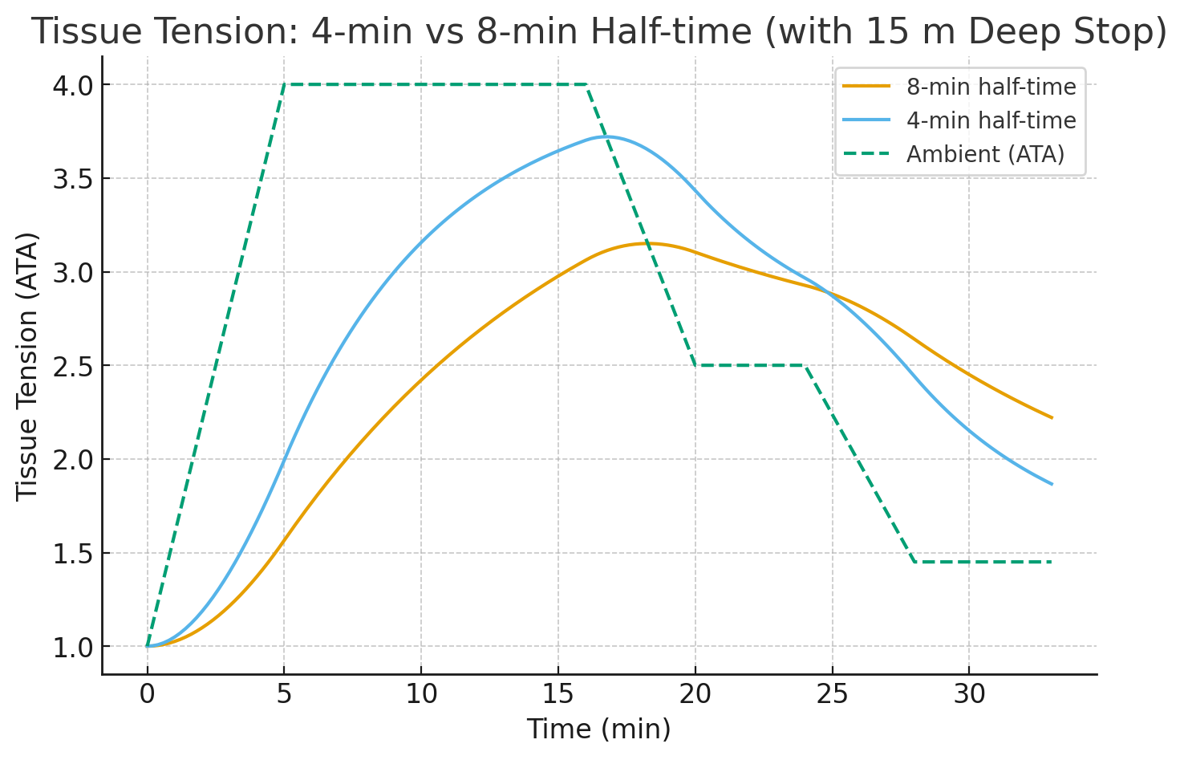
Dive Profile Tissue Loading adding 5 minute deep stop at 15 meters

Slide 17
Dive Profile Tissue Loading Key Takeaways
A deep stop at the half-depth point would provide a marginal amount of off-gassing to occur
It might be effective, but not needed
Without the deep-stop, diver arrives at the 15 ft safety stop with a +1 to +1.5 ATA gradient for the two tissues. Both are well below the Workman 1.58 max
A quick ascent to the surface at the end of the deep dive would be dangerous
Tissue tensions are +2.25 and +2.75, well above even the earlier Haldane max gradient of 2.0

Slide 18
Where the Gas Should Be Spent
A diver has limited “safety gas budget.”
The best return on that gas is:
Slow ascent through the 60–30 ft zone.
An extended safety stop at 12–15 ft or 1.4 ATA (5 min or longer if gas allows).
An extended stop at 12-15 feet after a slow ascent is where the largest gradient reduction occurs, and where most tissues can off-gas safely and efficiently.

Slide 19
Leadership Framing
Instead of saying deep stops don’t work, we frame it as:
“For recreational deep dives, the need for a deep stop isn’t demonstrated. You don’t have the gas load in slow tissues that would make it critical.”
“What really makes a difference is slowing your ascent and saving gas to extend time at the shallower safety stop — that’s where gas comes out most safely.”

Slide 20
Deep Stop Summary
Recreational divers get the most safety benefit by
ascending slower than 30 ft/min and
extending the shallow safety stop.
Deep stops are not typically necessary unless long exposures load slow tissues.
A deep stop just for the sake of off-gassing may actually see some tissues still on-gassing

Slide 21
A Case Study
on a slightly different topic

Slide 22
Fatal Buoyancy Failure
Incident Summary
Location: Lake Ray Roberts, Texas (2008)
Diver: 31-year-old male
Location: Lake Ray Roberts, North Texas
Date: July 2008 (holiday weekend)
Reported cause: BC corrugated inflator hose/tube ruptured
diver lost buoyancy control
Diver was reportedly carrying ~60 lb of lead weight:
full tank at start of dive
the vest weight and,
additional 18 lbs. of weight in belt and pockets
Air supply: still had ~1200 psi at time of incident

Slide 23
A Case Study
What we know – what we don’t
Hose/tube rupture caused sudden loss of buoyancy → diver could not offset excess weight.
Overweighting compounded risk: diver was unable to swim up effectively.
Panicking did not help matters

Slide 24
Does this teach us anything
Wetsuit Buoyancy Loss with Depth in cold water
7 mm wetsuit compresses significantly with depth.
Surface: high buoyancy → requires extra lead.
At 110 ft: most buoyancy lost → diver relies heavily on BCD.
Failure of BCD bladder at depth creates severe negative buoyancy.
Combination of depth + wetsuit compression = sharp edge of safe diving if things go wrong.

Slide 25
Uncontrolled Ascent Risk from 110 ft
If BCD fails, dropping weights may trigger runaway ascent.
Controlled ascent: slow gradient = gas tension managed.
Uncontrolled ascent: steep gradient = neurological bubble risk.
Blowing bubbles protects lungs (AGE)
Does nothing to mitigate bubble formations in neurological tissues
Fast tissue insult → spinal cord, brain most vulnerable.

Slide 26
What Next
Is deep, cold-water lake diving safe in a 7mm wetsuit?
Maybe
Risks are certainly higher
Equipment checks and servicing can mitigate failures
Planning and practicing can mitigate panic
Dive agencies do not teach or addresses the issue
Diver is responsible
know your limits
test your capabilities

Slide 27
Final Points
Deep Stops research shows us why rapid pressure changes are dangerous even within NDL.
7 mm wetsuit research shows how easily a diver can be forced into such a rapid ascent if buoyancy systems fail at depth.

Slide 28
Final Points
Together, the message is:
The physics and physiology don’t care about agency limits.
A “no-deco” label won’t protect you from a bad ascent.
Diving smart means preventing uncontrolled ascents before they start.

Slide 29
Final Points
The Leadership Reality Check
Recreational ≠ Always Immediate Exit:
True “no-overhead” diving applies in physical terms (no cave/ice/ship overhead), but
physiological overhead begins at depth when gas loading is high.
Instructor Responsibility:
Deep Diver specialties often spend too much time on narcosis anecdotes and not enough on ascent discipline.
As we move into being the better dive buddy, we need to practice and reinforce:
Controlled ascent
Gas planning (rule of thirds, rock-bottom minimums)
Safety stop discipline (extend when possible)

Slide 30
Addendum
Gas Laws (standard)
Gas Laws (the rest of the story)
Gas Laws (the necessary)

Slide 31
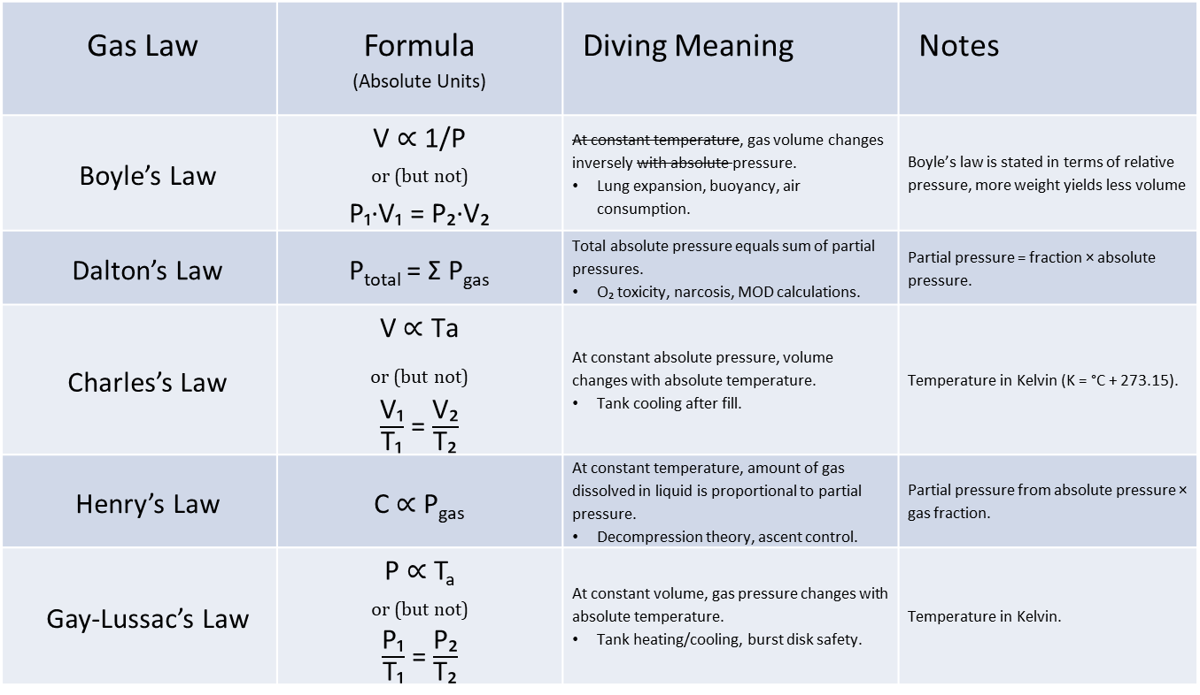
Gas Laws
Gas Law | Formula (Absolute Units) | Diving Meaning | Notes
Boyle’s Law | V ∝ 1/P _{or (but not)} P₁∙V₁ = P₂∙V₂ | At constant temperature, gas volume changes inversely with absolute pressure. Lung expansion, buoyancy, air consumption. | Boyle’s law is stated in terms of relative pressure, more weight yields less volume
Dalton’s Law | P_{total} = Σ P_{gas} | Total absolute pressure equals sum of partial pressures. O₂ toxicity, narcosis, MOD calculations. | Partial pressure = fraction × absolute pressure.
Charles’s Law | V$\text{ ∝ }\text{Ta}$ $$\text{or}\text{ (}\text{but} \text{not}\text{)}$$ $\frac{\text{V}\text{₁}}{\text{T}\text{₁}}$ = $\frac{\text{V}\text{₂}}{\text{T}\text{₂}}$ | At constant absolute pressure, volume changes with absolute temperature. Tank cooling after fill. | Temperature in Kelvin (K = °C + 273.15).
Henry’s Law | C ∝ P_{gas} | At constant temperature, amount of gas dissolved in liquid is proportional to partial pressure. Decompression theory, ascent control. | Partial pressure from absolute pressure × gas fraction.
Gay-Lussac’s Law | P ∝ T_{a} _{or (but not)} $\frac{\text{P}\text{₁}}{\text{T}\text{₁}}$ = $\frac{\text{P}\text{₂}}{\text{T}\text{₂}}$ | At constant volume, gas pressure changes with absolute temperature. Tank heating/cooling, burst disk safety. | Temperature in Kelvin.

Slide 32
Gas Laws (the rest of the story)
Archimedes’ Law (circa 250 BC) the buoyant force of a submerged object is equal to the weight of the displaced fluid.
Boyle’s Gas Law (1662) pressure and volume of a gas vary inversely
the mercurial thermometer was not invented until some 50 years later
Charles’ Gas Law (1787, 1802) at constant pressure, a volume of gas is directly proportional to its temperature (e.g., gas expands when heated)
Dalton’s Gas Law (1801) the total pressure of a gas mixture equals the sum of the partial pressures of each component gas
Gay-Lussac’s Gas Law (1802) at constant volume, the pressure a of gas is directly proportional to its temperature (e.g., pressure increases when heated)
Henry’s Gas Law (1803) at equilibrium, the amount of a given gas dissolved in water is directly proportional to the partial pressure of that gas above the water.
a tissue’s inert-gas tension tends toward the inspired partial pressure of that gas
The Ideal Gas Law (1834) : pV = nRT
p: pressure of the gas (absolute)
V: volume of the gas
n: amount of substance (moles of gas)
R: the universal gas constant
T: absolute temperature (kelvin K)

Slide 33
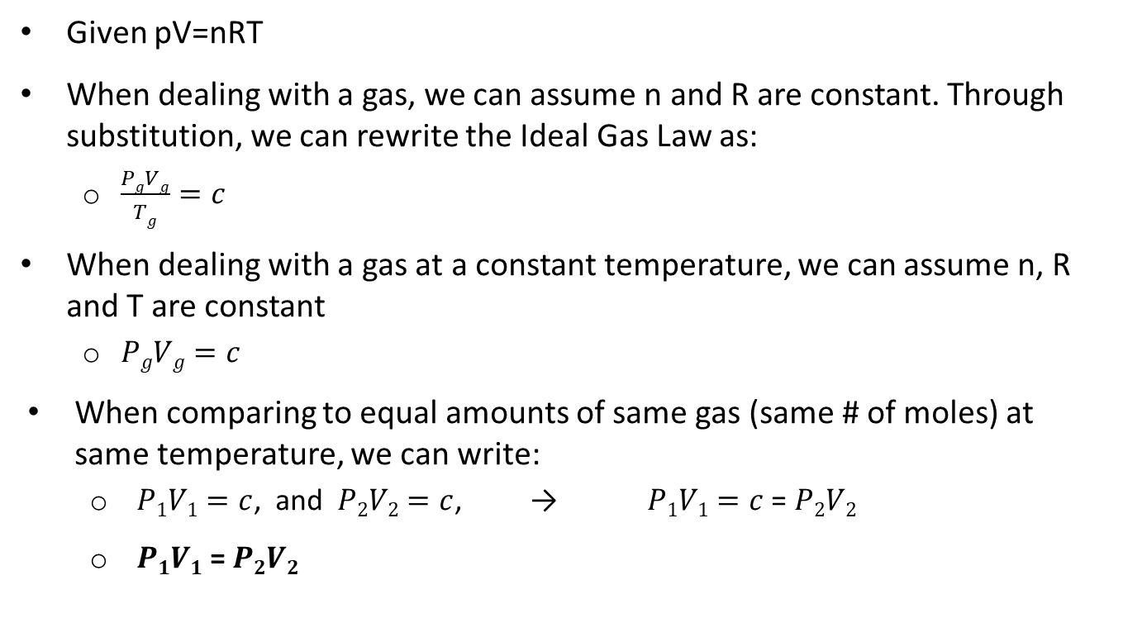
Gas Laws (deriving the scuba version of Boyle’s Law)
Given pV=nRT
When dealing with a gas, we can assume n and R are constant. Through substitution, we can rewrite the Ideal Gas Law as:
$\frac{PgVg}{Tg}=c$
When dealing with a gas at a constant temperature, we can assume n, R and T are constant
$PgVg=c$
When comparing to equal amounts of same gas (same # of moles) at same temperature, we can write:
$P1V1=c$, and $P2V2=c$, → $P1V1=c$ = $P2V2$
$P1V1$ = $P2V2$

Slide 34
Gas Laws (all you need to know for recreational diving)
pV=nRT
and maybe
Henry’s Gas Law
Memorizing the historical details of who claims credit for which law and when is nothing more than a pedagogical exercise. It may help you pass a test, but likely will not help you be a better diver
Even the Ideal Gas Law exhibits a degree of pedagogery!
If you plan on developing tissue gradient models and computer algorithms, or going into partial pressure blending, then study Dalton’s Law, otherwise save your limited cognitive shelf space for the important stuff

Slide 35
Fun Fact
The Ideal Gas Law, pV=nRT, tells us that the pressure in a tank would drop from 3000 PSI to 0 PSI if the temperature of the gas in a tank at room temperature were dropped to absolute zero.
Absolute 0 anything is usually an abstract concept, not attainable.
That said, at ~77 K (well before absolute 0), the Oxygen and Nitrogen and Argon components of air are liquids, and gas laws no longer apply.
The required scuba testing gas laws work good enough in the environment divers will be diving in (pressure & temperature)
The gasses we use in scuba diving follow the Ideal Gas Law close enough in the environment divers will be diving in (pressure & temperature)

Slide 36
References
Lake Ray Roberts Diver Death
https://scubaboard.com/community/threads/lake-ray-roberts-scuba-death.241696/page-4#post-3694373
Marroni, A., Bennett, P. B., Cronje, F. J., Cali-Corleo, R., Germonpre, P., Pieri, M., Bonuccelli, C., & Balestra, C. (2004) A deep stop during decompression from 82 fsw (25 m) significantly reduces bubbles and fast tissue gas tensions. Undersea and Hyperbaric Medicine, 31(2), 233–243.
https://www.swiss-cave-diving.ch/PDF-dateien/DeepStop_Marroni.pdf
Powell, Mark. Deco for Divers. Aqua Press, 2008. ISBN 978-1905492077
U.S. Navy. U.S. Navy Diving Manual: Revision 7, Change A. Washington, DC: Naval Sea Systems Command, 2020.
Available at NavSea Navy Portal

Slide 37
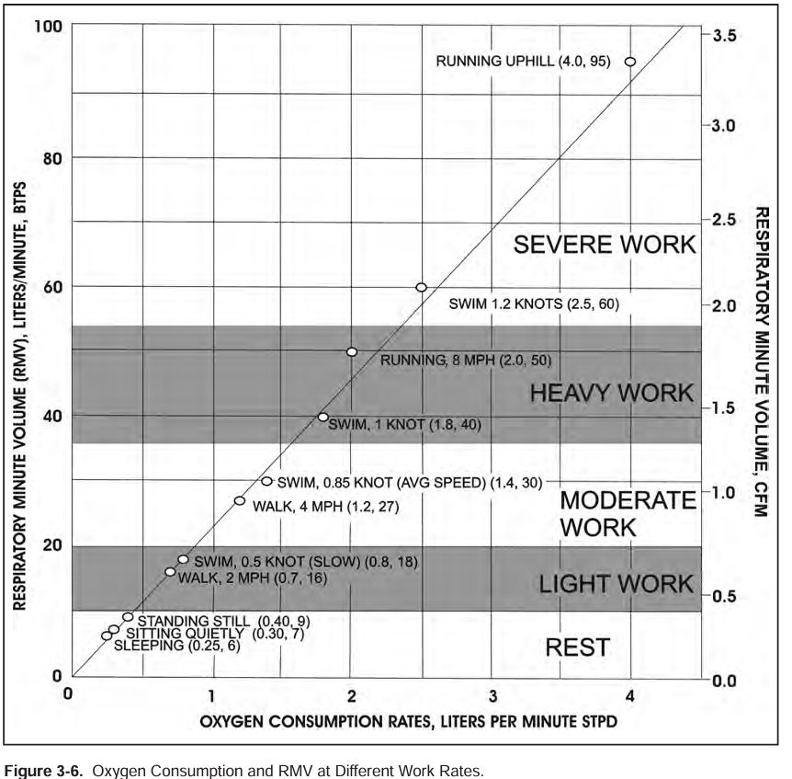
U.S. Navy Diving Manual

