Slide 1
PLACEMENT SCHEDULER
Real-time interview scheduling and replanning
Live demo
https://placement-scheduler-two.vercel.app
A Go + React system for scheduling 800 students, 35 companies, and 20 rooms during a four-day placement week.
Assessment focus: algorithm design, backend API design, frontend workflow, and deployment.
Placement Scheduler | Internship Skill Assessment
1
Notes:
[Sources]
- Project repository source code and README in C:/Users/abhid/Desktop/placement-scheduler.
- Screenshots captured from the local running Placement Scheduler app.
- Live deployment: https://placement-scheduler-two.vercel.app

Slide 2
The placement week problem is a live constraint puzzle
•
Students appear on overlapping shortlists and cannot be double-booked.
Design goal
•
Companies bring different numbers of panels, durations, and priority tiers.
Produce a defensible schedule, explain every gap, and recover from change without losing invariants.
•
Only 20 rooms are available, and a panel should not keep moving rooms.
•
Real disruptions need scoped replanning, not manual spreadsheet recovery.
Placement Scheduler | Internship Skill Assessment
2
Notes:
[Sources]
- Project repository source code and README in C:/Users/abhid/Desktop/placement-scheduler.
- Screenshots captured from the local running Placement Scheduler app.
- Live deployment: https://placement-scheduler-two.vercel.app

Slide 3
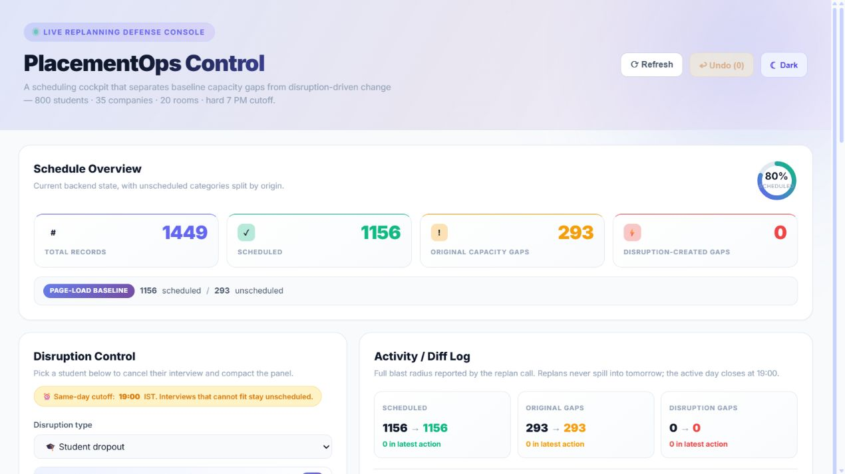
The dashboard turns the backend state into an operator workflow
•
Top metrics separate original capacity gaps from disruption-created gaps.
•
The action console supports all four disruption types.
•
Undo is surfaced as a first-class safety control.
Placement Scheduler | Internship Skill Assessment
3
Notes:
[Sources]
- Project repository source code and README in C:/Users/abhid/Desktop/placement-scheduler.
- Screenshots captured from the local running Placement Scheduler app.
- Live deployment: https://placement-scheduler-two.vercel.app

Slide 4
The generator creates realistic pressure before scheduling begins
800
35
20
4
Students
Companies
Rooms
Days
•
Mass recruiters shortlist high volume with short interviews.
•
Mid-tier companies create the Day 2 capacity crunch.
•
Niche companies use higher CGPA cutoffs and longer interviews.
•
A fixed seed plus sorted iteration makes demos reproducible.
Placement Scheduler | Internship Skill Assessment
4
Notes:
[Sources]
- Project repository source code and README in C:/Users/abhid/Desktop/placement-scheduler.
- Screenshots captured from the local running Placement Scheduler app.
- Live deployment: https://placement-scheduler-two.vercel.app

Slide 5
Scheduling uses an event-driven heap instead of fixed slots
1
Build waves
2
Admit panels
3
Pop earliest panel
4
Match student + room
5
Push panel back
•
The min-heap naturally handles panels becoming free at different times.
•
Busy maps prevent student and room conflicts across waves.
•
Panel-room stickiness is enforced by reusing the first room assigned to a panel.
Placement Scheduler | Internship Skill Assessment
5
Notes:
[Sources]
- Project repository source code and README in C:/Users/abhid/Desktop/placement-scheduler.
- Screenshots captured from the local running Placement Scheduler app.
- Live deployment: https://placement-scheduler-two.vercel.app

Slide 6
Replanning is scoped, reversible, and explicit
Student dropout
Cancel one interview and compact that panel
Panel dropout
Move future interviews to surviving panels
Late company
Re-run company matching from delayed arrival
Room unavailable
Find replacement rooms per affected panel
Every disruption returns a Diff: before slot, after slot, notification targets, and before/after summaries.
Placement Scheduler | Internship Skill Assessment
6
Notes:
[Sources]
- Project repository source code and README in C:/Users/abhid/Desktop/placement-scheduler.
- Screenshots captured from the local running Placement Scheduler app.
- Live deployment: https://placement-scheduler-two.vercel.app

Slide 7
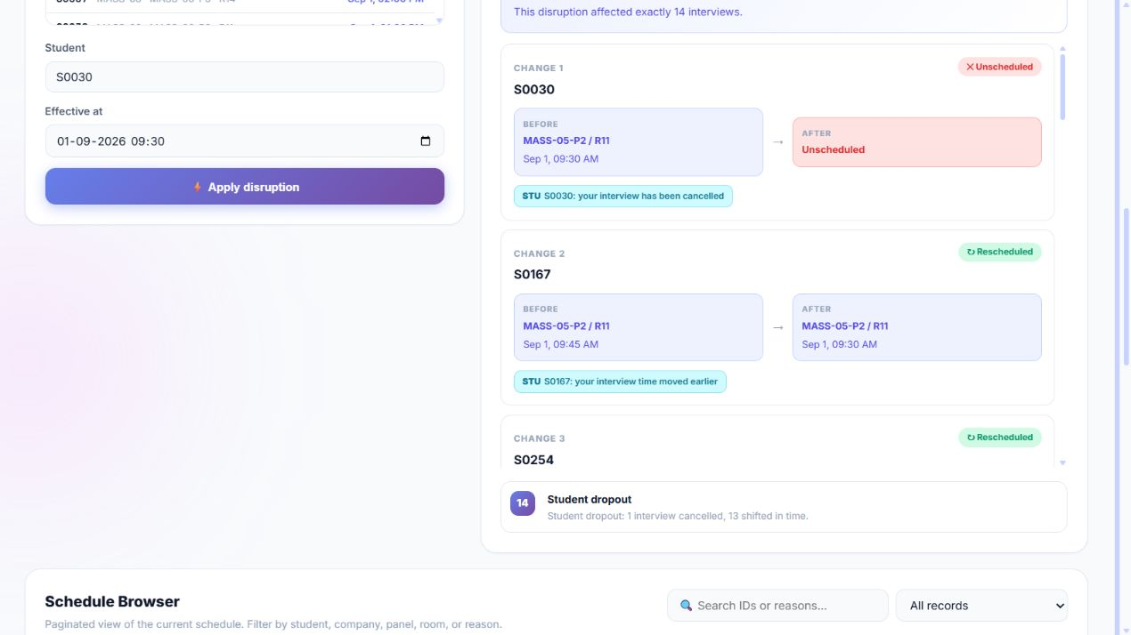
The diff view explains the blast radius immediately
•
The cancelled student is shown as unscheduled.
•
Later interviews shift earlier on the same panel.
•
The activity line summarizes the exact number of affected interviews.
Placement Scheduler | Internship Skill Assessment
7
Notes:
[Sources]
- Project repository source code and README in C:/Users/abhid/Desktop/placement-scheduler.
- Screenshots captured from the local running Placement Scheduler app.
- Live deployment: https://placement-scheduler-two.vercel.app

Slide 8
The deployed architecture keeps one logic path
React + Vite
Go API
Scheduler packages
•
Local development uses `go run ./backend/cmd/server` and Vite.
•
Production uses `api/index.go` as a Vercel Go serverless function.
•
`pkg/bootstrap` initializes the same generated data and schedule for both paths.
Placement Scheduler | Internship Skill Assessment
8
Notes:
[Sources]
- Project repository source code and README in C:/Users/abhid/Desktop/placement-scheduler.
- Screenshots captured from the local running Placement Scheduler app.
- Live deployment: https://placement-scheduler-two.vercel.app

Slide 9
What this demonstrates
•
Algorithmic reasoning under realistic constraints.
•
Clean separation between generated input, mutable schedule state, API, and UI.
•
Operational UX: act, review, inspect, undo.
•
End-to-end delivery: tests, README, screenshots, GitHub, and live Vercel deployment.
Live demo: placement-scheduler-two.vercel.app
Placement Scheduler | Internship Skill Assessment
9
Notes:
[Sources]
- Project repository source code and README in C:/Users/abhid/Desktop/placement-scheduler.
- Screenshots captured from the local running Placement Scheduler app.
- Live deployment: https://placement-scheduler-two.vercel.app

