Slide 1

TV-Tram
Team Tempo
Stefan Chrobot, Roberto Liffredo, Tomasz Olszewski , Jan Vogelgesang

Slide 2
Project objectives
Name: TV-Tram
Goal: Use a television to display public transportation timetable for bus stops near the facility
Motivation: Show how inexpensive hardware can be used to create data visualization;
Description: TODO: copy & paste from sharepoint

Slide 3
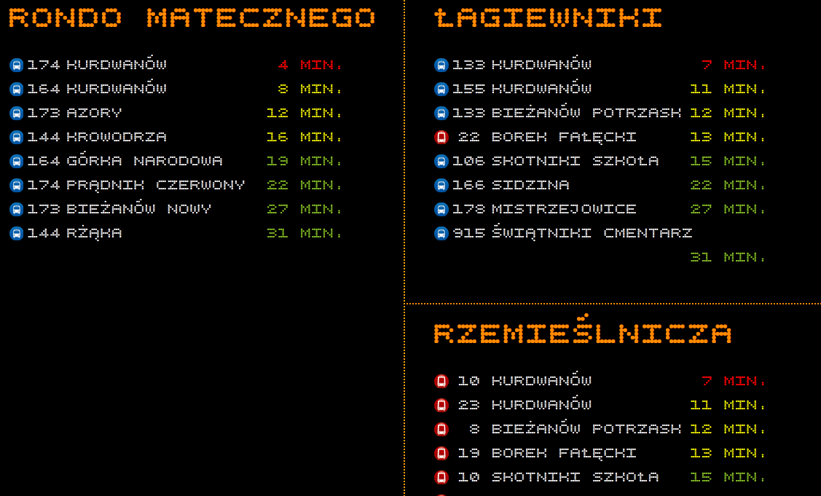
Initial prototype
Your presentation should have at least one screenshots showing real operations
Delete this box and insert screenshot #1 here

Slide 4
Feel free to add something here
But remember that you have 5 minutes!

Slide 5
Questions?
Sabre Airline Solutions, the Sabre Airline Solutions logo, Sabre Holdings, the Sabre Holdings logo, Sabre Hospitality Solutions, AirCentre, AirCommerce, AirVision, IntelXchange, Qik, Sabre and SabreSonic are trademarks and / or service marks of an affiliate of Sabre Holdings Corp. All other trademarks, service marks and trade names are the property of their respective owners.
© 2013 Sabre Inc. All rights reserved.

