Slide 1
TV-Tram
Team Tempo
Stefan Chrobot, Roberto Liffredo, Tomasz Olszewski , Jan Vogelgesang

Slide 2
Project objectives
Name: TV-Tram
Goal: Use TV to display public transportation timetable for tram and bus stops near Buma Square
Motivation: Show how inexpensive hardware can be used to create data visualization
Description: TV-Tram – a project for improving quality of life by showing the public transport timetable for stops near Buma Square.

Slide 3
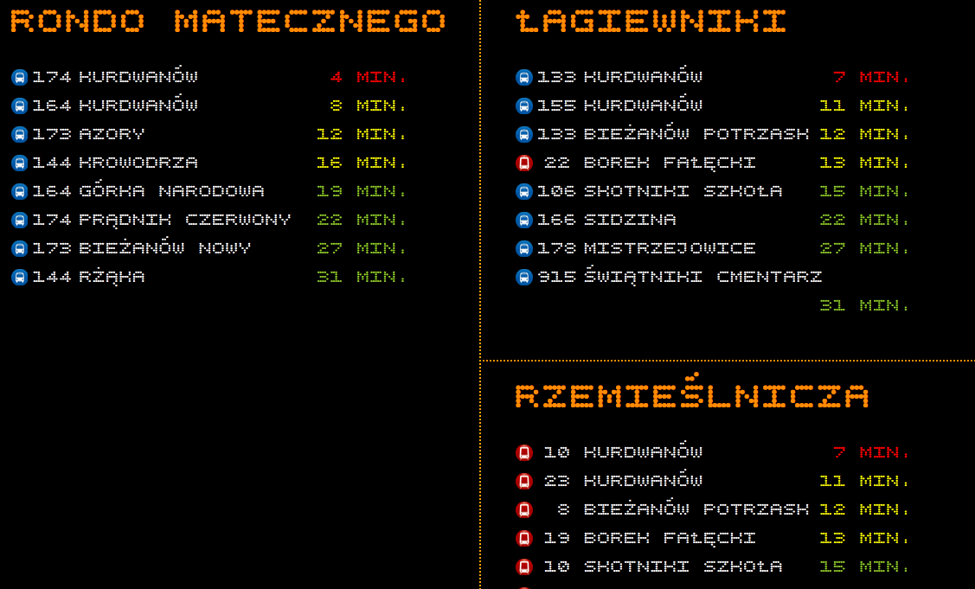
Initial prototype

Slide 4
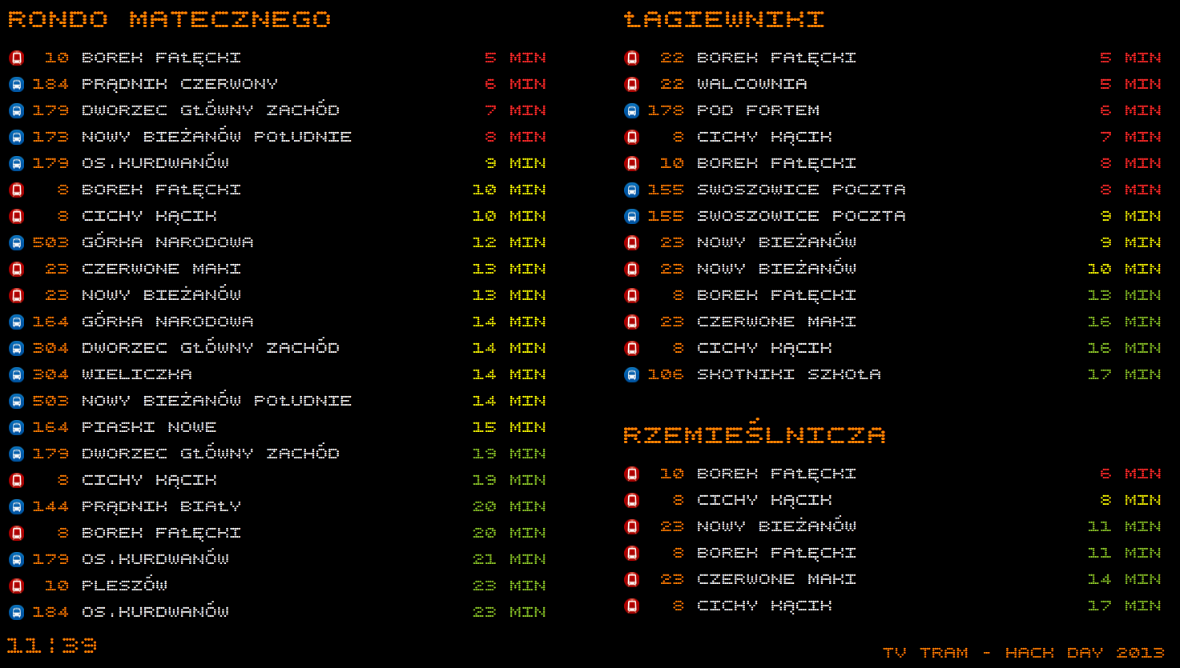
Final version!

Slide 5
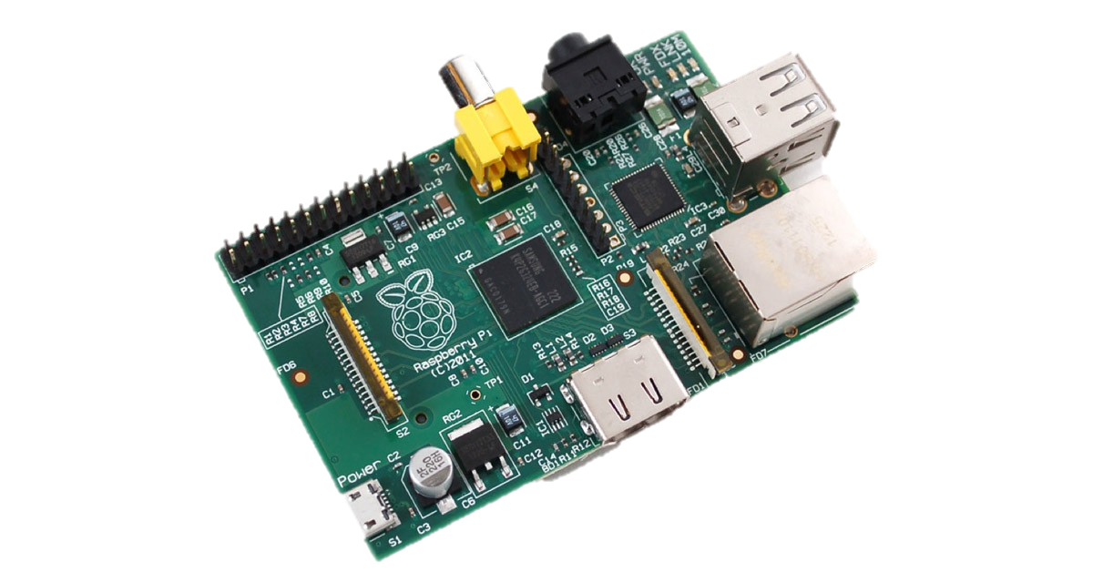
Raspberry PI, connected to a Full HD TV

Slide 6

On PI, a service, scraps data from MPK website every day

Slide 7
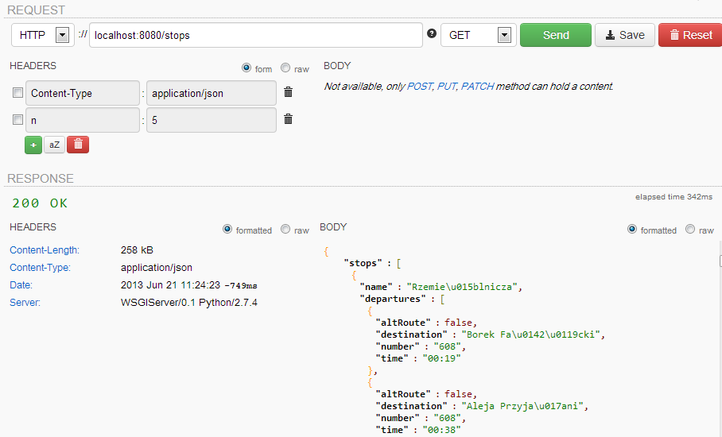
REST interface for clients

Slide 8
HTML used for presentation layer, showing stops near BUMA

Slide 9
Team Tempo TV-Tram
Liked? Vote it!
Sabre Airline Solutions, the Sabre Airline Solutions logo, Sabre Holdings, the Sabre Holdings logo, Sabre Hospitality Solutions, AirCentre, AirCommerce, AirVision, IntelXchange, Qik, Sabre and SabreSonic are trademarks and / or service marks of an affiliate of Sabre Holdings Corp. All other trademarks, service marks and trade names are the property of their respective owners.
© 2013 Sabre Inc. All rights reserved.

