Slide 1

Von Karman Challenge
Block Diagram

Slide 2
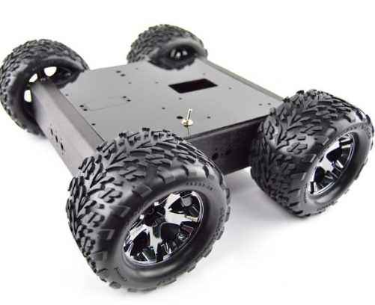
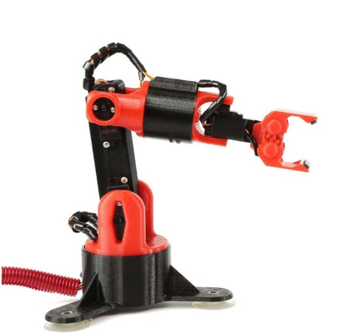
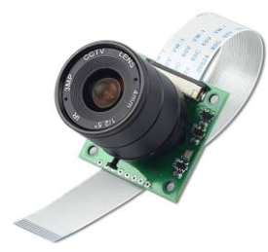
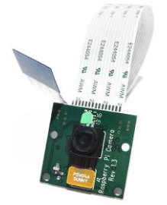
Von Karman Challenge Suggested Block Diagram
M
Front
Arduino
Motor Controller
M
Servo Hat¹
Rear
Spring Probes
Pi 6 ADC
M
Front
Pi EZ Connect
3
Motor Controller
Pi 3
M
Rear
Switch⁴
Battery
Pi A
XTGO
Connector
Voltage Regulator
Legend
Signal
12V Power
5V Power
USB
USB to Computer²

Slide 3
Notes
The Servo Hat must be on top so that the connectors are accessible.
USB Cable can be attached early in assembly, which is easier than attempting to access the port later in the build.
Insulate heat sink from adjacent hat.
Switch or circuit breaker should be added (approximately 4 Amp).

