Slide 1
What is the Best Location for Your Next Business?
Deyao Kong & Rui Lin

Slide 2
1
Motivation & Introduction

Slide 3
Introduction
Location, Location, Location
Where?
Why?
How?
Find an optimal location for restaurants
DBSCAN + k-means
Gradient Boosted Regression Trees (GBRT)

Slide 4
2
Flow Chart

Slide 5
Flow Chart
Possible influential variables
DBSCAN
Data Cleaning
First
Clustering
Second
Clustering
Features
Calculation
Regression
Model
GBRT
K-means

Slide 6
3
Data Set

Slide 7
Yelp Public Dataset
Attribute List
Business.json
ID
Latitude/Longitude
Rating
Review Count
Attribute List
Categories
Table Service | Good For Kids | Attire | Take-Out
Wheelchair Accessible | Wi-Fi | Music | Delivery
TV | Price Range | Reservation | Coat Check
Noise Level | Alcohol | Ambience | /
Notes:
We used Yelp public Dataset in this project, which includes ID, coordinates, rating and other features. Some attributes that we picked are shown on this table.

Slide 8
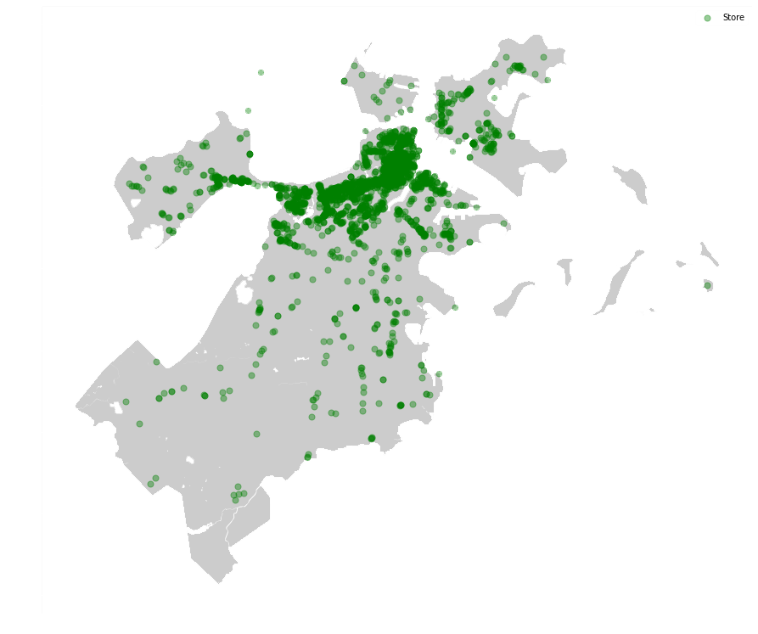
Data Cleaning
City List
Select Cities
Top 5 cities
Only restaurants
City Name | State Name | Count
Portland | OR | 5729
Orlando | FL | 3748
Atlanta | GA | 4179
Vancouver | BC | 4275
Boston | MA | 2845
Boston
Notes:
We picked the 5 cities that has the greatest number of restaurants as our target. And for today’s presentation, we will be focusing on Boston as our example. So, lets talk more about the models and algorithms behind the scene.

Slide 9
4
Clustering

Slide 10
Clustering Process
Data Coordinates
Data Attributes
Logistic Regressor
DBSCAN
K-Means
Group Label
Notes:
For clustering, the whole process looks like this. We first put all the attributes into DBSCAN, which gives a rough clustering result, and then we use that result with data coordinates and fit a K-Means model, which will give us our final grouping labels.
Let’s talk a bit more about the two algorithms.

Slide 11
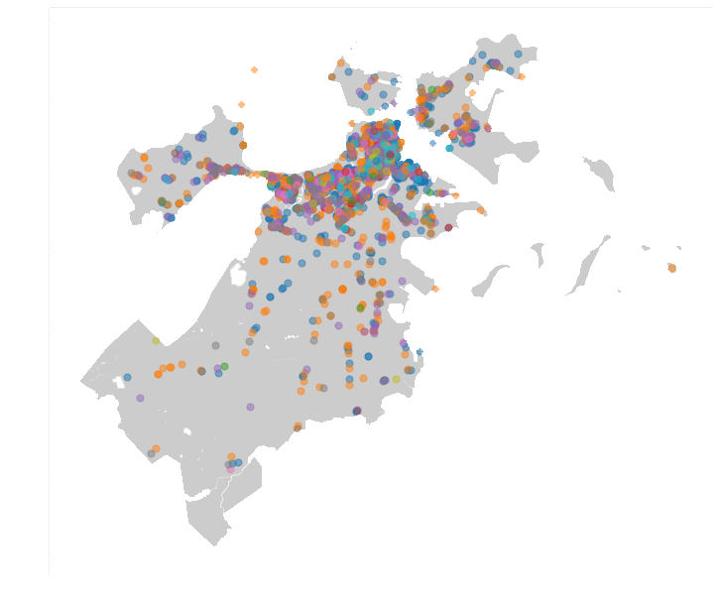
DBSCAN PROCESS
Data Coordinates
Data Attributes
DBSCAN
Logistic Regressor
Generate a rough clustering label based on Attributes only
Passing the result to the K-Means clustering process as a grouping basis
Saving the result for training the Logistic Regressor for later classification process.
K-Means
Group Label
Notes:
For DBSCAN here, we are generating a rough clustering label based on attributes only. The result is shown as this figure on the right, each color presents one cluster.
From the figure we could see that most businesses are located in the city center, Chelsea and Everett. And the clusters do not have a clear boundary, and they kinda overlays each other.
Hence, this result is passed to the next step as a grouping basis. Unlike K-Means, DBSCAN does not work well on predicting new data within given clusters, hence the result is also used for training a logistic regressor for a later classification process when introducing new data.

Slide 12
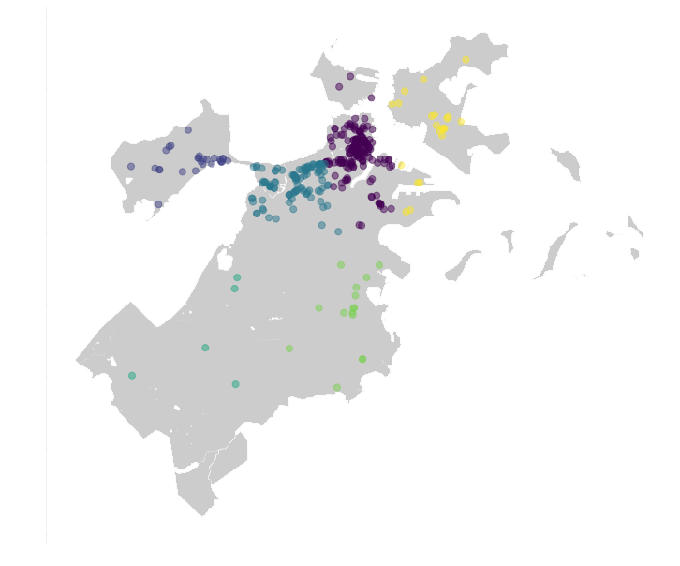
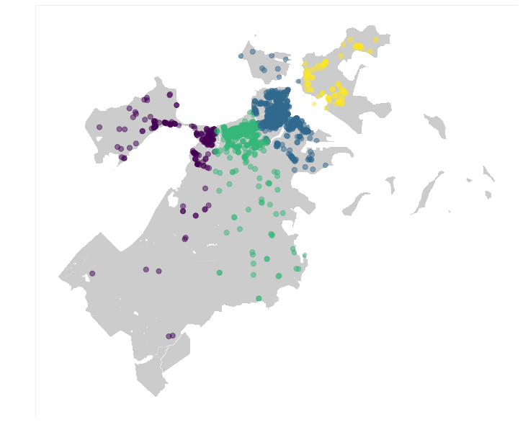
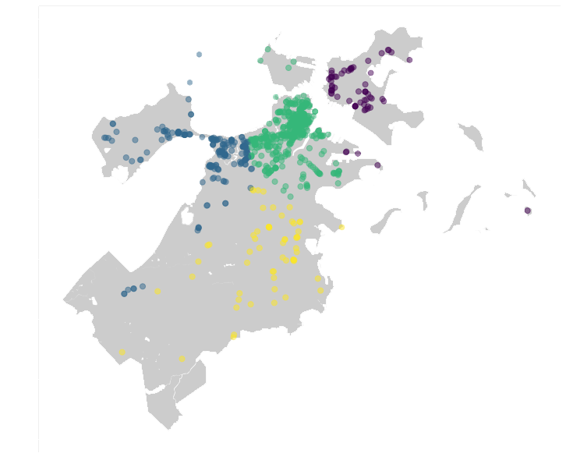
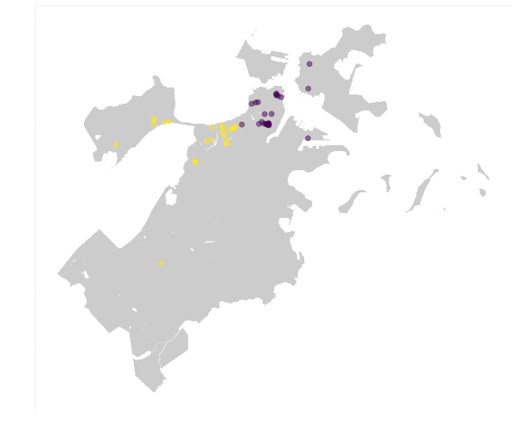
K-Means Process
Data Coordinates
Data Attributes
DBSCAN
Logistic Regressor
Generate a final clustering label based on Coordinates only within a certain group
K-Means
Group Label
Notes:
By introducing K-Means into our model, we could use the result from DBSCAN as a grouping basis and generate a final clustering label based on coordinates only. That way, the city is separated into different blocks, the result of some clusters are shown here.
And we are going to find which cluster should your business land later in other parts.

Slide 13
5
Features

Slide 14
After Clustering
Features
Average rating
Average review count
Density
Competitiveness
Similarity

Slide 15
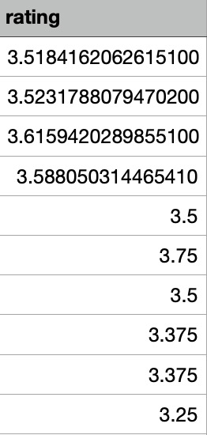
Average Rating
Calculate the average rating of all restaurants in a same cluster

Slide 16
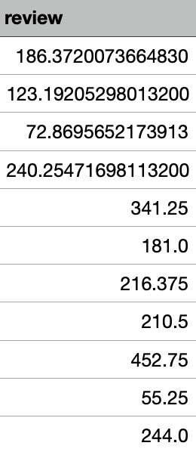
Average Review Count
Tring to find a way to measure customers flow rate
Calculate the average review count of all restaurants in a same cluster

Slide 17
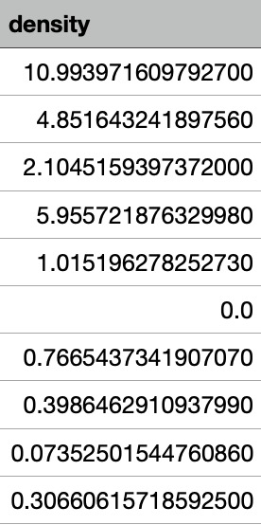
Density
How many restaurants located in a certain area?
Calculate the density for each cluster.
Center: cluster center
Radius: distance between center to the farthest restaurant in the cluster

Slide 18
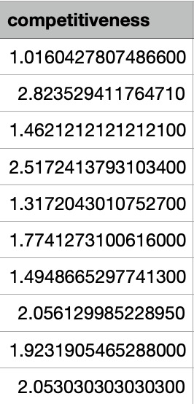
Competitiveness
Measure competitiveness based on restaurants’ type
Calculate the competitiveness for each restaurant with its cluster
Use the list of restaurants’ categories

Slide 19
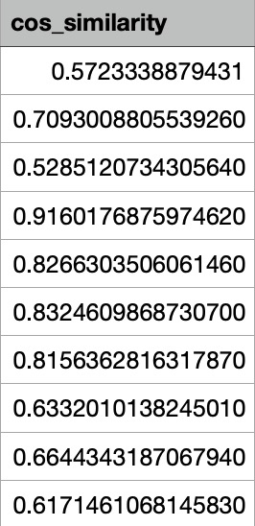
Similarity
How does certain restaurant like others?
Calculate the cosine similarity for each restaurant.
Using the list of restaurants’ attribute list.

Slide 20
6
Regression Model

Slide 21
Which Model to use?
Ridge Regression
Support vector regression
Gradient Boosted Regression Trees(GBRT)
We tried all three models and found that GBRT can best predict the data

Slide 22

GBRT
Gradient Boosted Regression Trees (GBRT) is a flexible non-parametric statistical learning technique for classification and regression.
It gives a prediction model in the form of an ensemble of weak prediction models, which are typically decision trees.

Slide 23
Regression Model
Repeated k-fold cross-validation
10 folds
3 repeats
Variables:
Dependent Variable: Review count
Independent Variable: 5 features calculated above
Fit the data

Slide 24
Predictions
Run predictions on the whole dataset
Get predicted review count for each restaurant in every cluster
Pick top 5 clusters with highest predicted review count
Compare it to the real cluster of the restaurant
Result: 752/2845 - 26.43%

Slide 25
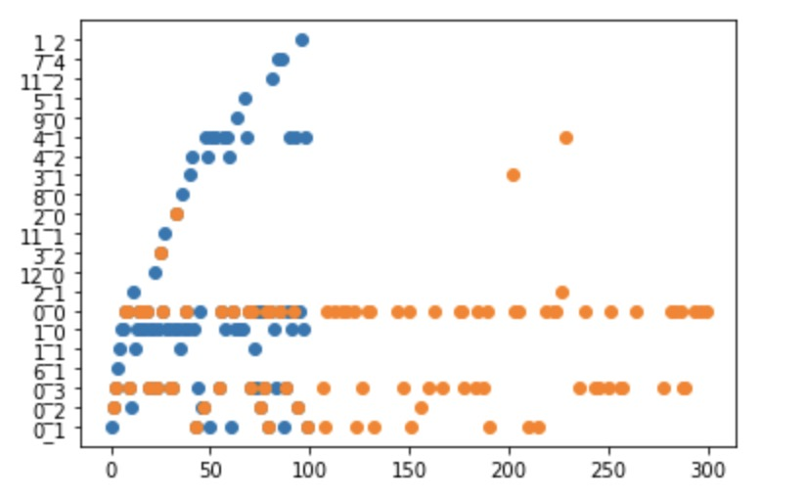
Predictions
121 Correct for the first 300 restaurant
Usually located in bigger cluster with more restaurants nearby
Need to improve the model

Slide 26
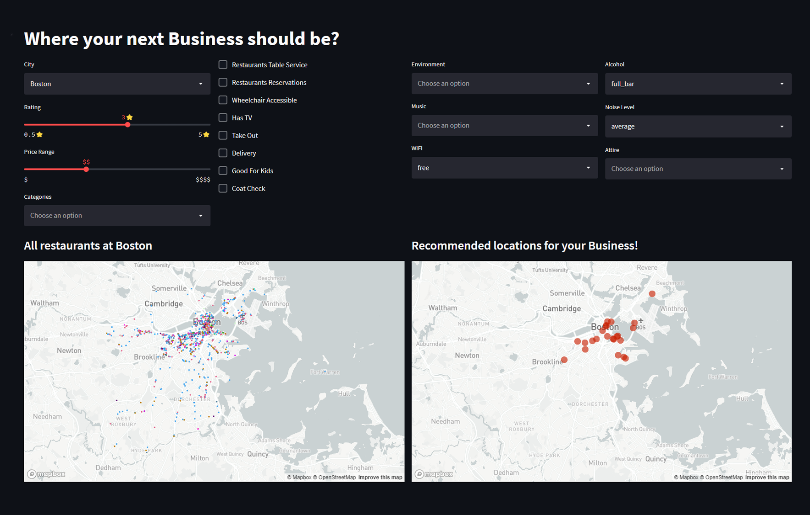


For New Restaurants
Where are the places you could possibly choose to get more customers?
GitHub
Web App
Notes:
So, for the ones who wants to open a new restaurant, where are the places could possibly choose to get more customers? We built an app for you based on the algorithms and process we just showed. You can access the app by scanning the QR code on the right. Your input will be classified and fitted into our model and will show you the first five clusters your new restaurant should be in.

Slide 27
7
Conclusion

Slide 28
Discussion & Future Work
Prediction rate is low
Need more attributes
Find more solid features / better way to calculate them
Try different models
Choose another city

Slide 29
In the Future
More Attributes
Geometric data
Population distributions
Features
Neighborhood entropy
measure nearby restaurants‘ diversity
Jensen Quality
Interaction between restaurants and venues

Slide 30
In the Future
Other Methods
Random forests
Optics
Cities
Restaurants located separately
Residents live separately

Slide 31
8
Reference

Slide 32
Reference
[1]A. K. P, S. S. G, P. K. R. Maddikunta, T. R. Gadekallu, A. Al-Ahmari, and M. H. Abidi,“Location Based Business Recommendation Using Spatial Demand,” Sustainability, vol. 12, no.10, p. 4124, May 2020.
[2]R. Deshpande, How to Choose the Ideal Site for Designing Your Restaurant Using Data Science,Aug 10, 2020. Accessed on: Oct 27, 2021. [Online].Available:https://medium.com/swlh/how-to-choose-the-ideal-site-for-designing-your-restaurant-using-data-science-2cbfb9853f93
[3]Y.Ding, Restaurant Location and Planning Study Using Machine Learning, Oct 25, 2020.Accessed on: Oct 27, 2021. [Online]Avaliable:https://www.linkedin.com/pulse/restaurant-location-planning-study-using-machine-learning-yimu-ding/
[4]F. Wang, L. Chen, en W. Pan, “Where to Place Your Next Restaurant? Optimal RestaurantPlacement via Leveraging User-Generated Reviews”, 11 2016.
[5]A. S. M. Tayeen, A. Mtibaa, en S. Misra, “Location, Location, Location! Quantifying the TrueImpact of Location on Business Reviews Using a Yelp Dataset”, in Proceedings of the 2019IEEE/ACM International Conference on Advances in Social Networks Analysis and Mining,Vancouver, British Columbia, Canada, 2019, bll 1081–1088.
[6] Brownlee, Jason. “How to Develop a Gradient Boosting Machine Ensemble in Python.” Machine Learning Mastery, 26 Apr. 2021, https://machinelearningmastery.com/gradient-boosting-machine-ensemble-in-python/.

Slide 33
Thanks!
GitHub
Web App
ANY QUESTIONS?

