Slide 1
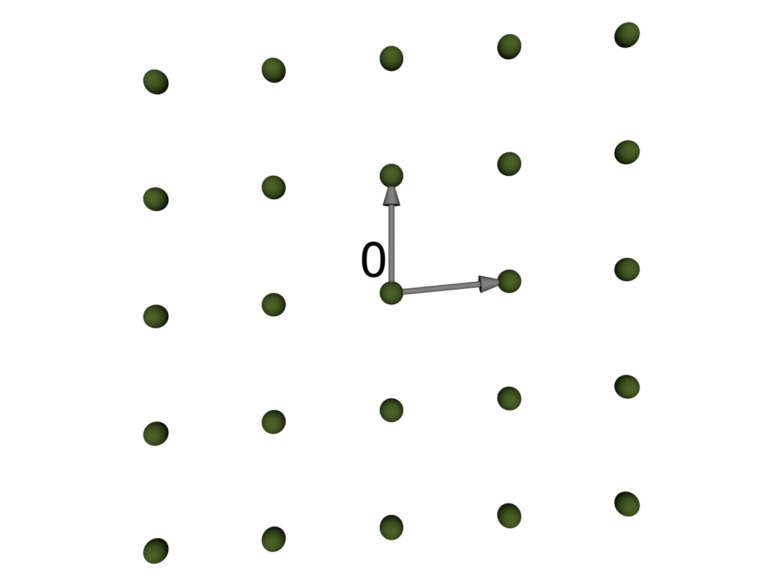
Towards Efficient Lattice-Based Cryptography
Richard Lindner

Slide 2
Motivation
Our everyday online needs
Updates, shopping, banking, webmail,…
Require secure cryptography
Digital signatures, public-key encryption
Our main hardness assumptions
Factoring, discrete logarithms
Are subject to strong attacks
Subexponential time, polynomial time (quantum)

Slide 3
Motivation
Replacement hardness assumptions
Shortest vector problem
Syndrome decoding problem
Solving multivariate systems
Major challenges
Hard random instances
Compact descriptions
Practical parameters
Notes:
Challenges build on top of each other

Slide 4
Lattices
Replacement hardness assumptions
Shortest vector problem
Syndrome decoding problem
Solving multivariate systems
Major challenges
Hard random instances (solution by [Ajt96, Reg05])
Compact descriptions (proposal by [LM06, LPR10])
Practical parameters (my thesis)
Use SIS/LWE
Use Ideal Lattices
Notes:
SIS/LWE guarantee security based on worst-case lattice problems

Slide 5
Lattices
Replacement hardness assumptions
Shortest vector problem
Syndrome decoding problem
Solving multivariate systems
Major challenges
Hard random instances (solution by [Ajt96, Reg05])
Compact descriptions (proposal by [LM06, LPR10])
Practical parameters (my thesis)
Use SIS/LWE
Use Ideal Lattices

Slide 6
Overview
Ideal Lattices
SIS – Digital Signatures
LWE – Public-Key Encryption

Slide 7
Overview
Ideal Lattices
SIS – Digital Signatures
LWE – Public-Key Encryption

Slide 8
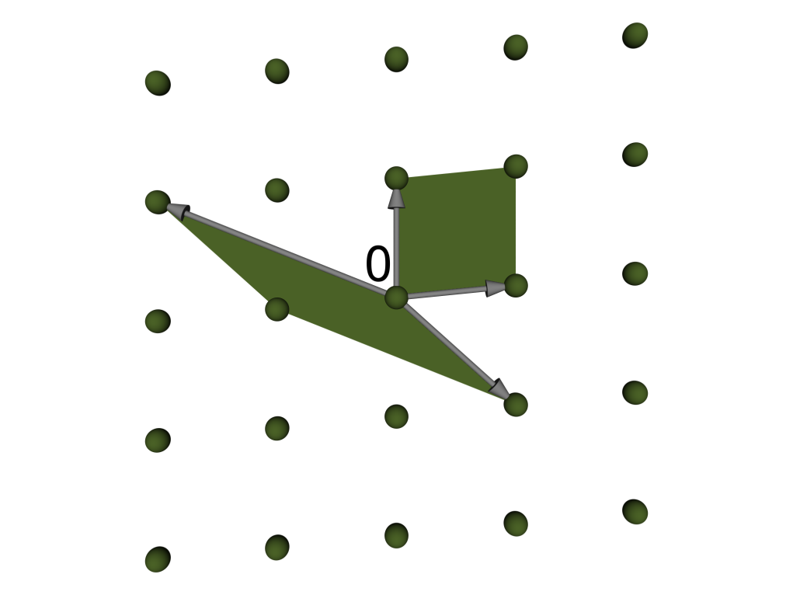
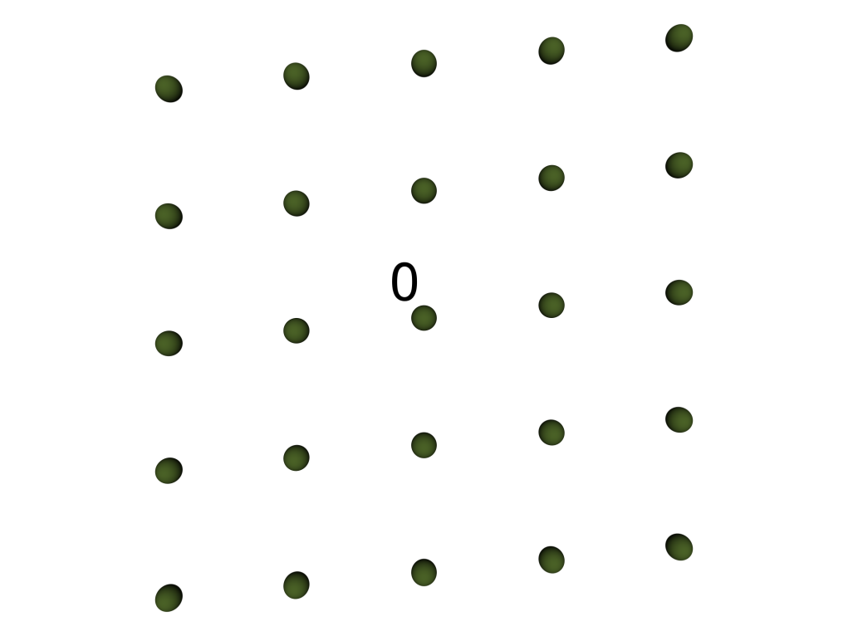
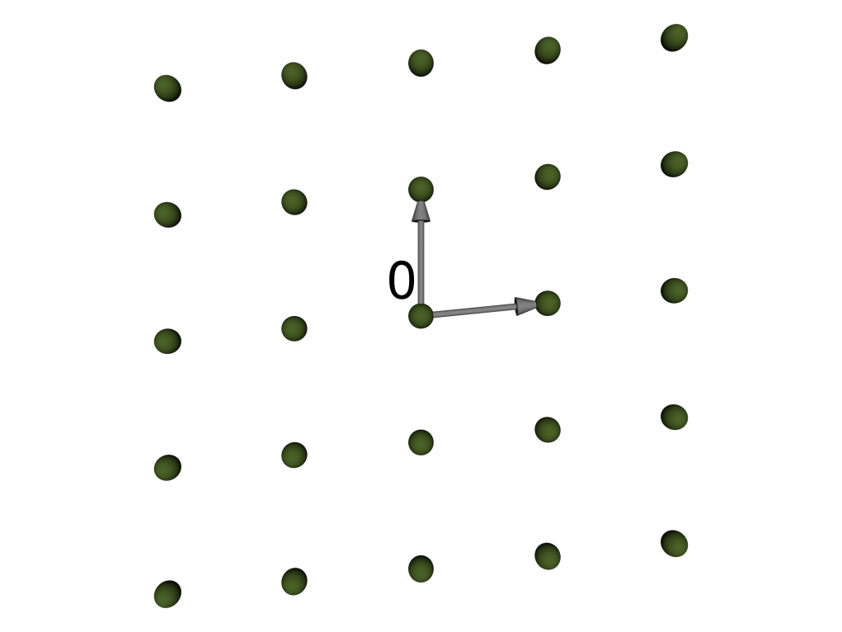
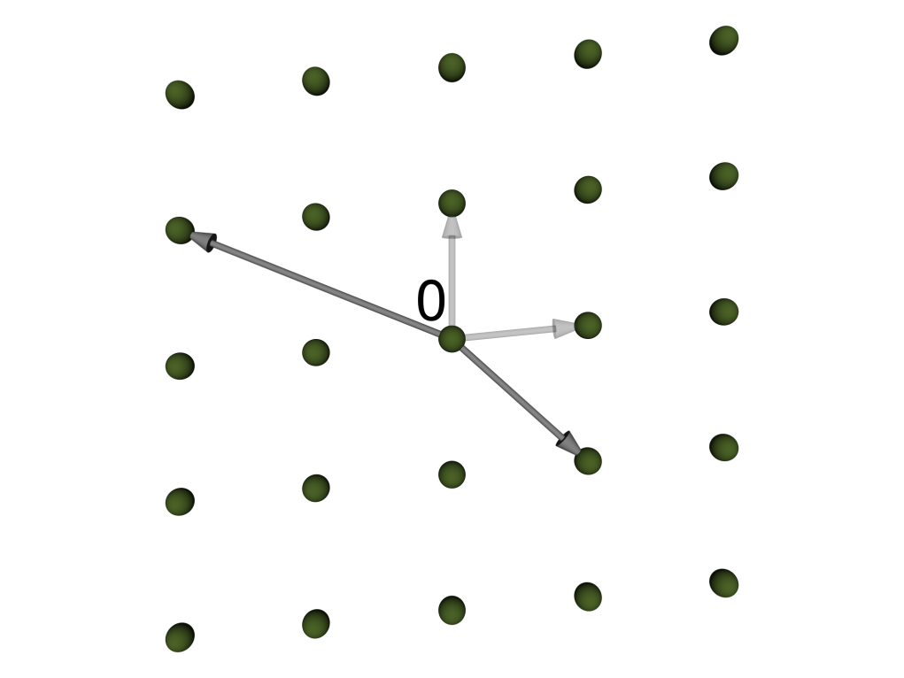
Lattices
Linearly independent
b₁,...,b_{m} 2 Z^{m}
Lattice
L = {x₁b₁+...+x_{m}b_{m} : x_{i} 2 Z}
Basis B = [b₁,...,b_{m}]
Det det(L) = det(B)
m = 2

Slide 9
Ideal Lattices
Ring
R_{f} = Z[x] /hfi for monic irreducible f with m = deg(f)
Embedding
¾: R_{f} ! Z^{m} : a₀ +…+ a_{m-1}x^{m-1}  (a₀,..., a_{m-1})
Ideal lattice
L = ¾(A) for ideal A µ R_{f} [LM06, Mic02]
Use cyclotomic f [LPR10, PR06]
Huge efficiency boost
Limit worst-case assumption to subclass
Notes:
Say that you don’t explain cyclotomic

Slide 10
My Contributions
L_{m}(b)
#Lattices, det · b
I_{m}(b)
#Corresponding ideals in R_{f}
Theorem 1
L_{m}(b) 2 Ω(b^{m}) as b ! 1
L_{m}(b) 2 O(b^{m}) [Sch68]
Theorem 2
I_{m}(b) 2 O(b) as b ! 1
Adapt [MvO03, DW1861]

Slide 11
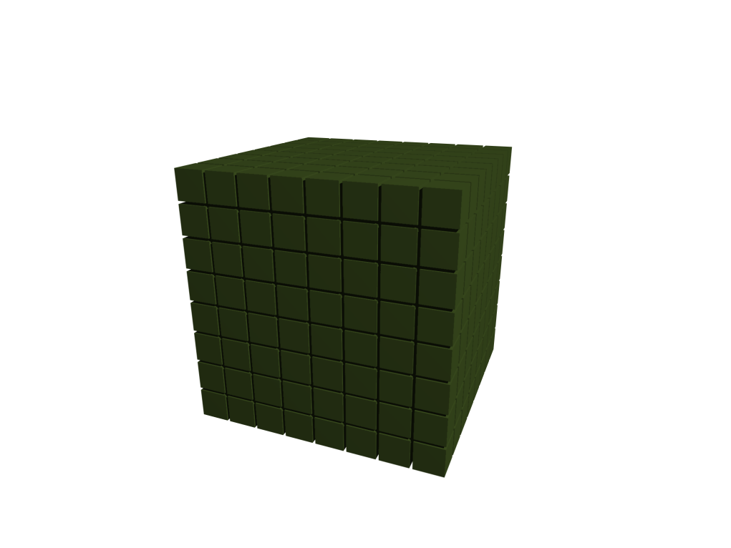
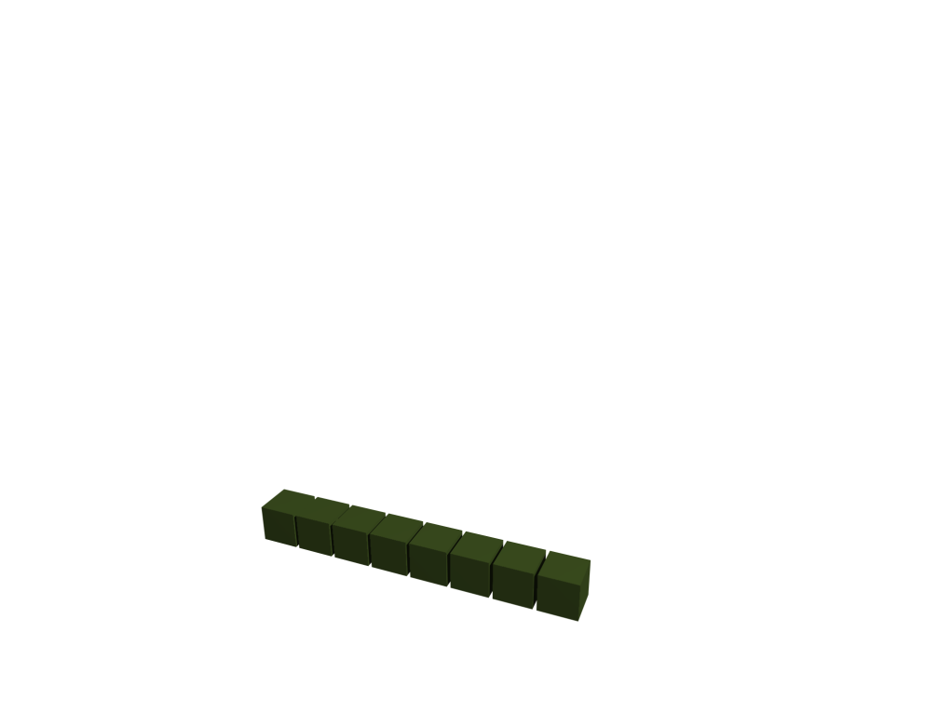
My Contributions
Theorem 1
L_{m}(b) 2 Ω(b^{m}) as b ! 1
L_{m}(b) 2 O(b^{m}) [Sch68]
Theorem 2
I_{m}(b) 2 O(b) as b ! 1
Adapt [MvO03, DW1861]
m = 3
b
Require worst-case assumptions for small subclass
Notes:
Instead of requiring that the worst-case of instances in the huge collection is hard,
we now require that the worst-case in the tiny collection is hard

Slide 12
Overview
Ideal Lattices
Require worst-case assumptions for small subclass
SIS – Digital Signatures
LWE – Public-Key Encryption

Slide 13
Overview
Ideal Lattices
Require worst-case assumptions for small subclass
SIS – Digital Signatures
LWE – Public-Key Encryption

Slide 14
Small Integer Solutions
Given random A in Z_{q}^{n x m}
Find small x ≠ 0 st Ax ≡ 0 (mod q) [Ajt96]
-1
-1
0
3
1
2
4
2
4
0
0
0
3
6
2
0
3
0
0
2
0
4
1
3
2
∙
1
≡
0
(mod 7)

Slide 15
SWIFFT
Instance A of Ideal-SIS (n, q, m) = (64, 257, 1024)
Efficient compression f(x) = Ax (mod q), x binary
[LMPR08]
Collision of f , Trinary solution of Ideal-SIS
Collision-resistant compression ) Signatures [Dah09]
Pseudo-collisions of f , Ideal-SIS solutions in the smallest ball containing all trinary solutions
“Pseudo-collisions useful starting point”
Lattice reduction algorithms cannot distinguish
Notes:
Comparable to SHA-2
CR compression => Signature scheme [Dah09]

Slide 16
Hardness of Pseudo-Collisions
Ideal SIS
(n, q, m)
Symmetric Bitsecurity
???
[MR09]
[LV01]
Sublattice Dimension d
Attack Runtime
Experiments

Slide 17
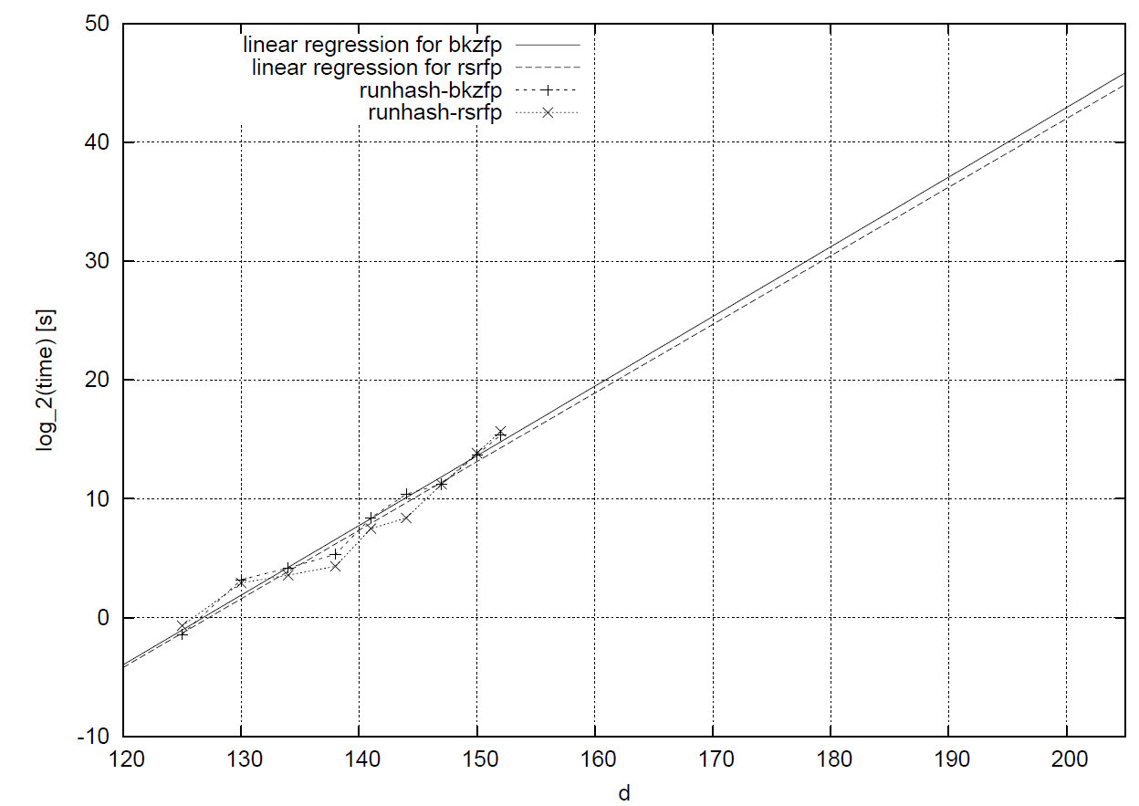
Experiments

Slide 18
My Contributions
Finding pseudo-collisions for SWIFFT
Estimated bitsecurity 2⁶⁸
Replacement parameters (n, q, m) = (96, 387, 1728)
Estimated bitsecurity 2¹²⁷
Double the exponent for +40% operations
SIS parameters where pseudo-collisions are hard
Notes:
Double exponent for +40% = Good deal because computation involved is parallelizable

Slide 19
Small Integer Solutions
Given random A in Z_{q}^{n x m}
Find small x ≠ 0 st Ax ≡ 0 (mod q) [Ajt96]
-1
-1
0
3
1
2
4
2
4
0
0
0
3
6
2
0
3
0
0
2
0
4
1
3
2
∙
1
≡
0
(mod 7)

Slide 20
My Contribution
Find n independent columns permute to front
Multiply by inverse of first block
If this cannot be done ) equivalent SIS with smaller n
Save 7% description bits for all (Ideal-)SIS primitives
-1
-1
-1
-1
0
0
1
0
0
-2
3
1
0
0
3
1
2
4
2
4
0
0
0
1
0
-3
-2
1
0
0
0
3
6
2
0
3
0
0
∙
∙
≡
≡
(mod 7)
0
0
1
3
1
0
1
0
(mod 7)
2
0
4
1
3
2
1
0
Notes:
Least revealing description

Slide 21
Overview
Ideal Lattices
Require worst-case assumptions for small subclass
SIS – Digital Signatures
Parameters where pseudo-collisions are hard
Save 7% description bits for all (Ideal-)SIS primitives
LWE – Public-Key Encryption

Slide 22
Overview
Ideal Lattices
Require worst-case assumptions for small subclass
SIS – Digital Signatures
Parameters where pseudo-collisions are hard
Save 7% description bits for all (Ideal-)SIS primitives
LWE – Public-Key Encryption

Slide 23
Learning with Errors
Given random A in Z_{q}^{m x n} and t = As + e (mod q) for secret s, small Gaussian e
Find e (or s) [Reg05]
Set of potential As (mod q) forms lattice L
t is lattice point perturbed by e
Say B basis of L obtained after T_{Reduce} time
Decode t to recover e

Slide 24
Bounded distance decoding
Nearest Plane (t, [b₁, b₂])
As
b₂
b₁

Slide 25
My Contribution
Nearest Plane (t, [b₁, 2b₂])
As
2b₂
b₁

Slide 26
My Contribution
If As not in [b₁, 2b₂] Z², then As + b₂ is
Also do Nearest Plane (t + b₂, [b₁, 2b₂])
Instead of one Nearest Plane run two
get two candidate e and check which works
Better success prob for post reduction work
T_{Total} = T_{Reduce} + T_{Planes}
Plane runs parallelizable

Slide 27
My Contribution
Parameters | Success | Attack [MR09] | New (Planes)
Keysize: regular / ideal | Probability | log(secs) | log(secs)
Previous [MR09] Public key: 342 / 2.5 kbyte | ¼1 2⁻³² | 219 33 | 68 27
New (medium security) Public key: 49 / 0.25 kbyte | ¼1 2⁻³² | 258 96 | 132 90
Save 86% on public key size and get stronger security
Improve best attack by factor at least 64
Notes:
More room for improvement –> Parallelization
Paradoxical result

Slide 28
Overview
Ideal Lattices
Require worst-case assumptions for small subclass
SIS – Digital Signatures
Parameters where pseudo-collisions are hard
Save 7% description bits for all (Ideal-)SIS primitives
LWE – Public-Key Encryption
Save 86% on public key size and get stronger security
Improve best attack by factor at least 64

Slide 29
List of Publications
Efficiency Improvement for NTRU. Johannes Buchmann, Martin Döring, Richard Lindner, Sicherheit, LNI 128, pp. 163 – 178, GI 2008.
Density of Ideal Lattices. Johannes Buchmann, Richard Lindner, WEWoRC, LNCS 6429, Springer 2011.
Secure Parameters for SWIFFT. Johannes Buchmann, Richard Lindner, Indocrypt, LNCS 5922, pp. 1 – 17, Springer 2009.
Explicit Hard Instances of the Shortest Vector Problem. Johannes Buchmann, Richard Lindner, Markus Rückert, Post-Quantum Cryptography, LNCS 5299, pp. 79 – 94, Springer 2008.
Post-Quantum Cryptography: Lattice Signatures. Johannes Buchmann, Richard Lindner, Markus Rückert, Michael Schneider, Computing 85, pp. 105 – 125, Springer 2009.
Probabilistic Analysis of LLL Reduced Bases. Johannes Buchmann, Michael Schneider, Richard Lindner, WEWoRC, LNCS 6429, Springer 2011.
Improved Zero-Knowledge Identification with Lattice. Pierre-Louis Cayrel, Richard Lindner, Markus Rückert, Rosemberg Silva, ProvSec, LNCS 6402, pp. 1 – 17, Springer 2010.
A lattice-based Threshold Ring Signature Scheme. Pierre-Louis Cayrel, Richard Lindner, Markus Rückert, Rosemberg Silva, Latincrypt, LNCS 6212, pp. 255 – 272, Springer 2010.
Identifying Ideal Lattices. Jintai Ding, Richard Lindner, Technical Report 322, ePrint 2007.
Better Key Sizes (and Attacks) for LWE-Based Encryption. Richard Lindner, Chris Peikert, CT-RSA, LNCS 6559, pp. 319 – 339, Springer 2011.

Slide 30
Thank you
Further Questions?

