Slide 1

Efficiency Improvement for NTRU
Johannes Buchmann
Martin Döring
Richard Lindner
Notes:
Total time is 25min plus 5min discussion.
With 2min per relevant slide this means i have ~4min intro and conclusion
10 slides with actual content
Introduction to NTRU
Motivation
Standard Multiplication (Bailey et al.)
Sliding Window Multiplication (Lee et al.)
Pattern Multiplication
Comparative Timings
Trinary Case

Slide 2
Quantum Computer Attacks
RSA
ECC
McEliece
Merkle
NTRU
1980 1990 2000 ∙∙∙ QComputer

Slide 3
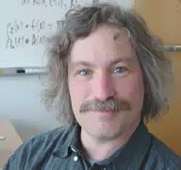
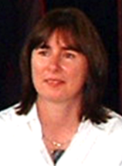
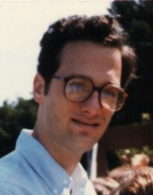
NTRU
Patented in 1996
Sony & Greylock invested $11M
IEEE Standard Proposal 1363.1 (in progress)
7x faster than RSA
Message Expansion
Parameters often updated
Hoffstein, Pipher, Silverman

Slide 4
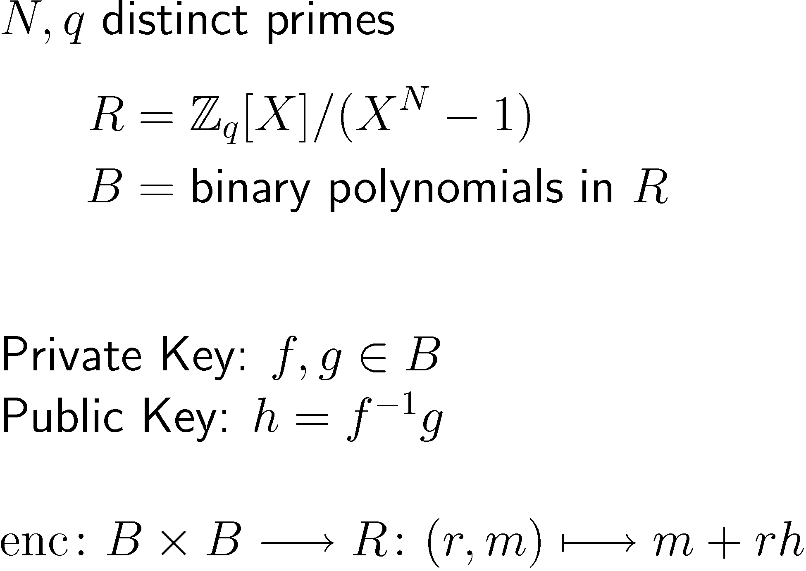
NTRU Trapdoor

Slide 5
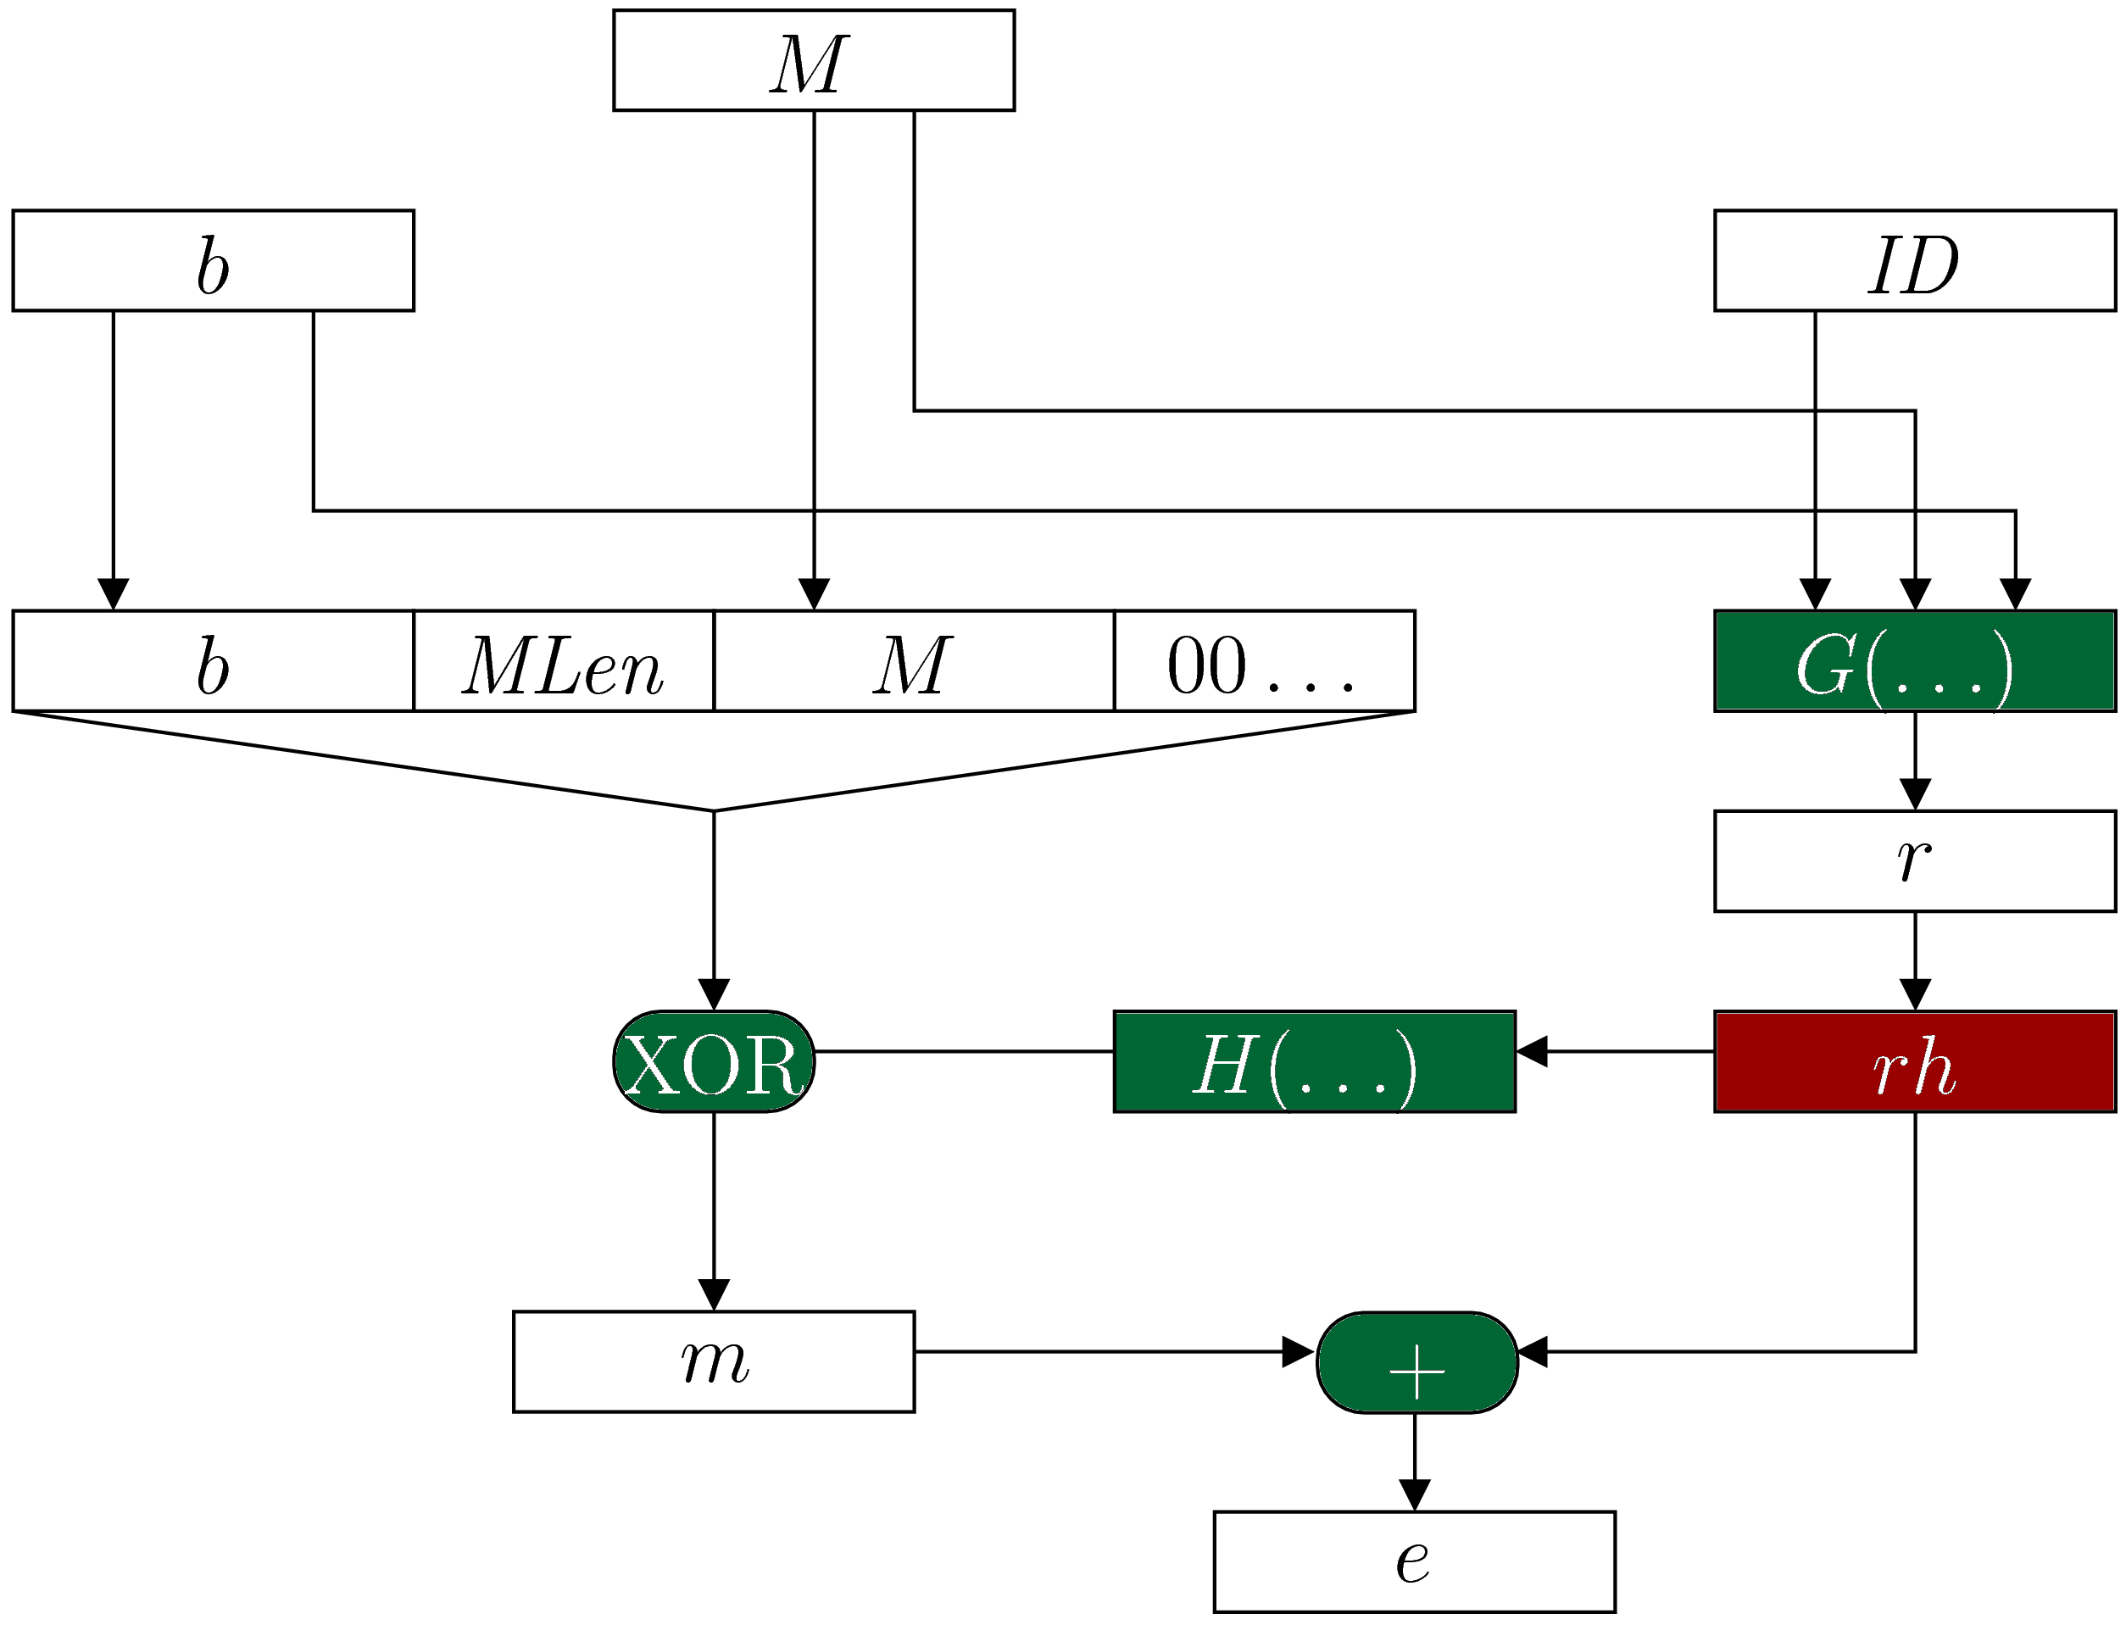
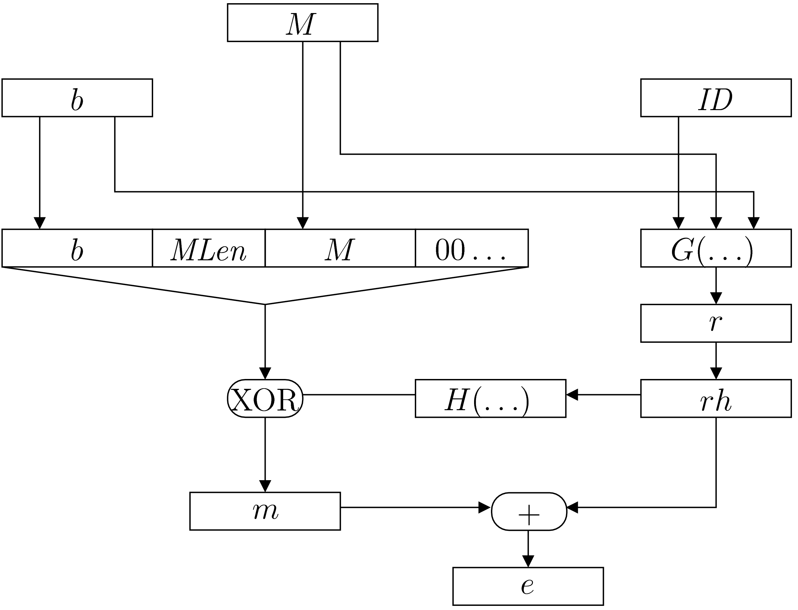
NAEP Encryption
Input
Fast
Slow
Output
Notes:
NAEP = NTRU Asymmetric Encryption Padding
OAEP = Optimal Asymmetric Encryption Padding

Slide 6
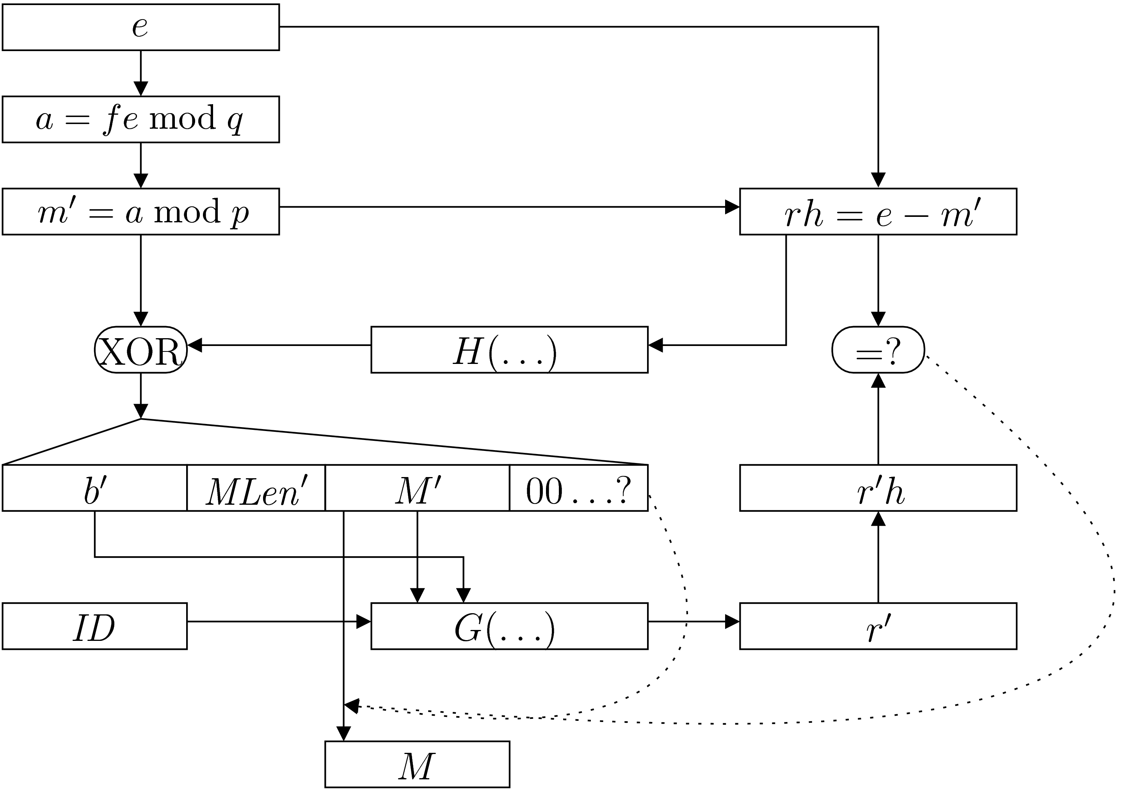
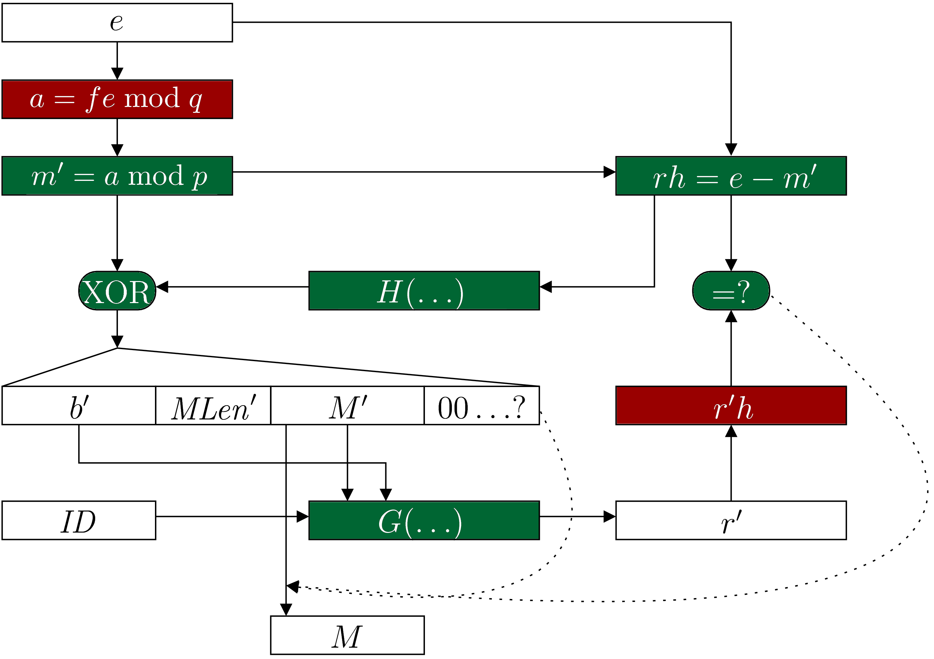
NAEP Decryption
Input
Fast
Slow
Output

Slide 7
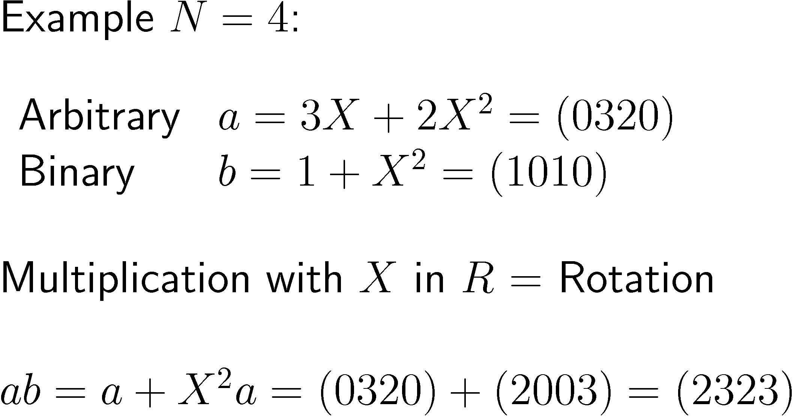
Multiplication with Binary Polynomials

Slide 8
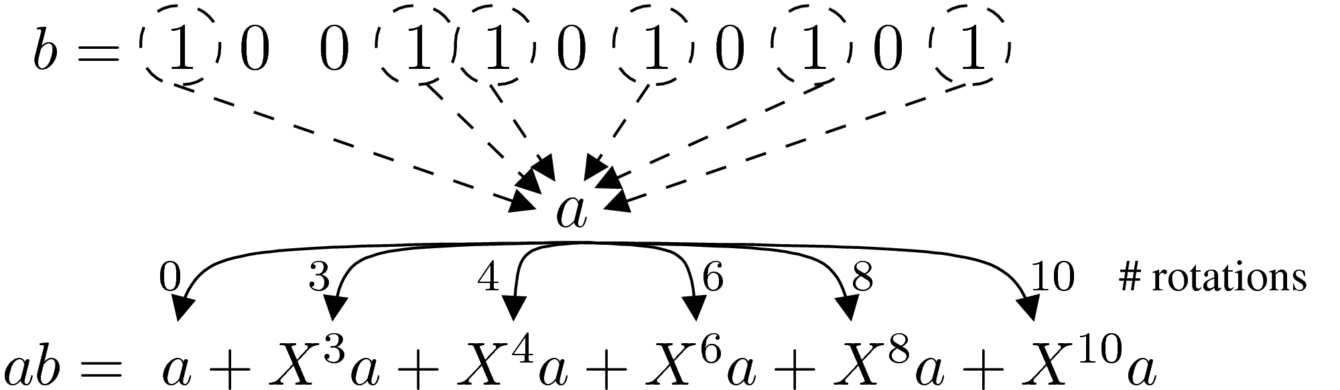
Standard Multiplication
Calculate rotations
Add

Slide 9


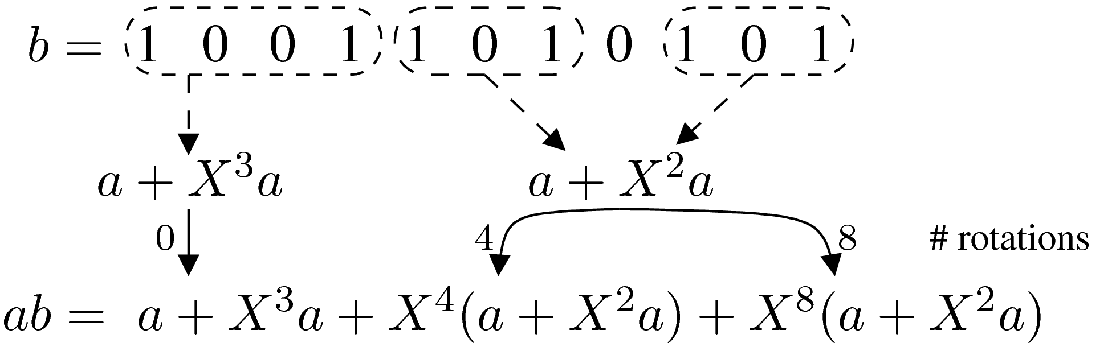
Sliding Window Multiplication
(Pre-)Calculate for
Calculate rotations
Add

Slide 10

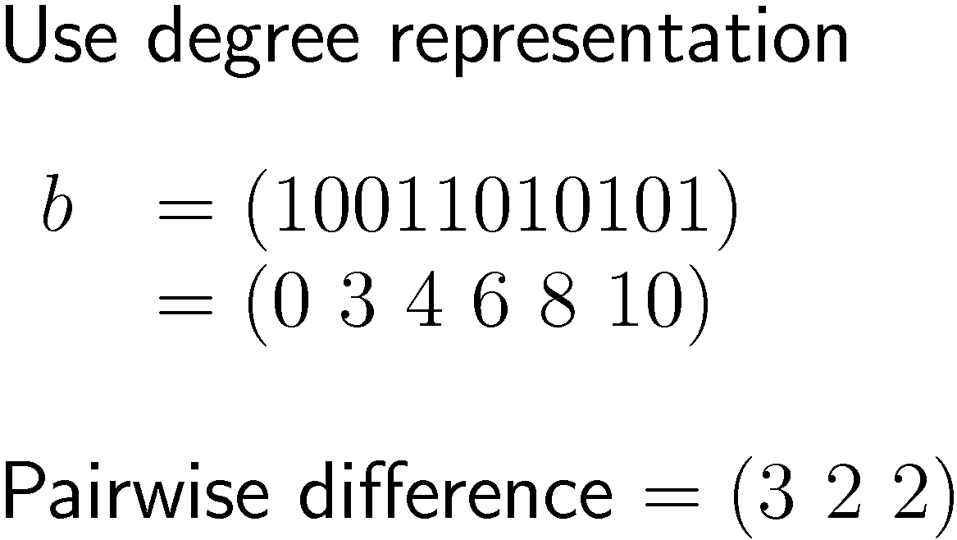
Pattern Multiplication
33% of recurring patterns have
Precalculation is not always possible
Not all patterns are needed
Finding needed patterns is easy
Notes:
Precalculation: 1 mul/encrypt, 2 mul/decrypt
ENCRYPT: Can only pre-calculate when sending to the same reciever again (a=recievers public key)
DECRYPT: Can NOT pre-calculate for a=encrypted message, can pre-calculate for (a=own public key)

Slide 11
Pattern Multiplication
Calculate needed
Calculate rotations
Add
Notes:
sagen: die a+X^i a werden nacheinander berechnet und gleich aufaddiert

Slide 12
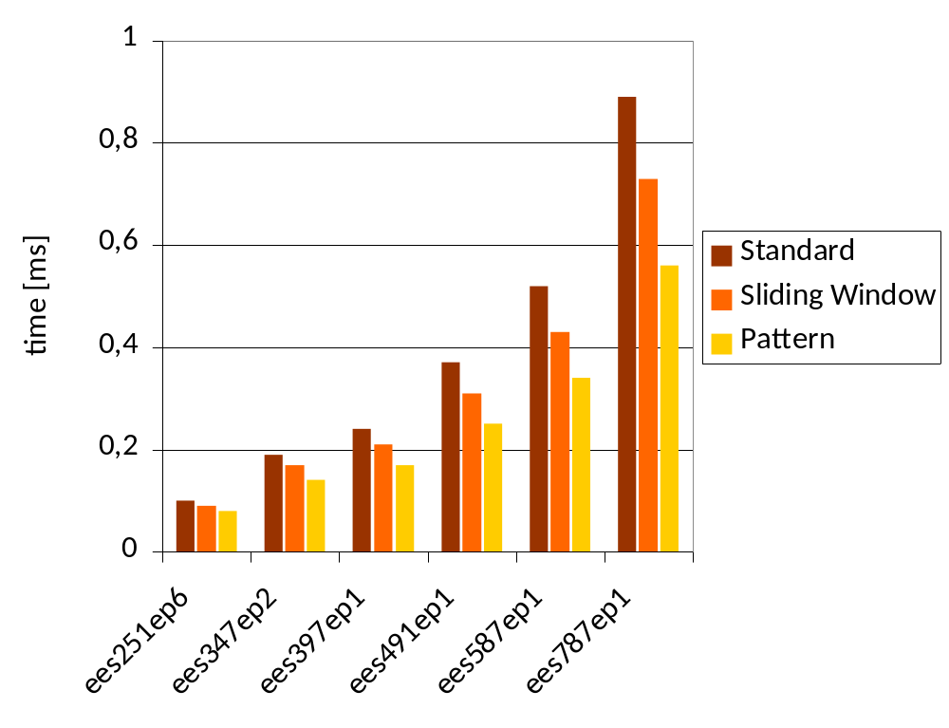
Comparative Timings
Platform: Pentium M, 1.6 GHz, 2GB RAM, JRE 1.6

Slide 13

Try it yourself
www.flexiprovider.de

Slide 14
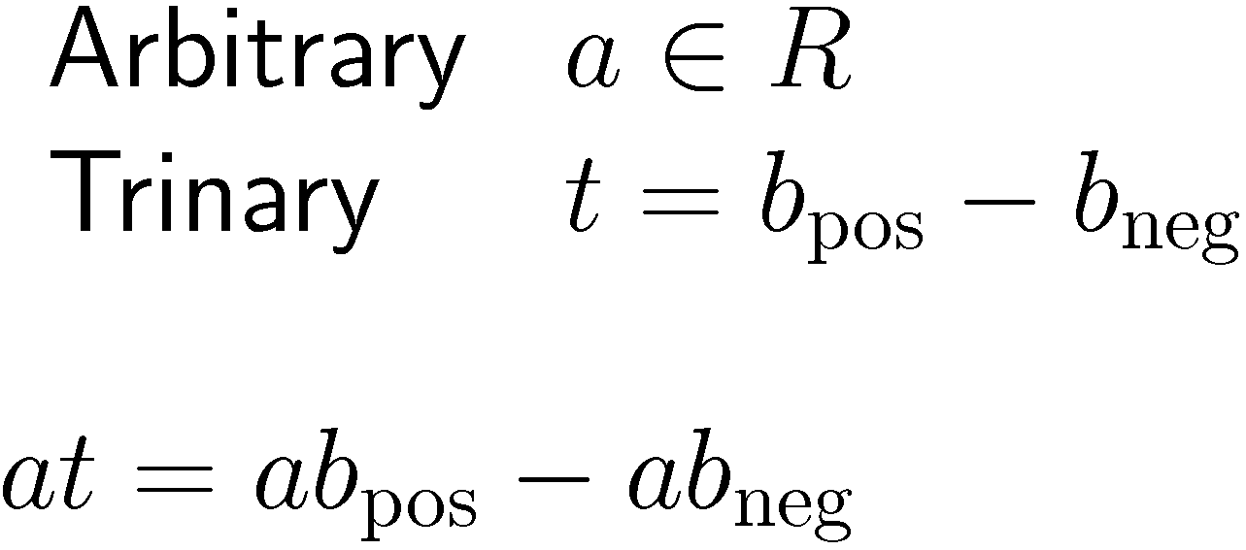
Trinary Case
Easy as binary case
Can reuse patterns

Slide 15
Thank You

