Slide 1
Explicit hard instances of the shortest vector problem
Johannes Buchmann
Richard Lindner
Markus Rückert

Slide 2
Outline
Motivation
Foundations
Construction
Experiments
Participation

Slide 3
Motivation

Slide 4
Motivation
PQC schemes rely on lattice problems
  GGH `96, NTRU `96, Regev `05, GPV `08
No unified comparison of lattice reduction
Other challenges based on secret
  GGH, NTRU
Notes:
No challenge is independent of a secret and offers a unified comparison of lattice reduction algorithms.

Slide 5
Foundations

Slide 6
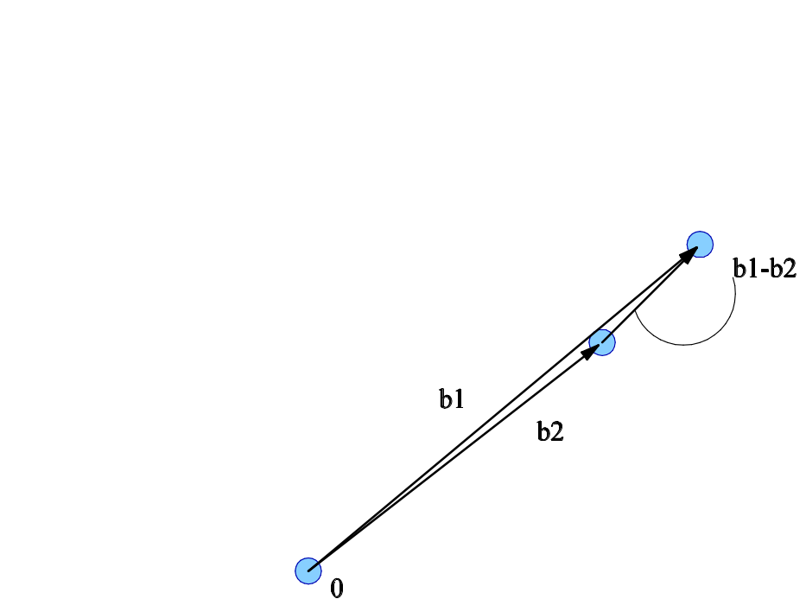
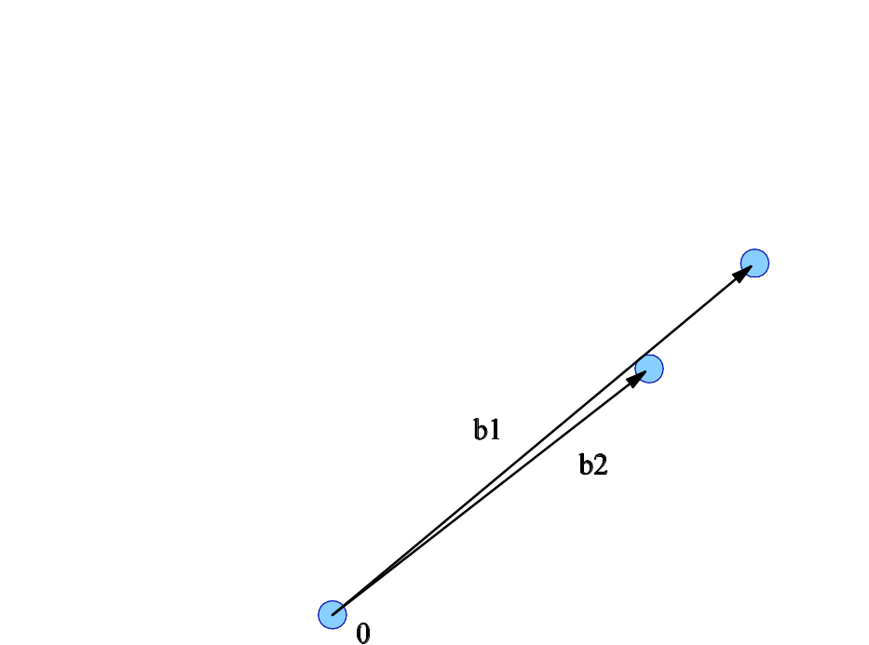
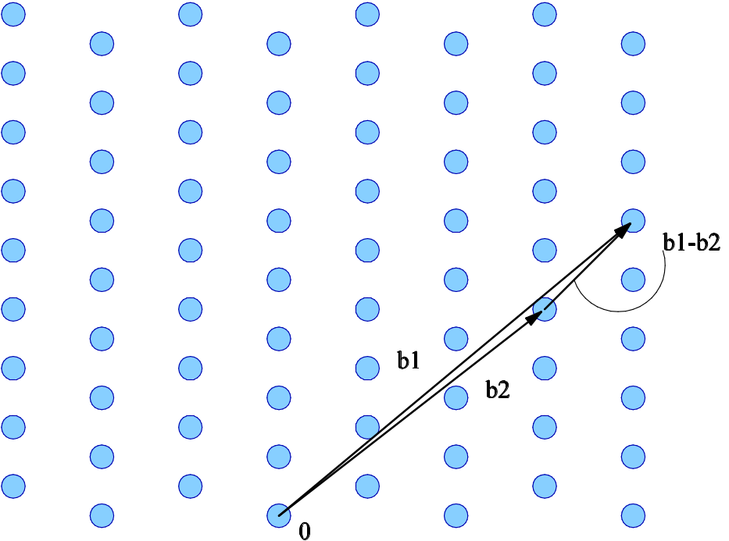
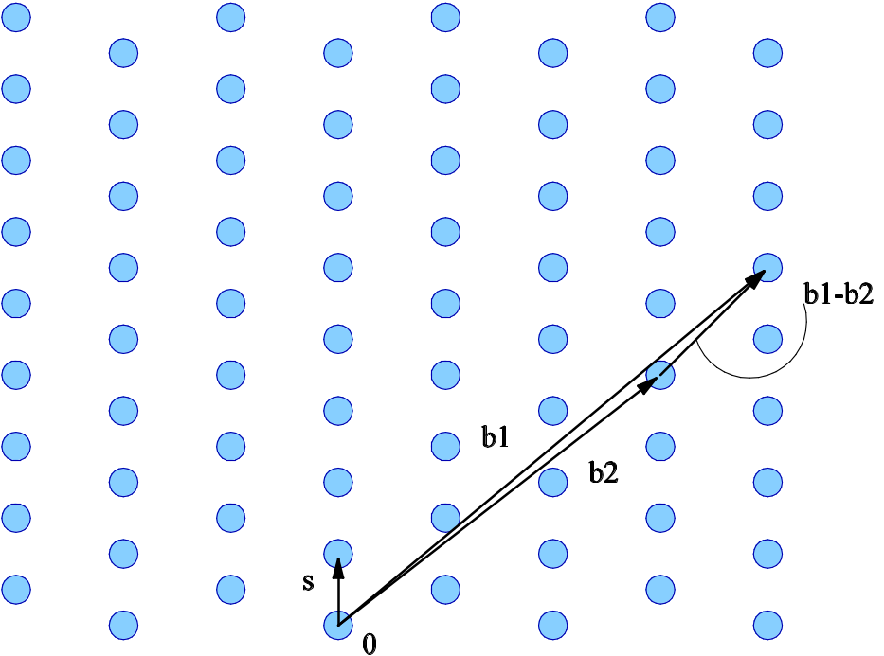
Family of lattice classes
Definitions
  Lattice: ¤ discrete additive subgroup of R^{m}
Notes:
Lattice: spanned by a basis

Slide 7
Family of lattice classes
Definitions
  Lattice: ¤ discrete additive subgroup of R^{m}
  Class: m = b c₁ n ln(n) c, q = b n^{c2} c,
  For X = (x₁,…,x_{m}) 2 Z_{q}^{n£n}
  L(c₁, c₂, n, X) = { (v₁,…,v_{m}) 2Z^{m} | ∑_{i} v_{i} x_{i} ´ 0 (mod q) }
  Class Family: L = { L(c₁,c₂,n,¢) | c₁¸2, c₂<c₁ln(2), n 2 N}
Notes:
Lattice: spanned by a basis

Slide 8
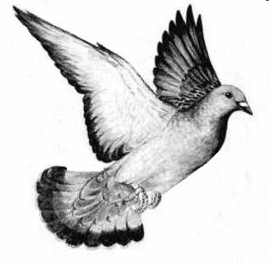
Existence of Short Vector
Consider v 2 {0,1}^{m} , x₁,…,x_{n} 2 Z_{q}^{n£n}
The function v  ∑_{i} v_{i} x_{i} (mod q)
Has collisions if 2^{m} > q^{n}
The lattice L(…,X) 2 L contains
v 2 {-1,0,1}^{m}, so kvk² · m

Slide 9
Hardness of Challenge
Asymptotically:
Ajtai,Cai/Nerurkar,Micciancio/Regev,Gentry et al.
Finding short vector ) Approx worst-case SVP
Practice:
Gama and Nguyen
Challenges hard for m ' 500
intractible for m ' 850

Slide 10
Construction

Slide 11
Explicit Bases
Using randomness of ¼ digits
Choose X 2 Z_{q}^{n£n} randomly
Set ¤ = L(…,X) 2 L
Construction via dual lattice basis
B = ( X^{T} | qI_{m} ) spans q¤?
  Turn B into basis
  Transform B/q into dual basis
Notes:
Pseudo-randomness from the digits of PI

Slide 12
Experiments

Slide 13
Implementations
LLL-type
LLL — Shoup
fpLLL — Cadé, Stehlé
sLLL — Filipović, Koy
Run on Opteron 2.6GHz
BKZ-type
BKZ — Shoup
PSR — Ludwig
PD — Filipović, Koy

Slide 14
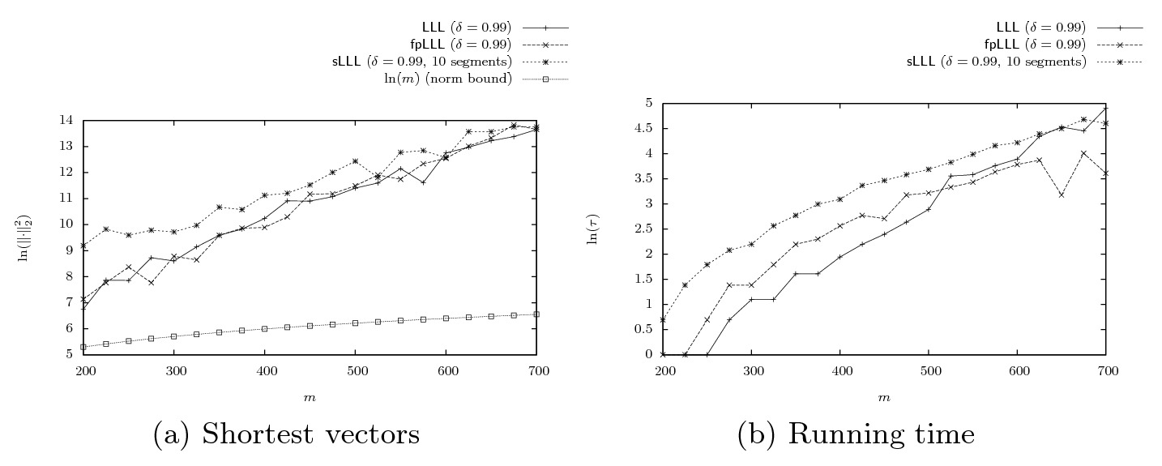
Performance of LLL-type Algorithms

Slide 15
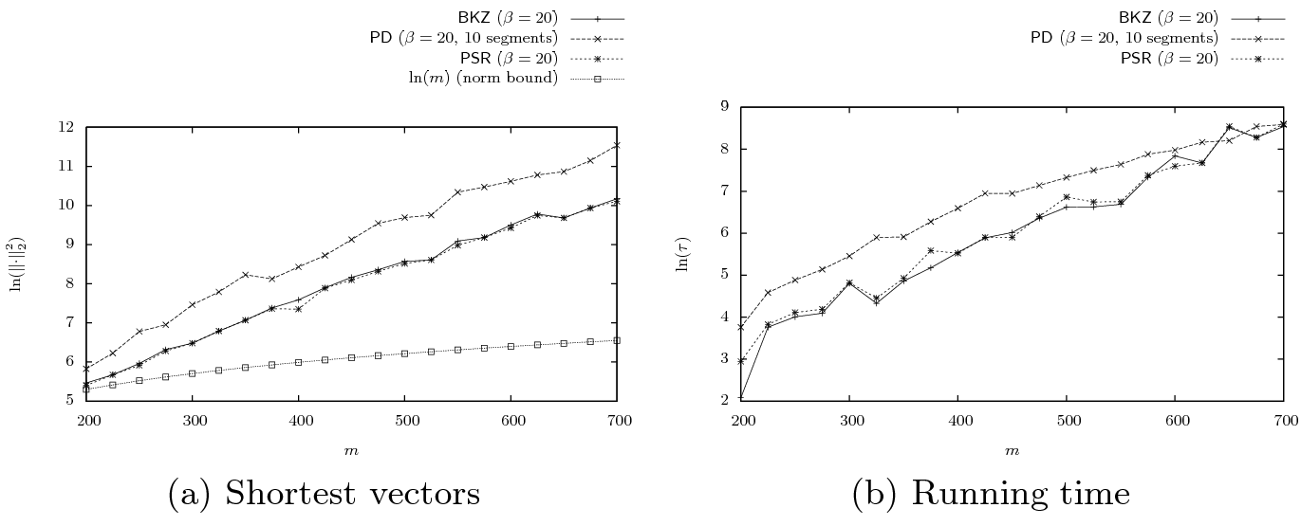
Performance of BKZ-type Algorithms

Slide 16
Participation

Slide 17
How to Participate
Go to www.LatticeChallenge.org
Download lattice basis B_{m} , norm bound º
Find v in ¤(B_{m}) such that kvk < º
Submit v

Slide 18

www.LatticeChallenge.org
Successful Participants (chronological order)
Nicolas Gama, Phong Q. Nguyen
Moon Sung Lee
Markus Rückert
Panagiotis Voulgaris

Slide 19
Story
Praticipants found: solutions have many zeros
Strategy to focus on sublattices
Same oberservation as May, Silverman in 2001 working on NTRU
Lead to Hybrid Lattice-Reduction proposed 2007 by Howgrave-Graham

Slide 20
Thank You
Questions?

