Slide 1
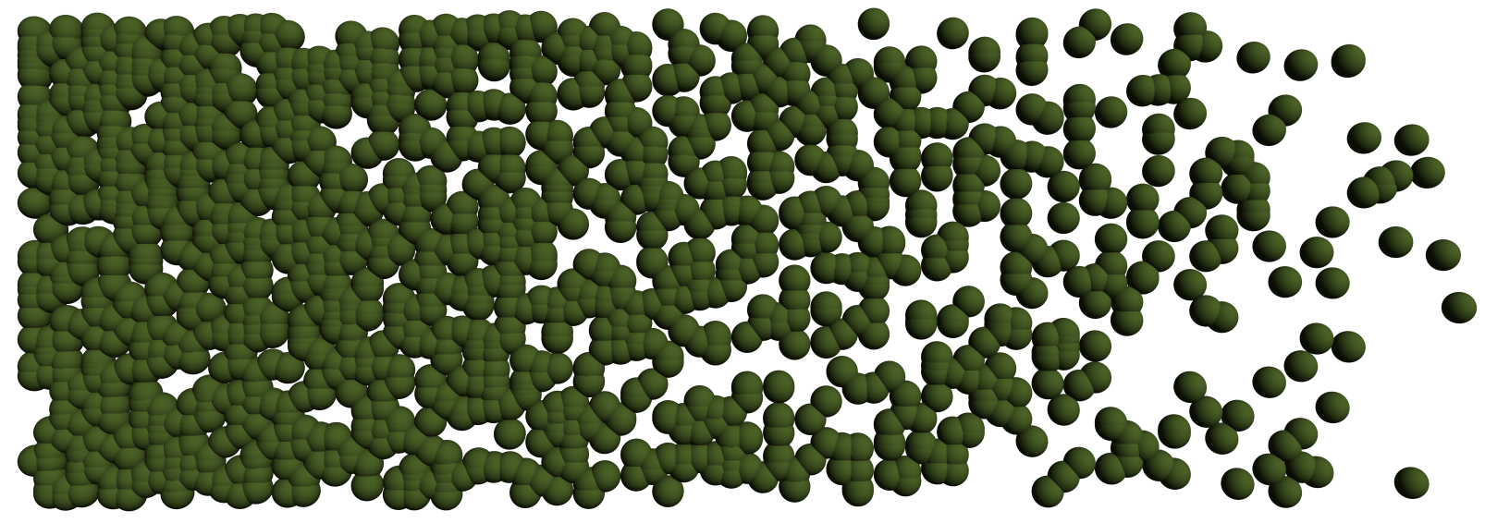
Density of Ideal Lattices
Johannes Buchmann
Richard Lindner

Slide 2
Agenda
Introduction to Lattices
Lattice-based Primitives
Counting Lattices
Main Ideas
Open Problem

Slide 3
Lattices

Slide 4
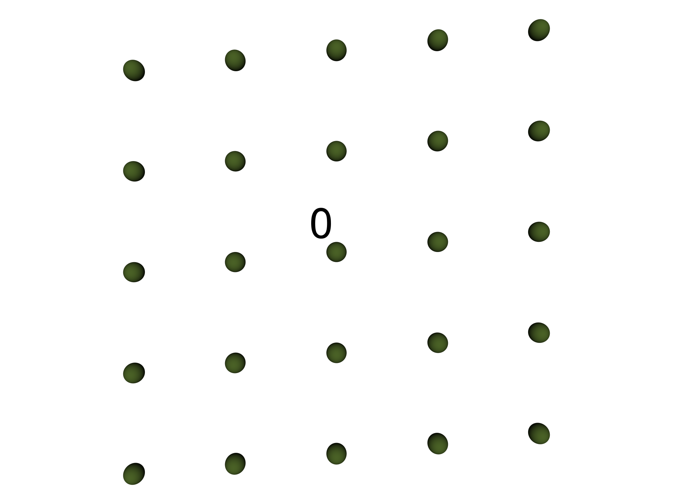
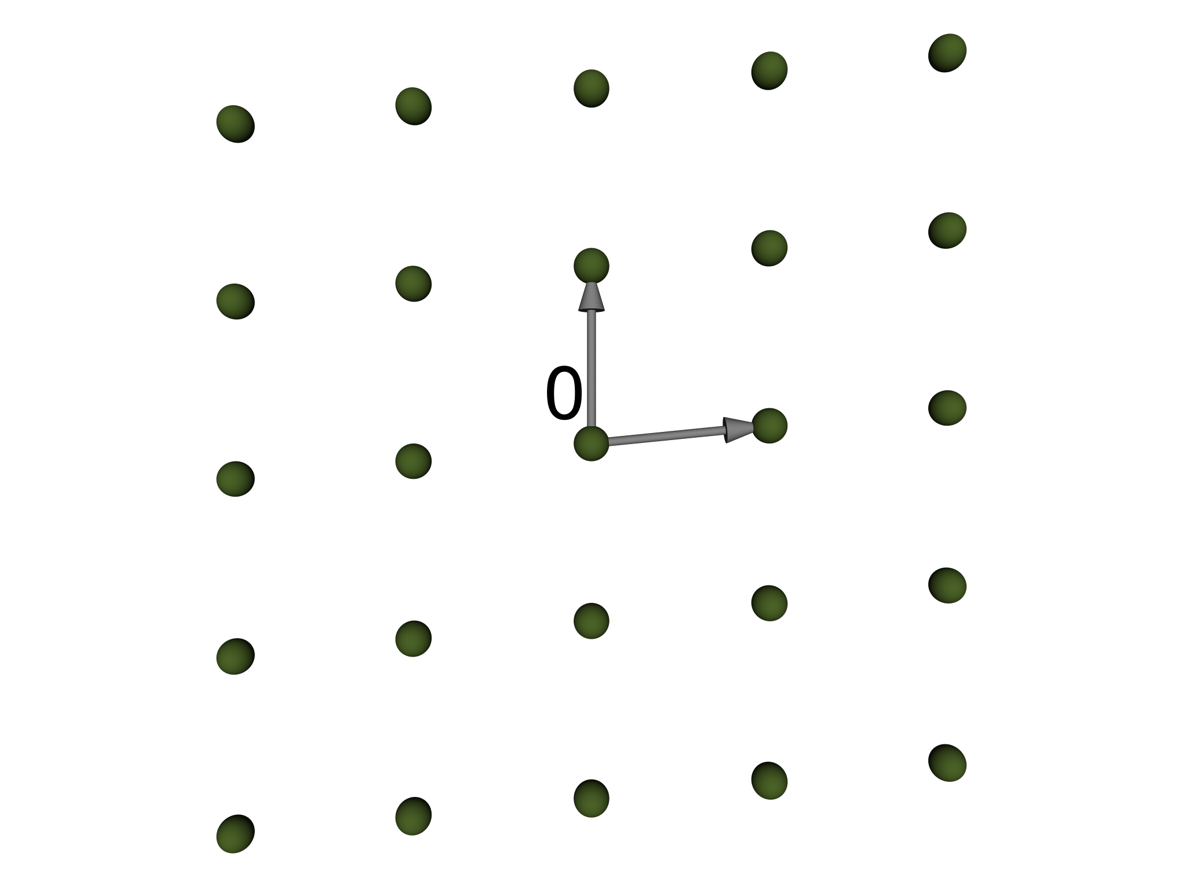
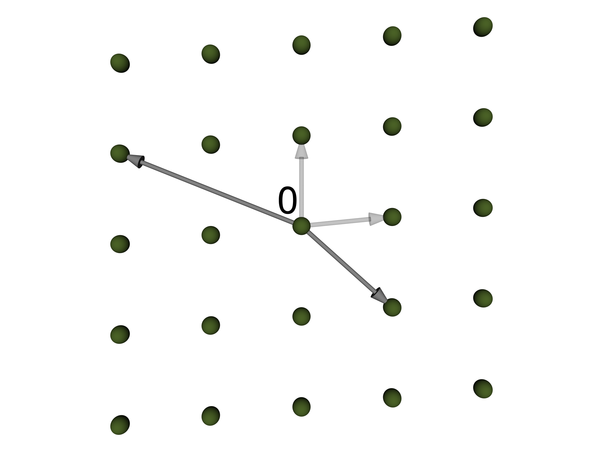
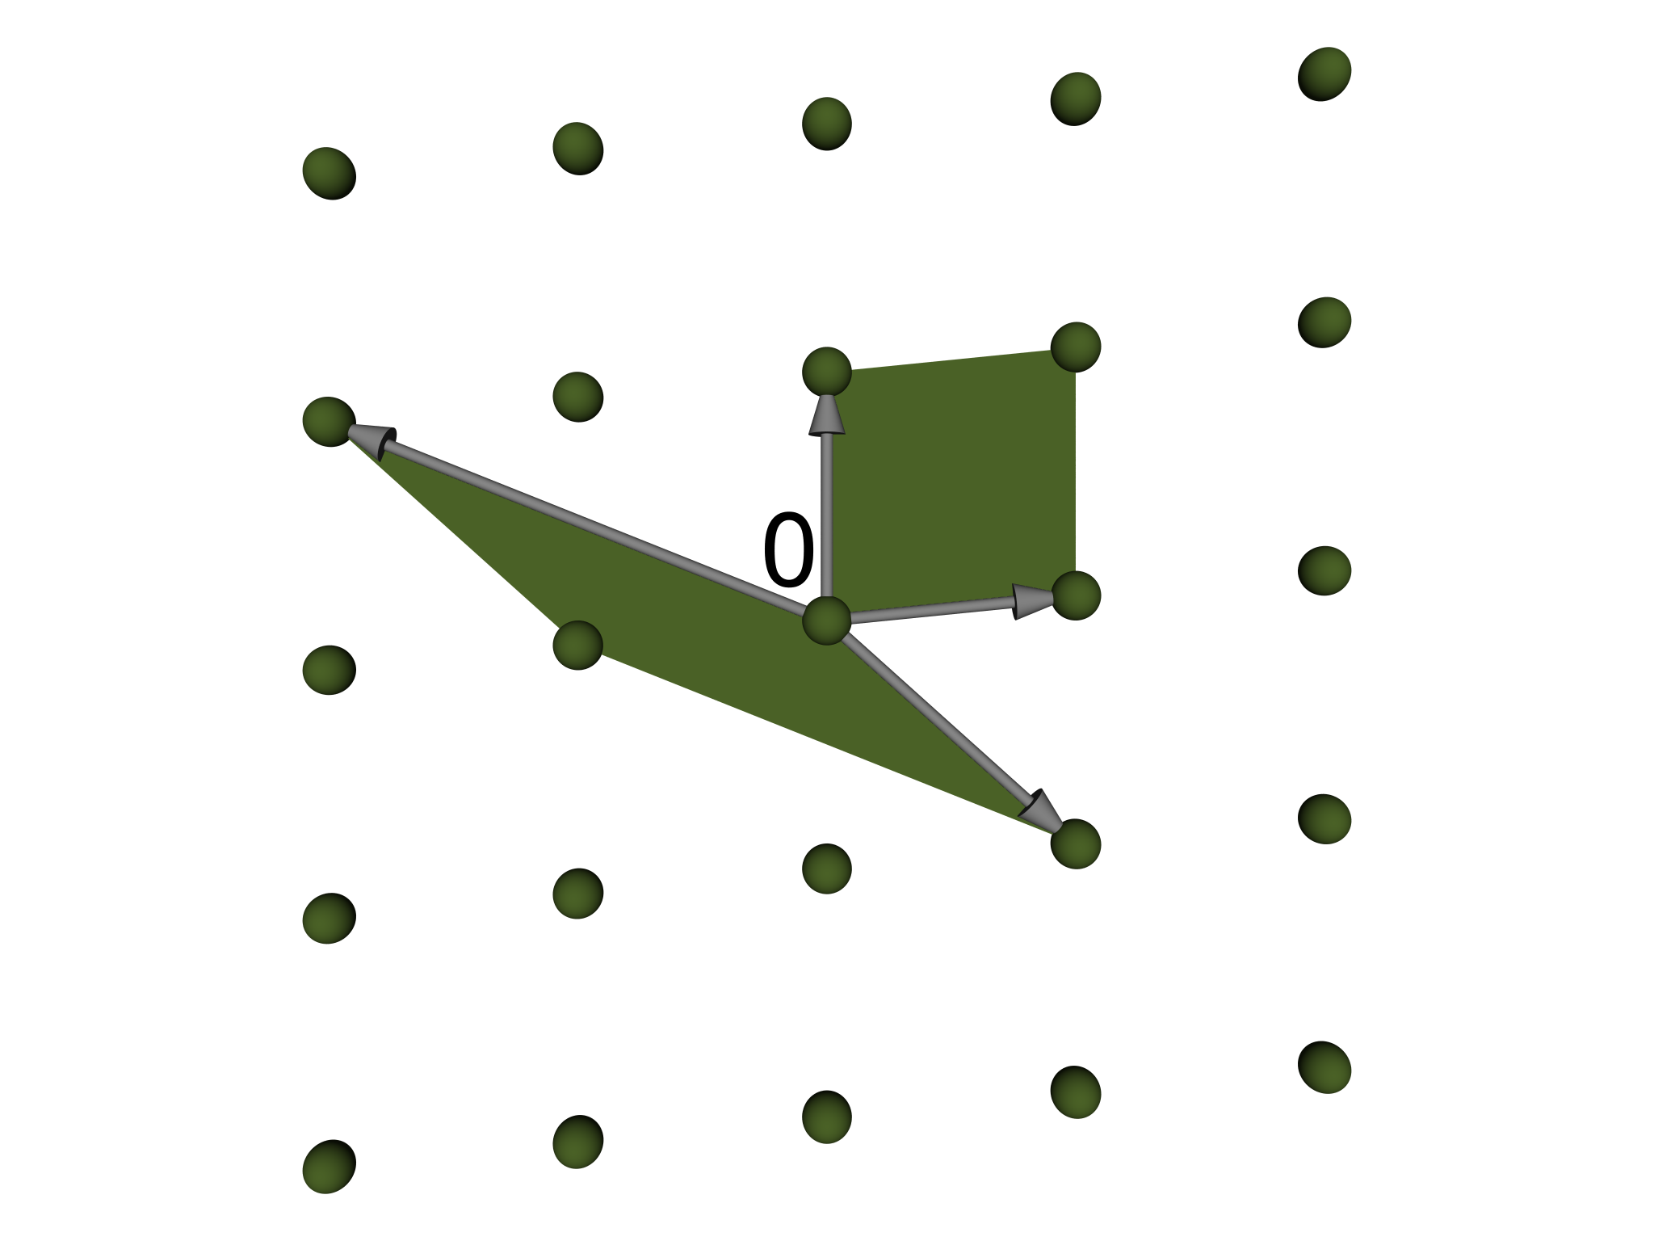
Lattices
Linearly independent
b₁,...,b_{d} 2 R^{n}
L = {a₁b₁+...+a_{d}b_{d} : a_{i} 2 Z}
Basis B = [b₁,...,b_{d}]
Det det(L) = √det(B^{T}B)
Integral b₁,...,b_{d} 2 Z^{n}
Full-rank d = n
d = 2

Slide 5
Ideal Lattices
Number field K = Q(±), n = [K : Q]
Ring Z[±] = [1, ±,..., ±^{n-1}] Z^{n}
Embedding ¾(a₀ + a₁± + ... + a_{n-1}±^{n-1}) = (a₀, a₁,..., a_{n-1})
Ideal lattice L = ¾(a), a µ Z[±]
[Lyubashevsky/Micciancio06]

Slide 6
Lattice-based Primitives

Slide 7
Lattice-based Primitives
Based on wcase problems in Lattices Ideal Lattices
  CR Hash Functions [AjtGGH96] [LyuM06]
  One-Time Signatures [LyuM08] [LyuM08]
  Digital Signatures [GenPV08] [XagT08]
  Public Key Encryption [RegP08] ...
Difference
  Keysize/Eval/Ver/Enc Õ(n²) Õ(n)
Practice
  Tight connection to wcase for cyclotomic fields ) Z[±] = O_{K}
Notes:
Xagawa [Kusagawa], Tanaka 08

Slide 8
Smaller keys, faster evaluation
What do we lose?

Slide 9
Counting Lattices

Slide 10
Results
L_{n}(b)
#Lattices in Z^{n}, 0 < det · b
I_{n}(b) µ L_{n}(b)
#Corresponding ideals in O_{K}
Theorem 1
L_{n}(b) 2 Ω(b^{n}), b ! 1
L_{n}(b) 2 O(b^{n}) [Schmidt68]
Theorem 2
I_{n}(b) 2 O(b) , b ! 1
Adapt [Murty/VanOrder03]
[Dedekind/Weber1861]

Slide 11
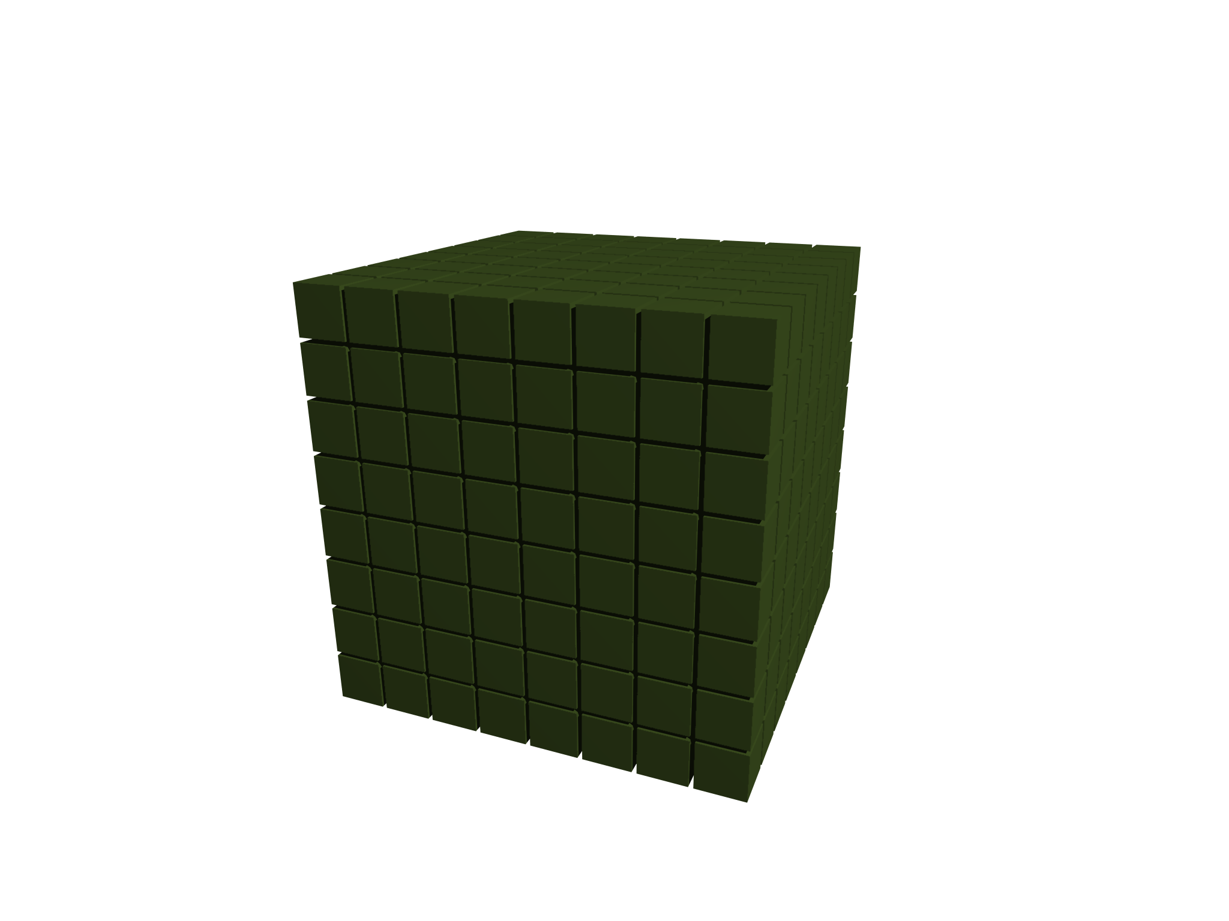
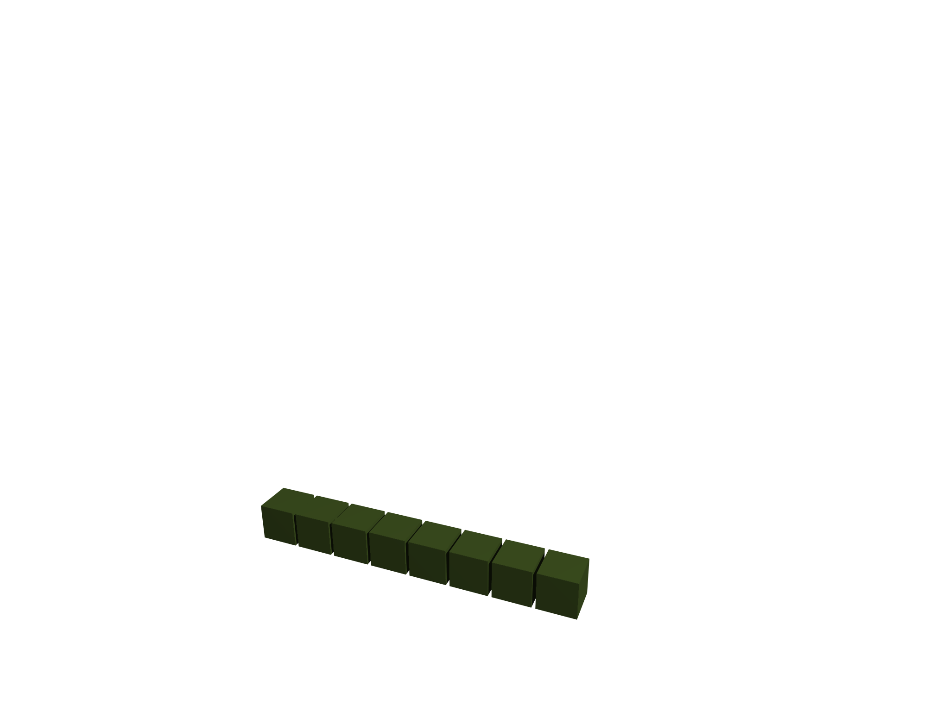
Visualization (n=3)
General Lattices Ideal Lattices
Ω(b^{n}) O(b)
Worst-case problems in ideal lattices seem easier
Far fewer lattices
b

Slide 12
Main Ideas

Slide 13
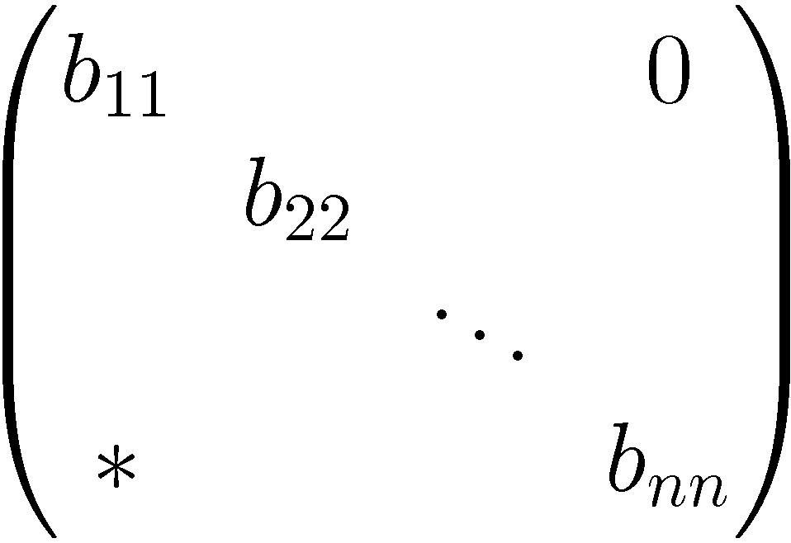
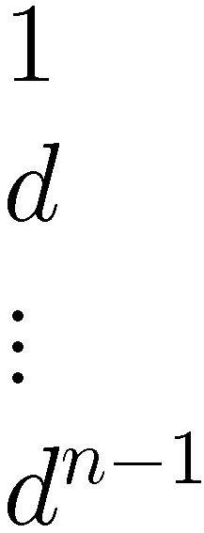
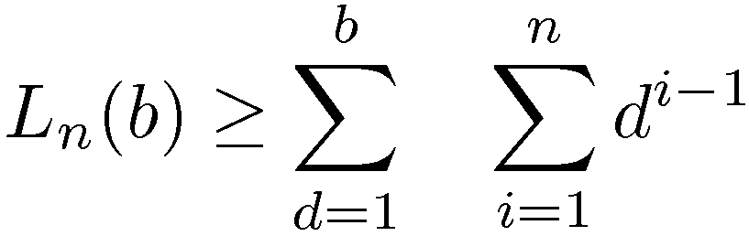
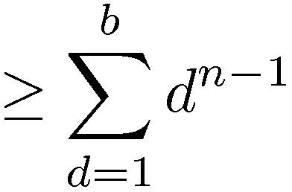
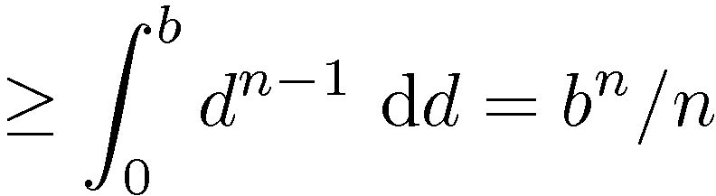
Counting Lattices
Dense
Subset
Count bases B in HNF
For fix d · b, consider b** = 1, b_{ii} = d for some i
[Goldstein/Mayer03]

Slide 14
Counting Ideals
Count ideals in O_{K} with bounded det
Count ideals in class C with bounded norm
Count principal ideals in b, for fix b 2 C⁻¹ with small norm
(Minkowski‘s Theorem)
Count elements in b spanning diff principal ideals
(Dirichlet‘s Unit Theorem)
Count integer tuples (x₁,…,x_{n}) st ∑_{i} ¯_{i} x_{i} 2 b,
where [¯₁,…, ¯_{n}] integral basis of O_{K}

Slide 15
Counting Ideals
Ideals in O_{K} behave like integers
2b+1 integers with absolute value · b
(2c_{K}b^{1/n}+1)^{n} / w ideals with norm · b

Slide 16
Open Problem

Slide 17

Open Problem
Worst-case problems in ideal lattices seem easier
www.latticechallenge.org
How much?

Slide 18
Thank you
Further Questions?

