Slide 1
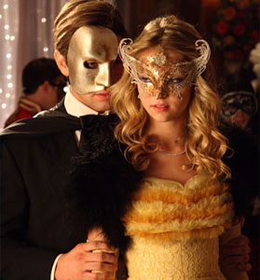

Improved Zero-Knowledge Identification with Lattices
P.-L. Cayrel, R. Lindner, M. Rückert, and R. Silva

Slide 2
Agenda
Zero-Knowledge Identification --- Theory
History
Zero-Knowledge Identification --- Practice
Take Away

Slide 3
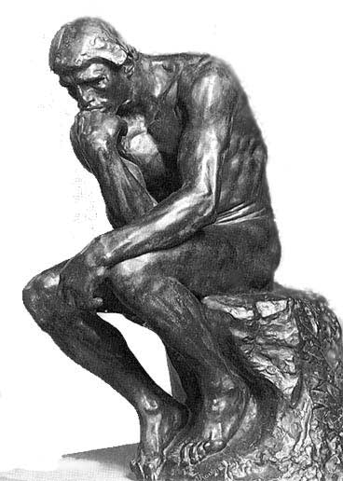
Zero-Knowledge Identification
Theory

Slide 4
Identification scheme
Protocol between Prover and Verifier
Prover produces key pair pk/sk
Verifier with pk learns whether Prover knows sk
Completeness: Honest Prover can convince
Soundness: Impersonation impossible
Zero-Knowledge: Verifier learns nothing else

Slide 5
Commitment scheme
2-phase protocol between Sender and Receiver
Commiting: Receiver gets commitment c Ã Com(s, ½)
Revealing: Receiver gets s, ½
Hiding: Receiver cannot compute s from c
Binding: Sender cannot find s’, ½’ st c Ã Com(s’, ½’)
Can be realized efficiently both with lattice and code assumptions using hash designs (SWIFFT, FSB)

Slide 6
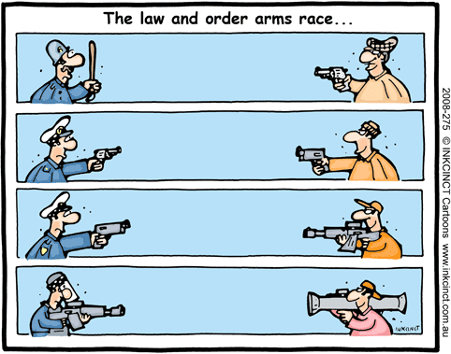
History

Slide 7
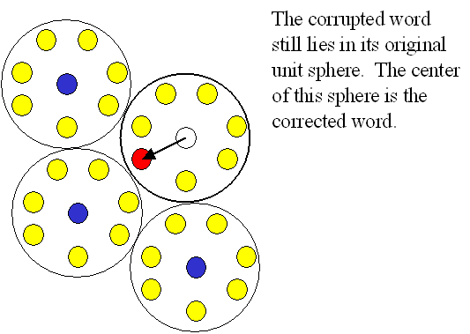

A Tale of Two Cities I
Codes
Lattices
Syndrome Decoding (SD)
Given random matrix A 2 F^{m£n} target vector y 2 F^{m} weight !
Find x 2 F^{n} st Ax = y Hamming wt(x) = !
Small Integer Solutions (SIS)
Given random matrix A 2 Z_{q}^{m£n} bound ¯
Find x 2 Z_{q}^{n} st Ax = 0 Euclidean norm(x) · ¯

Slide 8
A Tale of Two Cities II
Codes
Lattices
Post-Quantum
Very efficient for Quasi- Cyclic/Dyadic codes
As old as RSA
Syndrome decoding is NP hard in the worst case
Post-Quantum
Ideal lattices: Near optimal efficiency with novel assumptions
Actual security basis (average-case) SIS at least as hard as worst-case problems

Slide 9
Armsrace
Codes
Lattices
1993: Stern
3-Pass, Soundness error: 2/3
1996: Véron
Dual Variant of Stern
2007: Gaborit, Girault
Stern with QuasiCyclic codes
2010: Cayrel, Véron
5-Pass, Soundness error: 1/2
2008/2009: Lyubashevsky
Only Witness Indistinguishable
3-Pass, Perfect Soundness, Completeness Error: 2/3
2008: Kawachi, Tanaka, Xagawa
Adaption of Stern
2009: Xagawa, Tanaka
More efficient, but based on NTRU not worst-case problems
2010:
Adaption of Cayrel, Véron

Slide 10
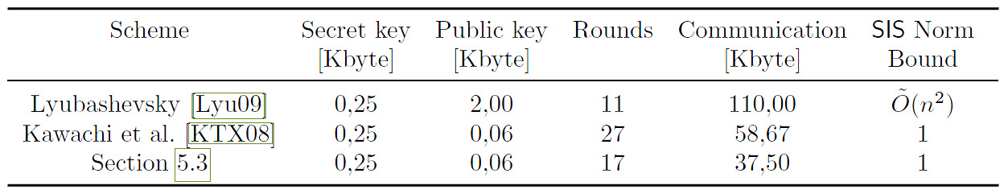
State of the Art
For schemes based on worst-case problems

Slide 11

Zero-Knowledge Identification
Practice

Slide 12
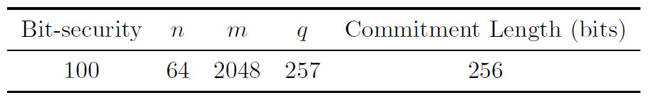
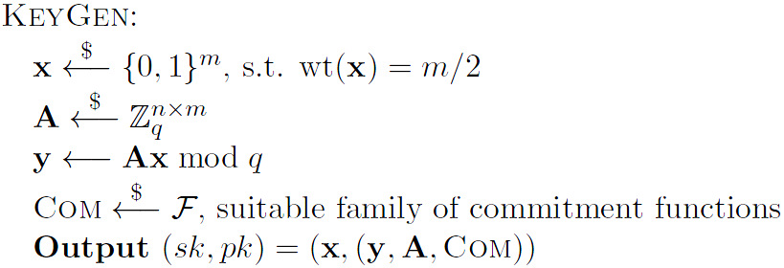
Our Identification Scheme I

Slide 13
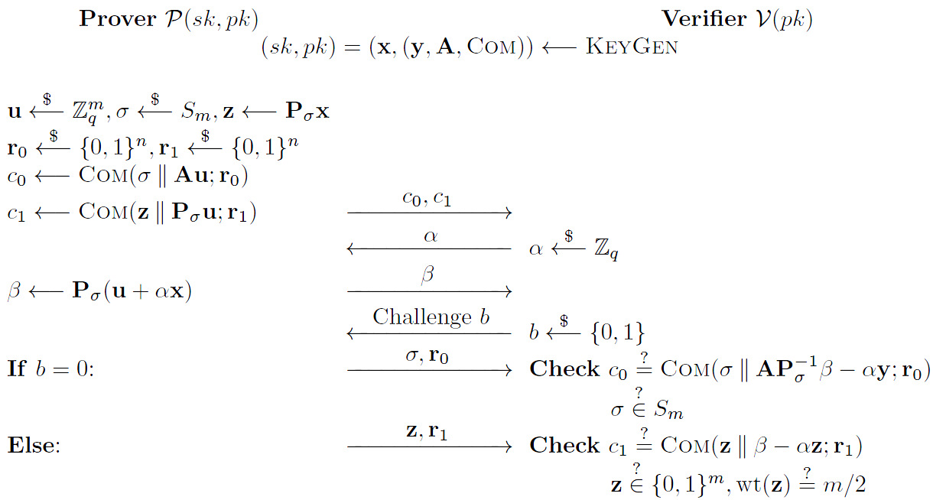
Our Identification Scheme II
Commit
Challenge
Response

Slide 14

Soundness (brief) I
There are 2q challenge pairs (®, b) 2 Z_{q} £ {0, 1}
Assume that an imposter answers > q+1 of those
We have ® ≠ ®‘
Answer for (®, 0) = Answer for (®’, 0)
Answer for (®, 1) = Answer for (®’, 1)

Slide 15
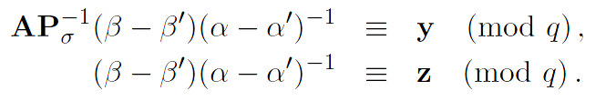
Soundness (brief) II
There are 2q challenge pairs, imposter answers > q+1
)
AP⁻¹z = y and Ax = y, but x is statistically hidden
A(P⁻¹z-x) = 0 and solves SIS, contradiction
Soundness Error · (q+1)/2q ¼ 1/2

Slide 16

Take Away

Slide 17
Take Away
Sometimes codes and lattices are interchangeable
Hash functions
Commitment Schemes
Identification Schemes
Threshold Ring Signatures ) Latincrypt 2010
…
Ideal lattice OWFs guarantee efficiency and security
Asymptotically quasilinear evaluation runtime
Based on worst-case problems (in ideal lattices)

Slide 18
Thank you
Further Questions?

