Slide 1

Secure Parameters for SWIFFT
Johannes Buchmann
Richard Lindner

Slide 2
Agenda
SWIFFT
Efficiency Trick
Security Analysis
Experiments

Slide 3
SWIFFT

Slide 4

Conception
Ajtai 96: OW-Hash based on worst case problems
Lyu/Micc 06: Asymptotically efficient CR-Hash based on worst case problems
(in smaller class)
Lyu/Micc/Pei/Ros 08: SWIFFT(X)
Wang/Feng/Lai/Yu 04: MD5 broken
Wang/Yin/Yu05: SHA1 coll 2⁶⁹
NIST 07: SHA-3 competition
NIST Oct 08: SHA-3 Deadline

Slide 5
Modest Hashing
n = 64, m = 16, q = 257
Ring: R = Z_{q}[x] /hx^{n}+1i, D = {0,1}[x] /hx^{n}+1i
Key: A = [a₁,…,a_{m}] in R^{m} chosen uniformly at random
h_{A}: D^{m} ! R : (z₁,…,z_{m}) ! ∑_{i=1}^{m} a_{i}z_{i} (mod q)
Thm: Finding coll => Short vectors in ideal lattices in Z^{n}

Slide 6
Efficiency Trick

Slide 7
New average case problem
n, m, q as before
Ajtai: random A in Z_{q}^{n x m}
h_{A} (x) = Ax mod q
coll for rand h_{A} => solve worst case probs
New: random B in Z_{q}^{n x (m - n)}
h_{B} = [I_{n}, B] x mod q
coll for rand h_{B} => coll for rand h_{A}
n² log(q)
bits less
for free in all
lattice-based schemes

Slide 8
Proof
New: random B in Z_{q}^{n x (m-n)}
h_{B} = [I_{n}, B] x mod q
coll for rand h_{B} => coll for rand h_{A}
with high prob there is permutation P st
AP = [A‘, A‘‘], A‘ inv mod q
set B = (A‘)⁻¹ A‘‘ (is right dist), get coll x, y
[I_{n}, B] x = [I_{n}, B] y (mod q)
[A‘, A‘‘] x = [A‘, A‘‘] y (mod q)
AP x = AP y (mod q)
so (P x, P y) are coll of h_{A}

Slide 9
Security Analysis

Slide 10
Security Guarantees
Worst case problems
hard in dim 64
Average case problems
hard in dim 1024
Swiffts
Collisions
Notes:
SWIFFT secure based on wc problem in dim 64
Dim 64 easy in practice
SWIFFT security based on

Slide 11
Problems
Dim 64 easy
Prove it suffices to work in dim 325 << 1024
Average case problems
hard in dim 325
Swiffts
Collisions
Notes:
SWIFFT secure based on wc problem in dim 64
Dim 64 easy in practice
SWIFFT security based on

Slide 12
Pseudocollisions
Collisions in max-norm
correspond to short vectors
Notes:
SWIFFT secure based on wc problem in dim 64
Dim 64 easy in practice
SWIFFT security based on

Slide 13
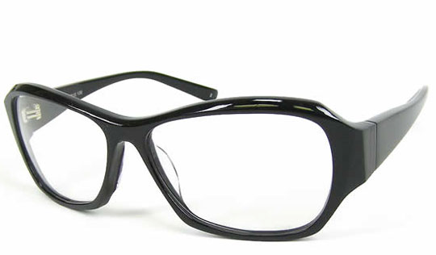
Pseudocollisions
Collisions in max-norm
Pseuocoll in euc-norm
LR algo cannot distinguish coll and pseudocoll
correspond to short vectors

Slide 14
Practical Analysis
[Micc/Reg 08]
SWIFFT Params (n, m, q) => Lattice Attack Dim
[Experiments]
Lattice Attack Dim => Runtime
[Lenstra 04]
Runtime => Sym Bitsec

Slide 15
Experiments

Slide 16
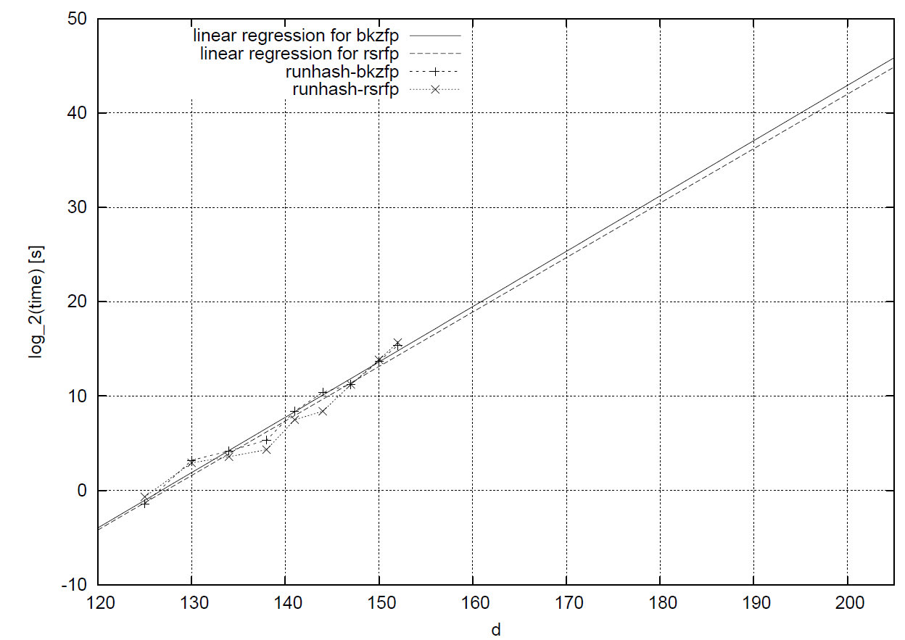

Slide 17
Results
Experiments on 90 instances up to dim 153
Pseudocoll can be found in dim 206
  sym bitsec 2⁶⁸
Replacement parameters (n, m, q) = (96, 18, 389)
  SWIFFT efficiency for all n = ϕ(k), ϕ Eulers totient function
  sym bitsec 2¹²⁷
  can be realized with +40% operations

Slide 18

Thank You

