Slide 1
Trading agent with virtual money/Bitcoins
Rez Godarzvandchegini
McGill University
Notes:
Jikun Kang, Ran Cheng and Haohan Bo

Slide 2
Introduction
Exchanging cryptocurrencies (Bitfinex)
Uninterrupted market
Liquid market
Reinforcement Learning
Stochastic environment
Learn from experience
Notes:
Exchange market of cryptocurrencies
24/7 continuous market: Forex regulated and bank open/close would affect its performance
any bid or offer is almost immediately actionable as there is a high traffic of sellers and buyers.
Bitfinex exchange market
Stochastic environment: Very noisy data due to many actors and influences news
Learn from experience: Long term effects
motivation/introduction (why did you want to work on this problem?),

Slide 3
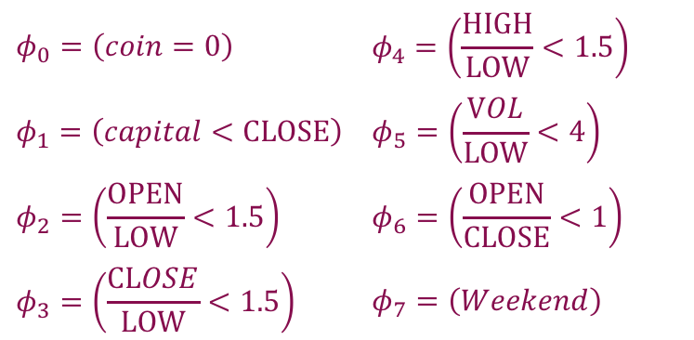
Action and state definition
Actions: Hold, Buy 1 coin, Sell 1 coin
Candles: ['MTS','OPEN','CLOSE’,'HIGH','LOW','VOLUME']
15 minute timestamps
HIGH
HIGH
$$φ_{0}=\left(coin=0\right)$$ | $$φ_{4}=\left(\frac{HIGH}{LOW}<1.5\right)$$
$$φ_{1}=\left(capital<CLOSE\right)$$ | $$φ_{5}=\left(\frac{VOL}{LOW}<4\right)$$
$$φ_{2}=\left(\frac{OPEN}{LOW}<1.5\right)$$ | $$φ_{6}=\left(\frac{OPEN}{CLOSE}<1\right)$$
$$φ_{3}=\left(\frac{CLOSE}{LOW}<1.5\right)$$ | $$φ_{7}=\left(Weekend\right)$$
CLOSE
OPEN
OPEN
CLOSE
LOW
LOW
Japanese Candlesticks
Notes:
Several peculiarities:
Transaction fee roughly 0.2%
Ratio cancels inflation of prices

Slide 4
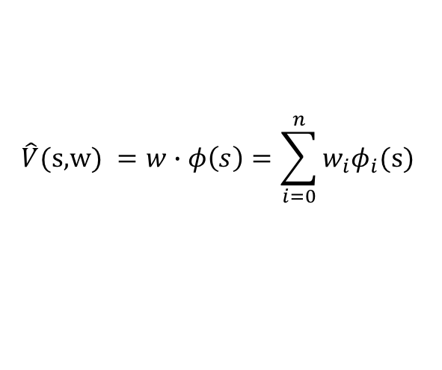
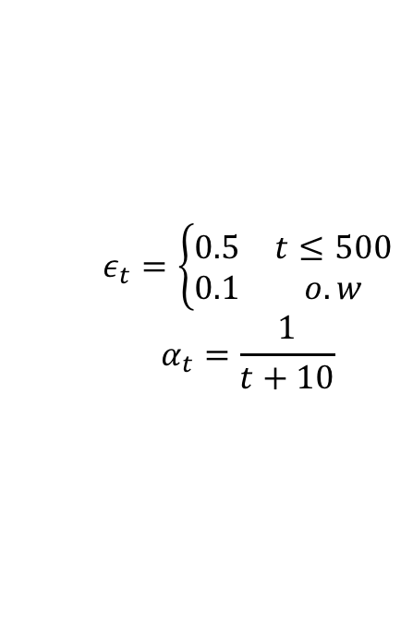
Algorithms
LSPI
Dyna-Q
Bootstrap historical data
Neural Fitted-Q/DQN
Stability
Policy gradient
Maybe Stochastic is best
$$\hat{V}\text{(}\text{s}\text{,}\text{w}\text{) }=w∙φ\left(s\right)=\sum_{i=0}^{n}{w_{i}φ_{i}\text{(}\text{s}\text{)} }$$
Environment update (1)
Synthetic updates (100)
Synthetic updates (100)
Synthetic updates (100)
Synthetic updates (100)
Synthetic updates (100)
$$ε_{t}=\left\{\begin{matrix}0.5 & t≤500 \\ 0.1 & o.w\end{matrix}\right.$$
$$α_{t}=\frac{1}{t+10}$$
Notes:
Dyna-Q : heuristical reasons as we get to bootstrap historical data

Slide 5
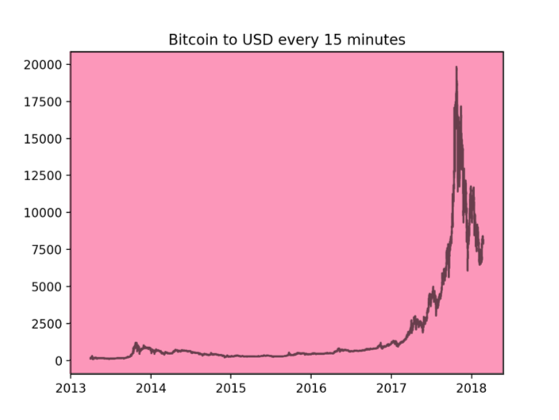
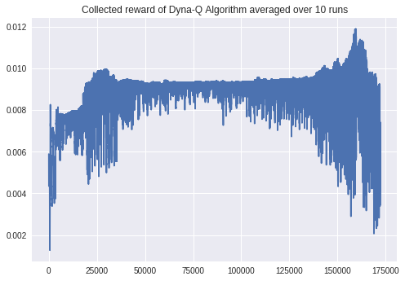
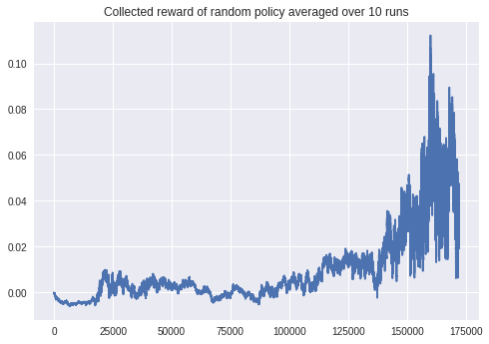
Policies learnt
Reward = capital – initial capital(1¢)
Notes:
Cute: agent keeps trying to buy more coins, but its balance is insufficient
Algo: Satoshi of 0.200000 and capital of 0.010614.png
Random: Number of Satoshis 3 worth of 0.000279 Capital of 0.046258 and in total 0.046537.png
We further do reward engineering

Slide 6
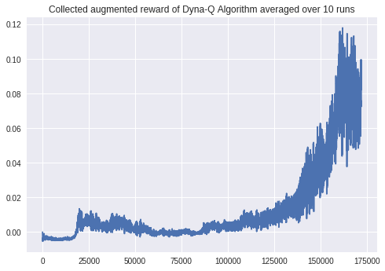
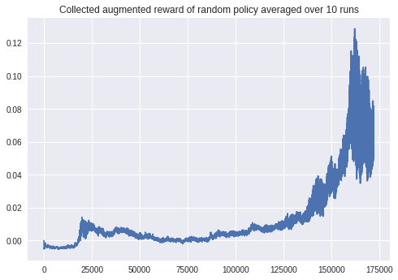
Policies learnt
Reward = capital (with 24h withhold) – initial capital(1¢)
Notes:
Left:
Leveraging the trend of changes of Bitcoin price:
q-10runs-Number of Satoshis 0 worth of 0.000000 Capital of 0.045200 and in total 0.045200.png
Right:
Capital of 0.100000 and capital in total 0.006030

Slide 7
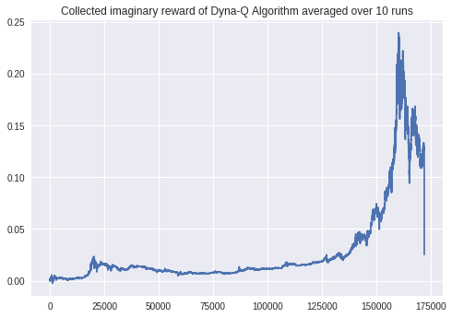
Policies learnt
Reward = coins × price (with 24h withhold) + capital (with 24h withhold) – initial capital(1¢)
Notes:
Cute: agent keeps trying to buy more coins, but its balance is insufficient
Algo
Satoshi of 9.800000 and capital of 0.010068
Random:
Number of Satoshis 3 worth of 0.000279 Capital of 0.046258 and in total 0.046537.png

Slide 8
Conclusion/future work
RL works!
Better than random 😄
Different Tunings for hyper-parameters
Augment state space
Volatility adjustment
Different Alorithms
FQI
Policy gradient
Thank you for your
time and attention
“Questions and comments”
Notes:
one slide of conclusion/future work (what worked well, what was harder than expected, what should be done further)
Frame of reference to check
As I won’t be able to implement these in this project, I only brought them here, in case you wanted me to have a discussion on the future directions I think is well worth spending time and energy,
Non-stationary -> scheduling of alpha should be readjusted when we have a transition to another behavior
Thank you for your time and attention and I will now take any questions you have
Funds accepted: do not bother verifying my theories here-ponzi game…come and talk to me after the talk

