Slide 1
A
A
0.2
0.8
0.2
0.8
0.2
0.5
0.8
0.5
B
0.8
C
B
0.2
C
0.5
0.5
positive
negative

Slide 2
Û₋₋
Û_{x}
Û₊
Negatives
Positives
0
100
Sum of state values along trajectory

Slide 3
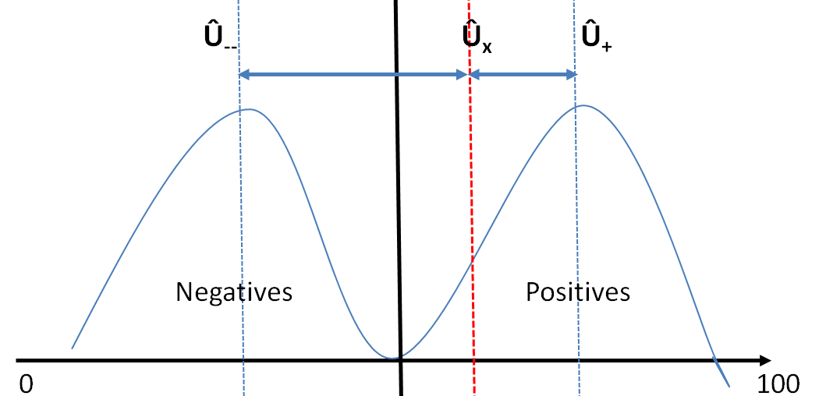
Sum of state values along trajectory

Slide 4
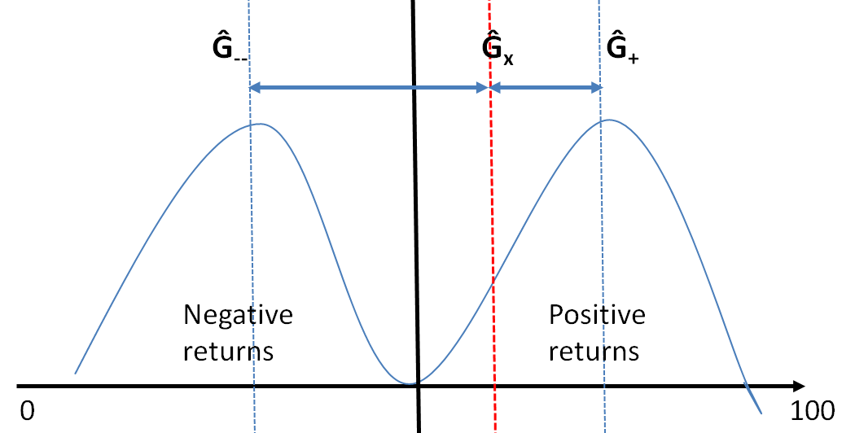
Returns

Slide 5
x₁
x₂
x₃
x₄
x_{m}

