Slide 1
A theory of Cerebellar Function (1971) James S.Albus

Slide 2
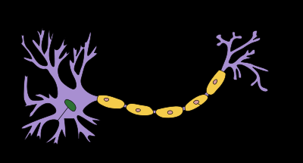
Background
Cerebellum : part of the brain that controls coordination and balance
Made up of different types of neurons.

Slide 3
The actors
Mossy Fibers (the input layer): relays information from receptor organs such as muscles, skin. Excite up to 50 granule cells.
Granule Cells (the associative cells): 100-250 granule cells per Mossy Fibers, excited by 4 mossy fibers.
Golgi Cells (part of the recoder): excited by both Mossy Fibers and Granule Cells. Inhibit Granule Cells.
Purkinje Cells (response cells): Excited by every Granule Cells.

Slide 4
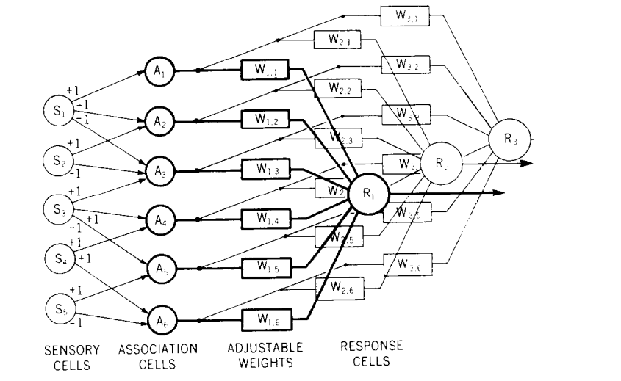
The Perceptron
Used to model the Cerebellum.
Most likely too simple for the task.

Slide 5
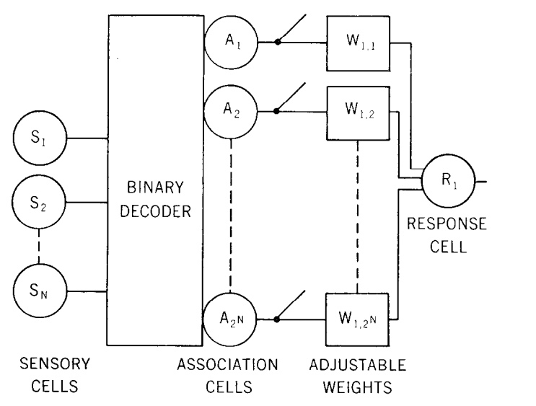
Binary Decoder
Turn N bit signal into 2^N bit signal.
Not realistic for the cerebellum.

Slide 6
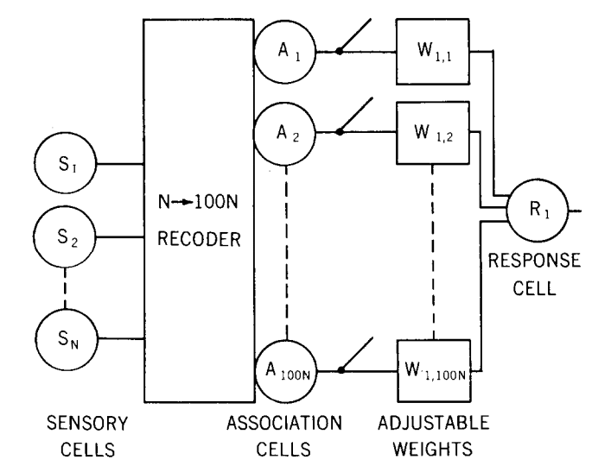
The Expansion Recoder
100 times more Granule Cells than Mossy Fibers.
Restricts the activation rate of the association layer at 1%. More than 100^N possible patterns.

Slide 7
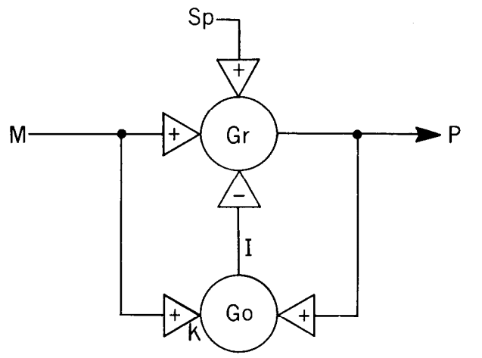
Maintaining constant activation in Associative Layer
When many cells in the associative Layer are active, the Golgi Cells inhibit their activity.
P = (M – I + Sp)*Gr
I = (KM + P)*Go
Gr = 100
Go = 100000/1000 = 100
K = 1/10^5
dP/dM = Gr(1-K*Go)/(1 + Gr*Go) = 0
Notes:
P expected value of the spike rate for a granule cell.
M expected value of the spike rate for a mossy fiber.
I expected value of the spike rate for a Golgi cell
Gr average transfer gain of granule cells
Go average transfer gain of Golgi cells
K relative strength of mossy fiber input on Golgi cells to that of granule input.

Slide 8
Advantages of using a recoder
Can map the 2^N patterns to over 100^N patterns (ratio of 1 to 50).
Allows pattern recognition for previously unrecognizable patterns.
Helps the model to learn more quickly (more likely that the weights will be shifted in the right direction on the first example).

Slide 9
The response cell
Purkinje cell serve as response cell for the cerebellum. The have a large fan-in whereas granule cells have large fan-out.
The output of the cerebellum is the firing rate of the Purkinje cells (not binary).
Problem with our model : Not possible for a neuron to be excitatory to one response cell but inhibitory to another.

Slide 10
The Actors(2)
Basket Cells : receive excitatory contacts from granule cells. Inhibits about 50 Purkinje cells.
Stellate Cells: Receive excitatory contacts from granule cells. A type inhibit Purkinje cells near them. B type similar to Basket Cells.

Slide 11
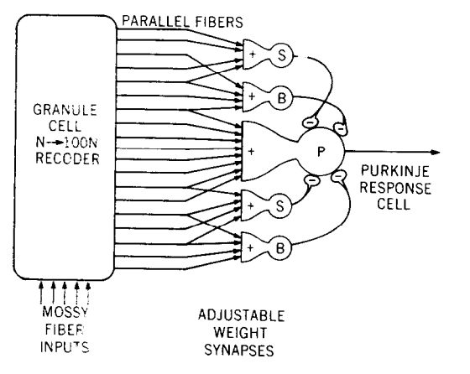
Inhibitory signals are summed by basket and stellate cell before being relayed to the response cell.

Slide 12
The Actors(3)
Climbing Fibers: make strong excitatory contacts with Purkinje cells. Triggers a pause in Purkinje axon spike activity of 15 msec. Signal comes from higher motor center.
Sends collaterals to branch on synapse between nearby basket and stellate b cells.

Slide 13
Hypothesis of variable synapses
When the climbing fiber triggers a pause in the firing rate of Purjinke cells, it also weakens the synapses between the Purjinke cell and any granule cell attempting to excite it. The weakening is proportional to the excitation signal.
On the other hand, it reinforces the synapse between granule cells and the basket and stellate b cells that inhibit the Purjinke cell.
Single event triggers update in the weights. Not clear how it is performed in practice.

Slide 14
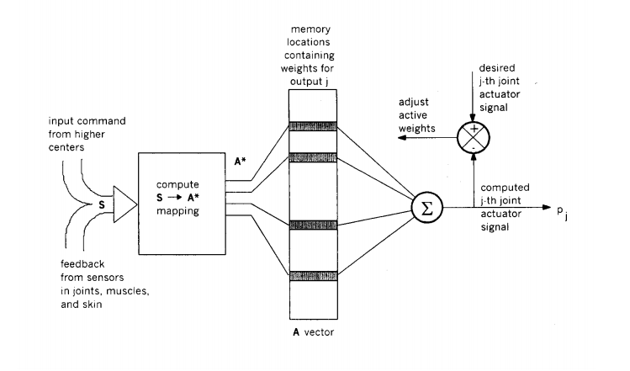
CMAC (origin of tile coding)
The S to A* mapping is similar to finding the N tiles out of the 100N in which S landed.
A new approach to Manipulator Control: The CMAC (1975)

Slide 15
Questions ?

