Slide 1
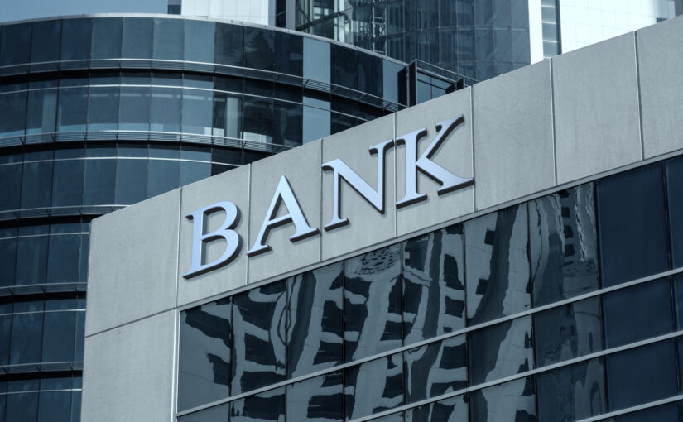
Churn Modelling
https://latribune.lazardfreresgestion.fr/en/analysis-silicon-valley-bank/
Rodrigo Rezende
Notes:
Hello everyone, good afternoon, my name is Rodrigo and my background is in Business Administration and Marketing in Brazil. I have been working on a data science project that can help banks to keep their customers.

Slide 2
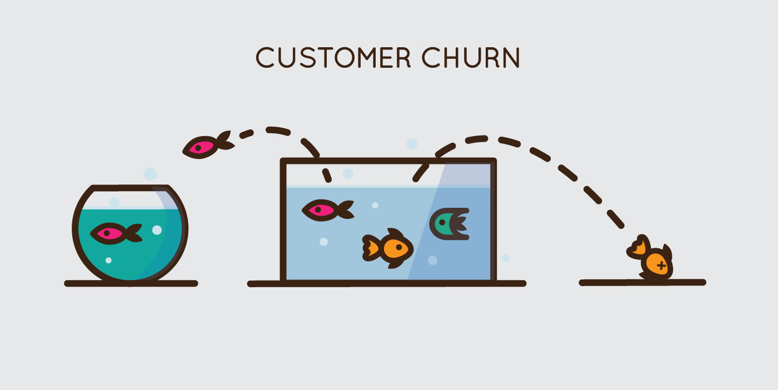
Notes:
The inspiration for this project came from my desire to find something where I could apply my background.
So, I chose a bank dataset from Kaggle, which represents of the bank struggle to retain their customers, a problem known as 'churn’. Churn is expensive for banks and any other companies in the market, as it costs more to attract a new customer than to keep an existing one. Therefore, I decided to build a machine learning model to predict which customers are likely to churn.

Slide 3
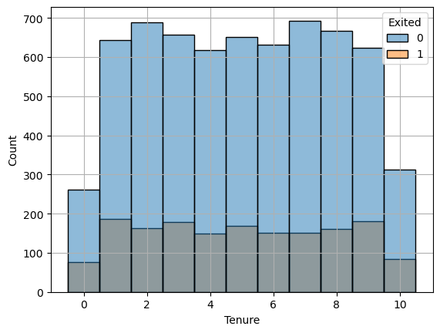
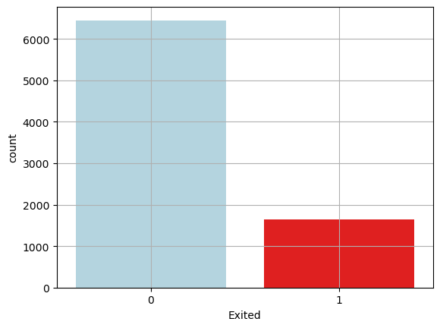
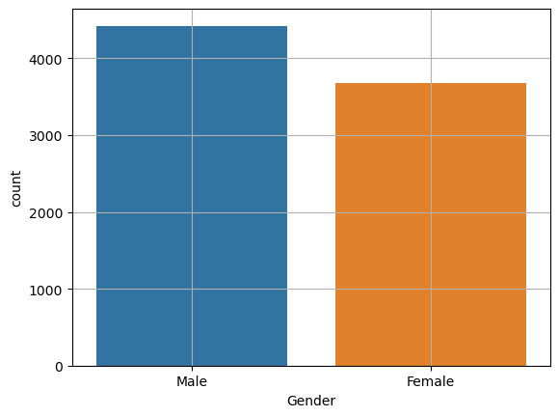
Exploratory Data Analysis:
Notes:
For this project, I used Python to explore the dataset. I began by analyzing the profile of the customers, then looked at different variables like credit score, gender, age, tenure, account balance, and a few others. I prepared the data for modeling by handling missing and duplicate values and separating variables into numeric and categorical.
Next, I attempted to balance the classes in the data. The data was unbalanced as we can see in the graphic at the left side, meaning we had more instances of customers who stayed with the bank than those who churned. This has the potential to introduce bias into the dataset. So to avoid that I tried different balancing techniques like SMOTE (oversampling) and NearMiss (undersampling) to allow the model to learn equally from both classes. However, the results did not meet my expectations.

Slide 4
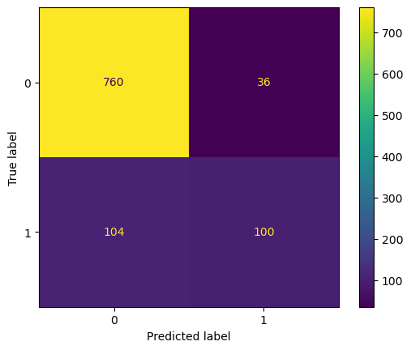
Models:
Confusion Matrix:
Logistic Regression
Support Vector Classifier (SVC)
K-Nearest Neighbors (KNN) Classifier
Decision Tree Classifier
Random Forest Classifier
Light Gradient Boosting Machine (LGBM) Classifier
Neural Network
Notes:
Through the process, I explored multiple machine learning models as listed here. After evaluating these models based on AUC-ROC performance metrics. I decided to proceed with the Neural Network, as it demonstrated the best overall results. Here in the right side is the confusion matrix for the final model. As you can see, the model performed well in predicting customers who did not churn, with only 36 false positives. However, there is 104 false negatives, which means these customers churned but the model predicted they would not. This is something that I would like to improve in the future, as these customers would not receive appropriate attention in terms of retention. Therefore, reducing the number of false negatives would be beneficial to the model. The true positives, a 100 which are the customers that the model correctly predicted would churn. These customers would then be the focus of a strategic marketing plan, ensuring they receive the appropriate attention from the company.

Slide 5
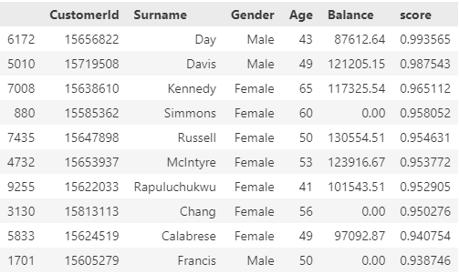
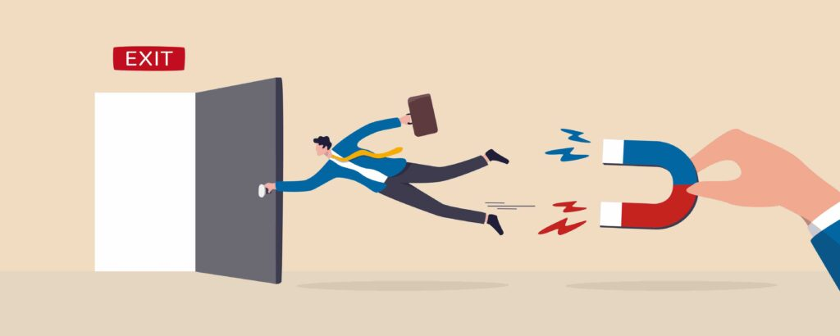
Factors leading to a higher chance of churn:
Advanced age;
Large account balance.
Marketing planning:
Temporary reduction in interest rates;
Savings account with a higher interest rate;
Premium credit card with more benefits.
Communication methods:
Regular check-ins;
Customer feedback.
Notes:
So, it was identified that age and account balance are the factors that contribute most to customer churn. Older customers tend to have a higher chance of churn, which could be due to changes in their financial situation maybe they are making more money or retirement, for example.
Also, customers with larger account balances showed a higher chance of churn. This could be because they have more options in the market, and they can get better offers from other banks.
In the right side we have a list of the top 10 customers with the highest churn rate. So, My recommendation to the bank would be to offer personalized promotions to those with substantial account balances. This could include a temporary interest rate reduction, a high-interest savings account, or a premium credit card with additional benefits. Also, improving communication methods such as implementing regular check-ins and gathering customer feedback, could prove beneficial to the business.

Slide 6
Credits:
Image of Slide 1: https://latribune.lazardfreresgestion.fr/en/analysis-silicon-valley-bank/
Image of Slide 2: https://growrevenue.io/churn-rate-benchmarks/
Image of Slide 5: https://www.questback.com/guides/a-complete-guide-to-churn/
Notes:
That concludes my presentation today. Thank you all for your time and attention.

