Slide 1
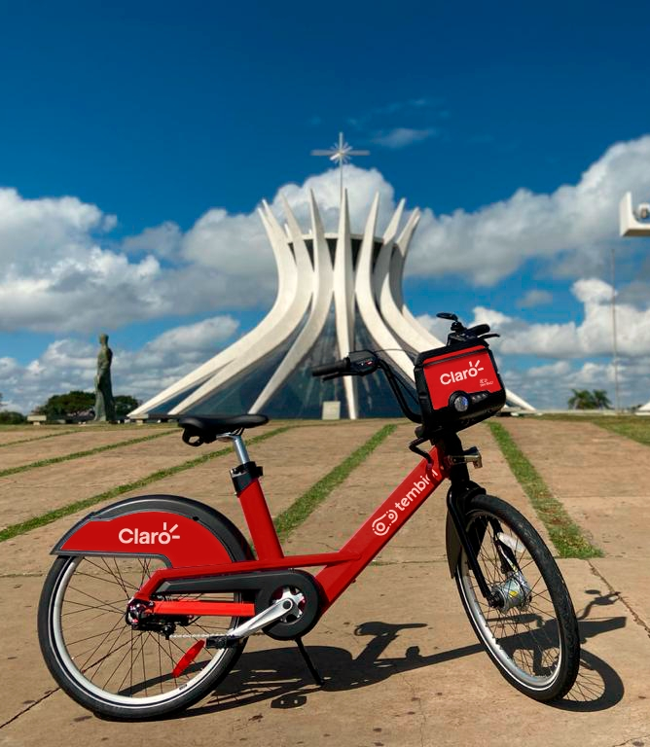
Cathedral of Brasília
Brazil
Statistical Modelling Project
Rodrigo Rezende
Notes:
Hello, everybody! I'm Rodrigo, and today I will be presenting my statistical modeling project with Citybikes in Brasilia, the capital of Brazil.
This city where I was born and raised.

Slide 2
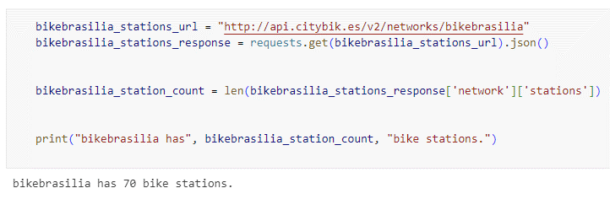
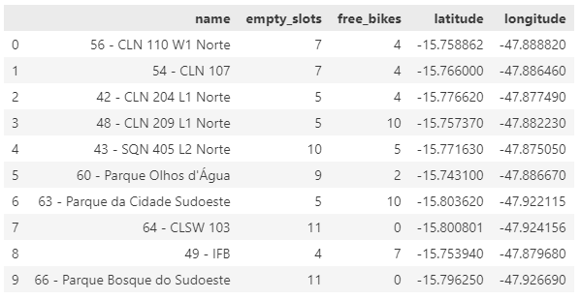
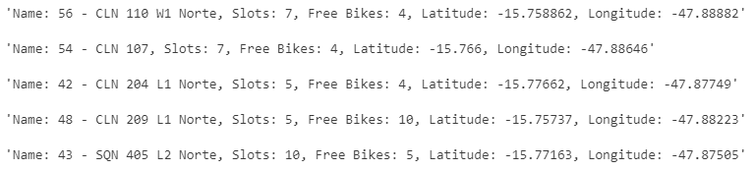
Start Process
Explore the data.
Choose a city and retrieve all bike stations.
Retrieve the latitude, longitude, and number of bikes.
Convert it into a Dataframe.

Slide 3
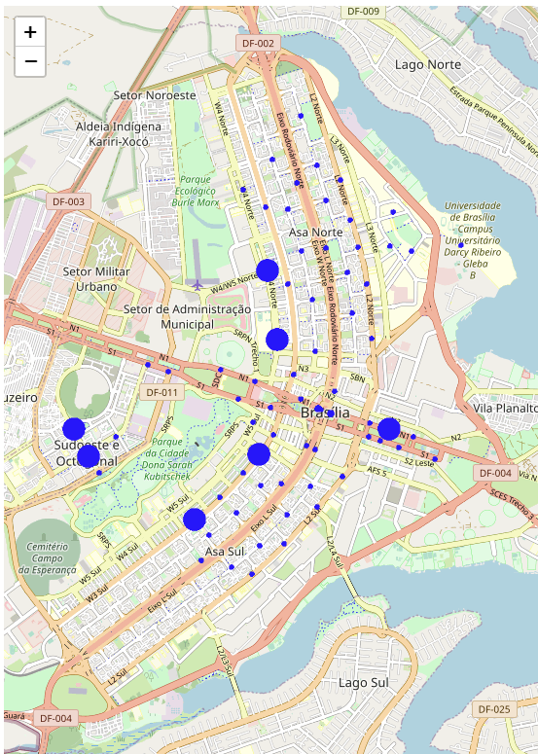
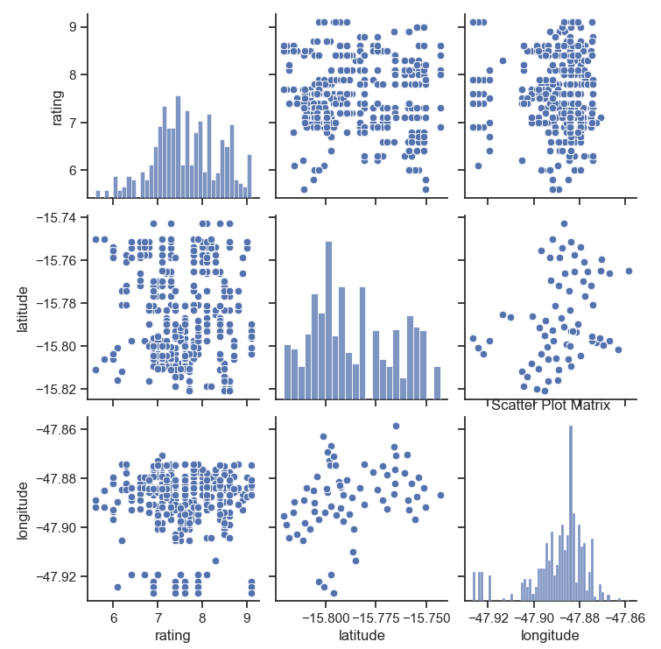
Connecting and Join Data
Brasília
Connect to the Foursquare and Yelp APIs.
Retrieve the points of interest.
Join and create a new Dataframe.
Explore data.
Notes:
Here there is a scatter plot matrix that we can see the relationships between the variables rating, latitude, and longitude.
Here we have a scatter plot for free bikes around the city, we can see that there is more available in the center. – made by folium
Just a curiosity Brasilia is a young city that was planned in the shape of an airplane.
Here for sure was the biggest challenge to connect and gather all the information. I went through this process multiple times and when I got all the information, understand how to join and what I need after that.

Slide 4
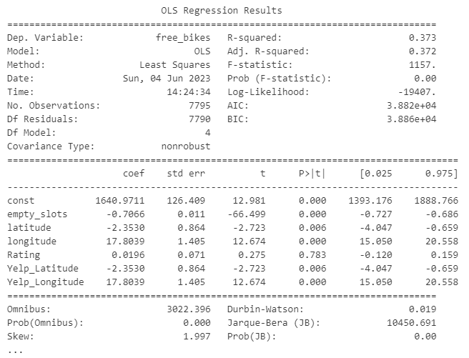

Build a regression model
Classification model
Notes:
R-squared: I have 37% of the variation in "free_bikes" that can be explained by the independent variables in the model.
P-values: I have the P-values less than 0.05 they suggests that the relationship are significant.
Accuracy: The accuracy is 0.09, indicating that the model classifies approx. 9% of the cases.
Precision: The precision is 0.07, indicating that only around 8% of the positive predictions are truly correct.
Recall: The recall is 0.94 meaning the model identifies around 94% of the positive instances.
F1: Demonstrates some imbalance between precision and recall
With more time, I could work on improving the data and special analysis.

