Slide 1
Grafana Monitoring Solution
Chatbot Monitoring with Loki and Promtail
Enterprise Monitoring Solution

Slide 2

High-Level Architecture
Log Analytics workspace
(system logs, Application logs)
Promtail
Log Collector & Shipper
Loki
Log Aggregation Storage
logs
push
query
Azure Monitor
Metrics API
Grafana
Visualization & Dashboards
metrics
view

Slide 3
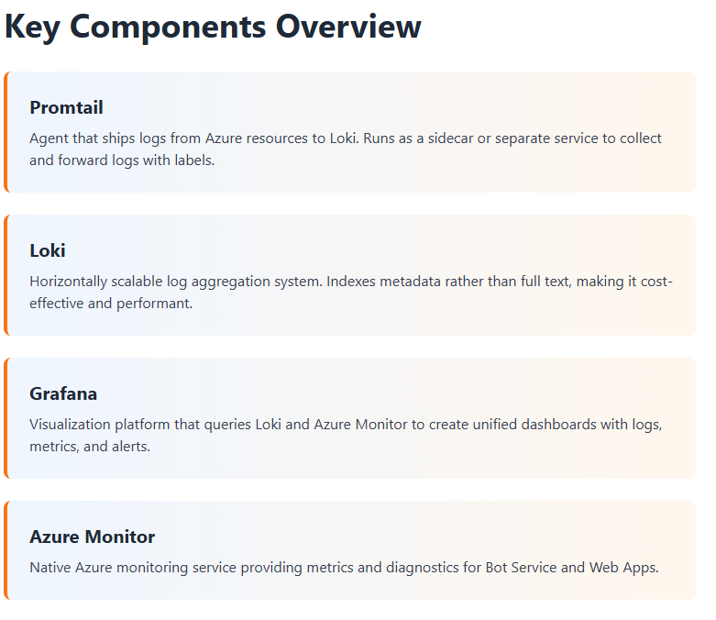

Slide 4
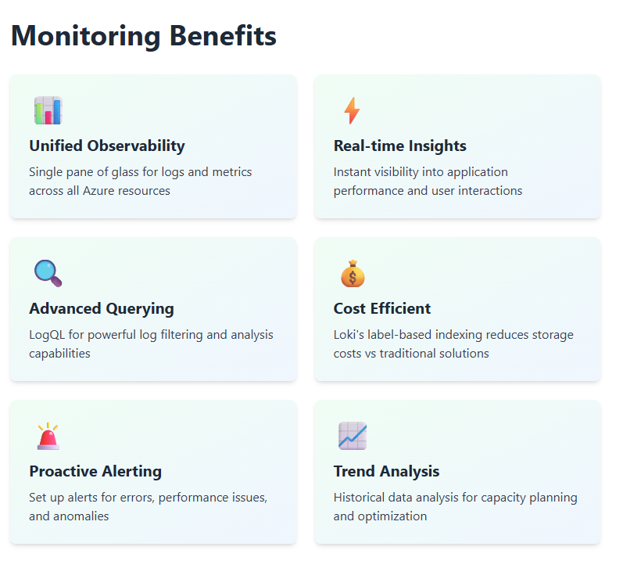

Slide 5
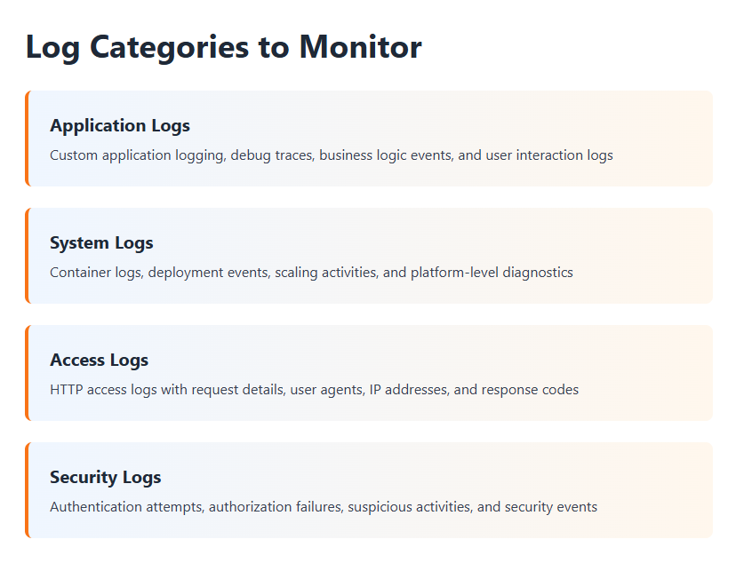

Slide 6
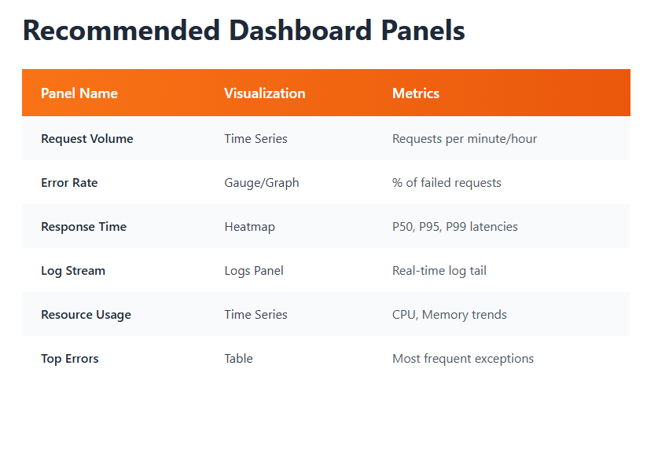

Slide 7
Implementation Roadmap
1
Setup Loki
Deploy Loki in Docker compose
2
Configure Promtail
Install agents on Azure resources with scrape configs
3
Install Grafana
Deploy Grafana and add Loki as data source
4
Azure Integration
Configure Azure Monitor data source in Grafana
5
Create Dashboards
Build panels for logs, metrics, and alerts
6
Setup Alerts
Configure alert rules and notification channels

Slide 8
