Slide 1
The HathiTrust Project
Analysing the New Zealand Corpus

Slide 2
HathiTrust
Collaborative digital repository committed to preservation and restoration
Open access
Intends to be the central digital text collection
Partner funded; member organizations pay yearly fees

Slide 3
The Collection
72 contributing organizations
10,641,980 volumes
477 terabytes of data
~1/3 of the collection is in the public domain
(…discuss: Google v. non-Google.)

Slide 4
HathiTrust Research Center (HTRC)
The HathiTrust represents a new scale in digital text collections–and hence new challenges in managing and accessing data.
HTRC is committed to providing computational tools and access to researchers, academics and librarians.
Pioneering ‘non-consumptive’ research tools which allow full access to the collection without breaking copyright laws.

Slide 5
(Non-consumptive research?)
In-copyright volumes are a valuable resource to digital scholars.
Non-consumptive research
….
Access without access….
Remote computation….
(Hmm, how to explain this succinctly?)

Slide 6
Access
APIs (Application Programming Interfaces):
Bibliographic
Data (public domain volumes only)
HTRC APIs:
Solr Index
Data (not externally available)
Datasets:
Non-Google
Google Digitized

Slide 7
The Data
HathiTrust catalogues the following data:
Raw scanned images
OCR (Optical Character Recognition) plain text
MARC bibliographic metadata
METS structural metadata

Slide 8
The Project

Slide 9
The Digital Humanities (in a nutshell)
A diverse, rapidly evolving, rapidly growing field which seeks to apply digital techniques to historical and contemporary data.
Quantitative and qualitative.
…
(segue, segue….)

Slide 10
DH and the HathiTrust
As a large, curated, open text collection, the HathiTrust is an invaluable resource for digital humanities scholars.
Coupled with the HTRC’s goals of providing non-consumptive access to in-copyright works, the HathiTrust represents a new scale of digital collection.

Slide 11
SoeR project
We set out to perform an analysis of the HathiTrust’s New Zealand content.
Goals:
Explore and leverage the HathiTrust’s APIs, tools, and datasets
Identify a ‘New Zealand corpus’
Perform a digital humanities inspired analysis of the NZ corpus

Slide 12
What can we DO with the data?
Metadata analysis: date/genre/form/author…
Text mining
Machine learning: classification and discovery

Slide 13
Non-Consumptive access
Unfortunately, non-consumptive data access is still a work in progress. As such we were limited to the in-copyright collection.
The HTRC expects to have an beta sandbox version of their non-consumptive environment completed by the end of March, with support for parallel algorithms like Map-Reduce.

Slide 14
Web Access
…. (Examples of the APIs/wrappers I wrote?)
Notes:
OCR and otherwise / metadata

Slide 15
Identification and Classification
Metadata keyword extraction
Solr proxy queries
Automatic classification (supervised learning)
Clustering (unsupervised learning)

Slide 16
Using the Solr Proxy
…(examples of command line tool?)

Slide 17
Processing MARC
MARC stands for MAchine-Readable Cataloging, and is a standard digital format for bibliograhic entries.
HathiTrust distributes metadata in the MARCXML schema.

Slide 18
Normalizing Metadata
MARC is anything but clean…
(example record)

Slide 19
The non-Google dataset
~300,000 documents

Slide 20
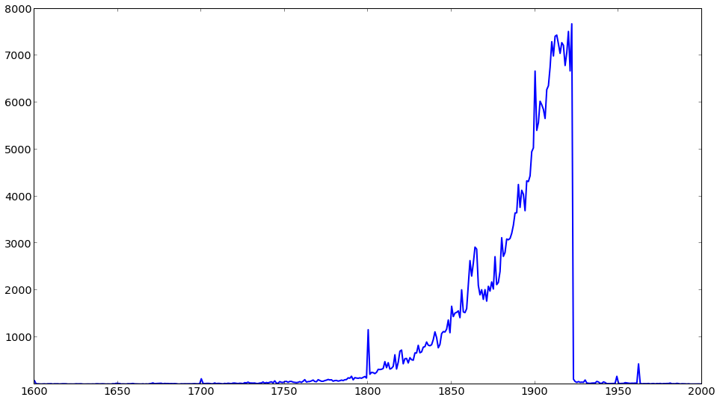
non-Google collection by year

Slide 21
OCR Quality

Slide 22
OCR Normalization

Slide 23
Identifying a NZ Corpus

Slide 24
Topic Modeling

Slide 25
Where to proceed

Slide 26
Elsewhere…
Ted Underwood (what he’s doing)

Slide 27
Open source software
IPython
Libraries:
pymarc
ptree, Pairtree
Scikit-Learn

Slide 28
Thank you:
James Smithies
Yiming Sun, Stephen Downie, and the HTRC

