Slide 1
The HathiTrust Project
Analysing the New Zealand Corpus
Robert Marchman
Dartmouth College
Dr James Smithies
Senior Lecturer in Digital Humanities
University of Canterbury
https://github.com/rlmv/HathiTrust-SoeR

Slide 2
“The mission of the HathiTrust is to contribute to the common good by collecting, organizing, preserving, communicating, and sharing the record of human knowledge.”¹

Slide 3

The HathiTrust Digital Library
Founded in 2008, the HathiTrust is a joint venture between 70 parters – including Google, the Internet Archive, and major US research institutions.

Slide 4
Vision and Goals
Be the first of it’s kind in providing a comprehensive and accessible digital repository of human culture.
Meet the archival needs of its partner institutions.
Develop tools and best practices for large scale and long term digital curation.

Slide 5
The Collection
72 contributing organizations
10,641,980 volumes
3,725,089,550 pages
477 terabytes of data
1/3 in the public domain
Hosted at the University of Michigan.

Slide 6
HathiTrust Research Center (HTRC)
The HTRC is a collaboration between Indiana University, the University of Illinois, and the HathiTrust digital library.
HTRC is committed to:
Enabling research within the HathiTrust collection.
Pioneering a paradigm of ‘non-consumptive’ research tools allowing full access to the HathiTrust without infringing academic copyright laws.

Slide 7
The Digital Humanities
The term Digital Humanities encompasses a diverse and rapidly evolving set of fields seeking to apply modern computational techniques to research questions in the arts and humanities.
Acquiring high-quality datasets can be challenging, depending on the desired content. As such, the size of HathiTrust collection is an invaluable resource for digital humanities scholars.

Slide 8
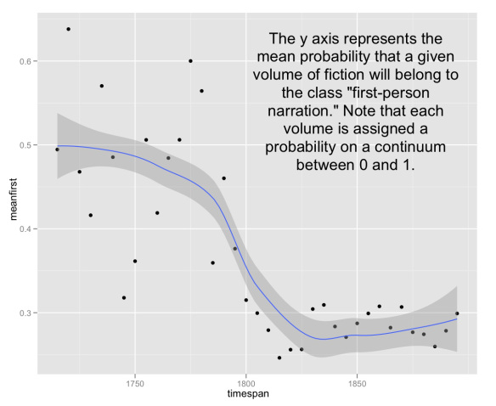
An example…
Ted Underwood, Associate Professor at the University of Illinois, has been working with a collection of 18th and 19th century texts drawn from the HathiTrust. His thesis: ‘We don’t already know the broad outlines of literary history’, but computational tools can provide the answer.²

Slide 9
Summer of eResearch Project Goals
Explore and leverage the HathiTrust’s APIs, tools and datasets, and attempt to assess the usefulness of the HathiTrust for New Zealand researchers.
Attempt to identify a ‘New Zealand corpus’; a subset of the HathiTrust collection pertaining to NZ and relevant to NZ researchers.
Lay groundwork for future access to HathiTrust resources by NZ researchers.

Slide 10
Accessing the collection…

Slide 11
The Bibliographic API
An access point for programmatic retrieval of metadata and bibliographic records.
Possible use cases:
Building a database of bibliographic information for a small standalone collection.
Replacing lost metadata.
Validating or improving metadata in an existing collection.
Specification at http://www.hathitrust.org/bib_api

Slide 12
The Data API
For small-scale retrieval of textual information.
Protected by OAuth certification.
Returns:
OCR (Optical Character Recognition) text
Raw document images
Structural metadata (METS)
http://www.hathitrust.org/data_api

Slide 13
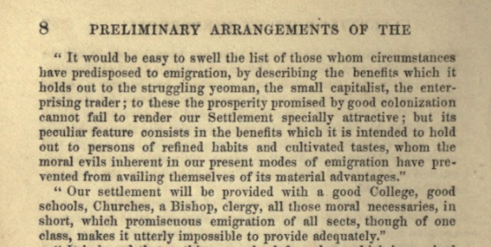
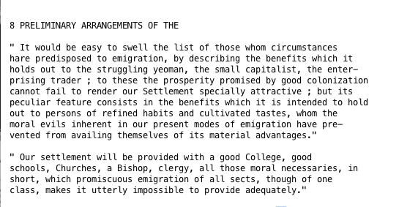
Example OCR and raw image source

Slide 14
The Solr Proxy
The HathiTrust Research Center exposes a Apache Solr search index through a web API.
http://wiki.htrc.illinois.edu/display/COM/2.+Solr+API+User+Guide

Slide 15
Identifying a NZ corpus
Using the Solr proxy to search metadata for New Zealand content (using keywords such as ‘New Zealand’, ‘Maori’, and names of NZ cities and universities) delivers ~2500 documents.

Slide 16
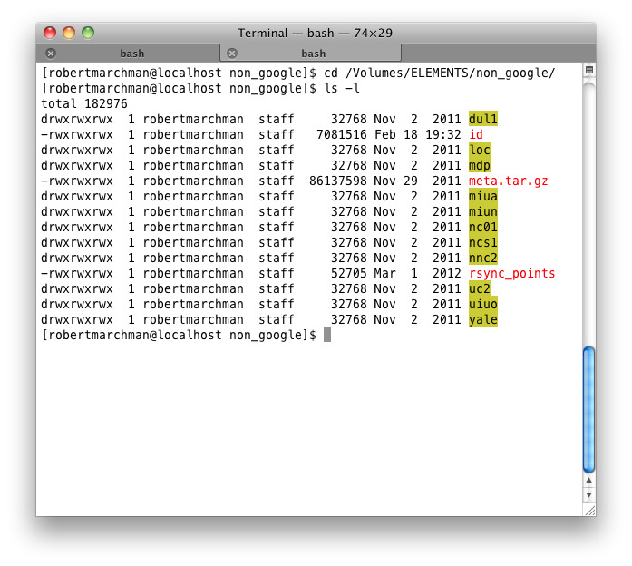
The non-Google dataset
We acquired the non-Google public domain dataset for local use.
The collection consists of 290,000 volumes.

Slide 17
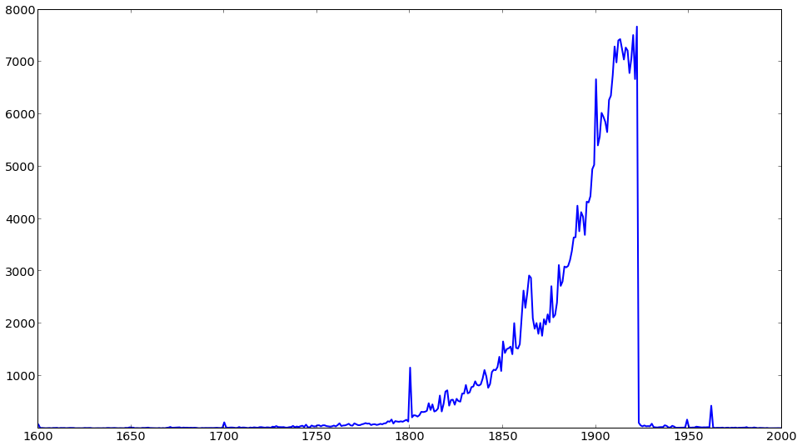
volumes by year

Slide 18
Metadata
The dataset metadata is distributed in MARC (MAchine-Readable Cataloging) XML format, a library standard schema for metadata encoding and transmission.

Slide 19
Normalizing Metadata
MARC quality varies greatly. Formatting is inconsistent, requiring extensive cleaning for any sort of metadata analysis.

Slide 20
For example, here are years found in the metadata for the non-Google collection:
1891
184[5?]
186-?]
18--
c19
18 -19
MDCCLXXIX.
5682 [1921]

Slide 21
Using the MARC records, we identified 180 documents in the non-Google collection that contain metadata references to New Zealand.

Slide 22
Open Questions
Classifying by metadata is accurate, but limited – how can we accurately identify relevant documents?

Slide 23
The future
Perform non-consumptive research over the entire collection.
Integrate NZ libraries and organizations such as digitalNZ.org with HathiTrust resources.
Contribute content from NZ research libraries to the HathiTrust.

Slide 24

Thanks to…
James Smithies
Yiming Sun, Stephen Downie, and the HTRC
Tim McNamara, Richard Hosking, Sina Masoud-Ansari, Nick Jones, and NeSI

Slide 25
¹ www.hathitrust.org/mission_goals
² http://tedunderwood.com/2013/02/08/we-dont-already-know-the-broad-outlines-of-literary-history/

