Slide 1
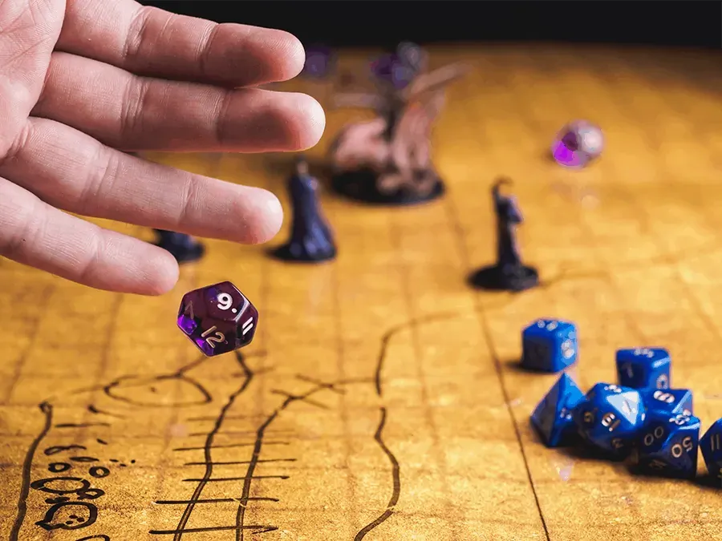

Utilizing Large Language Models as Interactive Dungeon Masters in Digital Role-playing Games

Slide 2

Interactive Storytelling through Dungeons & Dragons
What is D&D? A tabletop role-playing game where players create fictional characters and embark on adventures.
Roles:
Player: Takes on the role of a fictional character.
Dungeon Master: The game's storyteller and referee, adapting the game based on players' decisions.
Challenges:
Finding a quality Dungeon Master.
Coordinating logistics for sessions

Slide 3

As technology advanced, so did the ways we play and experience interactive stories

Slide 4
Evolution of Interactive Storytelling
Interactive Fiction (IF): This genre, typified by games like "Zork", relies purely on text input and output. Players use typed commands to interact with the world.
Graphic Adventure Games: As computers became more capable of handling graphics, IF evolved into graphic adventure games. These games, like "King's Quest", combine text commands with graphical representations of the game world.
Point-and-Click Adventure Games: These games, like "The Secret of Monkey Island" and "Shadowgate", transitioned away from text commands, allowing players to interact with the environment using a mouse. They often come with intricate stories and puzzle mechanics.
Narrative-Driven Games: Modern games, like "The Witcher 3" and "Mass Effect", have placed a heavy emphasis on narrative, offering players branching storylines based on their choices. These games often have complex dialogue trees and character interactions.
Massively Multiplayer Online Role-Playing Games (MMORPGs): Games like "World of Warcraft" and "EverQuest" bring the RPG experience online, allowing thousands of players to interact in a persistent world.
Role-Playing Video Games (RPGs): Games like "Final Fantasy" and "Baldur's Gate" put players in control of characters in a rich narrative world, often inspired by tabletop RPG mechanics. They usually come with predefined stories but offer players choices that can influence outcomes.
Interactive Narrative Platforms: Tools like "Twine" allow users to create their own interactive fiction stories with branching narratives. It democratizes the creation of interactive stories.
AI-Powered Interactive Experiences: More recently, with the advent of powerful AI models, there have been experiments in crafting interactive narratives using AI. For example, AI Dungeon (by Latitude) is a text-based game where the narrative is generated on-the-fly by an AI model, offering players an almost infinite array of possibilities.
LLM Dungeon Master: the next step in this evolution? — leveraging the vast capabilities of LLMs to emulate the role of a Dungeon Master in a digital RPG, offering dynamic, adaptable, and deeply immersive experiences.

Slide 5
The Power of GPT-3.5 & GPT-4: Beyond Text Generation
OpenAI LLMs
Scale of LLMs:
GPT-3.5: Boasts 175 billion parameters.
GPT-4: Rumored to have a staggering 1.3 trillion parameters and using a “Mixture of Experts” architecture.
Training set undisclosed
Emergent Capabilities:
Beyond generating human-like text, these models can code, understand complex instructions, and engage in sophisticated interactions.
Have been labelled “reasoning engines”

Slide 6
Function Calling: Expanding the Horizons of LLMs
What is Function Calling?
A Paradigm Shift: Not just returning text, but invoking functions provided by users.
Dynamic Interactions: Users can describe functions to LLMs, and the models intelligently output JSON objects containing arguments to invoke those functions.
Endless Potential: This capability effectively means LLMs can do anything within the constraints of described functions.
An Example: Weather Inquiry
User's Query: "What is the weather like in Boston?"
LLM's Response: Instead of a textual answer, GPT returns JSON describing a call to a function get_current_weather with arguments specifying Boston, MA.
The Power: Based on the function call and its arguments, developers can invoke the appropriate real-world action. This mechanism is how the LLM-DM can perform tasks like dice rolls, updating character states, and more.

Slide 7
Project Proposal: The LLM Dungeon Master
Core Idea:
Leverage the capabilities of state-of-the-art Large Language Models (LLMs) to act as dynamic and interactive dungeon masters in digital role-playing games.
Inspiration:
Traditional role-playing games like Dungeons & Dragons rely on a human dungeon master to guide players, craft the world, and drive the narrative.
Finding a quality DM and coordinating sessions can be challenging.
The goal is to capture the creativity and dynamism of a human DM using AI.
Why LLMs?
LLMs, with their human-like text generation and ability to understand context, offer a promising tool for this endeavor.
Their emergent capabilities, like coding and sophisticated interactions, make them suitable for dynamic storytelling.
The Game-Changer: Function Calling
Enables the LLM to interact with external tools and APIs.
Will allow our LLM Dungeon Master (LLM-DM) to manage game states, roll dice, update character states, and more.

Slide 8

Related work
Exploring the Intersection of Large Language Models and Agent-Based Modeling via Prompt Engineering Edward Junprung (14 Aug 2023)
Highlights the challenge of simulating real-world social systems using agent-based modeling (ABM).
Proposes the use of LLMs, like ChatGPT, to capture the complexity of human-driven behavior.
Presents simulations of human interactions, such as a two-agent negotiation and a six-agent murder mystery game.
Generative Agents: Interactive Simulacra of Human Behavior Joon Sung Park et al. (7 Apr 2023)
Introduces "generative agents" as computational entities simulating believable human behavior.
Describes an architecture that uses a large language model to store an agent's experiences, reflections, and plans in natural language.
Demonstrates the agents' capabilities in an interactive environment, showcasing emergent social behaviors and interactions.

Slide 9
Dataset
Traditional Importance of Datasets:
A solid foundation for training models.
Typically, a good dataset often outweighs a sophisticated algorithm.
Pre-trained Transformers:
Given unlimited resources: multi-billion dollar compute cluster, vast data, and ample time - one could train their own LLM.
Realistically, leveraging existing pre-trained models is practical and efficient.
Allows for rapid prototyping, deployment, and harnesses broad training data.
My Dataset:
"Curse of Strahd" sourcebook.
D&D Core Set.
Providing context and rules for the LLM.
Relevance & Value:
Focus on interacting with advanced models, not just creating.
Time Efficiency: Skip extensive training from scratch.
Robustness: Benefit from diverse training data for rich storytelling.
Cost-effectiveness: Avoid high computational costs.
Exploration of LLMs in novel domains: beyond text generation, into crafting narratives and immersive experiences.

Slide 10

Outcomes & Evaluation
Expected Outcomes:
Serve as a dynamic DM for the "Curse of Strahd" campaign's first chapter.
Navigate and describe the chapter's environment and events effectively.
Dynamically adapt the narrative based on player decisions.
Persistently recall player and NPC interactions, shaping the story.
Integrate core RPG mechanics into the narrative.
Evaluation Process:
Initial Phase: Personal playtest sessions to identify potential problem areas.
Automated Testing: Using saved "conversations" that lead up to identified issues, allowing for targeted evaluations.
Evaluation Metrics:
Narrative consistency with the source material.
Recall and integration of past interactions.
Depth and quality of responses to unforeseen player choices.

Slide 11

Questions?
Thank you for your attention.
Any feedback, suggestions, or queries are welcome.

