Slide 1
Adaptive Opponent
Modeling for MARL
Notes:
Open slowly. The whole talk is one controlled question: can a team measure an opponent's hidden strategy, keep uncertainty in the loop, and use that belief during planning?

Slide 2
CLAIM
The paper claim is narrow enough to defend
A predator team performs better when it plans against a calibrated belief over the prey's hidden intent.
4.31
1.42
4.08
captures/episode with inferred-belief planning
captures/episode with a wrong hard intent
captures/episode with the label-free JEPA belief
2
Notes:
Use this slide to state the exact claim. The evidence is captures per episode, not action accuracy. 4.31 is the main positive result. 1.42 explains why hard labels can hurt control. 4.08 shows the belief survives removing intent labels.

Slide 3
SETUP
The task hides strategy inside the prey
Episode draw
The prey receives one hidden corner intent at reset.
Observation
Predators see motion, positions, obstacles, and rewards.
Belief
The first k prey steps produce a posterior over four intents.
Control
The planner samples that posterior during lookahead.
The map stays fixed. Any lift must come from reading behavior and using the belief.
3
Notes:
Lived detail: three blue predators chase one red prey in the JaxMARL simple-tag arena; the red prey privately draws one of four corner intents at reset. The prey knows the intent; the predators infer it from motion. The map is fixed, so any lift must come from reading behavior, which isolates opponent modeling from map perception.

Slide 4
DEMO
The task in motion: hedge vs infer-and-intercept
4
Notes:
Play this in slideshow mode; the GIF animates. Four episodes, one per corner. Left panel: intent-blind predators hedge. Right: belief-driven predators infer the corner and intercept; the X is the JEPA-predicted destination and the bar strip is the belief sharpening. Narrate one episode: early scramble, belief flat; prey commits, belief spikes, pack converges.

Slide 5
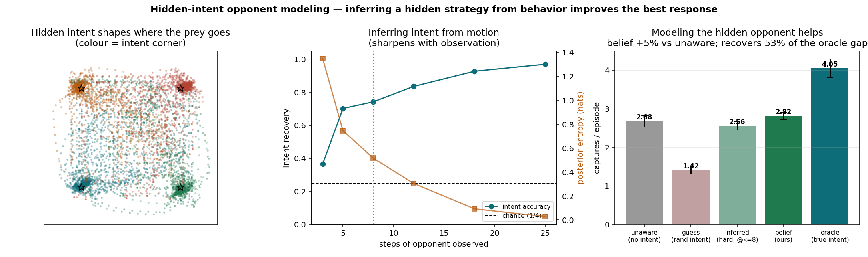
PART 1
The belief signal becomes measurable
• Accuracy rises from 0.37 at 3 observed steps to 0.97 at 25.
• Posterior entropy falls from 1.35 to 0.03 nats.
• The belief sharpens before the episode ends.
This validates the Part 1 encoder: early motion carries the hidden intent.
5
Notes:
Read the plot left to right: the encoder starts uncertain, then locks on as the prey commits. That matters because the planner can act before the final steps, while interception still has value. How it's generated: a supervised MLP classifier is trained on the prey's first-k absolute positions from oracle-condition rollouts, cross-validated; the bars are the capture ladder for the fixed predator conditions.

Slide 6
ABLATION
Hard intent labels can damage control
2.68
2.56
1.42
opponent-blind baseline
hard intent inferred at k=8
confident wrong intent
A point estimate throws away uncertainty. When the estimate is wrong, the predators commit to the wrong interception.
6
Notes:
This slide explains why the method carries a distribution. The wrong hard-intent condition is a stress test: 1.42 captures, far below 2.68 for the blind policy. Even the HONESTLY inferred hard intent at k=8 (2.56) loses to blind: the argmax throws away calibrated uncertainty. That failure is the argument for uncertainty-aware control.

Slide 7
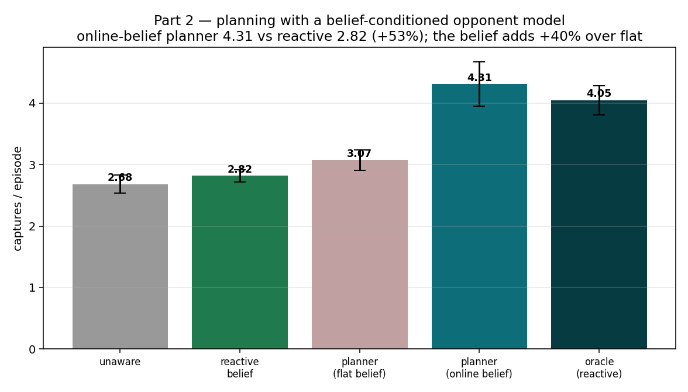
PART 2
The planner gets value from the whole belief
• Flat-belief planner: 3.07 captures/episode.
• Reactive oracle with true intent: 4.05.
• Planner with inferred belief: 4.31.
The lift comes from inference plus lookahead, measured against a flat-belief ablation.
7
Notes:
Central evidence slide. The flat planner controls for generic lookahead, so the 3.07-to-4.31 step (+40%) is attributable to the opponent inference. Mechanics if asked: at each real step the planner enumerates all 125 joint predator actions, samples 8 intents from the belief (shared across candidates for a paired, low-variance comparison), rolls the true simulator 5 steps with the prey playing its policy under each sampled intent, and scores discounted captures minus distance to the imagined prey at the horizon: an interception.

Slide 8
INTERPRETATION
The oracle comparison needs precise wording
Oracle policy
Belief planner
Reviewer line
Receives the true intent, then reacts with the trained policy. Perfect intent information, no lookahead.
Receives an inferred distribution, then searches short futures with simulator dynamics.
Say it exceeds a reactive oracle. An oracle planner remains the real ceiling experiment.
This wording preserves the strongest result without overstating the comparator.
8
Notes:
Defense slide. The planner has lookahead; the oracle policy reacts. That difference is why 4.31 can sit above 4.05 without overstating: say it exceeds a REACTIVE oracle, and name the oracle PLANNER as the true ceiling experiment still to run.

Slide 9
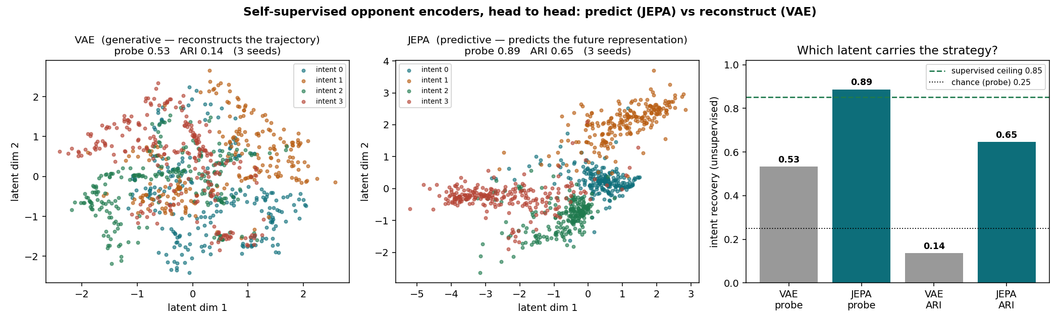
REPRESENTATION
JEPA recovers the belief without intent labels
• Same trajectory data and the same 2-D latent size.
• JEPA probe 0.89 vs VAE probe 0.53 (3 encoder seeds).
• JEPA belief planner reaches 4.08 captures/episode.
Predicting future behavior keeps the stable intent signal.
9
Notes:
Label-free route to the belief. JEPA predicts the representation of the future window through an EMA target encoder, no decoder; the prediction task rewards features that explain future motion, which IS the intent. The VAE spends capacity reconstructing evasion detail. Bar plot, if asked: probe = cross-validated logistic regression on the latent (is the strategy linearly decodable), ARI = unsupervised GMM clusters vs truth (does it cluster on its own); dashed line = supervised ceiling on the raw window, dotted = chance.

Slide 10
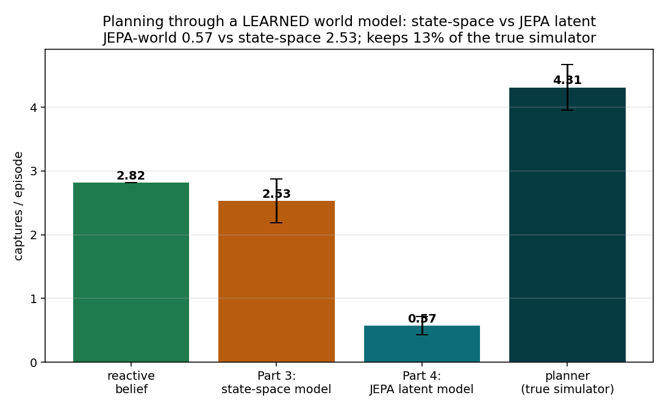
BOUNDARY
Learned dynamics failed the control test
• Simulator belief planning works.
• The latent world planner reaches 0.57 captures/episode.
• The control bottleneck is dynamics fidelity.
Keep this negative result in the talk. It tells reviewers where the method breaks today.
10
Notes:
The honest boundary. An encoder can discard nuisance motion; a dynamics model must preserve the details that affect control, and the compressed latent loses them (5-step position error roughly 3x the state-space model). Belief planning currently needs simulator dynamics.

Slide 11
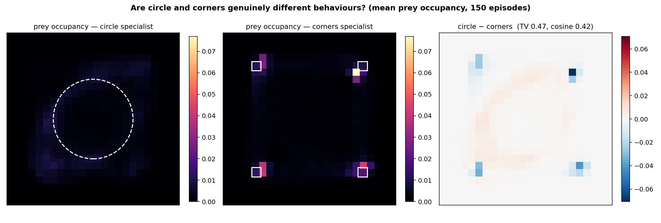
SECOND AXIS
“Are circles just squares?” Look at the occupancy
• Corners specialist: four sharp hot-spots at the corners.
• Circle specialist: a diffuse, smeared ring, no crisp peaks.
• Different behaviours (cosine 0.42), but asymmetric: the circle signal is weak.
The diffuse circle behaviour is why clustering fails and vanilla BC struggles; it motivates a genuinely distinct placement such as a snake path.
11
Notes:
Direct answer to the meeting question. Four resources on a circle are geometrically a small square of points, and the heatmap shows the consequence: the corners prey commits to four spots while the circle prey smears its time over a ring. Cosine similarity 0.42 and total-variation distance 0.47 between the two mean-occupancy distributions: different, but not cleanly separable. Generated from 150 episodes per specialist, 100 steps each, 24x24 histogram of prey positions, resource geometry overlaid.

Slide 12
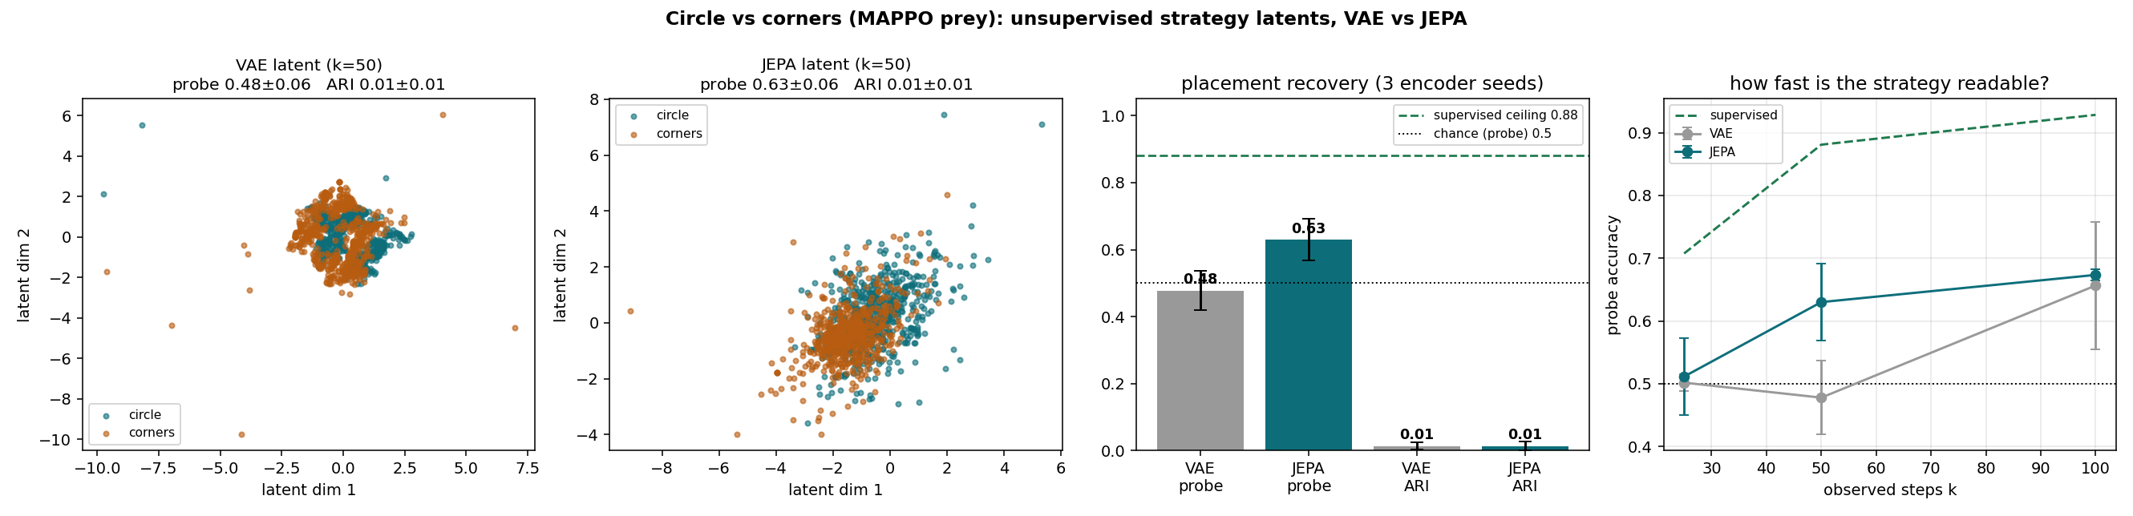
REPRESENTATION
The latent scatter: what the axes are
• Each point = one episode's prey occupancy, embedded by the encoder; color = true placement (never shown to the encoder).
• Axes = the 2-D latent directly (PC1/PC2 of the latent when 4-D). No t-SNE, no rescaling.
• Linearly decodable (supervised 0.93, latents to 0.81) but ARI ≈ 0: a direction, not two clusters.
Signal yes, separated modes no. Shaping the latent (contrastive or equivariant) is the open problem.
12
Notes:
Generation pipeline, end to end: (1) roll out both specialists in their native envs, 1,200 episodes, 3 seeds, keep ABSOLUTE positions; (2) featurize each episode as a normalized 8x8 occupancy histogram, z-scored (a raw coordinate window is at chance even for a SUPERVISED probe, 0.54, so the featurization gates the task, not the encoder); (3) train VAE and JEPA unsupervised; (4) scatter the per-episode latent. The supervised probe is a labeled logistic regression on the same 64-D histogram: the ceiling. If asked which encoder wins here: at 2-D JEPA leads, at 4-D the VAE (0.81 vs 0.67), because occupancy already removed the noise JEPA's advantage feeds on.

Slide 13
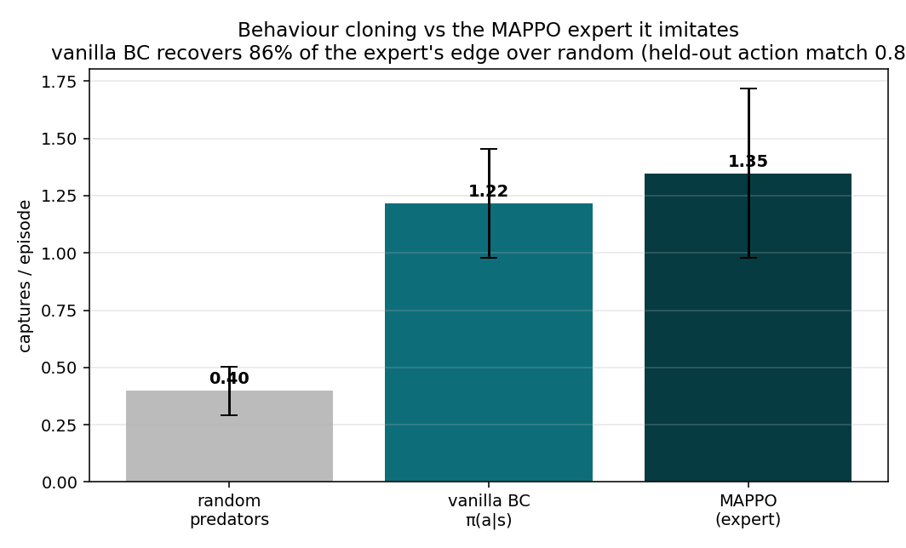
FOLLOW-UP
BC is strong enough to test strategy inputs
• Random policy: 0.40 captures/episode.
• Vanilla BC: 1.22 captures/episode.
• MAPPO expert: 1.35 captures/episode.
The clone recovers 86% of the expert edge, so the follow-up can test strategy information.
13
Notes:
Sanity check before the latent question: a poor clone would make the latent experiment unreadable. Deployed in the game against the same prey, the clone recovers 86% of the expert's edge over random, at an 0.80 held-out action match (episode-level split). Cloning is not the bottleneck; the residual 14% is the headroom a strategy signal could fill.

Slide 14
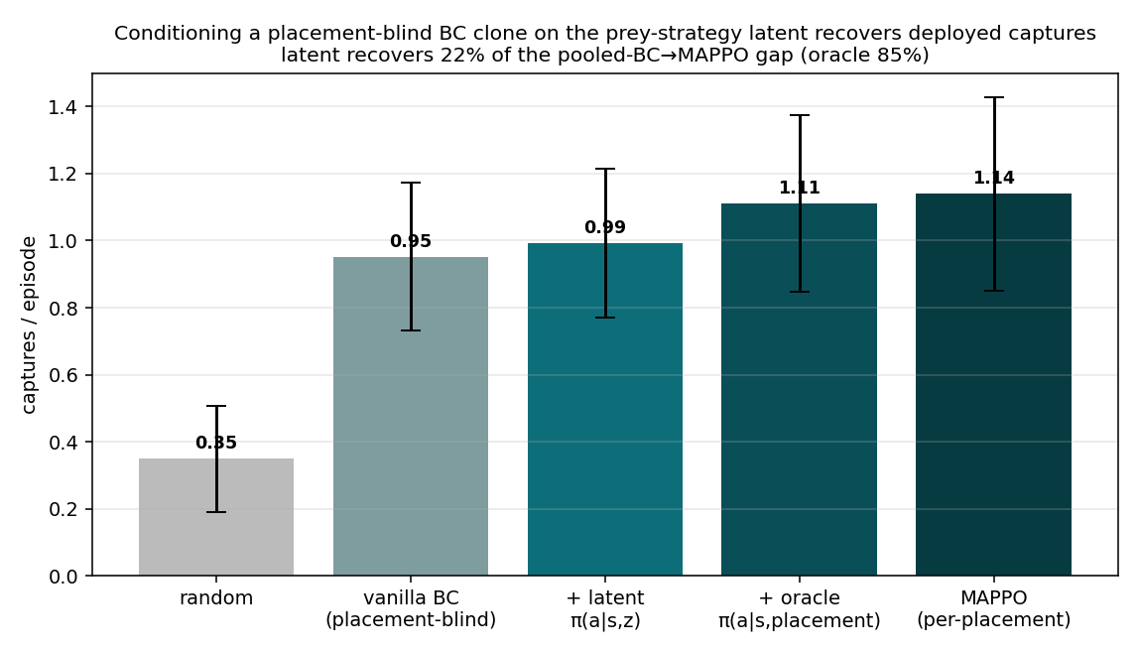
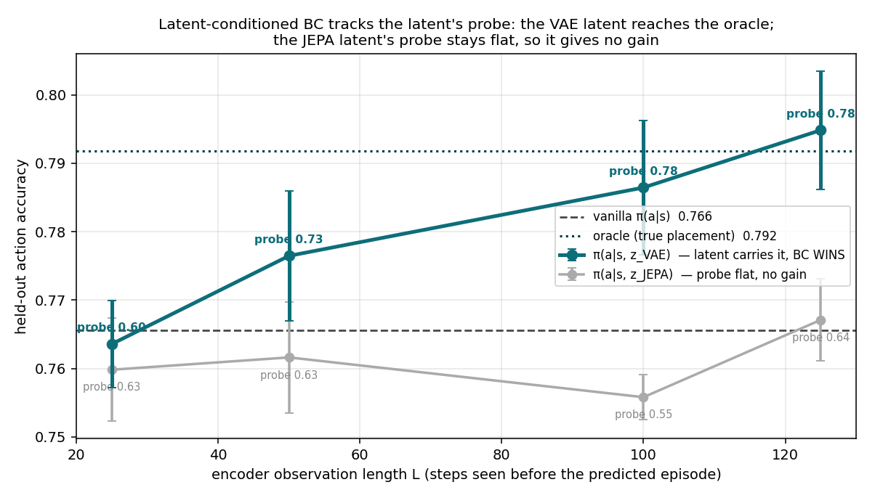
FOLLOW-UP
Strategy information has value, even when the latent is weak
• Oracle placement closes most of the deployed capture gap (85%).
• The unsupervised latent gives a small deployed lift today (22%, within noise).
• The sweep shows better probes translate into better BC.
14
Notes:
Careful BC interpretation. Left, deployed captures: the placement-blind pooled clone gets 0.95; give it the TRUE placement and it reaches 1.11 vs expert 1.14, recovering 85% of the gap, so strategy information has real control value. The unsupervised latent recovers about 22%, within error bars today. Right, the observation sweep in action accuracy: as the encoder watches longer its probe climbs 0.60 to 0.78 and BC accuracy climbs with it, overtaking vanilla by 50 steps and reaching the oracle band by 125. Sell this as evidence a better strategy code matters, not as the main win.

Slide 15
CAVEAT
Honest mechanism: is the gain just averaging?
• The placement is fixed across a specialist's episodes.
• More observation → a better occupancy ESTIMATE: averaging, not the strategy unfolding.
• Different from the hidden-intent task, where intent is revealed within the episode.
• So: a scaling-with-observation result, stated without overclaim.
• Stronger tests next: a latent that clusters, or a switching prey.
15
Notes:
Get ahead of the sharpest question in the room. The placement is FIXED across a specialist's episodes, so when the encoder watches longer and the latent improves, that is a better ESTIMATE of a fixed quantity: statistical averaging, not a strategy unfolding. Contrast with the hidden-intent task, where the intent genuinely reveals itself within the episode. So describe the sweep as scaling-with-observation. What would prove more: a latent that clusters (contrastive or equivariant shaping), or a switching prey where the belief must track a change.

Slide 16
FAILURE CASE
Where vanilla BC struggles
16
Notes:
Concrete failure example; the GIF animates in slideshow mode. A held-out episode replays and each variant predicts every predator action: green ring = predicted the actual action, red = missed, with running accuracy. On route-dependent corners episodes the placement-blind clone cannot tell a committing prey from a passing one, hedges, and misses (0.60); told the placement, the same architecture follows the commit (0.83 circle, 0.92 corners). Caveat to volunteer: these are tail episodes chosen to show the effect; the average gap is the +2.4-point table.

Slide 17
PROCEDURES
How every plot is generated
• 3 seeds throughout; mean ± std shown on every bar and curve.
• Episode-level train/val splits; conditioning never sees the predicted steps (leakage-checked).
• Occupancy = normalized 8×8 histogram of prey positions; z-scored before any encoder.
• Supervised probe = labeled, cross-validated logistic regression on the same features: the ceiling.
• Captures = raw reward / 10 per first episode, deployed in the game.
• CI: 12 unit tests + mopa-check-results validates all paper-facing numbers against raw logs.
• Full procedures: docs/METHODS.md; interpretation guide on /present.
17
Notes:
Rigor slide, keep it brief unless probed: every number is 3 seeds; all BC splits are episode-level so autocorrelated timesteps never straddle folds; conditioning latents only ever see steps strictly before the predicted episode; captures come from the raw +10-per-capture reward divided by 10, not the wrapper-scaled logs; and the repo has 12 fast tests plus a results checker that re-validates every paper-facing number against the raw npz files.

Slide 18
POSITIONING
The literature slot is belief plus planning
Closest comparator
Model-based MARL
Opponent modeling
HOP couples goal belief with tree search. The most direct system-level baseline to run.
MAZero, MAMBA, MARIE, and MATWM test the planning and dynamics side of the story.
MBOM and AORPO test whether the opponent model adds value beyond policy conditioning.
Paper line: calibrated opponent belief improves planning in a controlled hidden-intent task. Broader claims need adaptive opponents and external baselines.
18
Notes:
Literature answer, three lanes. HOP (ICML 2024) couples a goal belief with tree search and is the closest system-level baseline to run first. The model-based MARL lane (MAZero, MAMBA, MARIE, MATWM) tests the planning and dynamics side. The opponent-modeling lane (MBOM, AORPO) tests whether an explicit belief beats conditioning on opponent history. For the BC thread the anchor is STRIL (AAAI 2025), per-trajectory strategy latents for imitation; for the clustering gap it is CTR (NeurIPS 2024), contrastive identity grounding.

Slide 19
DEFENSE
Questions they'll ask
Q Beating the oracle looks too good — is it real?
A It exceeds a REACTIVE oracle (true intent, no lookahead). Planning pre-positions, so 4.31 > 4.05. An oracle PLANNER is the true ceiling, and it's on the to-run list.
Q Why does an honestly inferred hard intent (2.56) lose to blind (2.68)?
A The argmax at k=8 is ~74% accurate; committing to a wrong corner costs more than hedging. That's the whole case for carrying the distribution, not a point estimate.
Q Probe vs ARI — what's the difference?
A Probe = can a LINEAR readout with labels decode the latent (chance 0.25). ARI = does it cluster WITHOUT labels. On intent both are high; on circle-vs-corners only the probe is.
Q Isn't JEPA just a better-tuned VAE?
A Same data, latent size, and budget. JEPA predicts the future representation (no decoder); the VAE reconstructs. The gap (0.89 vs 0.53) is the objective, not the tuning.
19
Notes:
Anticipated questions — answer crisply, then stop. These are the sharpest ones the plots invite; each answer concedes what's honest and states the claim precisely. Full set with figures on the /present page's Figure guide.

Slide 20
DEFENSE
Questions they'll ask (cont.)
Q Aren't circles just squares? (the meeting challenge)
A Geometrically yes — 4 points on a circle are a small square. Behaviourally no: corners commit to 4 sharp spots, the circle smears a diffuse ring (cosine 0.42). The circle signal is just weak.
Q If it's decodable (0.93), why doesn't it cluster (ARI≈0)?
A Linear separability ≠ two modes. The placement is a DIRECTION in latent space, not two blobs. Shaping it to cluster (contrastive / equivariant) is the open problem.
Q Is the latent-BC sweep gain just averaging over more episodes?
A Largely yes, and I say so: the placement is FIXED, so longer observation is a better occupancy ESTIMATE, not a strategy unfolding. It's a scaling-with-observation result.
Q The BC-failure GIF — cherry-picked?
A Deliberately: tail episodes chosen to show the mechanism. The average is the table (86% recovery, +2.4 accuracy pts). The GIF explains WHY, the table is the claim.
20
Notes:
Anticipated questions — answer crisply, then stop. These are the sharpest ones the plots invite; each answer concedes what's honest and states the claim precisely. Full set with figures on the /present page's Figure guide.

Slide 21
CLOSE
Before submission, run the missing tests
Oracle planner
Measures the true planning ceiling with known intent.
Switching prey
Tests whether the belief tracks a strategy change mid-episode.
HOP baseline
Checks the closest belief-search comparator.
Snake placement
A genuinely distinct behaviour class, so clusters can exist.
Raw artifact archive
Pins checkpoints, logs, and metrics to a release DOI.
End with a concrete ask: accept the controlled result, then fund the baseline and switching-opponent run.
21
Notes:
Close on specific work. The repo has code hygiene, tests, result checks, and this deck. The scientific gap is the next experiment set: the oracle planner ceiling, a switching prey to test belief tracking, the HOP baseline, a genuinely distinct placement (snake path), and archived raw runs pinned to a release DOI. End with the concrete ask: accept the controlled result, fund the baseline and switching-opponent runs.

