Slide 1







Technology Trends and Implications for Business Strategy
Richard Longlands
4th July 2022

Slide 2



OUTLINE
Executive Summary
Introduction
Methodology
Results
Visualization – Charts
Dashboard
Discussion
Findings & Implications
Conclusion
Appendix

Slide 3

EXECUTIVE SUMMARY
Evidence shows stability in technologies with major languages and databases continuing to be popular for next year.
Several top technologies look set to continue to be popular in future such as
HTML/CSS
JavaScript
Mongo DB
There are opportunities for to develop upcoming technologies such as
Go
Elasticsearch
Docker is the most worked with platform and this is set to increase next year
In web frames Angular/Angular.js is the most desired for next year

Slide 4

INTRODUCTION
This report looks at technology trends in programming languages, databases and demographics
The report aims to be useful for those making business decisions about what technologies are the most useful for future development.
Charts and discussions cover top languages and databases currently and for the near future.
Dashboards show several datapoints for this year and next including
Web Frames
Platforms
Languages
Databases
Demographics

Slide 5

METHODOLOGY
Scrape data from the web on job postings for technology jobs and the most popular language. Analyze this data for insights into technology trends
Analyze data from Stack Overflow Developer Survey 2019 about technology trends
Draw from this data the most popular languages and databases in current use and which respondents wanted to learn next year (future trends)
Draw further data insight from the survey data such as:
Platforms used
Demographics

Slide 6
RESULTS

Slide 7
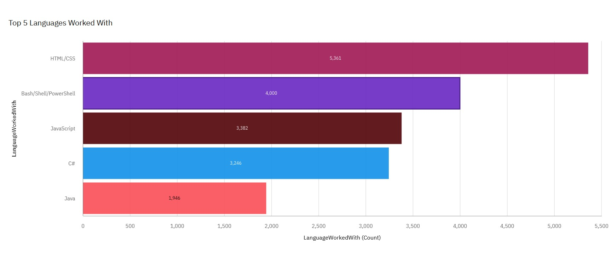
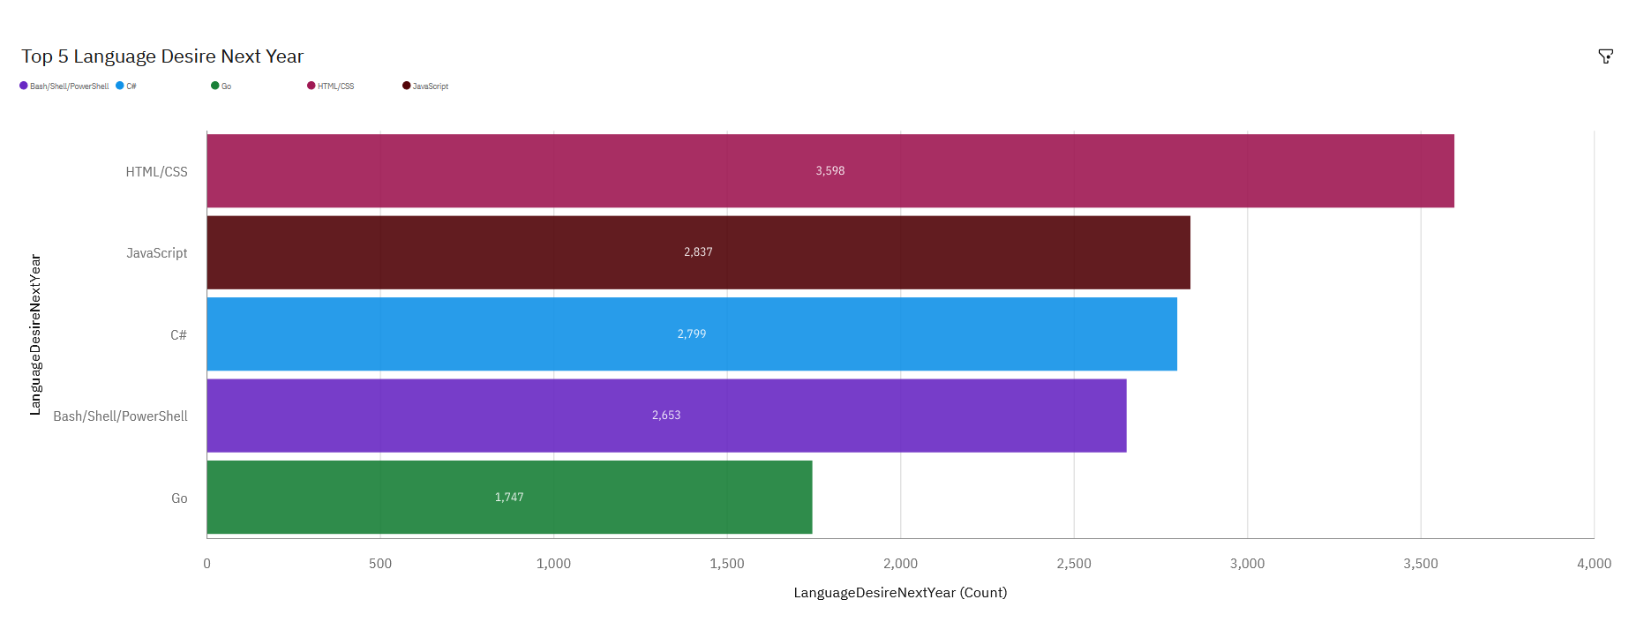
PROGRAMMING LANGUAGE TRENDS
Current Year
Next Year
<Bar chart of top 5 programming languages for the current year goes here.>
< Bar chart of top 5 programming languages for the next year goes here.>

Slide 8
PROGRAMMING LANGUAGE TRENDS - FINDINGS & IMPLICATIONS
Findings
4 of the top 5 languages are the same next year although the order is changing
Html/CSS is top both years
Go moves into the top 5 next year up from 10th position
Bash/Shell/Powershell and Java are both moving down slightly
Implications
Dramatic changes are not expected
Continue investment in the most popular languages where it suits business needs
Consider increasing investment in Go

Slide 9
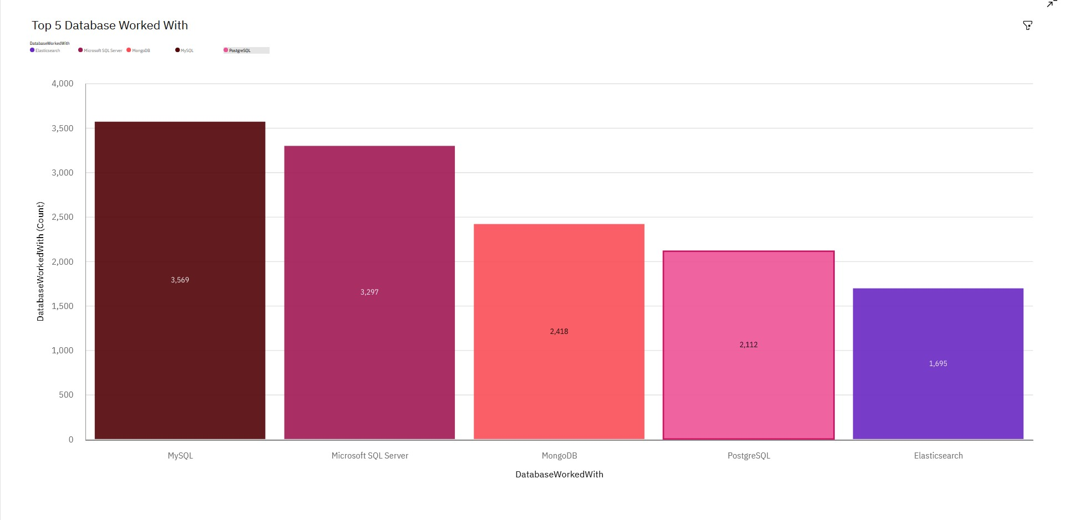
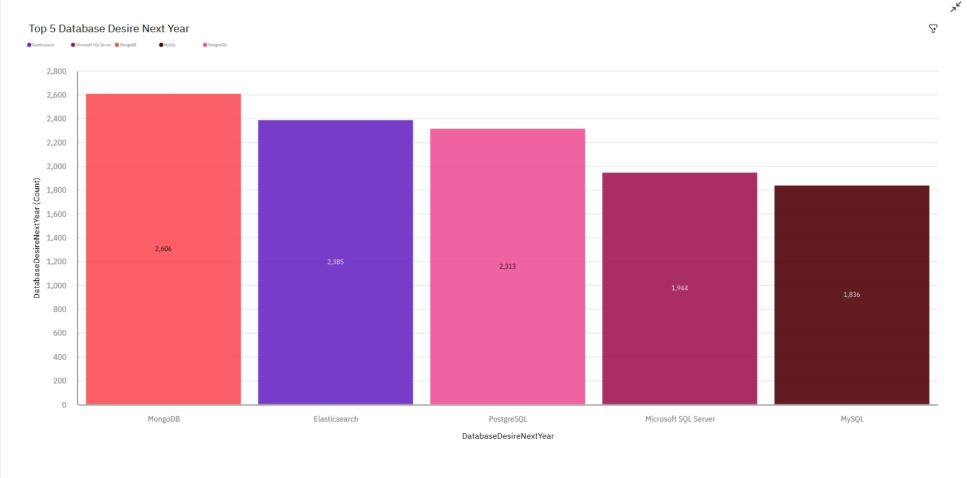
DATABASE TRENDS
Current Year
Next Year
< Bar chart of top 5 databases for the current year goes here >
< Bar chart of top 5 databases for the next year goes here.>

Slide 10
DATABASE TRENDS - FINDINGS & IMPLICATIONS
Findings
Top 5 DBs are the same for both years although the order changes significantly
Elasticsearch moves up significantly in next year’s predictions
MongoDB is also more popular next year
MySQL moves down significantly from 1st to 5th
Implications
Movement in the top 5 but no new entrants means changes are modest
Elasticsearch is the one to consider expanding into for next year
MySQL is less popular going forward so invest cautiously in this technology

Slide 11

DASHBOARD
https://eu2.ca.analytics.ibm.com/bi/?perspective=dashboard&pathRef=.my_folders%2FCapstone%2BDashboard&action=view&mode=dashboard&subView=model00000181b0e8d151_00000002

Slide 12
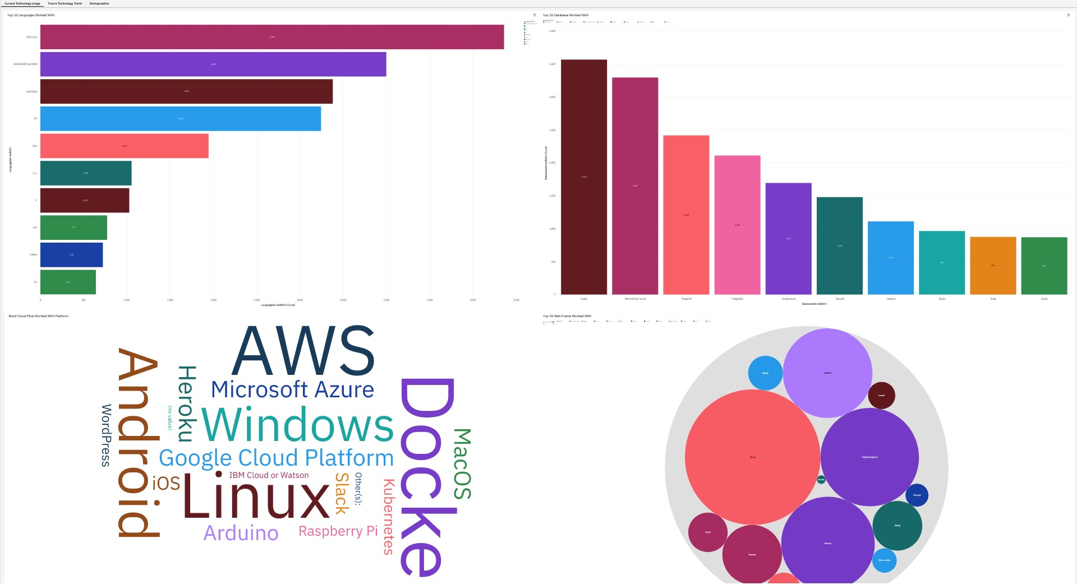
DASHBOARD TAB 1

Slide 13
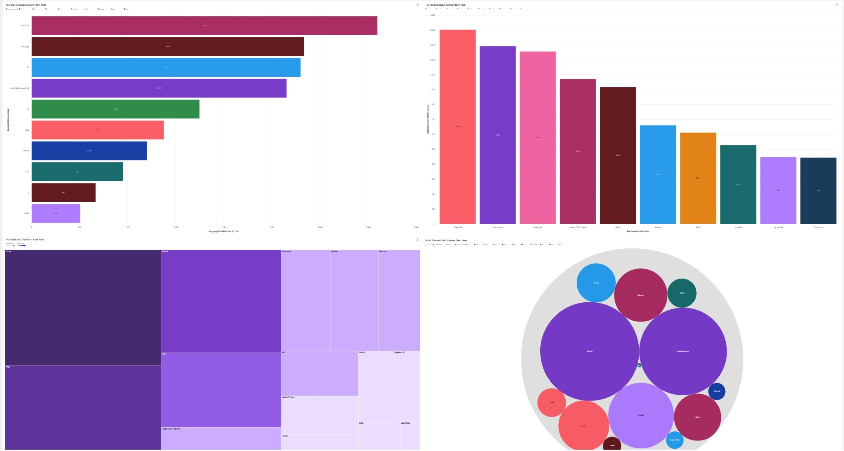
DASHBOARD TAB 2

Slide 14
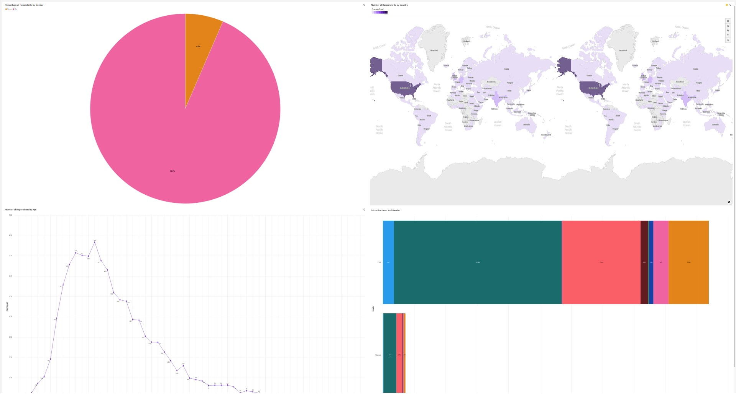
DASHBOARD TAB 3

Slide 15
DISCUSSION
Which technologies are good opportunities for future investment?
Are there any that we use that we should consider moving away from?
Which technologies look strong for ongoing use?

Slide 16
OVERALL FINDINGS & IMPLICATIONS
Findings
Strong ongoing technologies include HTML/CSS, JavaScript, Docker, jQuery, MongoDB
Upcoming technologies include Go and Elasticsearch
MySQL, Java, PowerShell/Shell show slight downward trends in popularity
Demographics show men under 40 dominate the respondents to the developer survey
Implications
Strongest technologies look like safe options for the future
Opportunities exist to expand into upcoming technologies
Some technologies may be at or past their peak so require caution for the future
There may be a large body of untapped talent in other demographic groups

Slide 17

CONCLUSION
Continue investment in the most popular ongoing technologies such as HTML/CSS, JavaScript, Docker, jQuery, MongoDB
Consider expanding into upcoming technologies such as Go and Elasticsearch
Go cautiously investing in technologies that are less popular for the future
Consider how to make the most of new talent in the labour market

Slide 18

APPENDIX
Job Postings data scraped from the web
Most popular language data

Slide 19
JOB POSTINGS

Slide 20
POPULAR LANGUAGES

