Slide 1
ASURION
Expert Workspace
An AI-powered workspace for 10,000+ agents—making every interaction feel simple and personal.
ROLE
TIMELINE
TEAM
PLATFORM
Sr. Manager, Product Design
2025 – Present
2 Designers
Web · Call Center & Messaging

Slide 2
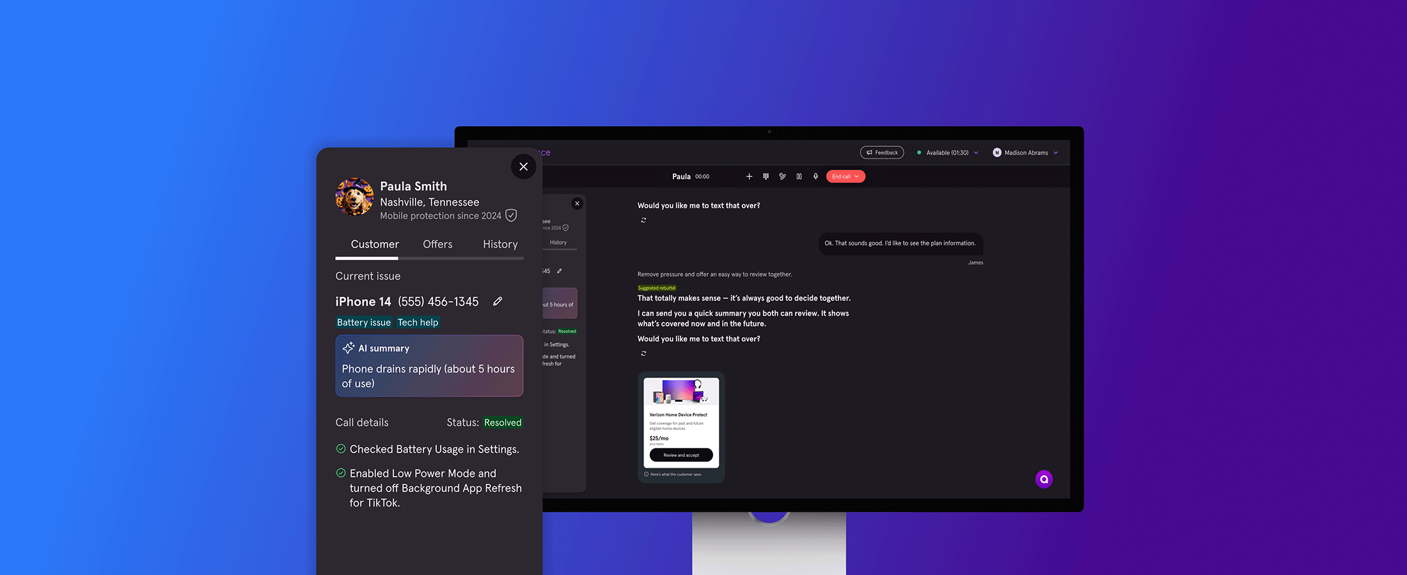
Expert Workspace — product vision
Asurion · 2 / 6

Slide 3
THE PROBLEM
18 months of sales-driven decisions
01
02
03
No user-centered vision
Fragmented, slow tools
Org in transition
Sales priorities had shaped the product for over a year—agents weren't the focus.
Agents juggled disconnected systems to handle every customer interaction.
Leadership and team structure were shifting, creating a need for clarity and direction.
Asurion · 3 / 6

Slide 4
MY LEADERSHIP
Setting direction from the top down
Defined the product vision and design principles
Aligned design, product, ops, and sales leadership
Built the AI guidance methodology for agent communication
Mapped agent pain points to business impact to set priorities
Asurion · 4 / 6

Slide 5
DESIGN PRINCIPLES
How the workspace should feel
See What You Need
Know the Customer
Build Clarity
Right tools and next steps, always in view.
Personalized from the first message.
Plain language, transparent AI.
Remove Friction
Improve Together
Automate busywork, focus on connection.
Learns from every interaction.
Asurion · 5 / 6

Slide 6
REFLECTION
"The hardest part wasn't the design—it was resetting 18 months of organizational momentum in the middle of a leadership transition."
Asurion · 6 / 6

