Slide 1
ASURION · UBREAKIFIX
Next-Gen Portal
The new operating system for 680+ repair stores—built from scratch in under 2 years.
ROLE
TIMELINE
TEAM
PLATFORM
Sr. Manager, Product Design
2022 – 2025
4 Designers
Web Application

Slide 2
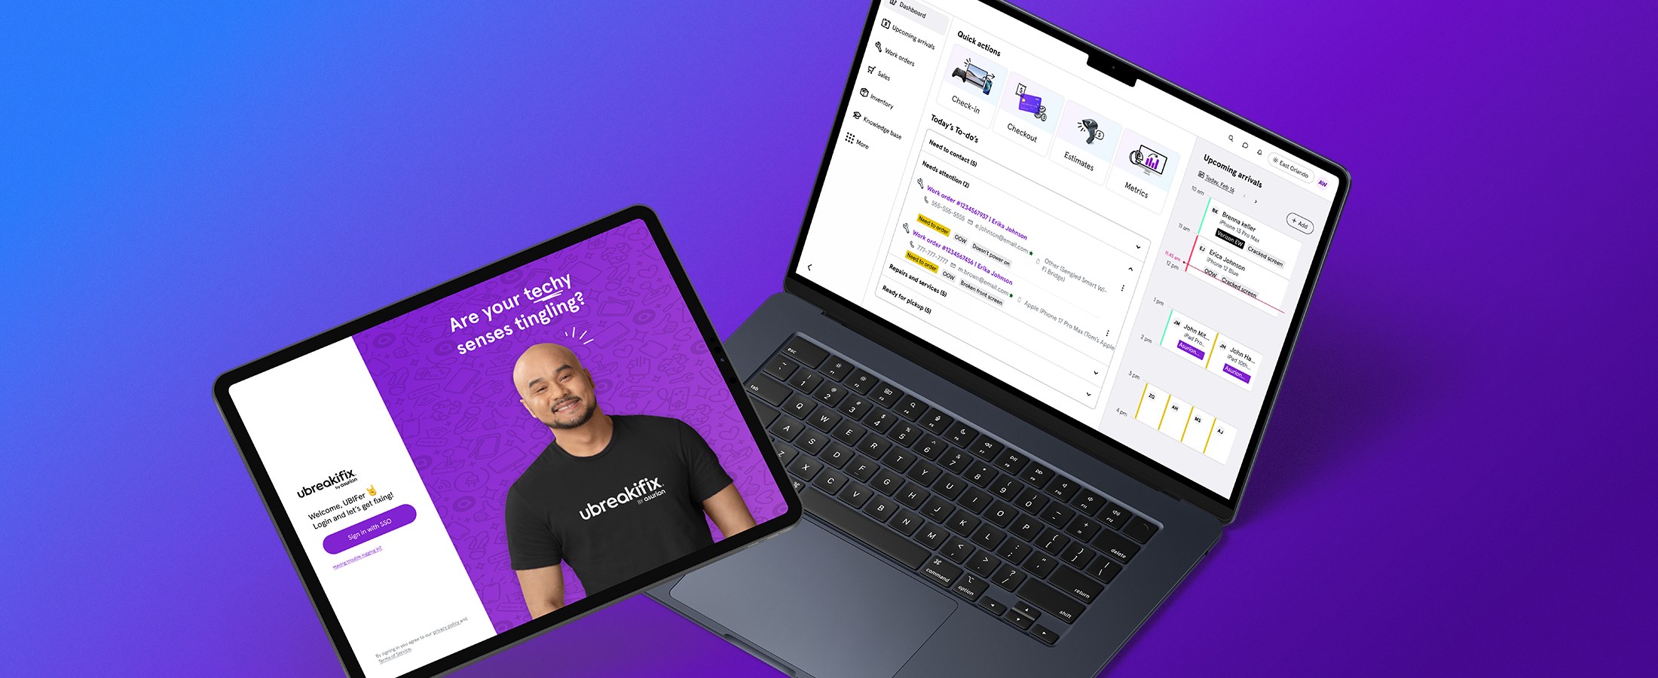
Next-Gen Portal — new platform
Asurion · uBreakiFix · 2 / 7

Slide 3
THE PROBLEM
Replacing 10 years of band-aids
01
02
03
Slow & buggy legacy
Siloed from Asurion
2 weeks just to learn it
Outdated tech, unreliable performance, no path to scale.
No integration with inventory, supply chain, or partner systems.
New technicians had to memorize every workflow before day one.
Asurion · uBreakiFix · 3 / 7

Slide 4
MY LEADERSHIP
Building design culture from 0 to 1
Hired and managed a team of 4 designers
Set long and short-term product strategy
Led service blueprinting with ops, engineering, and execs
Moved design from service function to strategic partner
Advocated for iterative shipping over waterfall delivery
Asurion · uBreakiFix · 4 / 7

Slide 5
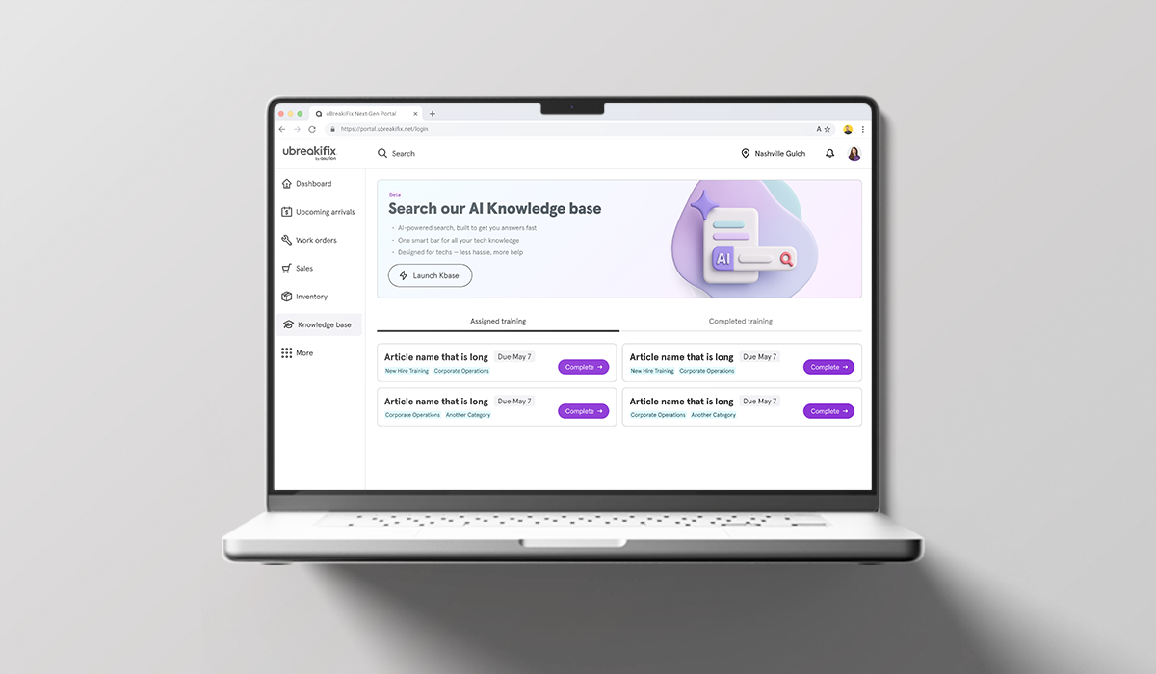
THE SOLUTION
Fast, clear, and built to scale
Built on Microsoft D365—single source of truth
Partner onboarding in 1 week, not 2 months
Training time cut in half
Pay by Link, price estimates, and faster search
Asurion · uBreakiFix · 5 / 7

Slide 6
IMPACT
Powering the entire retail network
680+
50%
1 wk
stores running on Next-Gen Portal
reduction in technician training time
to onboard new partners vs. 2 months
Asurion · uBreakiFix · 6 / 7

Slide 7
REFLECTION
"I wish we'd shipped faster. Earlier launches would have given us real signal sooner—and let us adjust while we still had room to move."
Asurion · uBreakiFix · 7 / 7

