Slide 1
ASURION
In-Store Claims Kiosk
From 45 minutes to under 10—giving 10,000+ customers a month a way to self-serve claims in store.
ROLE
TIMELINE
TEAM
PLATFORM
Principal Designer
2021 – 2022
Cross-functional
Tablet Kiosk → Handheld

Slide 2
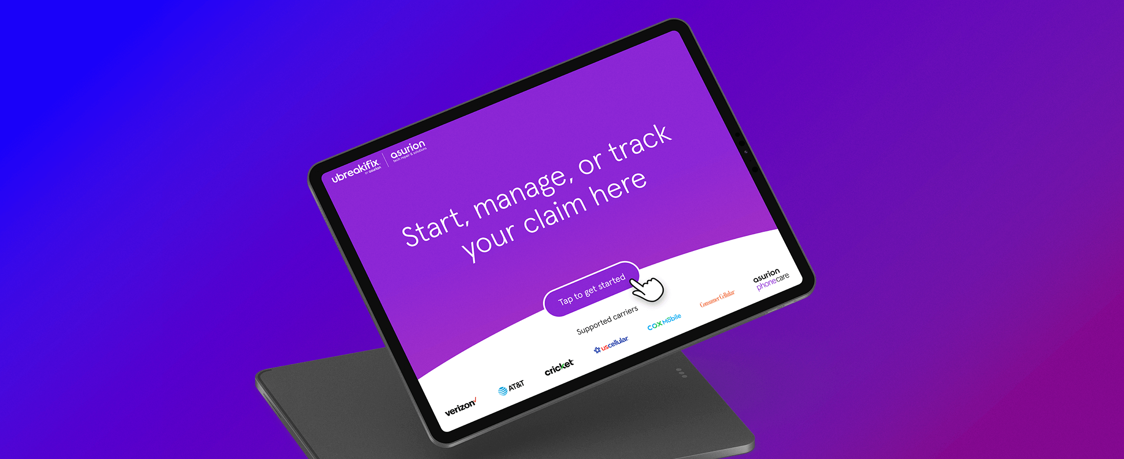
In-Store Claims Kiosk — tablet experience
Asurion · 2 / 6

Slide 3
THE PROBLEM
Stores couldn't help with claims
01
02
03
Regulatory barriers
Disconnected systems
Technicians spread thin
Employees can't file claims—legally. They aren't licensed insurance adjustors.
Stores had zero visibility into Asurion's claims platform.
Up to 45 minutes per customer on claim issues—time they didn't have.
Asurion · 3 / 6

Slide 4
MY ROLE
Principal designer, research to scale
Led research planning and in-store interviews
Facilitated service blueprinting workshops with ops, stores, and product
Designed and ran a 20-store pilot to validate the kiosk format
Collaborated with marketing on kiosk signage and tablet motion
Asurion · 4 / 6

Slide 5
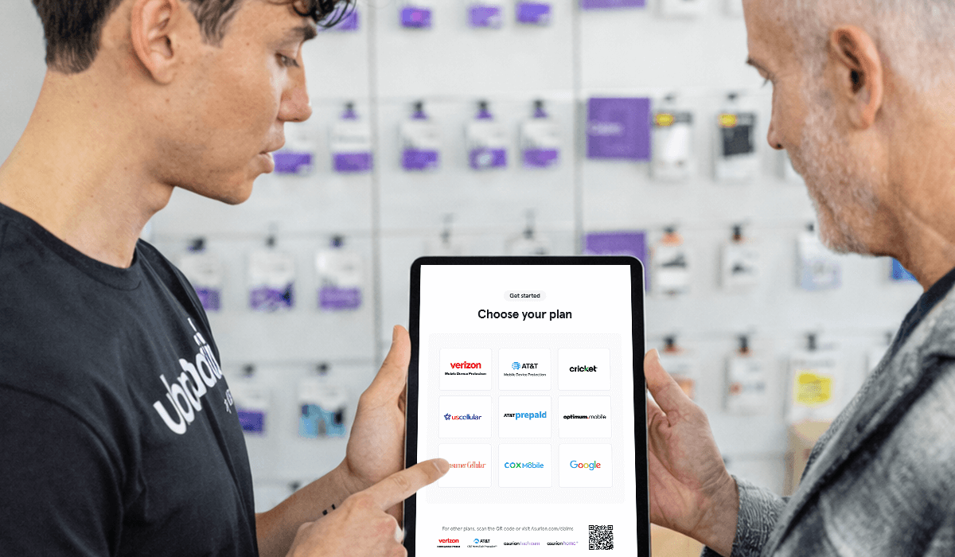
THE SOLUTION
Warm handoff, self-serve claims
Technicians identify claim eligibility instantly
Customers self-serve on a guided tablet flow
Location pre-filled, verification simplified
Piloted as kiosk, evolved to handheld for 1:1 feel
Asurion · 5 / 6

Slide 6
IMPACT
From 45 minutes to under 10
<10m
10K+
$100K+
claim resolution time, down from 45 min
customers helped per month
saved in call and chat deflection
Asurion · 6 / 6

