Slide 1
TRAVEL + LEISURE CO
Club Wyndham Vacation Planner
Personalized resort discovery across 220+ properties—turning decision paralysis into confident bookings.
ROLE
TIMELINE
TEAM
PLATFORM
Design Manager
2020 – 2022
2 Designers + Agency
Web, Mobile

Slide 2

Club Wyndham Vacation Planner — Explore Resorts
Travel + Leisure Co · 2 / 6

Slide 3
THE PROBLEM
220 resorts, zero guidance
01
02
03
Discovery was broken
Prospects weren't converting
Inventory imbalance
Users couldn't find the right resort. Map and list views overwhelmed rather than guided.
No onboarding path for new visitors from social or email campaigns.
Popular resorts overbooked; comparable resorts with availability had no visibility.
Travel + Leisure Co · 3 / 6

Slide 4
MY ROLE
Design Manager—strategy, team, and craft
Led design for the website, dashboard, booking flow, and Vacation Planner
Managed 2 in-house designers + reviewed agency design
Defined product strategy for discovery and onboarding
Ran high-fidelity prototype testing with real members
Travel + Leisure Co · 4 / 6

Slide 5
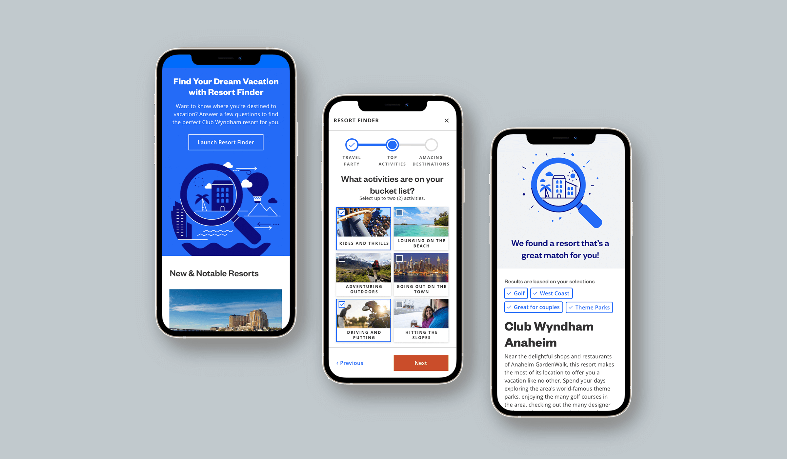
THE SOLUTION
Different flows for different goals
Quiz-style flow reduces 220+ options to a match
Members see actionable results tied to their points
Prospects see aspirational results with a clear path to join
Surfaces under-booked resorts with similar amenities
Travel + Leisure Co · 5 / 6

Slide 6
REFLECTION
"Personalization isn't a nice-to-have. The same content, presented differently based on who's looking, creates dramatically different outcomes."
Travel + Leisure Co · 6 / 6

