Slide 1
DISNEY PARKS & EXPERIENCES
Guest Service Suite
Replacing 60+ disconnected apps with one responsive experience for 30,000+ Cast Members.
ROLE
TIMELINE
TEAM
PLATFORM
Lead Product Designer
May 2019 – Dec 2020
2 → 4 Designers
Responsive Web

Slide 2
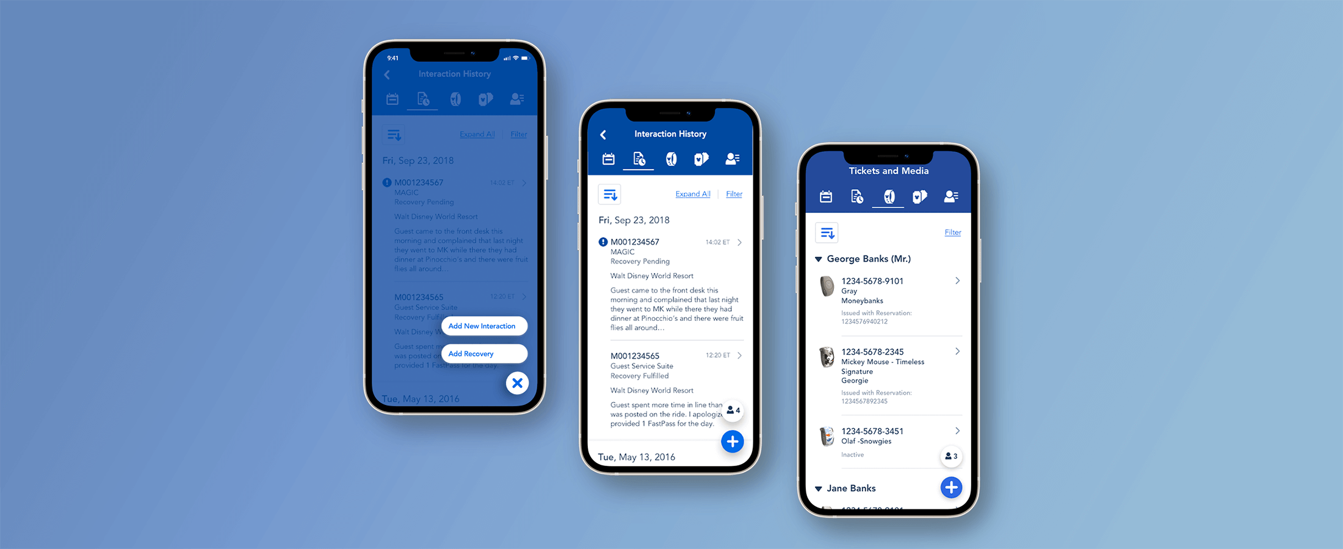
Guest Service Suite — unified Cast Member tool
Disney Parks & Experiences · 2 / 7

Slide 3
THE PROBLEM
60+ apps, paper docs, frustrated Cast
01
02
03
Not built for mobile
Limited guest info
60+ disconnected apps
60%+ of Cast only had tablets or phones—but tools weren't responsive.
Staff relied on paper flyers. No real-time park or guest data.
Jumping between tools made it nearly impossible to take quick action.
Disney Parks & Experiences · 3 / 7

Slide 4
MY ROLE
Lead Product Designer, 0 to launch
Led design for Guest Interaction Tracking—the product's core
Conducted user research with front-line and call center Cast Members
Grew the design team from 2 to 4 designers throughout the project
Ran sketch boarding and user testing sessions from start to finish
Disney Parks & Experiences · 4 / 7

Slide 5

THE SOLUTION
One app to replace them all
Guest interaction history at a glance
MagicBand scanning and media management
Simplified incident reporting—11 dropdowns → guided flow
Responsive: works on desktop, tablet, and mobile
Disney Parks & Experiences · 5 / 7

Slide 6
IMPACT
Built with Cast, adopted enthusiastically
~25%
30K+
80%
efficiency improvement for Cast Members
staff across 5 Disney parks
positive Cast response at launch
Disney Parks & Experiences · 6 / 7

Slide 7
REFLECTION
"When you build with your users—not just for them—adoption comes naturally. That's the lesson that changed how I approach every project."
Disney Parks & Experiences · 7 / 7

