Slide 1
UNIVERSAL ORLANDO
Halloween Horror Nights
A mobile-first e-commerce redesign that broke attendance records and drove double-digit ticket sales growth.
ROLE
TIMELINE
TEAM
PLATFORM
UI/UX Art Director
Mar 2018 – Mar 2019
Creative + Ad Directors
Web, Mobile

Slide 2
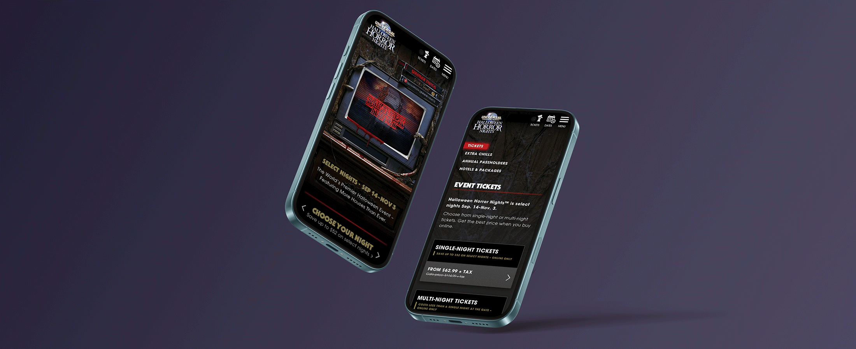
Halloween Horror Nights — new responsive experience
Universal Orlando · 2 / 6

Slide 3
THE PROBLEM
Terror doesn't translate to ticket sales
01
02
03
Not built for mobile
7 ticket options
Fragmented brand
Mobile traffic was growing fast. The existing site wasn't optimized for it.
Too many choices confused users and stalled the path to purchase.
Digital experience didn't align with TV, OOH, and marketing campaigns.
Universal Orlando · 3 / 6

Slide 4
MY ROLE
UI/UX Art Director — lead on a record-breaking launch
Led responsive web and mobile design end-to-end
Reduced ticket options from 7 to 2 to drive purchase decisions
Separated Tickets, Extras, and Packages into focused pages
Collaborated with Creative and Ad Directors for brand alignment
Universal Orlando · 4 / 6

Slide 5
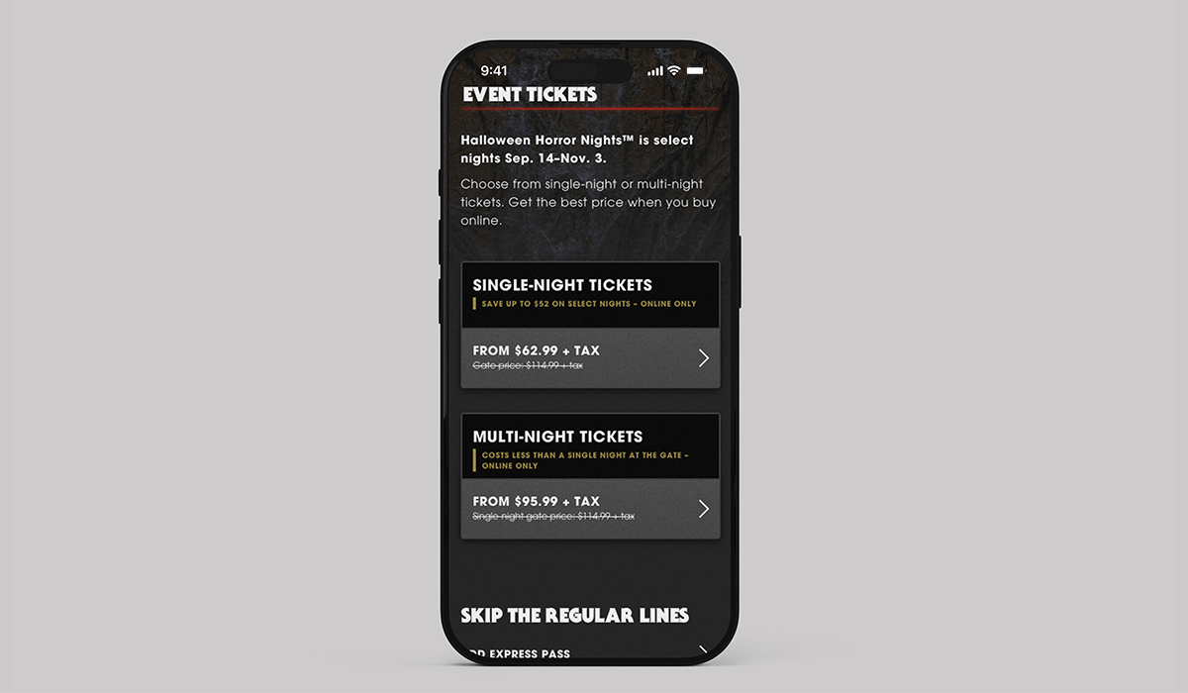
THE SOLUTION
Simplify the path, amplify the fear
Mobile-first—built for the growing mobile audience
7 ticket options simplified to 2
Clear, focused pages for each ticket type
Immersive horror atmosphere preserved throughout
Universal Orlando · 5 / 6

Slide 6
IMPACT
Record-breaking results
#1
2×
↑
all-time HHN attendance record broken at launch
double-digit growth in online ticket sales
mobile traffic and conversions—fastest growing segment
Universal Orlando · 6 / 6

