Slide 1

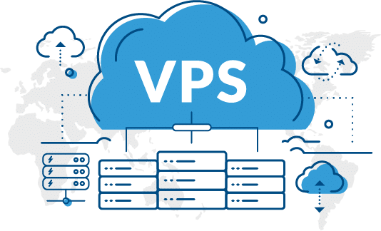
THE JOURNEY TO THE VPS
Raphaël &Dominga

Slide 2
Introduction

Slide 3
Summary schema
Looking for Dominga at work

Slide 4
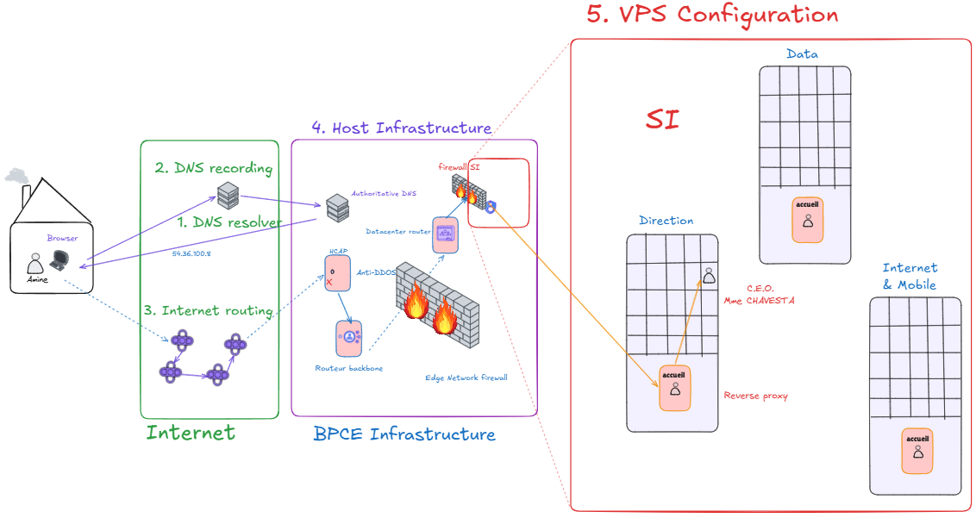

Slide 5
Summary
Introduction
DNS Resolver
DNS Recording
Internet Routing
Host infrastructure
VPS Configuration

Slide 6
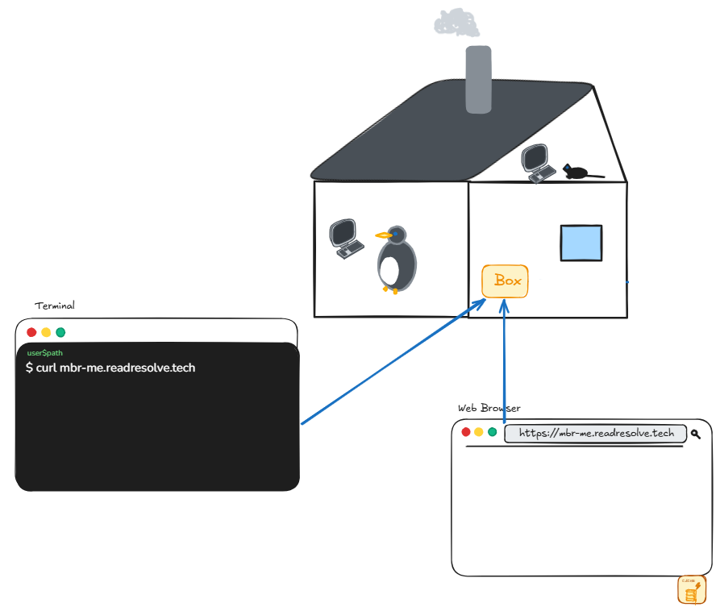
Hands-on case study

Slide 7
1. DNS Resolver

Slide 8
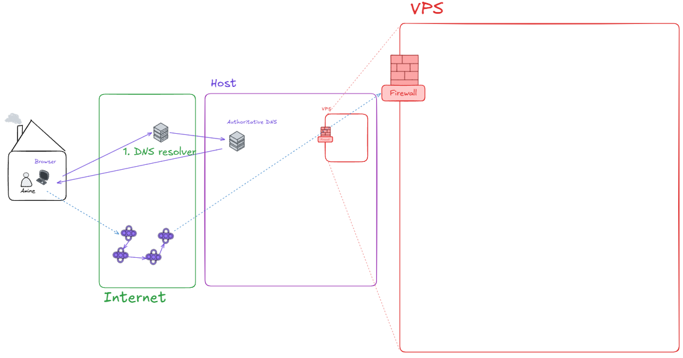
DNS Resolver Step

Slide 9
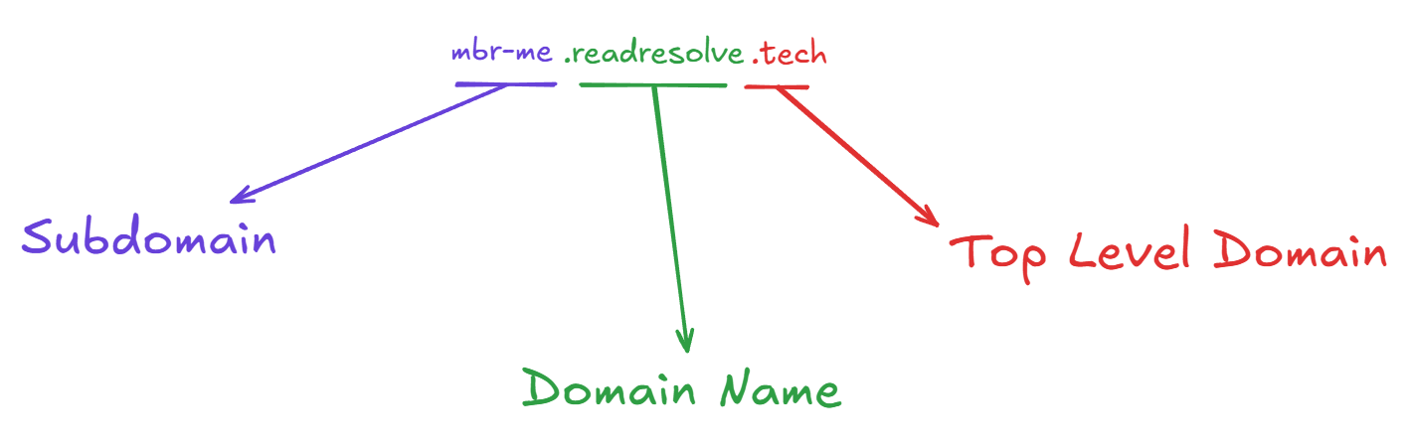
DNS Resolver - Theory

Slide 10
DNS Resolver - Theory
Hands-on case study
$ dig +trace readresolve.tech

Slide 11
DNS Resolver - Cache
Multiples caches
Shortcuts for DNS lookup
DNS modification takes time

Slide 12
2. DNS Recording

Slide 13
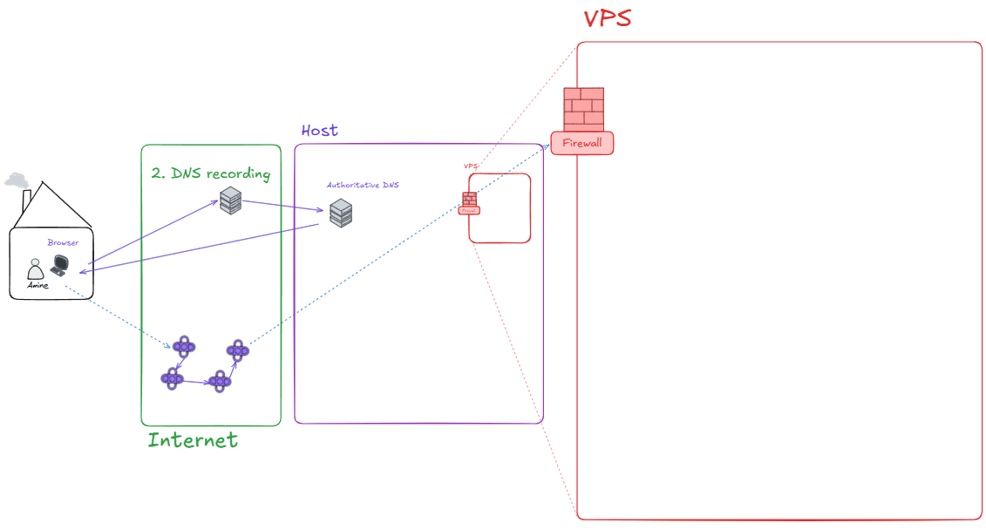
DNS Recording

Slide 14
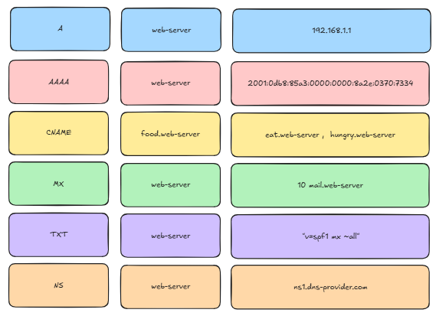
DNS Recording : Type of Records

Slide 15
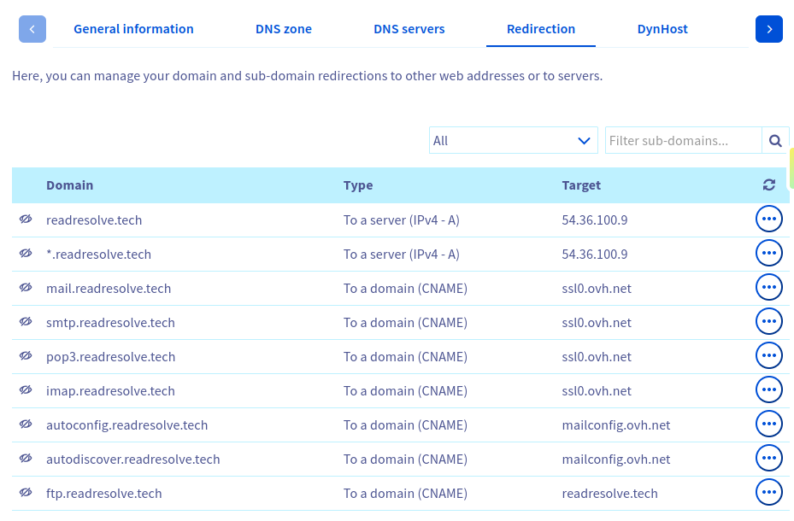
DNS Recording : Host records

Slide 16
DNS Recording : TTL
Each record has a TTL : Time To Live
A TTL affects DNS propagation.
Before an IP switch, the TTL is often lowered in advance

Slide 17
Hands-on case study
Mac & Linux OS
$ dig A readresolve.tech
Windows OS
$ Resolve-DnsName -Name "readresolve.tech" -Type NS

Slide 18
3. Internet Routing

Slide 19
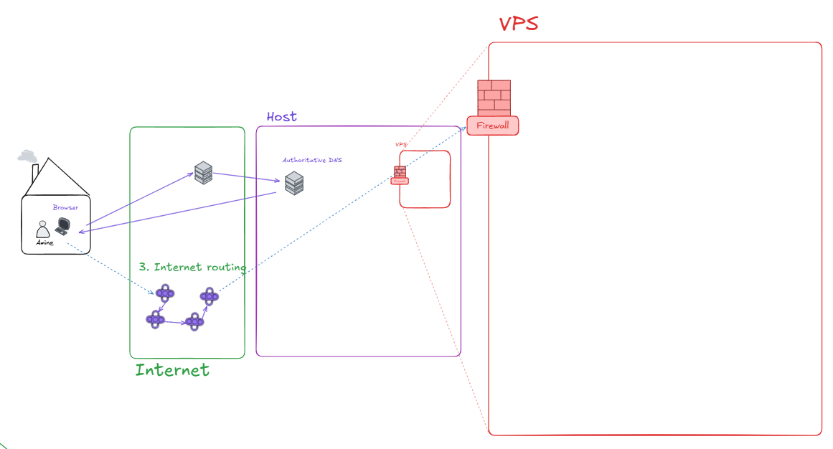
Internet Routing

Slide 20

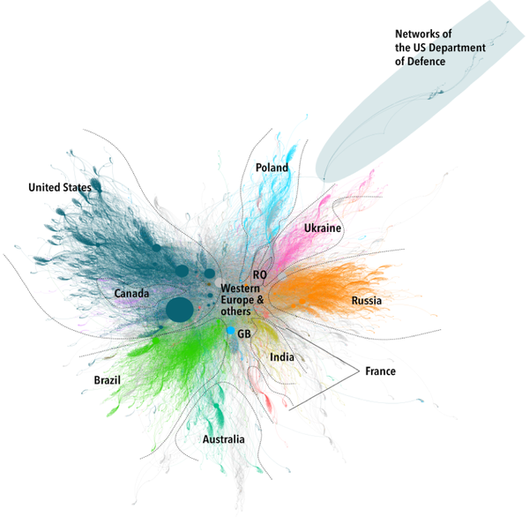



Internet Routing : Theory
Autonomous System
Routing table
Source : https://geode.science/geopolitique-du-routing/

Slide 21
Internet Routing : Theory
BGP : Border Gateway Protocol
  Prefix
  Highways / Big Operators
  Cheapest ways
Source : https://geode.science/geopolitique-du-routing/

Slide 22
Internet Routing : Theory
OSPF : Open Shortest Path First
  Suffix
  Local ways
Source : https://geode.science/geopolitique-du-routing/

Slide 23
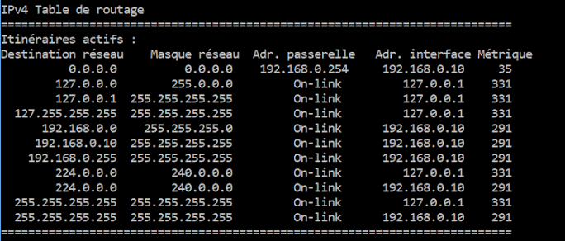
Internet Routing : Routing table

Slide 24
Hands-on case study
Mac Linux OS
Windows OS
$ ping 54.36.100.9
$ traceroute 54.36.100.9
$ ping 54.36.100.9
$ tracert 54.36.100.9

Slide 25
4. Host Infrastructure
OVH : for the case study

Slide 26
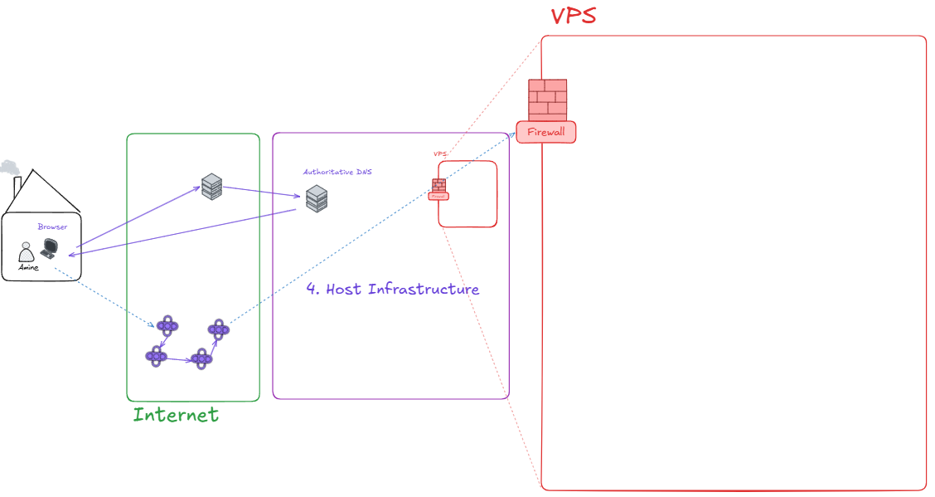

Slide 27

Host Infrastructure : Why ?
Handle hosting multiples website
Prevent Cyber-attack
One of the simplest attacks : DDoS

Slide 28
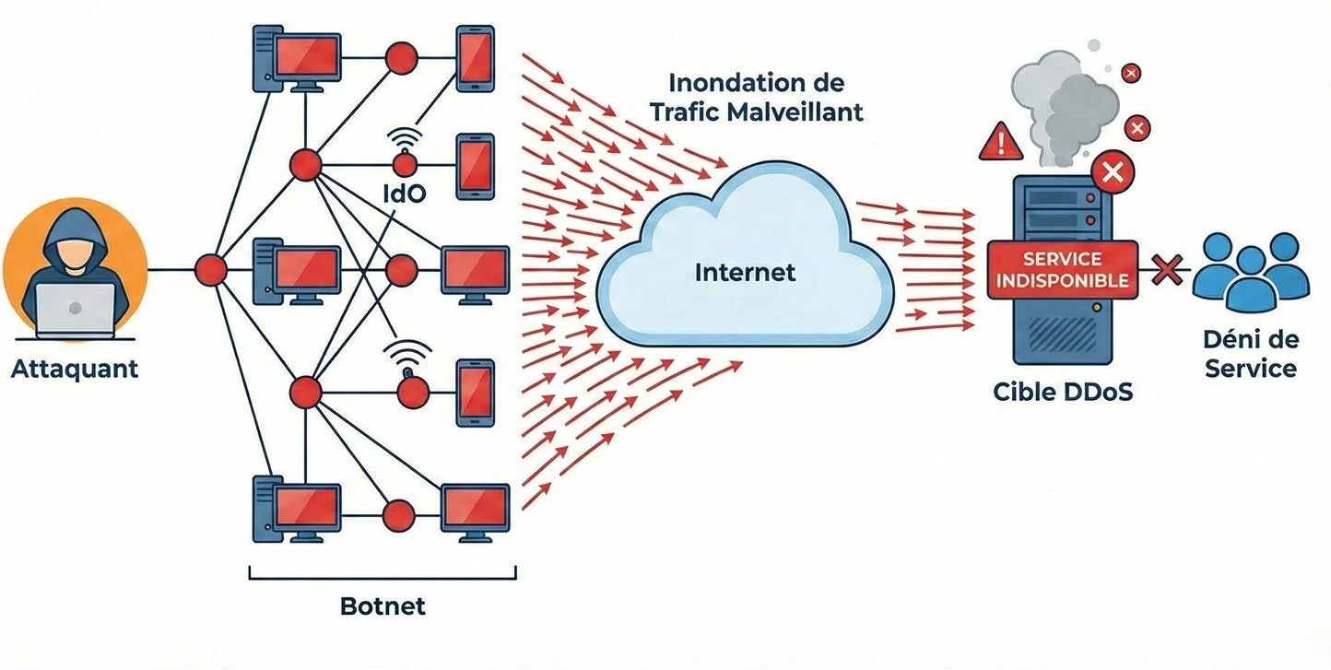
What is a DDoS attack ?
Dos : Deny of Service
  disrupts a single service
DDoS : Distributed Deny of Service
  makes a service unavailable by flooding it with traffic.
  Disrupt operations or extort money.
  more powerful, can take down entire infrastructures (including cloud).
Website outage
SLA activation
Chain reaction

Slide 29
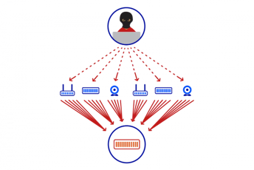
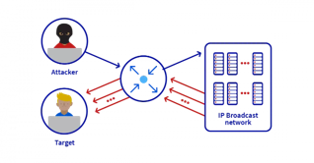
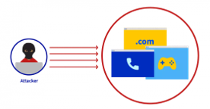
Types of DDoS Attacks
Volumetric attack
Protocol Attack
Application-layer (L7) attack
NZX 2020 3-day outage
Global hyperscaler 2020 20.6M req/sec
Memcached 2018 multiple companies hit

Slide 30
DDoS Mitigation
Analyze and detect
Closer view
Real mitigation
Detection
in-depth analysis & precise filtering
Deep analysis
Combined power
Multiple network links per region
Attacks processed without affecting legitimate traffic
multi-stage traffic filtering
only legitimate traffic reaches server
Most complex and difficult part
Notes:
Détection : analyse en temps réel du trafic via NetFlow, sFlow, etc. Si trafic suspect détecté → redirection automatique vers des nœuds VAC distribués (aspiration). Objectif : analyse approfondie et filtrage précis.
2. Analyse effectuée simultanément dans tous les datacenters
Puissance combinée : plus de 17 Tbps (2021)
Connexions réseau multiples par région + capacité surdimensionnée
Permet de traiter les attaques sans affecter le trafic légitime
3. Mitigation = filtrage du trafic en plusieurs étapes → seul le trafic légitime arrive au serveur
Partie la plus complexe et la plus difficile
Basée sur la technologie ACL, avec innovations sur architecture x86 et puces FPGA ultra-rapides

Slide 31
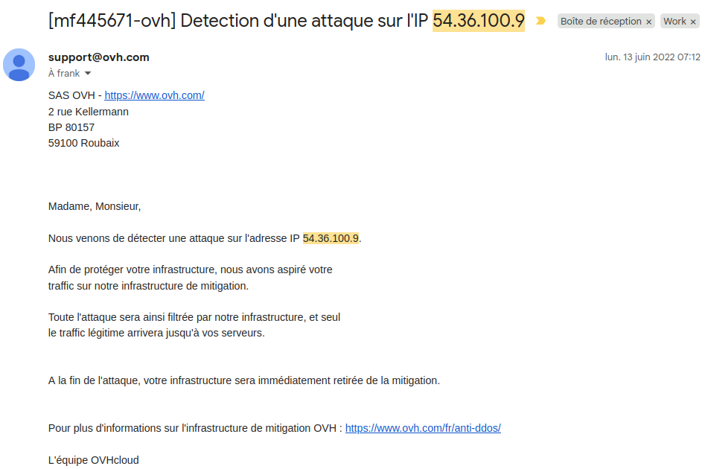
Hands-on case study

Slide 32
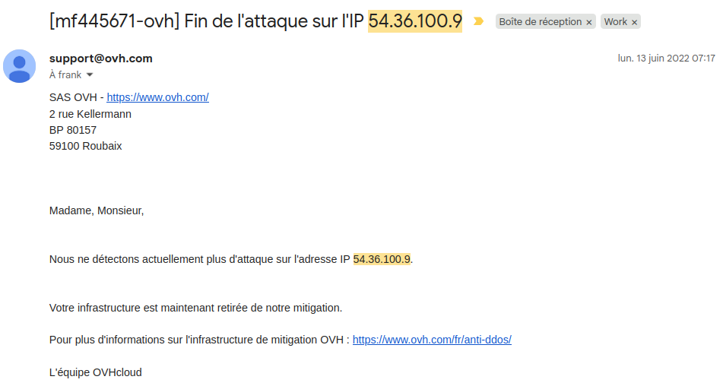
Hands-on case study

Slide 33
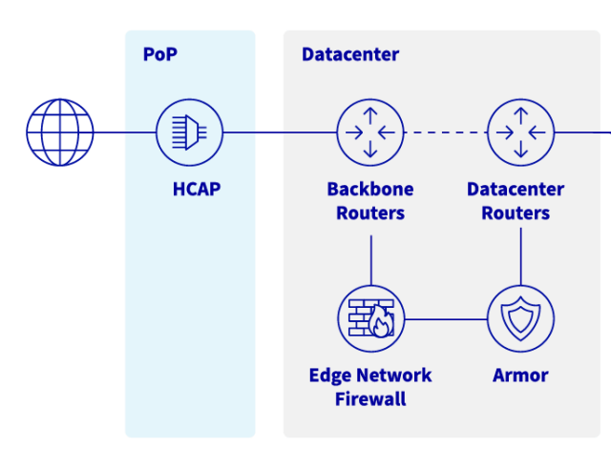

Host Infra : Security
HCAP : first line of def.
Offloads datacenter VAC
Can be rate-limiting
HCAP : Hardware Client Amplitude Policer

Slide 34
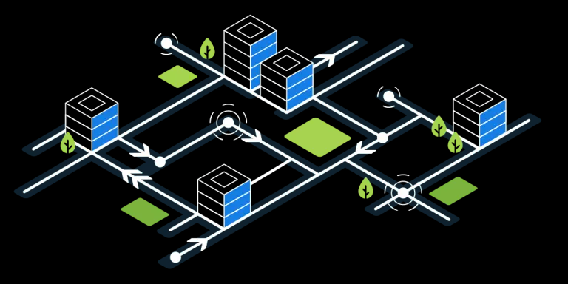
Host Infra : Backbone routers
Transports network traffic
Connects different networks
Chooses the best path

Slide 35
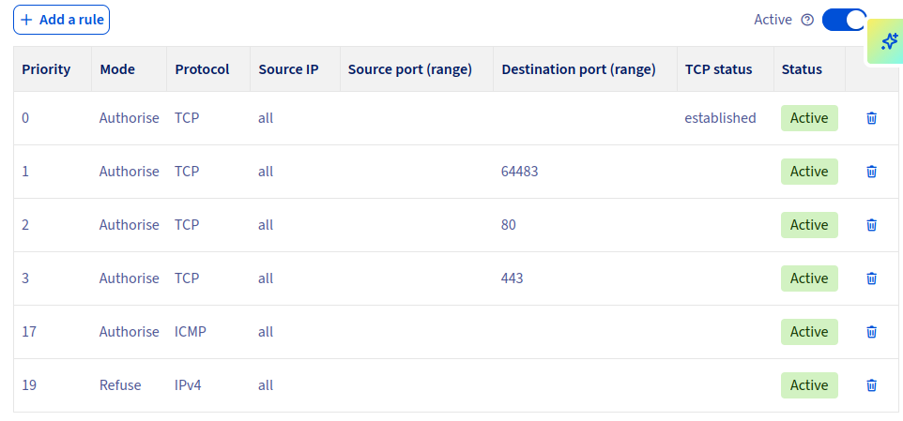
Host Infra : Edge Firewall

Slide 36

Host Infra : Datacenter routers
Receives incoming traffic
Routes traffic internally
Connects to servers and VPS

Slide 37
5. VPS Configuration

Slide 38
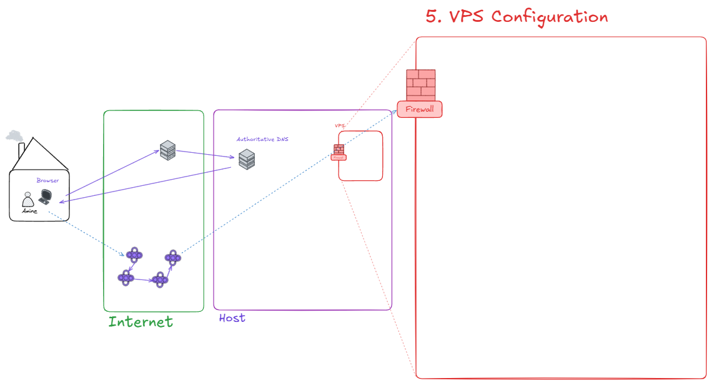
VPS Configuration

Slide 39
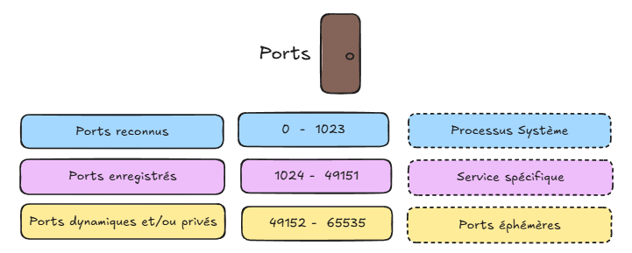
VPS Config : Port
Logical Port : Door Number
Recommandation IANA
Internet Assigned Numbers Authority

Slide 40
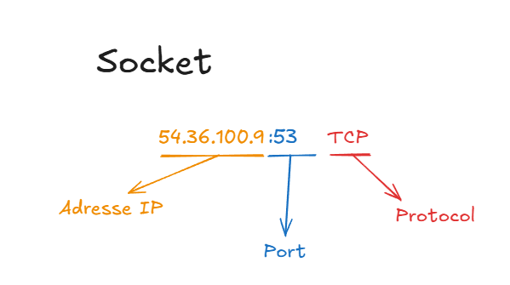
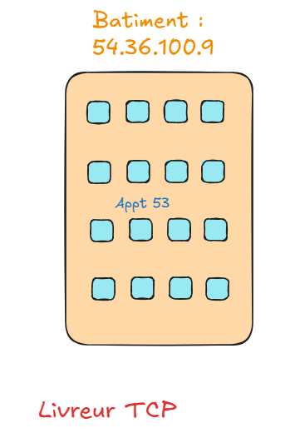
VPS Config : Socket
Analogy

Slide 41
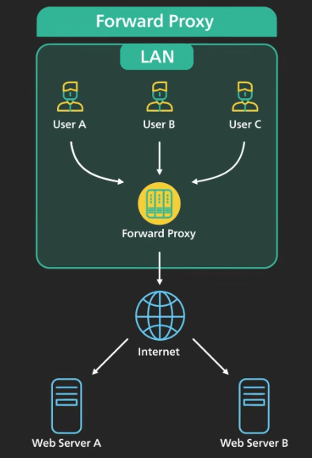
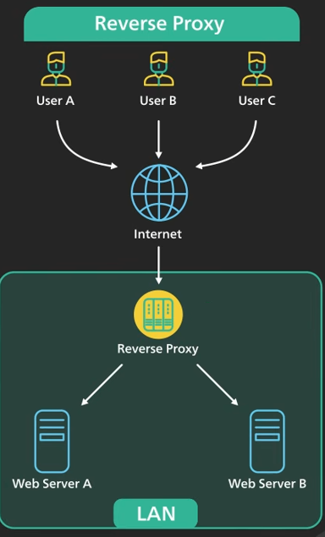
VPS Config : Proxy

Slide 42
VPS config : (Forward) Proxy
Why ?
Protects the client’s online identity
Bypasses browsing restriction
Blocks access to certain content

Slide 43
VPS Config : Reverse proxy
Why ?
Protects a web site
Load balancing
Caching

Slide 44
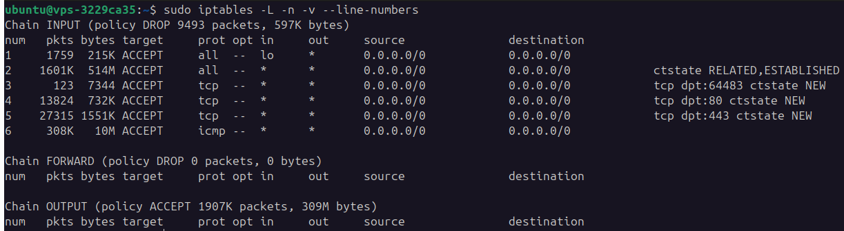
DNS Resolver - Theory
Hands-on case study
$ sudo iptables -L -n -v --line-numbers

Slide 45
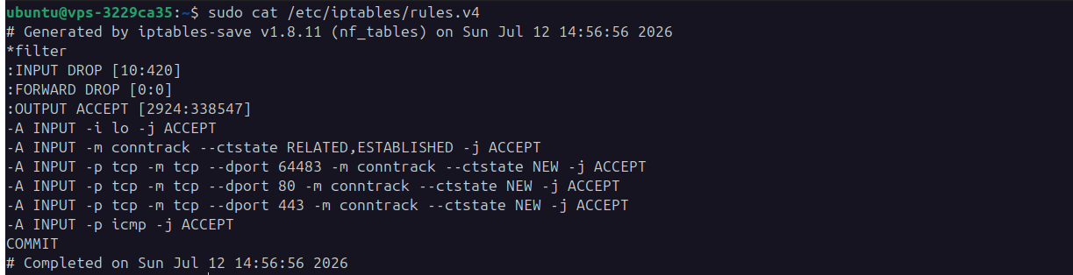
DNS Resolver - Theory
Hands-on case study
$ sudo cat /etc/iptables/rules.v4

Slide 46
DNS Resolver - Theory
Hands-on case study
$ ss -ltnp

Slide 47
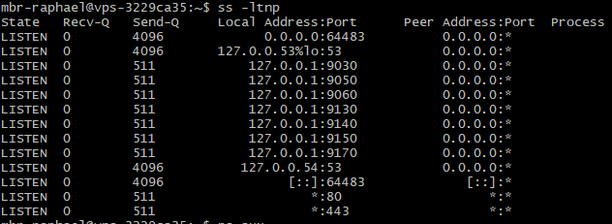
DNS Resolver - Theory
Hands-on case study
$ ss -ltnp

Slide 48
Ports : Practice
nmap ?

Slide 49
DNS Resolver - Theory
Workshop : port 443 closed
$

Slide 50
Questions

Slide 51
Ressources

