Slide 1

File-Rater
Robert Lowman
Dr. Maria Jump
CS315: Programming Paradigms
12/15/2016

Slide 2
Why Python?
- Object – Oriented
- Syntax is similar to Ruby
- Dynamically typed (different than my comfort zone)
- Peers

Slide 3
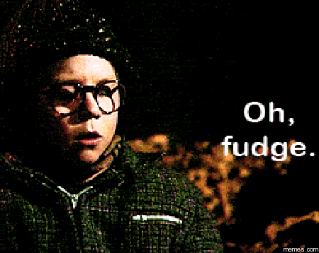
Do You Know What Your Child is Reading?
- Determines how mature the content of the given file is.
- Uses database that is modified by user in the program interface as reference for which words are considered mature and not.
- Developed in Python 2.
- Lower rating means less mature content, while a higher rating means the file contains more mature content.

Slide 4

What is considered a Bad Word?
Sexual Word
Violent Word
Mature Word
Adult Content/ Curse Word

Slide 5
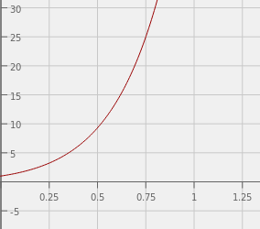
The Algorithm
(1+(x*b))^(10 + (x * b))
Rating
x = # of bad words / total # of words b = degree of bad word (set by user, default is 5 shown in graph)
x

Slide 6

Porter Stemmer
Sex, Sexy, Sexiest, Sexier = Sex
Stab, Stabbed, Stabber = Stab
F***, F***ed, F***er, F***s = F***

Slide 7

Rundown of Python 2
- Dynamically – typed
- Object - Oriented
- Automatic Memory – Management
- Interpreted
- Procedural

Slide 8
Comparing Python
Multiple Inheritance: Like C++, Python classes can have multiple parent classes
- Java/Ada can only have single parent class but inherit multiple interfaces
- Ruby classes have exactly one parent but can inherit behavior from multiple modules
- Scheme does not have the ability to have any parent classes
Multiple Assignment: Python, as well as Ruby, allows for parallel assignment
- Java only allows single assignment

Slide 9
Why Python Was the Right Choice
- Simplicity with Readability
- Substring functionality: if word.endswith("sses") or word.endswith("ies"):
returnValue = word[:-2]
- Not going to be used on mobile device
- Due to Object-Orienteering, easy to seperate responsibilities into classes between database code and file reading code
- List Capabilities

Slide 10
Challenges Faced
- Integer Division
- cur.execute() syntax:
cur.execute("DELETE FROM adult_content WHERE string = %s", (theWord,))
- Creating the rating algorithm
- Splitting the test files into separate directories
- Creating the most efficient Schema for the database

