Slide 1

Matplotlib for Publication
Rebecca Pitts

Slide 2
You may ask yourself...
Which plot format best communicates my research results?
How can I combine or overlay related data without sacrificing readability?
How do I work with poorly-supported axis scales?
How do I make my figures typographically consistent?
How can I make my figures more accessible to readers with colorblindness?
What might be lost if my figure is printed (e.g., in grayscale or resized for A4 paper)?

Slide 3
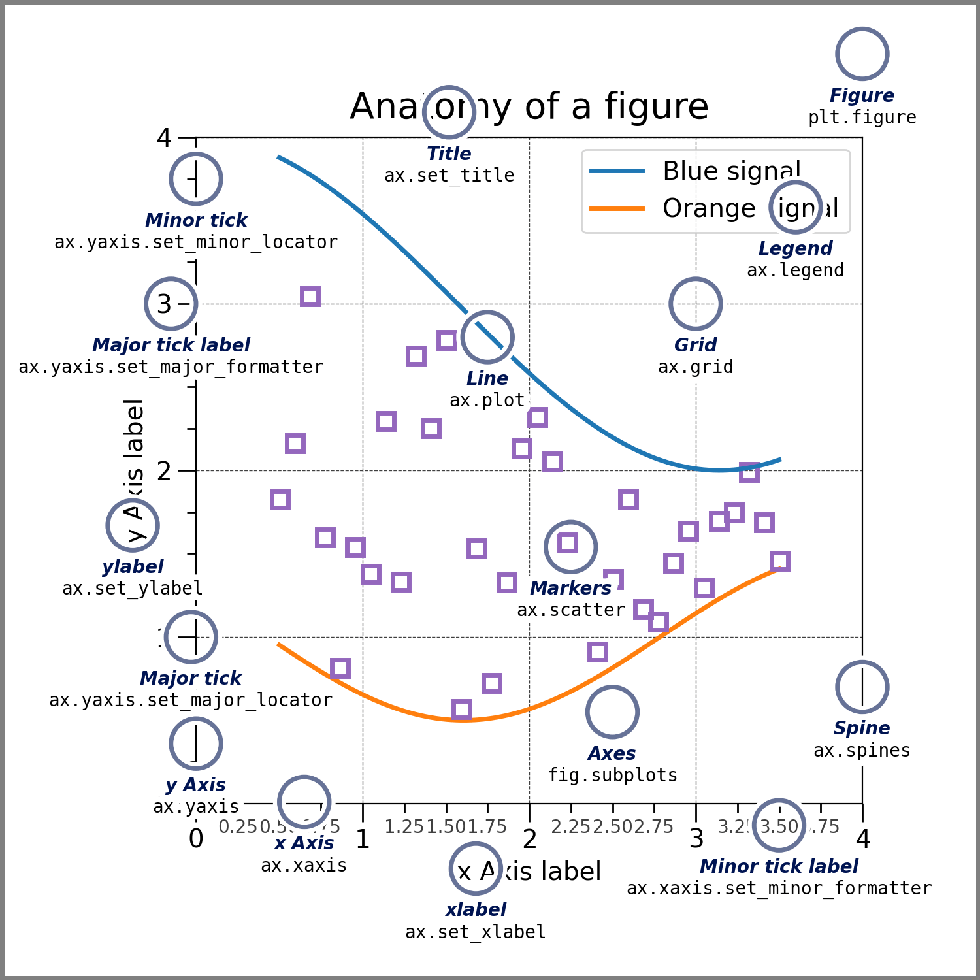
Definitions
Make sure you’re familiar with “args” (positional arguments, usually mandatory), “kwargs” (keyword arguments, usually optional), and the terms on this plot
2 ways to declare axes objects:
fig, ax = plt.subplots(nrows=nrows, ncols=ncols, **kwargs)
fig = plt.figure(**kwargs)
ax=fig.add_subplot(nrows, ncols, n)
Former is preferred and better documented. Use plt.plot() mainly for quickly viewing single datasets.
Notes:
Note also that when you see or hear “args”, that refers to positional arguments, which are often but not always mandatory. When you see or hear “kwargs”, that means “keyword arguments”. Those are almost always optional.

Slide 4
Overview
PART I
PART II
When choosing a plot type, consider:
The shape of your data
The number of parameters or dimensions
The number of points
The distribution of data in the parameter-space
The most printworthy figures have:
Typeset, easily readable text
Colorblind-friendly color maps and palettes
Consistent style throughout your paper (same fonts, grids, etc.)
Helps to use a .mplstyle file!

Slide 5
Part 1. Choosing a Plot Type

Slide 6
Standard representations for some data types:
Data type | Plot Format
Probabilities | Histograms or Kernel Density Estimations (KDEs)
Budgets & Fractions | Proportional area charts (pie chart is most [in]famous)
Vector fields | Quiver plots
Spectra | Line of intensity vs frequency, wavelength, or wave number
Elevation or Intensity | Contour maps or (pseudo)color images

Slide 7
If your data don’t fit the mold, consider:
Regularity
Dimensionality
Quantity
Density
Are data randomly dispersed or on a regular grid?
How many spatial dimensions or free parameters are there?
How many data points or models do I have to show?
How much do my data overlap each other or ticks/grids?
1
2
3
4
*Note: I assume there is a general understanding of which plots are fit for purpose for qualitative vs quantitative data.

Slide 8
Regularity
N-D array of values on a regular grid → image, field, or surface-like formats (2D or 3D projections)
Challenge for 3D: find clearest, most informative viewing angles/slices that fit in your article
  Not much to say here: it’s trial and error.
Online-only content: recommend interactive or animated graphics for 3D or temporally varying data
Notes:
Most science images have metadata that require field-specific packages or H5Py to handle, but I’ll show a demo of PIL (aka Pillow) for basic jpeg, png, or svg files, and how to draw ellipses on top.

Slide 9
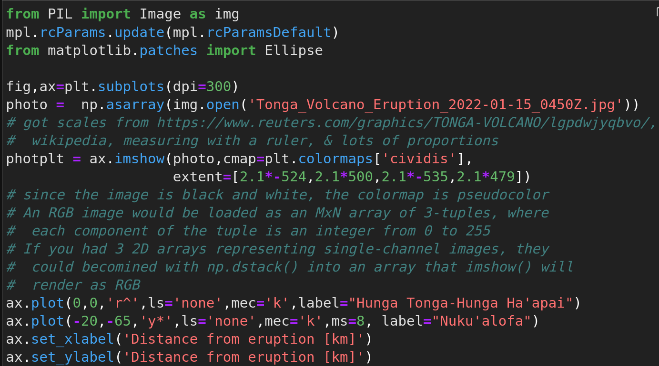
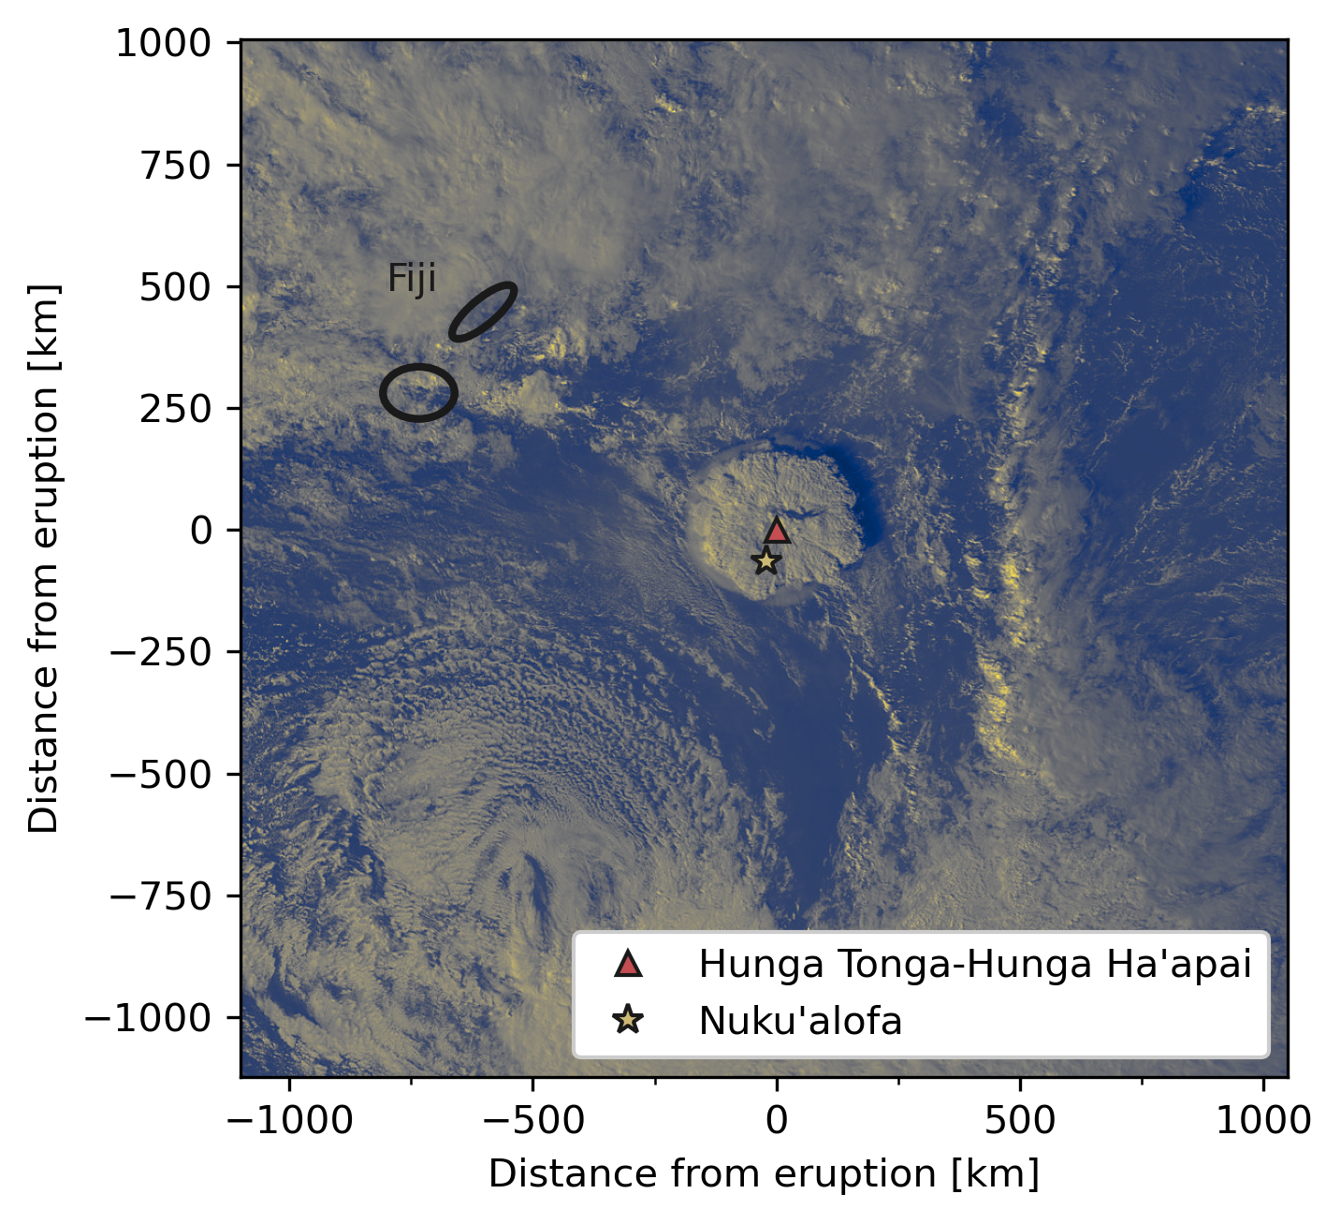
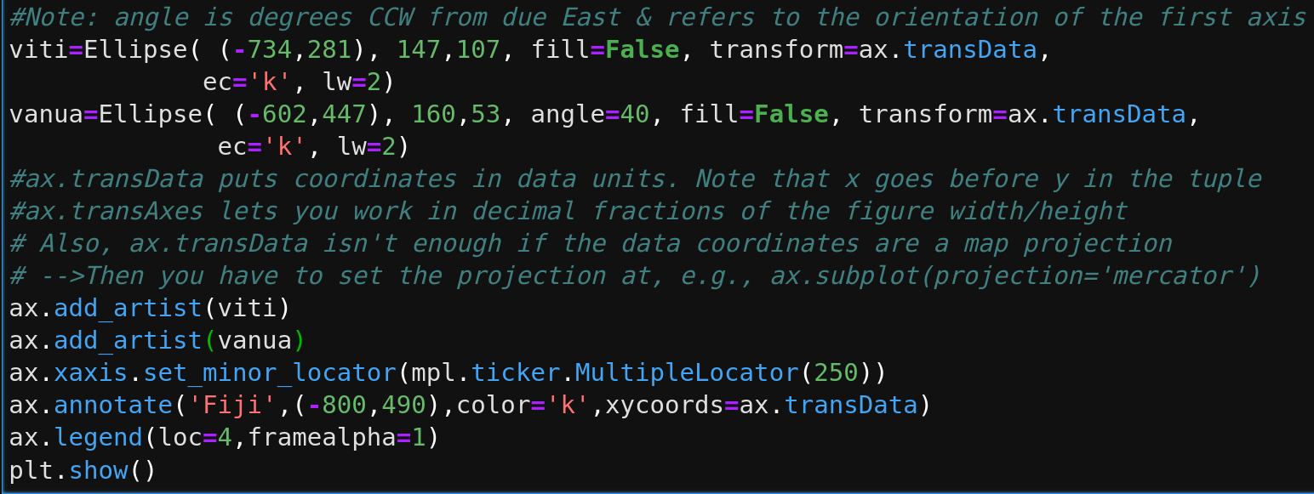
Image demo
Notes:
Imshow accepts 2D arrays, 3D arrays of depth = 3 where every xy location has an associated RGB 3-tuple, and 3D arrays of depth = 4 where the first 3 terms at each xy position are RGB specifiers and the 4th is a fractional opacity term. If you input a 2D array with a color map that isn’t just shades of gray, the result is what’s called a pseudocolor image.

Slide 10
imshow() vs. other image-like formats
Function → | imshow() | pcolormesh() | pcolor()
Pixel shape | Square | Any quadrangle | Any quadrangle
Accepts RGB(A) input? | Yes | Yes | No
Supports masks | Values only | Values only | Coordinates & values
Supports map projections | Yes | No | No
# of interpolation options | 19 | 4 | 3
Relative processing speed | Fastest | Medium | Slowest
Notes:
Pcolormesh is good for simulations where the grid cells have 4 sides of varying lengths or degrees of curvature, and could be advantageous if you have a large heat map and need to save space vertically.
Basically the only advantage of pcolor is it eliminates edge artifacts by not drawing masked elements, whereas pcolormesh still draws masked rectangles, but sets the color to transparent.
Do we have anyone here in astrophysics? Good, if you don’t already know, imshow supports not only a variety of geospatial projections, but also astronomical coordinate systems with AstroPy’s world coordinate systems module.

Slide 11
Other Grid Formats
3 options for vector fields: streamplot(), quiver(), and barbs() ( wind).
Most “good” color maps will make some quiver() or barbs() arrows hard to see (colormaps work OK with streamplots). Recommendations:
  Plot black arrows on translucent imshow() colormap of vector magnitudes (demo incoming)
  Put quiverkey() outside plot area - no clean way to set the background color for the entire key, only the text.
1 option (technically 2) for irregular grids: tricontour[f](). Otherwise must interpolate to regular grid (may have to anyway if data are in logspace)
Notes:
*barbs() is for meteorologists

Slide 12
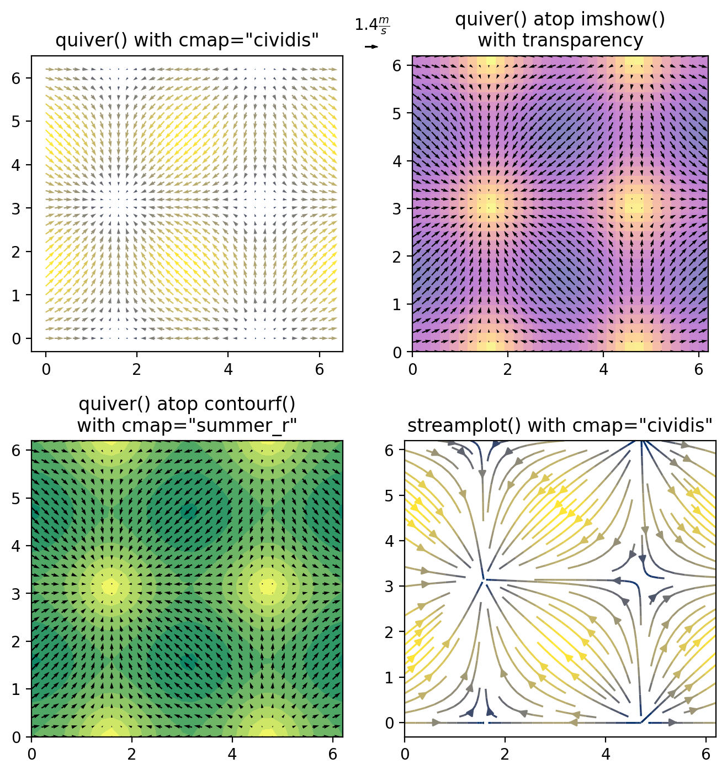
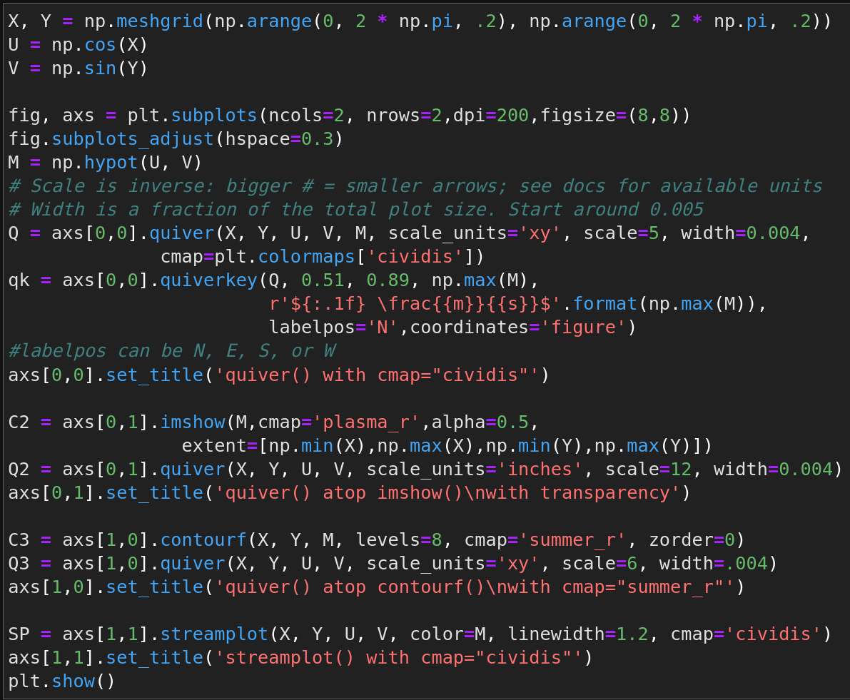
Quiver and streamplot demos

Slide 13
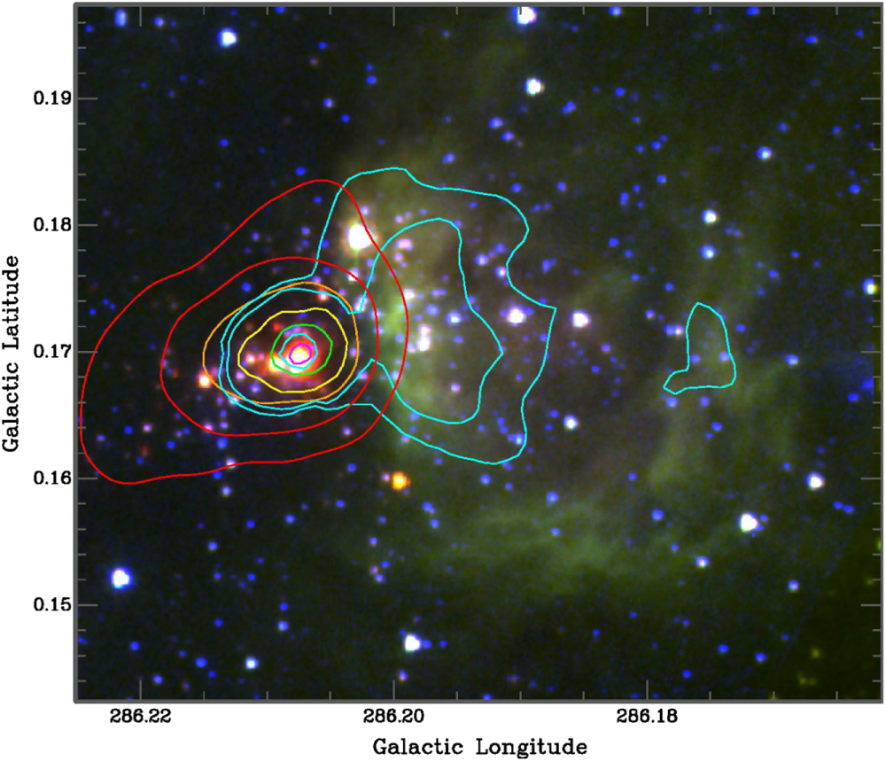
Dimensionality - Unstructured Data
Greatest range of options for 3(-4) dimensions or parameters. You could...
Add or overplot with extra axes
Use different markers, colors, or line styles for extra qualitative variables
Group, stack, color, and/or crosshatch bars or units of a proportional area chart
Plot contours or markers on a RGB image
Etc.
Notes:
The figure at right is a rather extreme example from my and my PhD advisor’s first paper

Slide 14
Let’s start with a non-example (+ alternatives)
Why should you NOT use pie or donut charts? Per many data science consultancy studies and other institutions...
Pie & donut charts are inefficient (low info for space occupied)
Hard to add other parameters except by grouped colors
Humans are better at judging relative lengths than angles
Pie charts are easier to read when categories are ordered by fractional size, which may conflict with more natural orders, e.g. alphabetical or by numerical brackets.
State of belonging less important than relative or absolute quantities

Slide 15
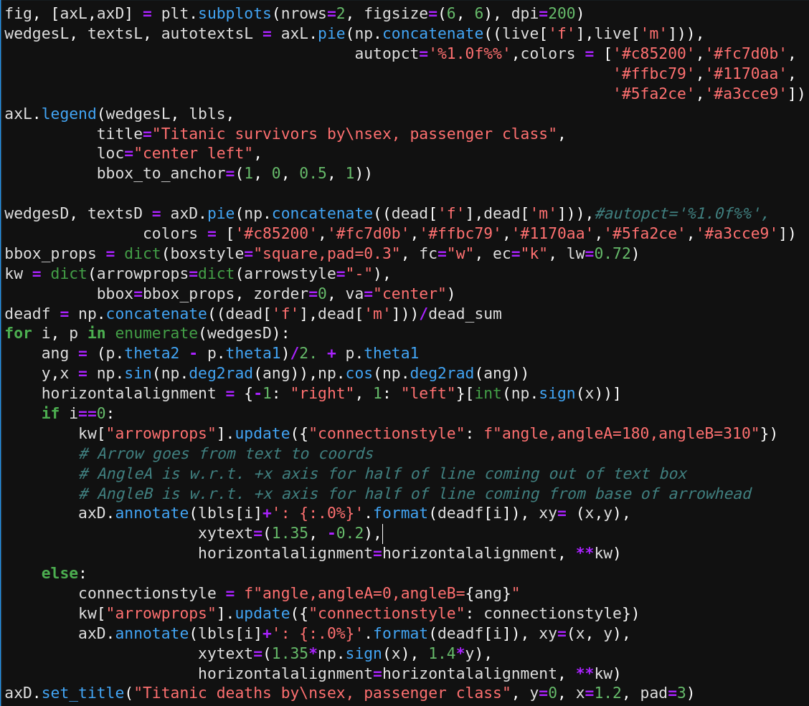
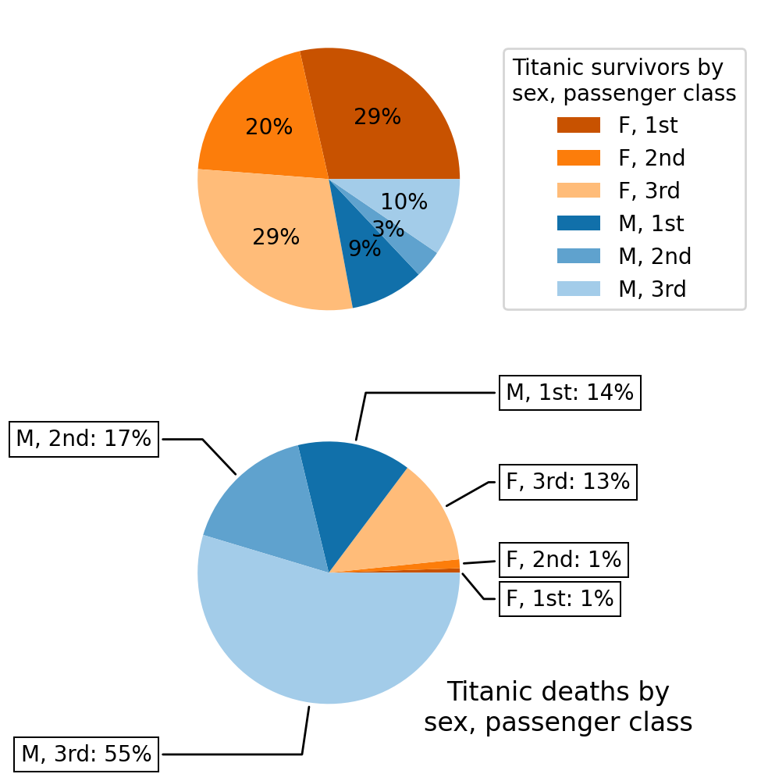
Pie chart code and comparison

Slide 16
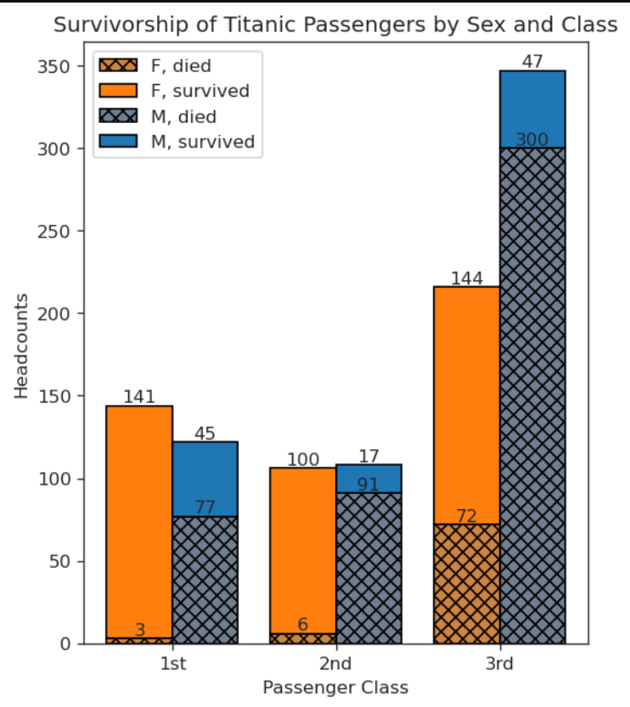
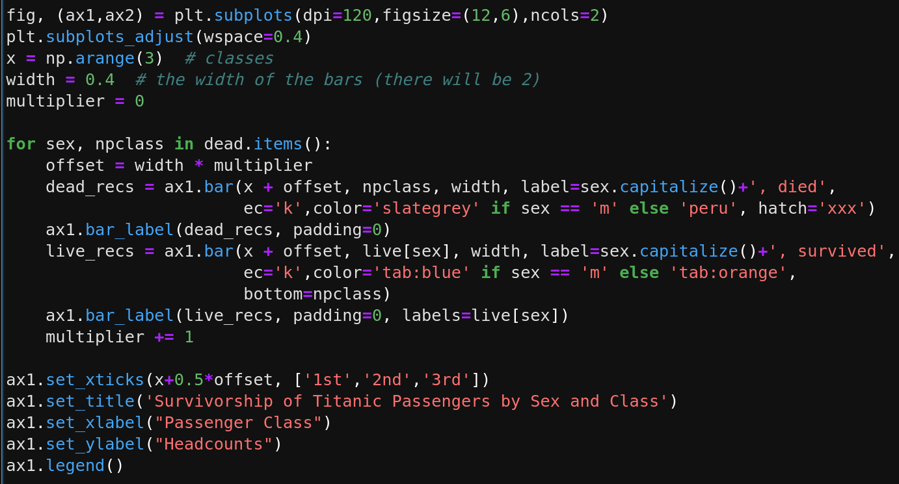
Better Alternatives: Bar Charts
If you’re more interested in raw counts…

Slide 17
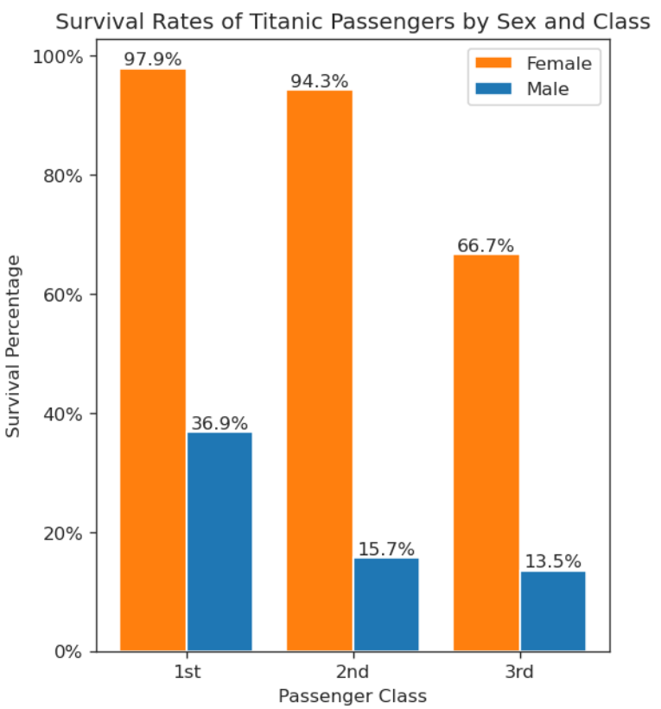
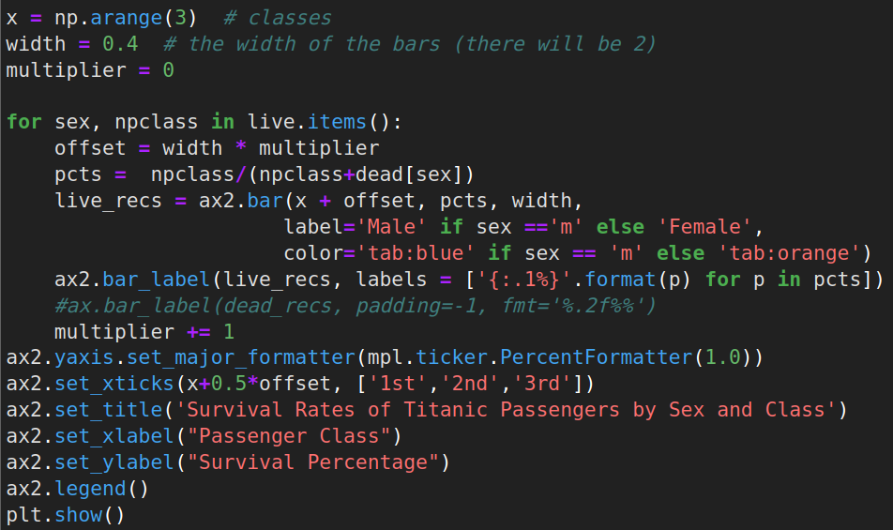
Better Alternatives: Bar Charts
If you’re more interested in percentages…

Slide 18
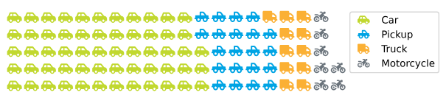
Other rectilinear proportional-area charts
2 other good options:
Treemaps (next slide)
Waffle charts (example below)
Both much easier to make with external packages: Squarify (treemaps) & PyWaffle (used below)
https://github.com/gyli/PyWaffle

Slide 19
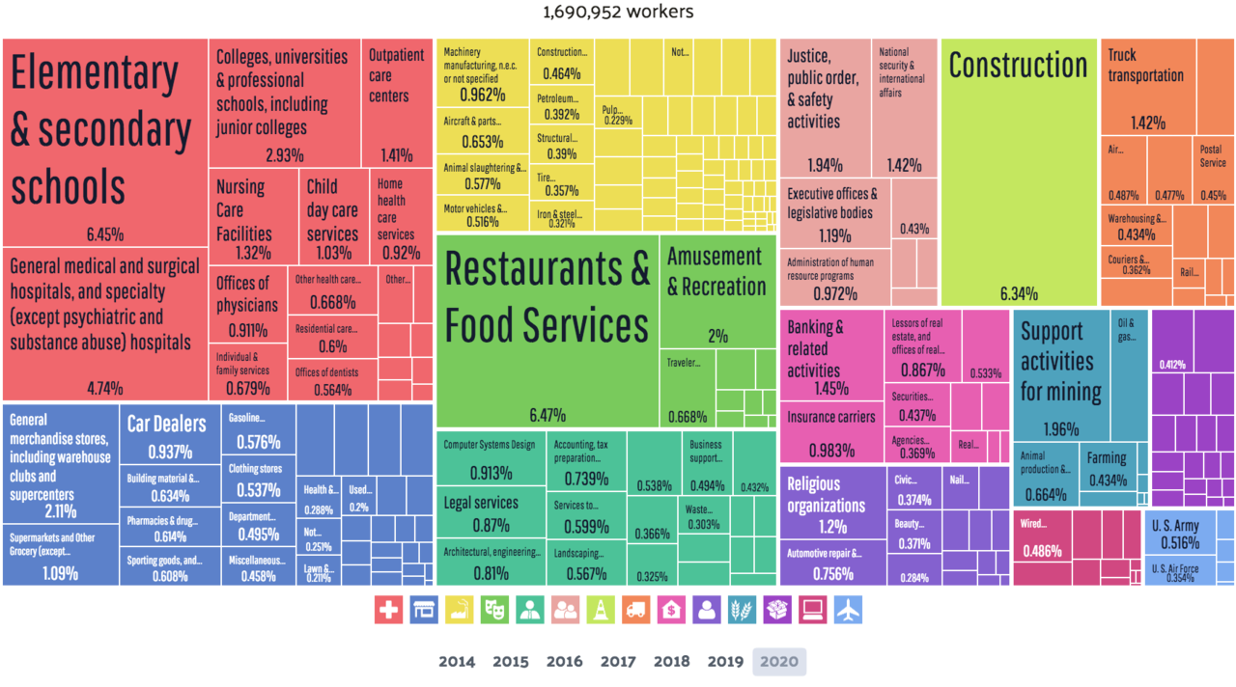
Treemap of employment in Oklahoma in 2020 (public)

Slide 20
Dimensionality - Unstructured Data 2
More dimensions/parameters can make your choice easier because:
Display options that can accommodate all variables are limited.
Journals have hard size and resolution limits.
For 4-6 numerical parameters, if data are scattered or include outputs of Markov Chain Monte-Carlo (MCMC)* simulations, corner plots or pair grids are typically best - & best made with extra packages
*MCMC simulations are a way of modelling the probability distributions of model parameters, both individually and given the distributions of other parameters, in the Bayesian framework of statistics where, instead of the data, it’s the model that is assumed to be uncertain.
Notes:
MCMC simulations are a way of modelling the probability distributions of model parameters

Slide 21
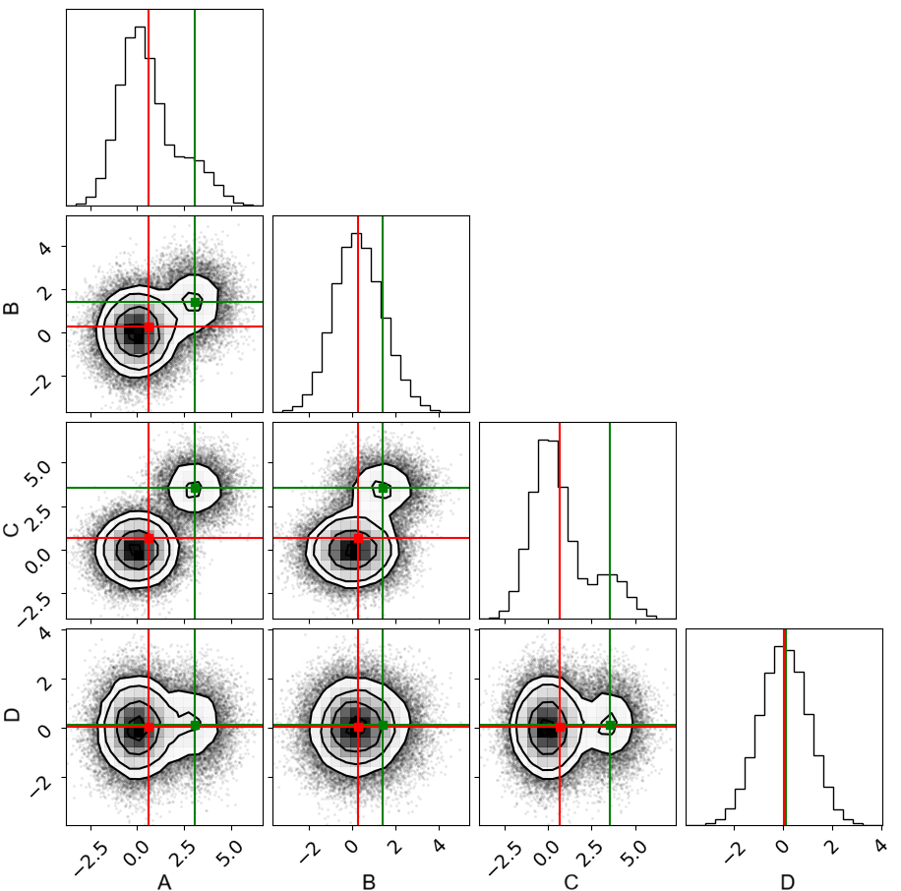
Corner Plots
Standard plot format for MCMC sims of any size
Good for 2D projections of large datasets with up to ~5 parameters
Lightweight external package - corner.py is pure matplotlib
Note switch from scatter to contours at density threshold

Slide 22
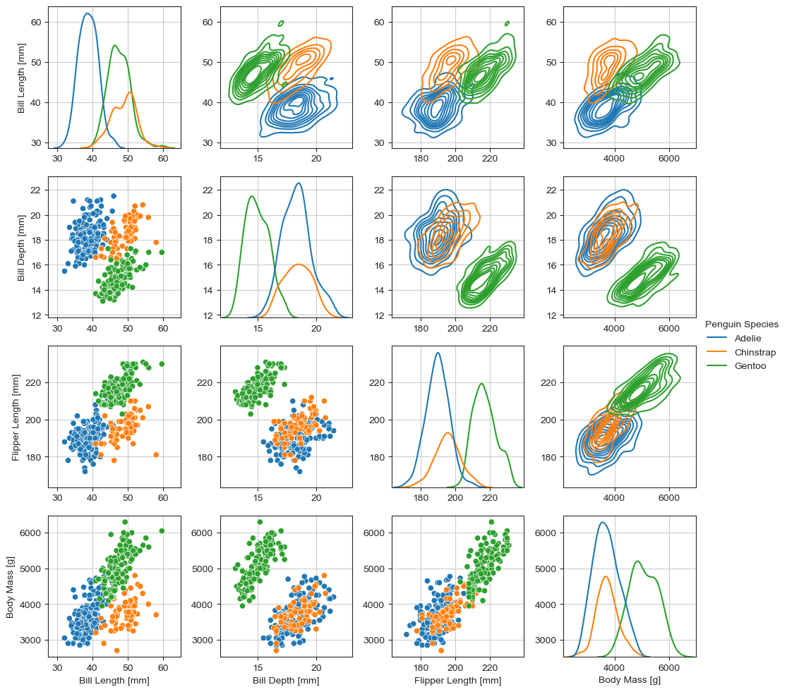
Pair Plots/Grids
Easy to make with Seaborn package - if you know Pandas
Ideal for numerical variables + 1 categorical variable (hue)
MANY format options for diagonal, upper & lower off-diagonal panels
Downside: have to override axis labels to typeset them well (tricky)

Slide 23
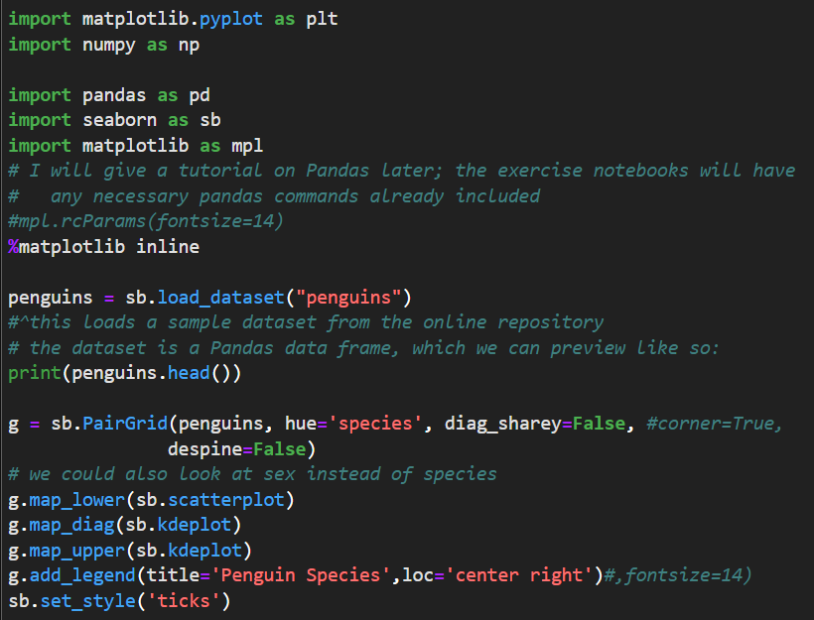
seaborn.PairGrid() - main

Slide 24
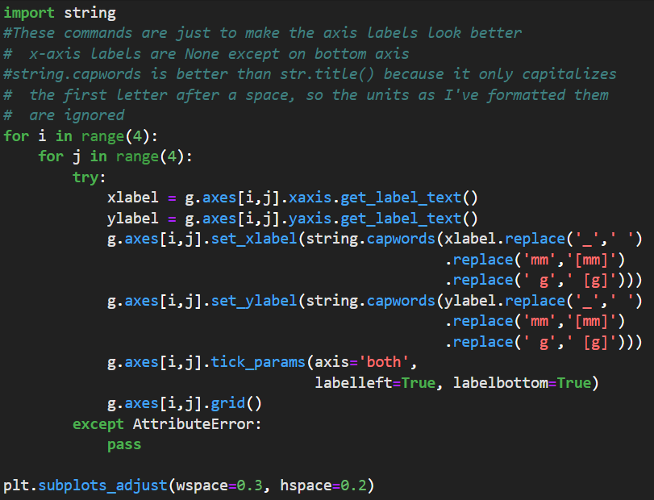
seaborn.PairGrid() - typesetting

Slide 25
Larger ND Parameter Spaces
Options decline steeply for >6 parameters
For ~10-30 numerical parameters, only a heatmap of correlation coefficients will fit
  Journal-mandated minimum font size sets hard upper limit
Ask yourself: do I really have to plot that many variables on one figure?
If you absolutely must, use either imshow()-based heatmap (more flexible) or seaborn.heatmap() (more straightforward if you know Pandas)

Slide 26
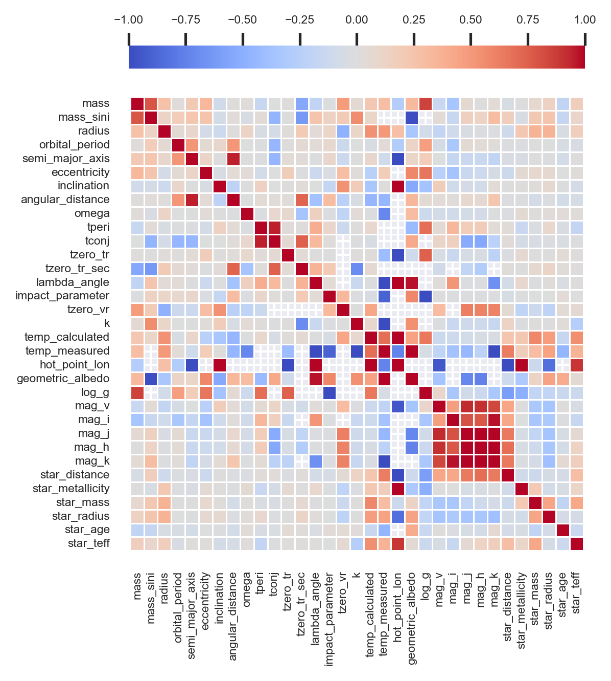
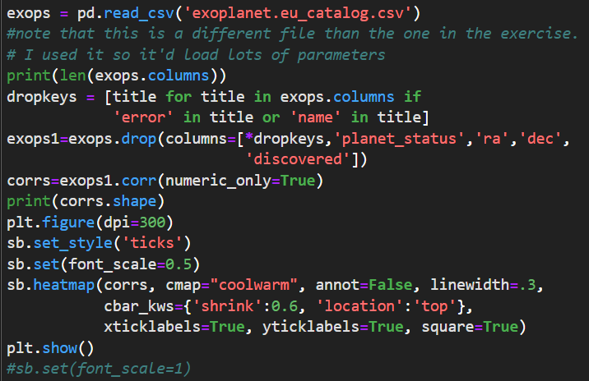
Heatmap demo
Notes:
Again, you should not do this unless you and your co-authors agree that it’s absolutely necessary

Slide 27
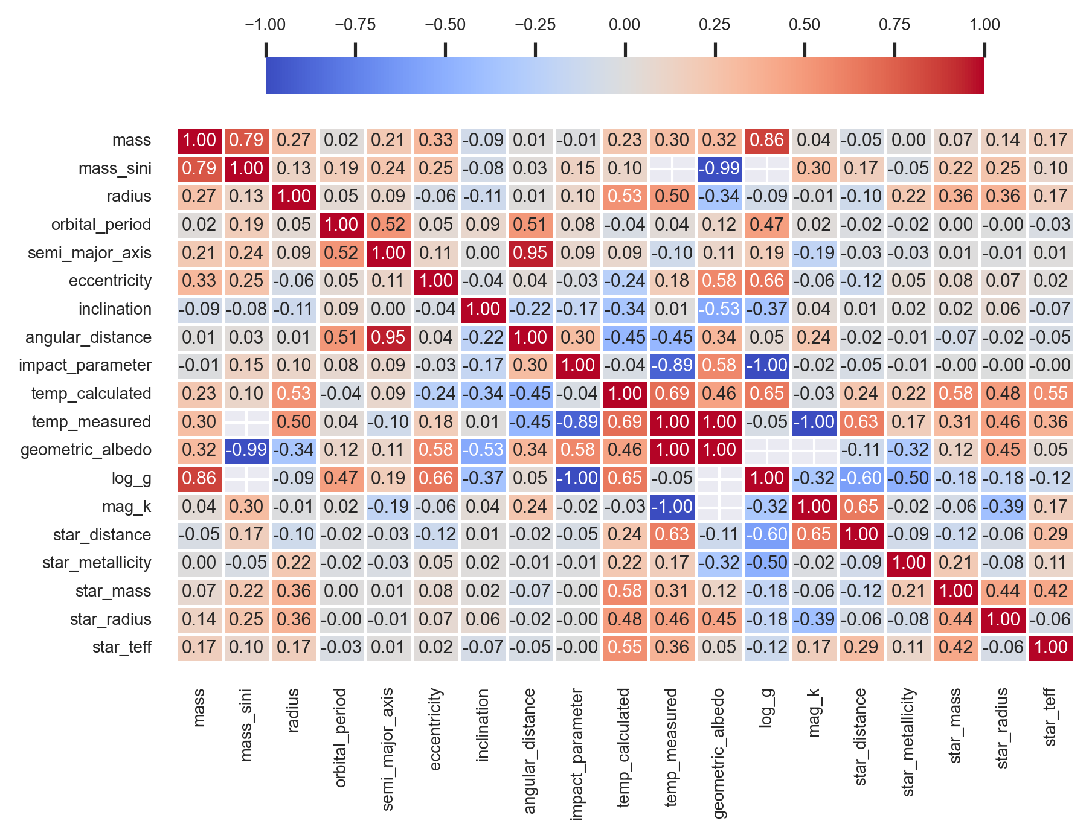
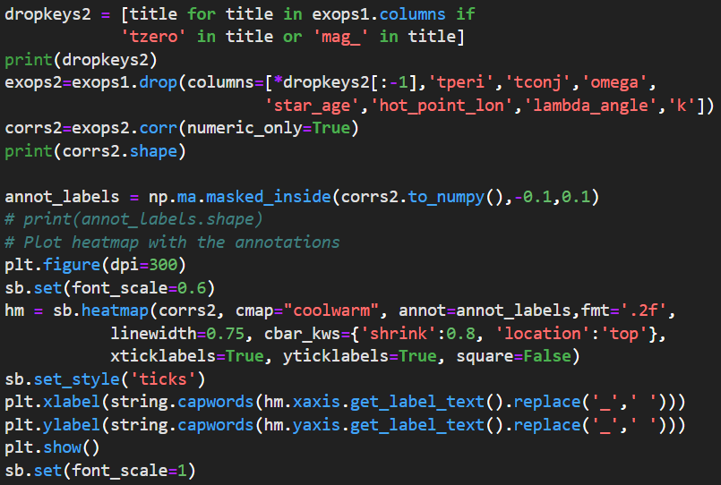
Typesetting heatmap() is even harder than for most seaborn modules - simple override doesn’t work
Better if you don’t plot more variables than heatmap() can annotate

Slide 28
Quantity & Density
Best approach depends on:
Number of data points or lines
Distribution across parameter space
  This also determines if or where you include a legend
What other data/models need to be shown on the same plot
What features of the data or its distribution you want to emphasize

Slide 29
Quantity & Density
Lines
Functions/Models (continuous)
Surfaces
Your Data
Scatter plots
Observations (usually discrete)
Density or intensity plots (histograms)
Notes:
In the interest of time, for the rest of this section, I’m only going to discuss data that is describable by this flow chart.

Slide 30
Overcrowding is the biggest risk you face with scatter plots or plots featuring multiple models.
When adding data to a figure that other research groups have contributed to, it is OK to deemphasize other data & highlight your own.

Slide 31
To emphasize your contributions to a common plot, consider…
Decreasing the opacity (alpha) or marker sizes of other data.
Showing error bars only for your own data.
Coloring your data black & all other data lighter colors, e.g. with a custom color cycler*.
  *Module cycler works with colors & line styles, but adding a marker cycle disables the whole cycler instance → use itertools.cycle
Making line(s) you want readers to focus on thicker & more solid, or diminishing less important lines by making them dotted.
Notes:
You can also keep your data on top by setting a kwarg called

Slide 32
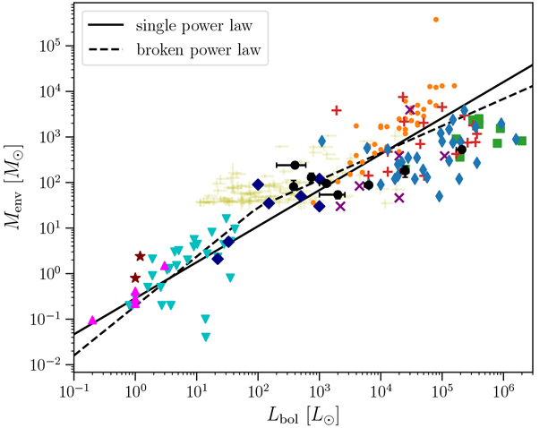
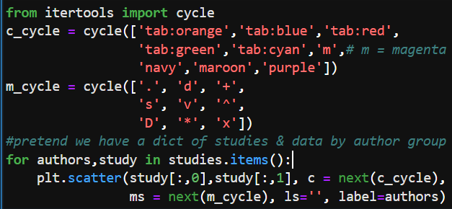
I set the markers & colors in the ASCII table, but this is how you might handle it in a script:
Example plot from R. L. Pitts et al. 2021b using many of the previous tips (data & markers were labelled in a caption)

Slide 33
Scattered Data by the Numbers 1.
A few × 10 to a few × 100 data points
Vary color (c kwarg of scatter()) &/or marker style to denote different datasets or values of a categorical parameter
Only color by numerical 3rd parameter (cmap kwarg of scatter()) if it’s correlated with at 1+ axis parameter
If feasible, vary colors & markers together for colorblind accessibility & so data are still distinct in grayscale
  Keep in mind: some markers are hard to tell apart

Slide 34
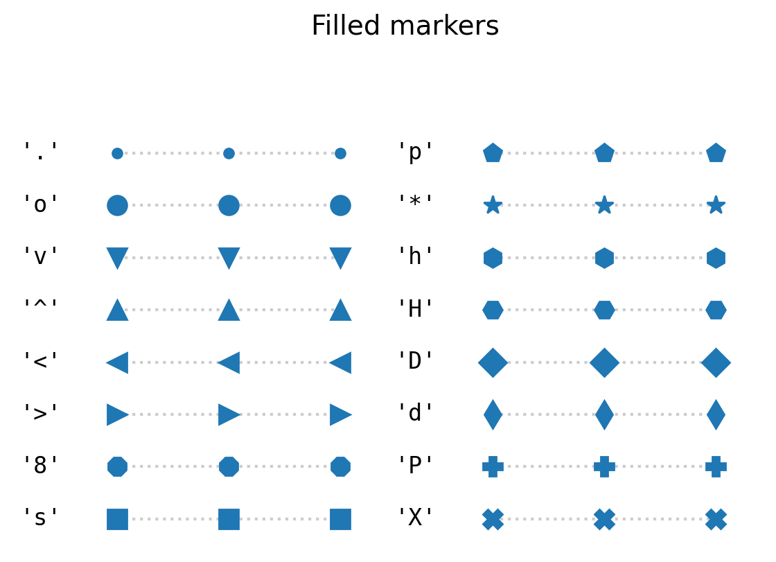
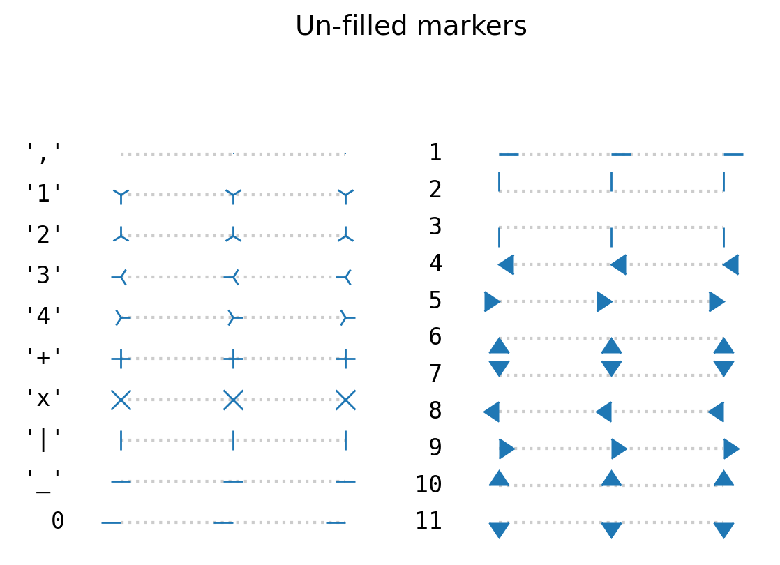
Avoid reusing shapes with different rotations (can be problematic for dyslexic readers), or octagons with big circles
“+” can be confused for error bars if error bars don’t have caps.
Reserve | & – for specialty plots (event plots, rug plots, etc.)
Notes:
https://pubmed.ncbi.nlm.nih.gov/16306024/
Should this go in global constraints part? Should Part 2 be Part 1?

Slide 35
Scattered Data by the Numbers 2.
A few × 100 to a few × 1000 data points
Recommend scatter() with transparency or histogram with logarithmic bins if outliers are important
Reduce scatter plot opacity by setting alpha kwarg between 0 and 1 (usually 0.2-0.5)
Many rules for histogram binning, but generally, n data points should be distributed over n^{1/2} to n^{1/3} bins
Minimally overlapping distinct datasets can be shown with different colors or as line contours (harder)

Slide 36
Scattered Data by the Numbers 3.
1000s of data points or more
Use histograms, Gaussian Kernel Density Estimations (KDEs), or contours, or corner.hist2d() if outliers are important
Gaussian KDEs ≈ histograms smoothed by a treating every point as a bell curve of unit height and width = kernel bandwidth & summing them up
  Pros: continuous functions, essential for smooth contours of scattered data
  Cons: require SciPy or Seaborn; can be computationally expensive

Slide 37
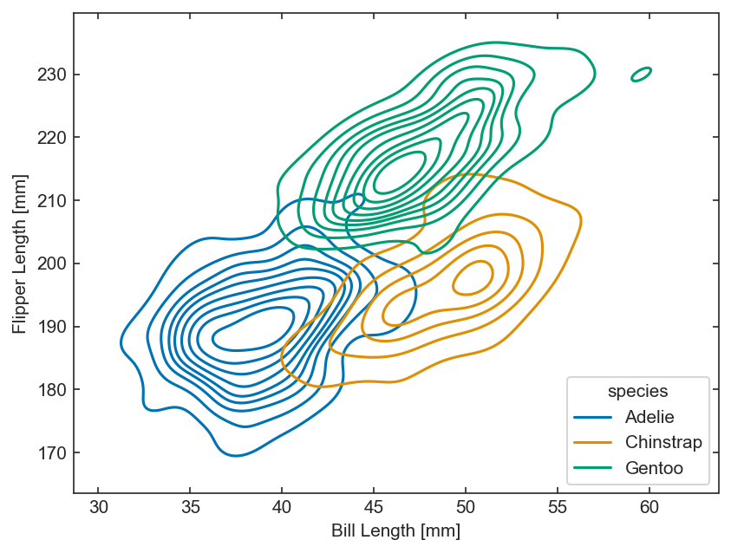
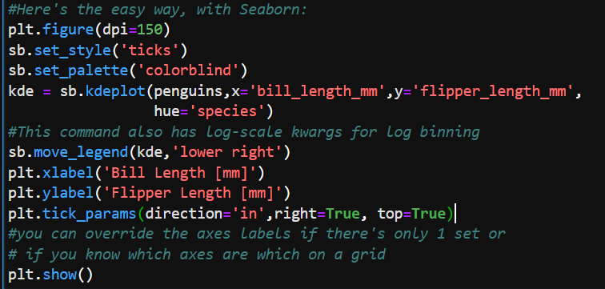
KDE example with Seaborn

Slide 38
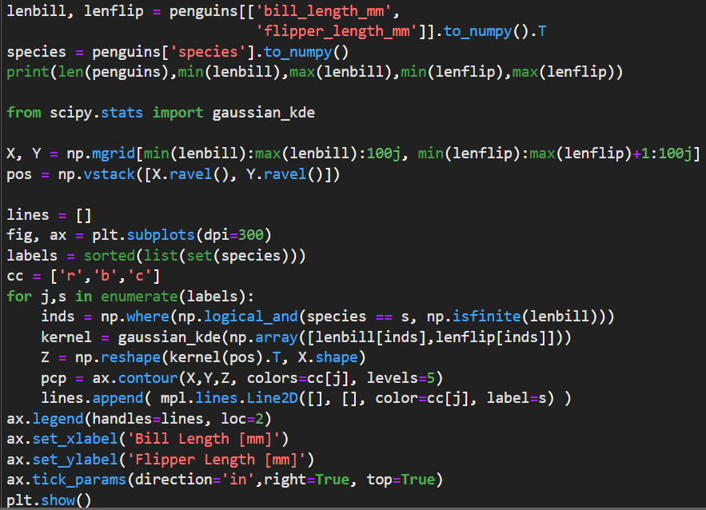
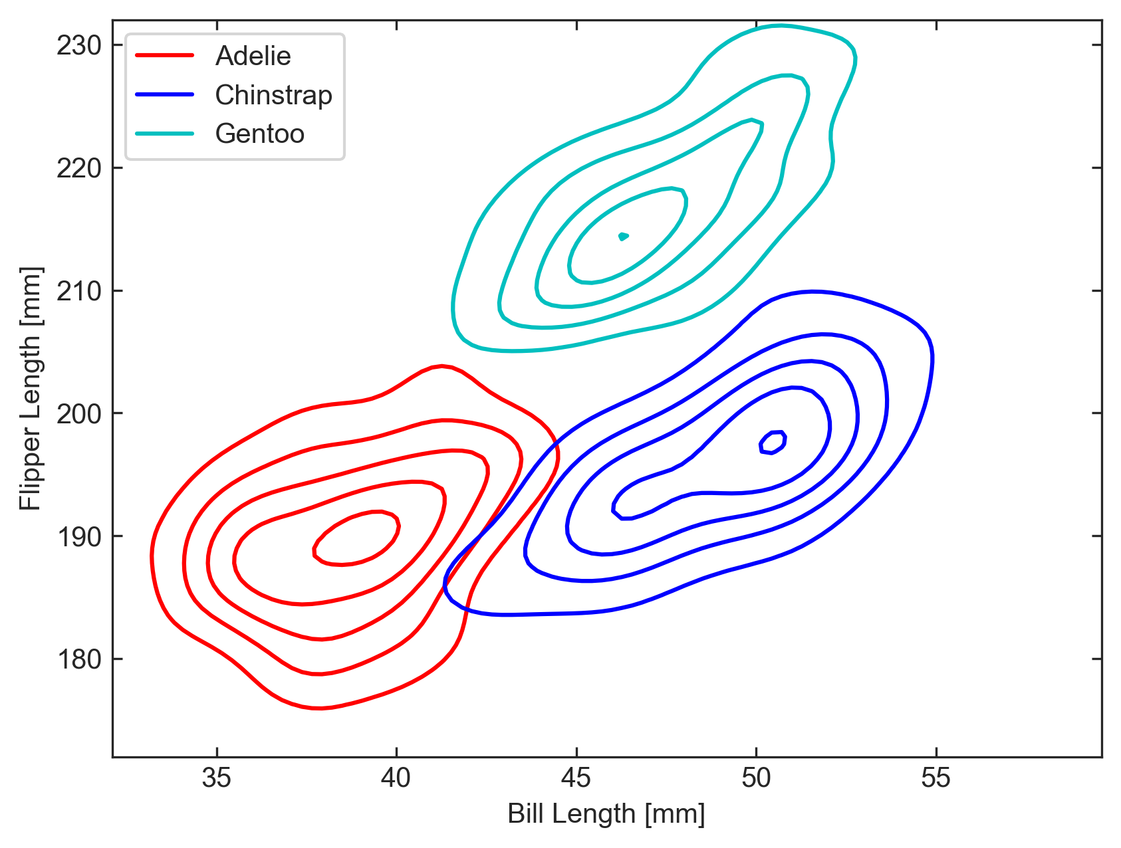
KDE example with SciPy
Notes:
You can kind of ignore the first few lines since that’s what was required to convert the pandas dataframe to numpy arrays
The empty [] in the lines.Line2D() are the x- and y-dat, of which there aren’t any since this is a proxy artist.
This SciPy approach takes 6 lines minimum, where the Seaborn approach took 1, not counting anything to do with legends for either

Slide 39
Notes on Contours
Matplotlib's contouring functions ([tri]contour[f]()) can’t accept scattered data directly; must first make a KDE on a regular grid, & contour that (don’t try to contour histograms!)
Filled contours ([tri]contourf()) are more intuitive, less confusing if you need to plot linear or scattered data on top.
Line contours are better to overlay on images, other contours, or other continuous 2D distributions.
Legends are not natively supported for contours: if you put >1 set of contours on 1 plot, you have to make a proxy artist
Notes:
A proxy artist is something I had to make in the previous slide. Technically tricontour[f]() can take scattered data, but the internal interpolation method is not very robust, so most of the time you still have to interpolate onto a grid.

Slide 40
Speaking of lines…
Max # of lines per figure depends heavily on other content.
Lines with error margins &/or underlying scattered data: 4-5 curves depending on whether overlying data have color
Lines without error margins & no underlying scattered data:
  8-10 independent curves of similar importance
  10-20 curves on a hierarchy with minimal crossing
  Many if data are correlated & evolving with a 3rd variable (e.g., monthly mean temperatures over years - let older curves fade out)
Notes:
Example of that last one: https://climate.copernicus.eu/july-2023-sees-multiple-global-temperature-records-broken

Slide 41
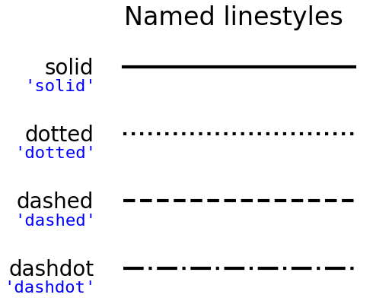
Lines Cont.
Line styles vary in clarity → unspoken hierarchy to consider for your narrative:
Solid lines (ls='-'): clearest → most important
Dashed lines (ls='--') (could argue if #2 or #3)
Dash-dotted lines (ls='-.') (↑ ditto)
Dotted lines (ls=':'): easiest to lose among scattered data → least important

Slide 42

Uncertainty Handling
# of data points | Best error bars/limits format
Up to a few 10s | Error bars/limits on every point, with caps if large
Few 10s to ~100 | Error bars on every point; omit caps
Few 100s | Error bars on every nth point (errorevery kwarg)
Many 100s & up | Representative error bar(s) in an unoccupied corner
For lines: favor fillbetween(x, yerr_lo, yerr_up) in a light or translucent color with the main line on top. Separate upper & lower margin lines are less intuitive.
Notes:
For moderately large error bars, caps help make it clear they are error bars and not the + marker, but they can contribute to clutter. Also, if you have both x & y errors & the error bar lengths are smaller than the cap sizes, the caps can be confused for error bars in the orthogonal direction. It’s data dependent.

Slide 43
Complex error bars
Error bars can be tricky if asymmetric or mixed with limits.
lolims, uplims, xlolims, & xuplims kwargs take boolean mask arrays.
Where limit masks are True, xerr &/or yerr arrays must still have values for limit arrow lengths.
If error bars are asymmetric, wherever there is a limit, xerr or yerr must have a value >0 in the direction that the limit arrow points.
  Any value on the other side will be ignored unless it raises a ValueError (e.g. 0 on a log-log plot).

Slide 44
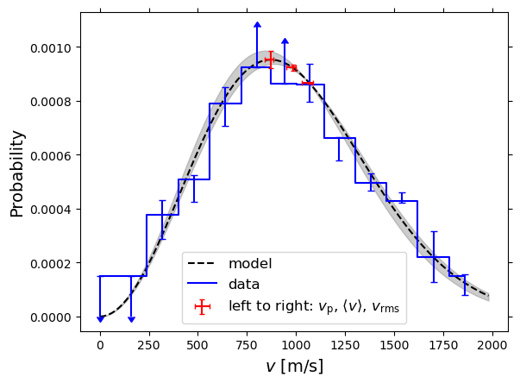
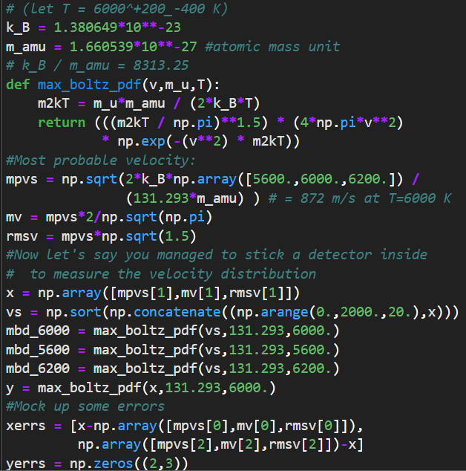
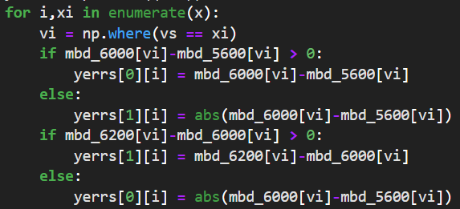
Example: faux Maxwell-Boltzmann distribution of a hot (5600-6200 K)) Xenon arc lamp

Slide 45
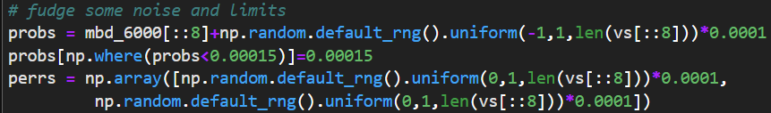
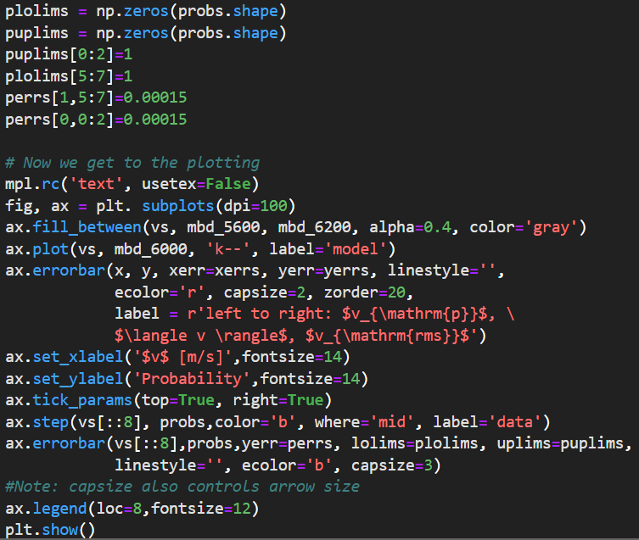

Slide 46
Part 2. Global Format Constraints

Slide 47
Figure sizes
Maximum figure size is determined by the journal’s printable area, especially the width along the minor axis.
Format | Dimensions | Margins | Printable area
A4 | 21 × 29.7 cm 8.3” × 11.7” | 2-3 cm 0.8-1.2” | 15-17 × 23.7-25.7 cm 6-6.5” × 9.3-10.1”
US Letter | 8.5” × 11” 21.6 × 27.9 cm | 1-1.25” 2.5-3.2 cm | 6-6.5” × 8.5-9” 15-17 × 21.6-22.9 cm
Notes:
What’s nice is that the minor axis of both paper formats is about the same
A good safe maximum figure size is about 21x15 cm or, to the nearest whole numbers in inches, 6”x8”

Slide 48
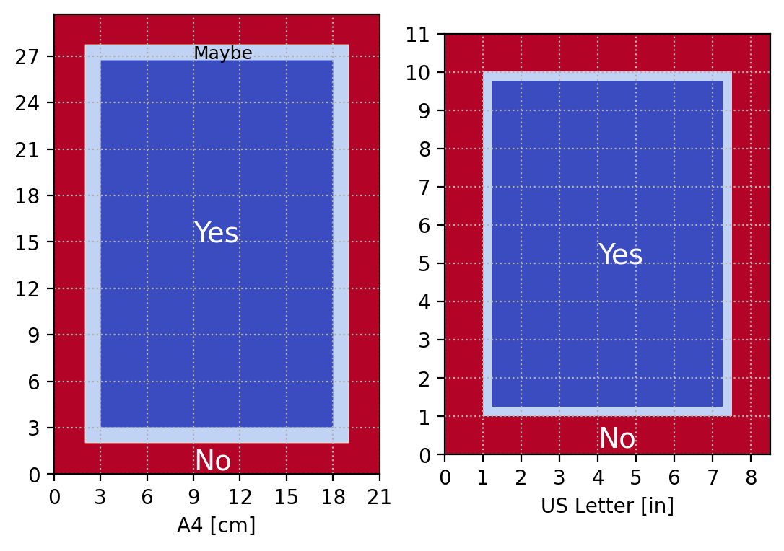
Sub-Figure Sizes
Minimum subfigure size varies, but try to avoid panels <1” or <3 cm on a side.
Remember: color bars, axis labels, & captions take up space, too.
Notes:
In practice, this means a subplot grid bigger than 4x6 probably won’t fit in the printable area.

Slide 49
Figure Output Formats
Editors usually request high-res (300 dpi) figures separately from compiled publication files. Preferred formats vary by journal. Matplotlib supports PDF, (E)PS, PNG, & JP(E)G.
Recommended: PDF. Most widely supported & scales well.
PS & EPS are some journals' top format choices, but require special viewing software & may not support transparency.
Matplotlib default: PNG. Accepted but discouraged (large file sizes).
JPG/JPEGs have small file sizes but degrade when edited or resized.
PIL (pillow) module supports SVG and TIFF output formats

Slide 50
Figure Output Formats Cont.
Journals often request 300 dpi images. Matplotlib’s default figure size is 6.4" x 4.8" (16.26 x 12.19 cm) with 100 dpi resolution. Jupyter Lab’s inline backend defaults to 80 dpi.
Can set dpi=300 in plt.figure() or plt.subplots() at runtime, or in plt.savefig() or plt.imsave() for the saved version only
  Set mpl.rcParams['figure.dpi'] = 300 to apply to all figures in current session (or until kernel restarts)
Can adjust figure size & aspect ratio with figsize = (i,j) kwarg in figure(), subplots(), savefig(), and imsave(). Note: figsize is in inches

Slide 51

Fonts & Font Sizes
No consensus on whether serif or sans-serif fonts are more readable.
Pick a common font (or similar) & stick with it
Most journals set hard minimum font size ~9-10 pt.
11-14 pt font preferred. If in doubt, err larger for older readers
Sans
Serif
Notes:
You will find researchers on both sides of the serif vs sans debate claiming the matter is settled in their favor, but impartial meta-analyses are inconclusive.

Slide 52
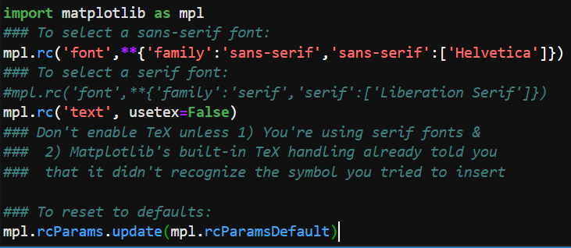
Setting Fonts with rcParams

Slide 53
Matplotlib & LaTeX 1
Need to know LaTeX basics to typeset plot text like journal text:
LaTeX expressions must be bracketed by “$ $” (dollar signs)
Syntax of most LaTeX functions to modify characters: “$\function{char}$”
  Superscript (“^”) & subscript (“_”) operators can work without “{}” but only on the first character that follows.
Conventionally italicized (math-text) letters indicate variables. Use \mathrm{char} to un-italicize letters in, e.g. super- or subscripts
See online tables for Greek letters, operators, & other symbols

Slide 54
Matplotlib & LaTeX 2 - the Intrigue
String insertion (‘{ }’.format()) creates conflict between Matplotlib & LaTeX → must double all {} associated with LaTeX commands, including nested braces
Most Greek letters & ±/∓ symbols require the input string to have r before the first quote mark
Operators with special meanings in LaTeX or Python (e.g. % and $) must have a backslash (\, LaTeX commands) or two (\\, for Python operators) to render them as text.
Spaces within $$ are not rendered: use \, or \; to insert them

Slide 55
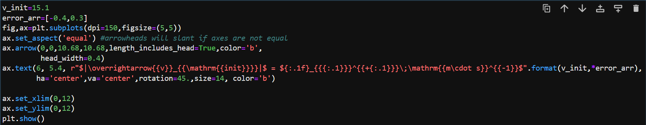
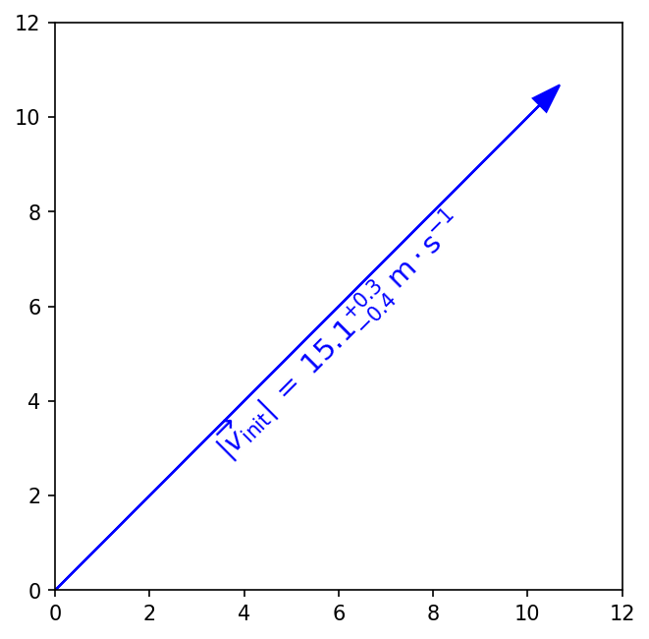
No, you cannot break the string over multiple lines with a backslash, even outside of a TeX expression. A backslash with nothing after it is treated like \n.

Slide 56
Axis Ticks
Matplotlib's default is outward-pointing ticks on the left & bottom. Ticks on all sides are preferred for readability, but not required.
To add outward ticks on top and right:
ax.tick_params(axis='both', which='both', top=True, right=True)
To set inward ticks all the way around:
ax.xaxis.set_tick_params(direction='in', which='both')
ax.yaxis.set_tick_params(direction='in', which='both')
ax.tick_params(axis='both', which='both', top=True, right=True)
Remember: Be consistent!
Notes:
Also, if one of your axes is a metric where 2 units are commonly used interchangeably but the conversion isn’t doable in your head, expect a referee to ask you for a second axis with the converted values. Like if you plot a spectrum w.r.t. Frequency, expect to be asked to add a 2nd wavelength x-axis

Slide 57
Tick Labels & Locators
May need to modify or manually set tick locators & labels if you want:
Units with special formats or symbols (dates, fractions, money, etc.)
Categorical variables (e.g. countries, species, etc.)
Axis tick labels centered between major ticks
Secondary axes that are transformations of the primary axes
Custom or power-law axis scales
Log-, symlog-, or asinh scaling with labels on every decade and visible minor ticks over >7 decades
on one or more axes, or if you want any of the above on a colorbar.

Slide 58
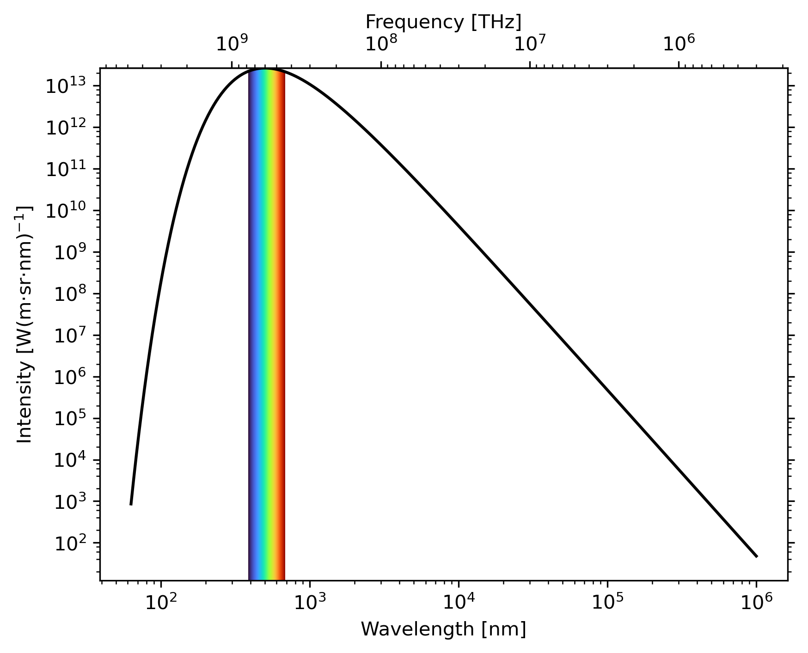
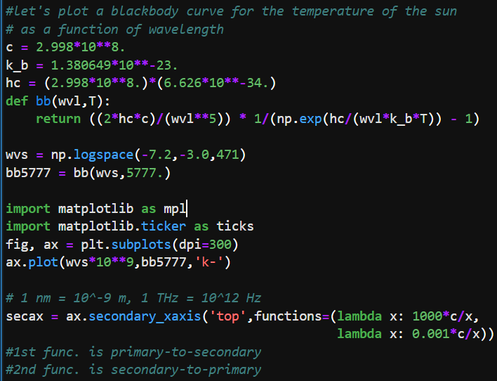
Example of ax.secondary_xaxis('top',functions=(prim2sec,sec2prim)) & mpl.ticker.LogLocator()

Slide 59
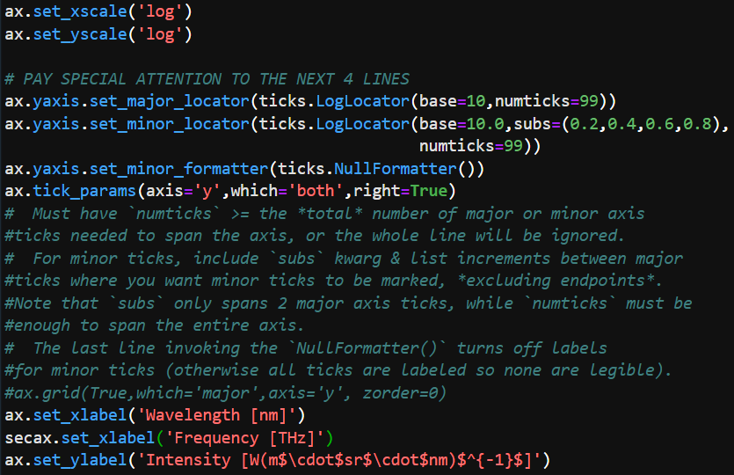
Example of ax.secondary_xaxis('top',functions=(prim2sec,sec2prim)) & mpl.ticker.LogLocator()

Slide 60
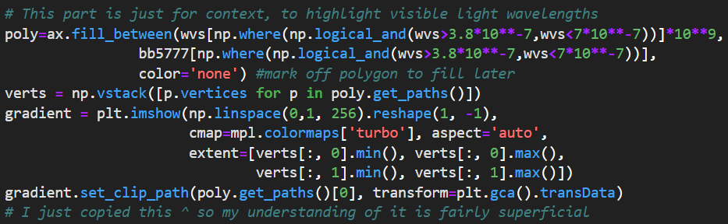
In case you’re interested in the rainbow part…

Slide 61
Final notes on ticks & tick locators
For color bars, use ticks and format kwargs of colorbar()
Format kwarg accepts all the same locator functions as ax.[x|y]axis.set_[major|minor]_locator()
Scales that are neither linear nor logarithmic are not suitable for histograms, contours, or image-like data
Contours don’t work well with log axes either - have to work in log units & use tick label formatters to override the labels

Slide 62
Grids
Essential for non-Cartesian coordinate systems, discouraged otherwise. Matplotlib defaults reflect this (for polar & axes3d plots)
Newer releases include matplotlib.projections.geo → supports Aitoff, Hammer, Lambert, & Mollweide axes projections, & has a customizable GeoAxes base class. Docs haven’t caught up.
Matplotlib also accepts AstroPy WCS instances as axes transformations.
Example: ax.grid(True, ls=’:’, color=’silver’, lw=2) turns grid on with defaults altered

Slide 63
Grids & data format
Images & 2D histograms: use contrasting but neutral color, dotted lines to deemphasize grid.
Scattered data: choose light, thin, solid lines in a neutral color.
Set zorder=0 to put grid behind sparse data. Leave grid above dense data
For online-only figures, can use styles with light grids on a dark background
Lines, bars, & stems: thin lines in neutral color set behind data
Bar & stem plots: only turn on grid lines perpendicular to the bars/stems using the which kwarg of grid()

Slide 64
Choosing colors
Color blindness affects 1/12 people with 1 X-chromosome & 1/200 people with at least 2 X chromosomes → worth making plots color-blind friendly
Lots of online simulators to help → I like Coblis
Shades of blue & orange are the most easily distinguishable colors for all 3 major types of dichromacy.
Can import Tableau’s colorblind10 palette with plt.style.use('tableau-colorblind10') (more on styles later)

Slide 65
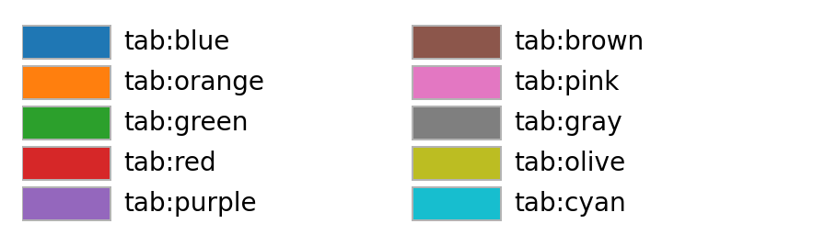
Default color cycle is a poor choice for >4 colors
But must vary marker/line styles for >4 data sets anyway

Slide 66
Choosing Colormaps
Matplotlib docs mostly cover this. In short, consider:
Data type requirements: should colormap be sequential, diverging, cyclical (only 1 good option), or categorical?
Dynamic range: enough contrast between lights & darks?
Monotonicity: does brightness vary smoothly & linearly?
Note: all colormaps can be reversed by appending ‘_r’ to colormap name string.

Slide 67
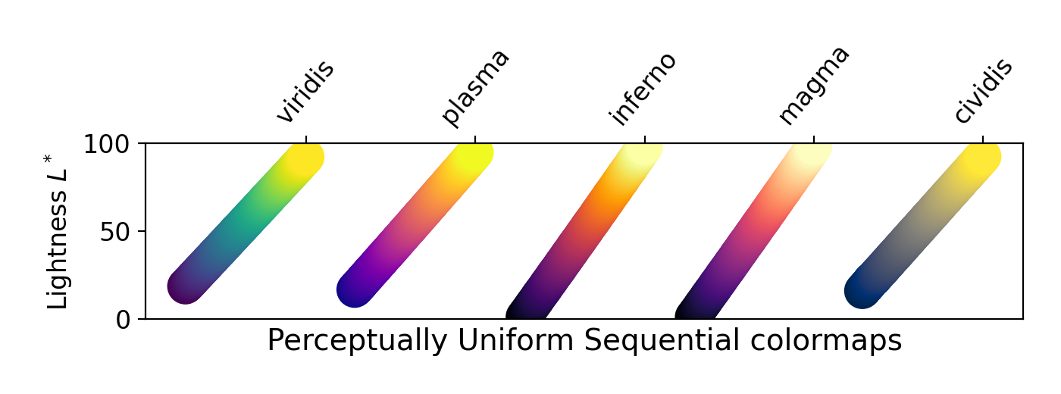
For sequential colormaps, these, ‘binary’, ‘gray’, & ‘bone’ are good. The rest…not so much. Avoid ‘rainbow’ & ‘jet’.

Slide 68
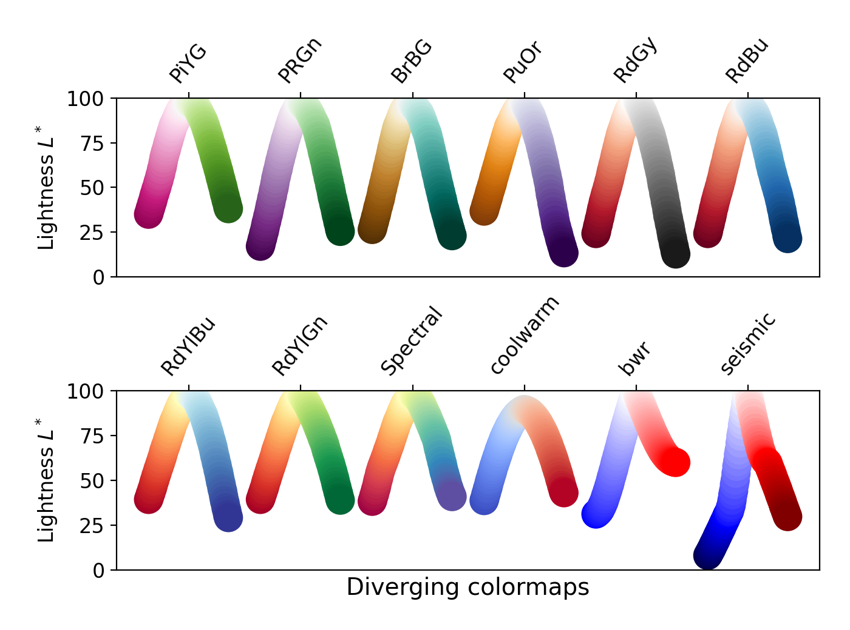
For colorblind accessibility, avoid the colormaps not circled. Also avoid diverging color maps with very different lightness at each end.

Slide 69
Putting it all together: rcParams & style files
MANY plot properties set internally by Matplotlib's default runtime configuration parameters, or rcParams, including but not limited to:
figure size, resolution, aspect ratio, padding, & subplot spacing
fonts, font sizes, weights & letter spacing (e.g. monospace)
marker sizes, fill styles, default shape, color- & line-cycles
axes tick lengths, widths, colors, visibility, & orientations
backends
Any can be changed at runtime with dict-like syntax, or imported from file. The mpl4publication.mplstyle file is my provided example.

Slide 70
rcParams & style files
A .mplstyle file is a text file of key-value pairs where each key is the rcParam to modify.
Can create & import list of style sheets, each of which addresses different set of rcParams.
Need only include rcParams to be changed from defaults
Built-in style sheets can be called by name without full path
Set for whole session: plt.style.use('./your_style.mplstyle')
Set one plot: with plt.style.context('./your_style.mplstyle'):
Notes:
The mpl4publication.mplstyle file customizes font, grids, & a 10-color palette tested with Coblis not limited to oranges, blues, & grays

Slide 71
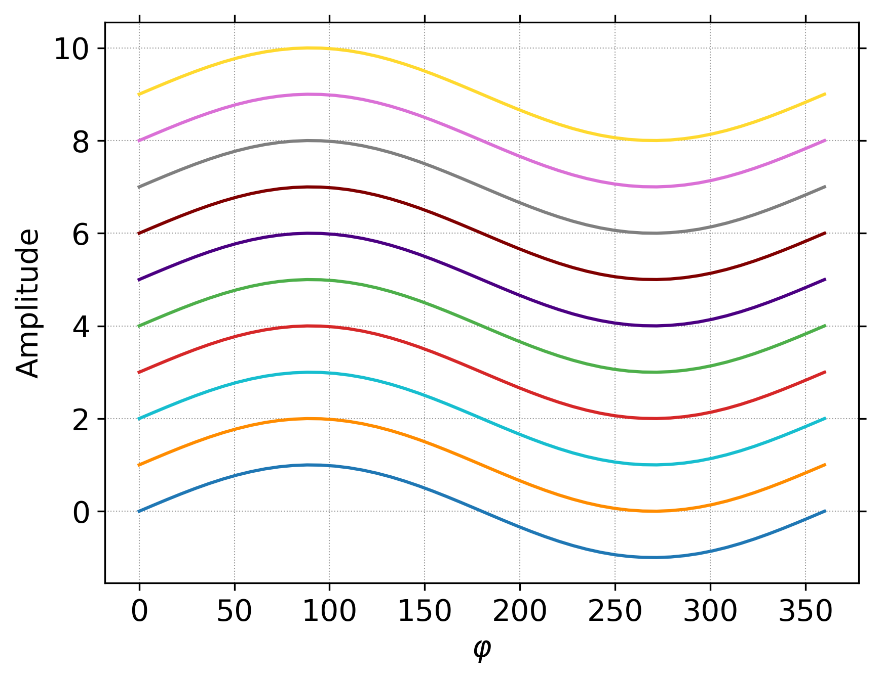
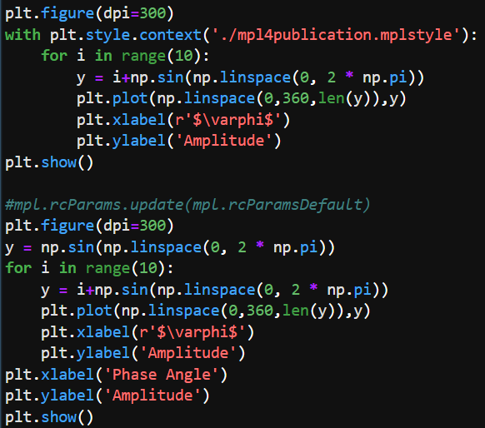
Example with mpl4publication.mplstyle

Slide 72

Example with mpl4publication.mplstyle (after with clause)

