Slide 1
Reducing US traffic fatalities capstone:
Progress update
Rhiannon Rognstad
July 25, 2017

Slide 2
Overview of problem:
Over 35,000 fatalities occurred on US highways in 2015, and increase by 7.2% from 2014.
The goal of this project is to analyze traffic fatality and supporting data to identify spatial patterns and factors that are related to fatal traffic incidents.
Additionally, the 2014 and 2015 data will be compared in detail to identify specific segments of the population that saw increased fatalities

Slide 3
Main datasets:
 | FARS (Fatality Analysis Reporting System) | GES (General Estimates System)
Temporal coverage: | 1975-2015 | 1988-2015
Spatial coverage: | All 50 US states, DC, Puerto Rico; latitude and longitude reported for each accident | All 50 US states, DC; location reported by region (northeast, south, midwest, west)
Accident coverage: | All accidents with least one fatality | Representative sample of police-reported crashes
Supplementary information: | Conditions of accident (weather, road location, date/time, speeding, alcohol involved), driver and passenger info (age, sex), vehicle (make, model, year) | Conditions of accident (weather, road location, date/time, speeding, alcohol involved), driver and passenger info (age, sex), vehicle (make, model, year)
URL | ftp://ftp.nhtsa.dot.gov/fars/ | ftp://ftp.nhtsa.dot.gov/GES/

Slide 4
Supplementary datasets
Dataset | Data | URL
US census | Demographic data on population size, age distribution | https://www2.census.gov/programs-surveys/popest/datasets/
State traffic laws | Speed limits, red light/speeding cameras, DUI/DWI laws, cellphone/texting | http://www.iihs.org/iihs/topics/laws/
Stanford Open Policing Project | Traffic-related police stops by state, contains information on reason and outcome of stop, completeness varies by state | https://openpolicing.stanford.edu/data/

Slide 5
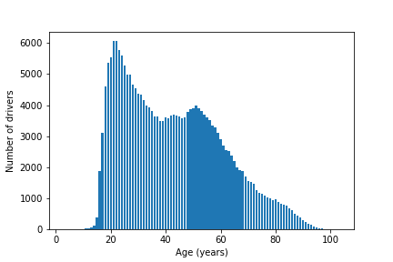
Exploratory data analysis:
Age of drivers

