Slide 1

ANSYS contact
- Penalty vs. Lagrange
- How to make it converge
Erke Wang
CAD-FEM GmbH. Germany

Slide 2
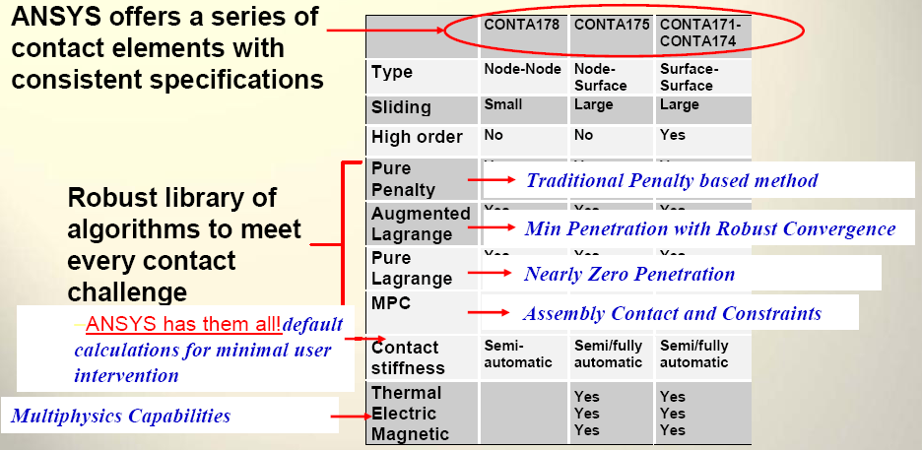
Variety of algorithms

Slide 3
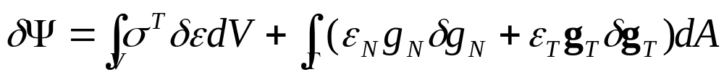
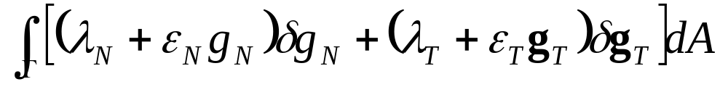
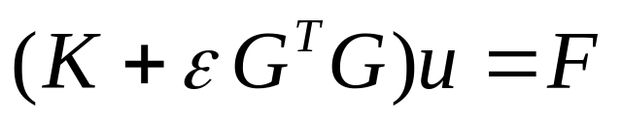





Pure penalty method
Penalty means that any violation of the contact condition will be punished by increasing the total virtual work:
Augmented Lagrange method:
F
The equation can also be written in FE form:
This is the equation used in FEA for the pure penalty method where is the contact stiffness

Slide 4

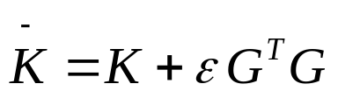
Pure penalty method
F
The contact spring will deflect an amount Δ, such that equilibrium is satisfied:
Some finite amount of penetration, Δ > 0, is required mathematically to maintain equilibrium. However, physical contacting bodies do not interpenetrate (Δ = 0).
The condition of the stiffness matrix crucially depends on the contact stiffness itself.
There is no additional DOF.
N
There is no overconstraining problem
Iterative solvers are applicable – large models are doable!

Slide 5
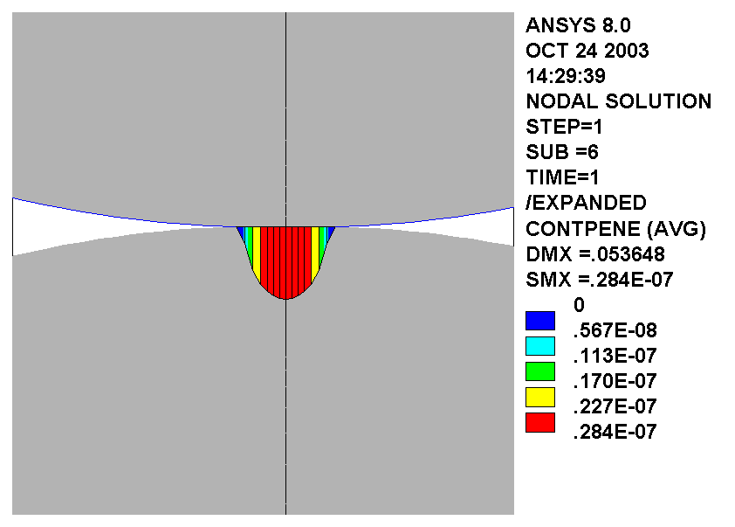
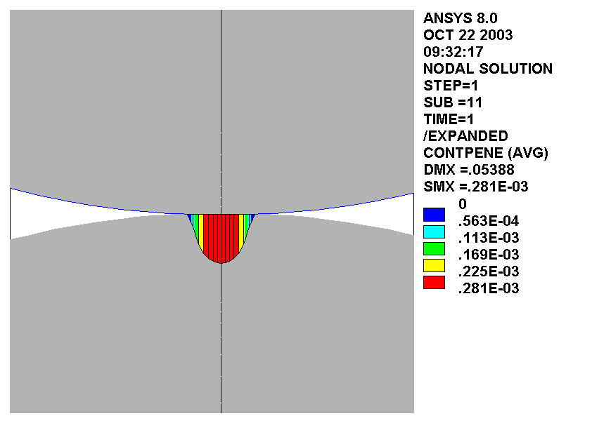
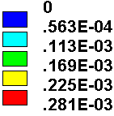
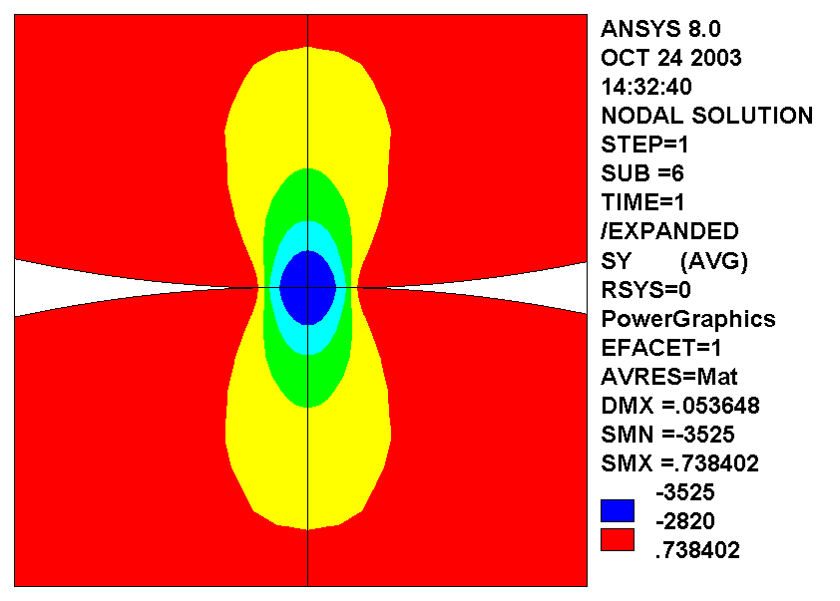
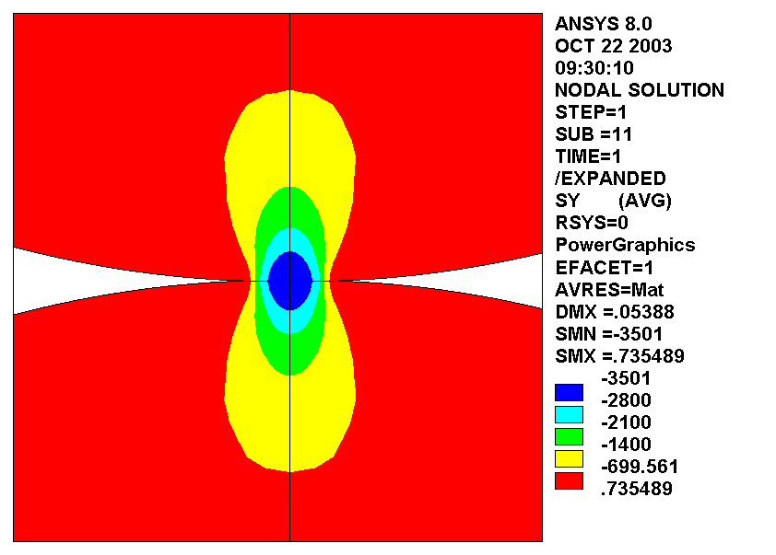
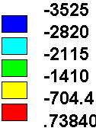
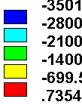
Pure penalty method
Some finite amount of penetration, Δ > 0, is required mathematically to maintain equilibrium. However, physical contacting bodies do not interpenetrate (Δ = 0).
Δ is the Result from FKN and the equilibrium analysis. Pressure= Δ * => Stress
100-times Difference in FKN leads to 100-times Difference in Δ
but leads to only about 1% Difference in Contact pressure and the related stress.
FKN=1e4
FKN=1
Difference in d:
0.281e-3/ 0.284e-7
=1e4
PENE
PENE
Difference in stress:
(3525-3501)/ 3525
=0.7%
Stress
Stress

Slide 6
Pure penalty method
Some finite amount of penetration, Δ > 0, is required mathematically to maintain equilibrium. However, physical contacting bodies do not interpenetrate (Δ = 0).
Tip:
As long as the penetration does not leads to the change of the contact region,
The penetration will not influence the contact pressure and Stress underneath the contact element
Caution:
For pre-tension problem, use large FKN>1, Because the small penetration will strongly influence the pre-tension force.

Slide 7
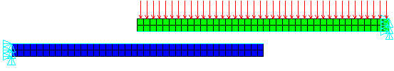
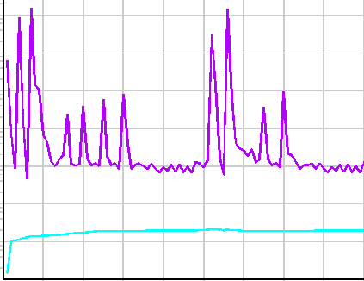
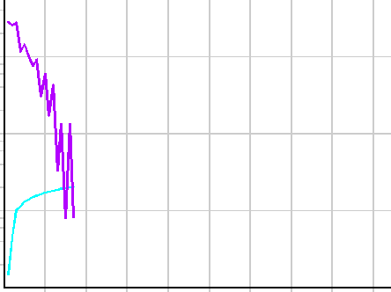
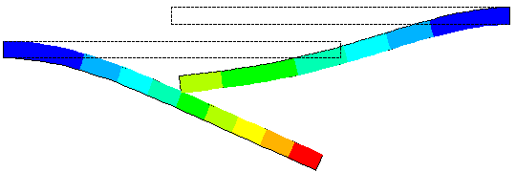
Pure penalty method
The condition of the stiffness matrix crucially depends on the contact stiffness itself.
If the contact stiffness is too large, it will cause convergence difficulties.
The model can oscillate, with contacting surfaces bouncing off of each other.
F
F
F
F^{Contact}
Iteration n
Iteration n+1
Iteration n+2
FKN=1
FKN=0.01

Slide 8
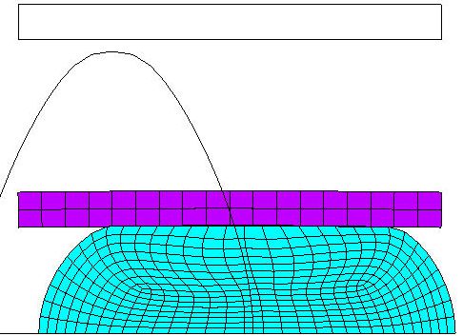
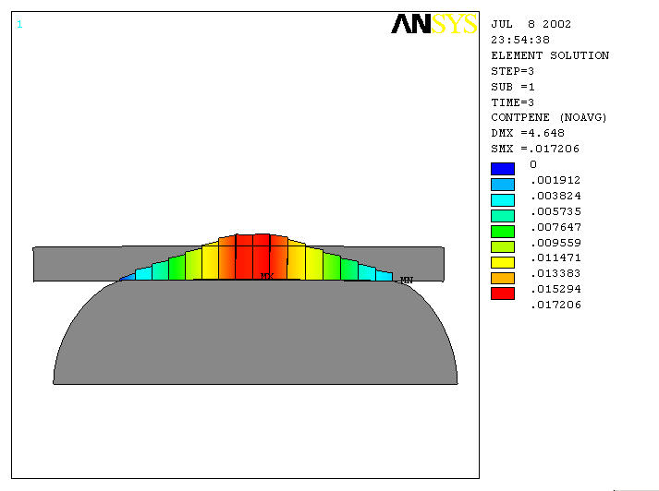
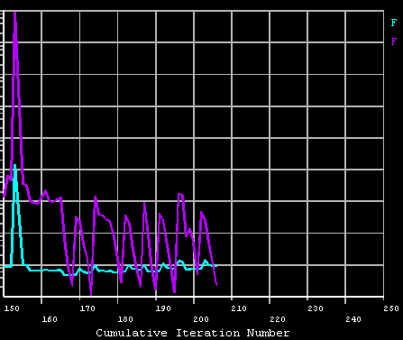
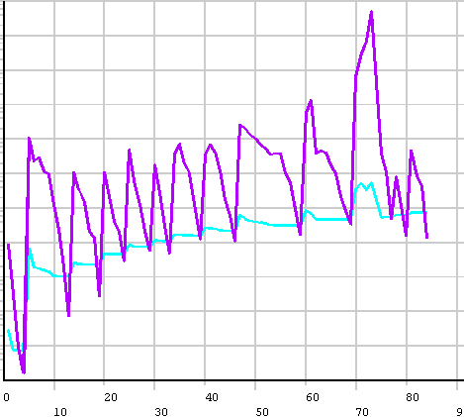
Pure penalty method
The condition of the stiffness matrix crucially depends on the contact stiffness itself.
This problem is almost solved since 8.1, with automatic contact stiffness adjustment.
KEYOPT(10)=2
84 iterations
205 iterations
KEYOPT(10)=0
KEYOPT(10)=2

Slide 9
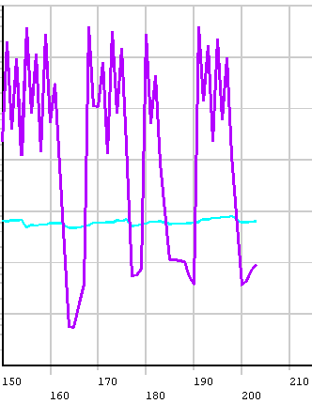
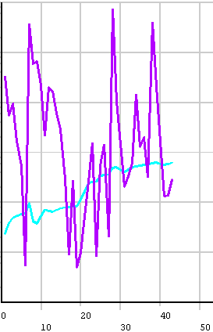
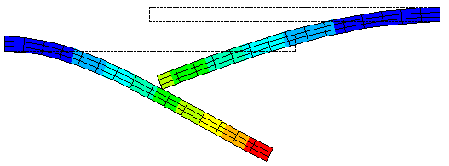
Pure penalty method
The condition of the stiffness matrix crucially depends on the contact stiffness itself.
For bending dominant problem, you should still use the 0.01 for the starting FKN and combine with
KEYOPT(10)=2
203 iterations
43 iterations
FKN=1: KEY(10)=0 Divergence
FKN=0.01, KEY(10)=0
FKN=0.01, KEY(10)=2

Slide 10
Pure penalty method
The condition of the stiffness matrix crucially depends on the contact stiffness itself.
Tip:
Always use KEYOPT(10)=2
For bending problem use FKN=0.01 and KEYOPT(10)=2
For bulky problem use FKN=1 and KEYOPT(10)=2
Caution:
For pre-tension problem, use large FKN>1. Because the small penetration will strongly influence the pre-tension force.

Slide 11
Pure penalty method
There is no additional DOF.
There is no overconstraining problem
Iterative solvers are applicable – large models are doable!
Tip:
Always use Penalty if:
Symmetric contact or self-contact is used.
Multiple parts share the same contact zone
3D large model(> 300.000 DOFs), use PCG solver.

Slide 12
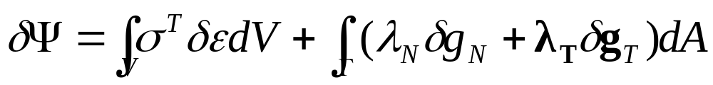
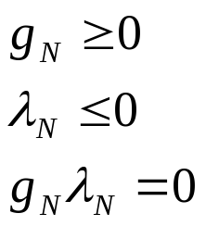


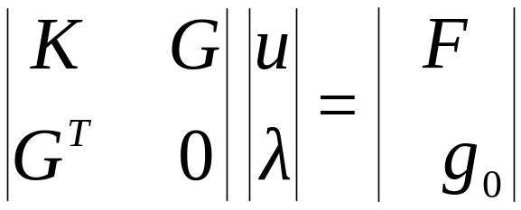
Pure Lagrange multipliers method
Any violation of the contact condition will be furnished with a Lagrange multiplier.
Contact constraint condition:
Ensure no penetration
Ensure compressive contact force/pressure
No contact , gap is non zero
Contact , contact force is non zero
The equation is linear, in case of linear elastic and Node-to-Node contact. Otherwise, the equation is nonlinear and an iterative method is used to solve the equation. Usually the Newton-Method is used.
For linear elastic problems:

Slide 13
Pure Lagrange multipliers method
N+G
Lagrange multipliers are additional DOFs → the FE model is getting large.
Zero main diagonals in system matrix →No iterative solver is applicable.
For symmetric contact or additional CP/CE, and boundary conditions, the equation system might be over-constrained
Sensitive to chattering of the variation of contact status
No need to define contact stiffness
Accuracy - constraint is satisfied exactly, there are no matrix conditioning problems

Slide 14
Pure Lagrange multipliers method
Lagrange multipliers are additional DOFs → the FE model is getting large.
Tip:
Always use Lagrange multiplier method if:
The model is 2D.
3D nonlinear material problem with < 100.000 Dofs

Slide 15
Pure Lagrange multipliers method
For symmetric contact or additional CP/CE, and boundary conditions, the equation system is over-constrained
Tip:
If the Lagrange multiplier method is used:
Always use asymmetric contact.
Do not use CP/CE in on contact surfaces
Do not define the multiple contacts, which share the common interfaces.
Contact pair-1
Single contact pair
Contact pair-1

Slide 16
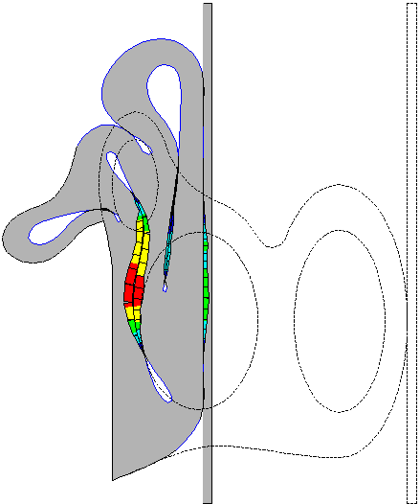
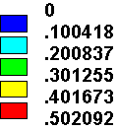
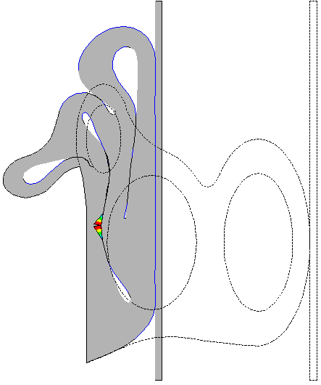
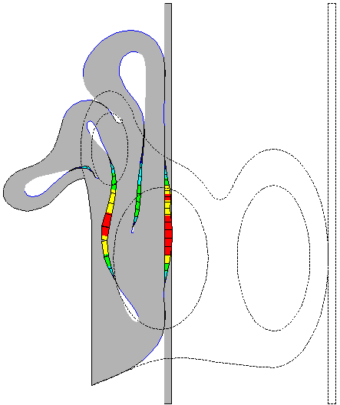
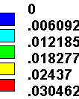
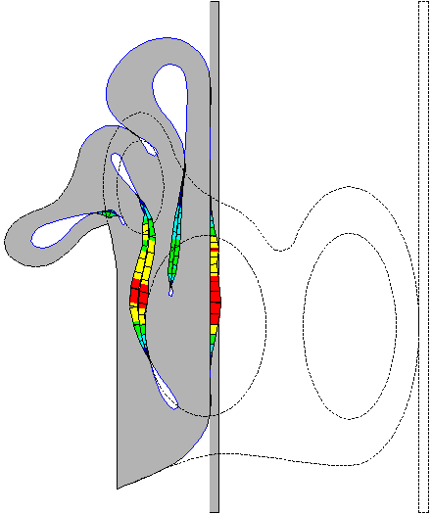
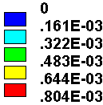
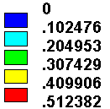
Pure Lagrange multipliers method
Penetration
Pressure
Penetration
Pressure
Iterations: 174
CPU: 100
Iterations: 92
CPU: 50
Penalty symmetric
Lagrange symmetric

Slide 17
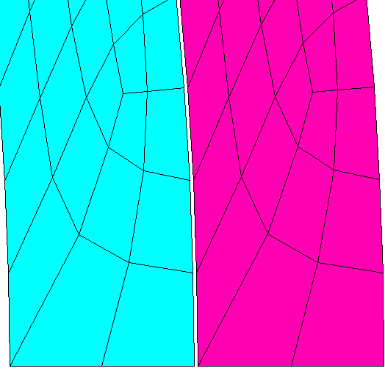
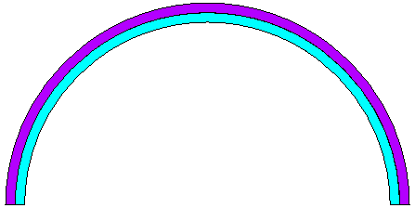
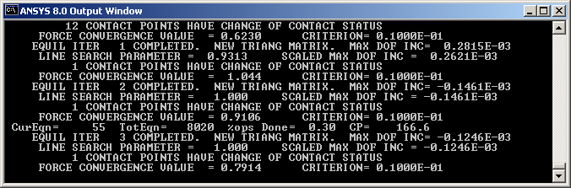
Pure Lagrange multipliers method
Sensitive to chattering of the variation of contact status
Tip:
Use Penalty is chattering occurs or
Chattering Control Parameters: FTOLN and TNOP
R1=R2-Delta
F
R1
R2

Slide 18
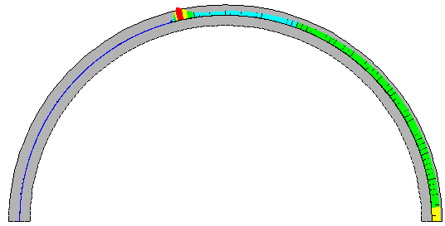
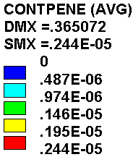
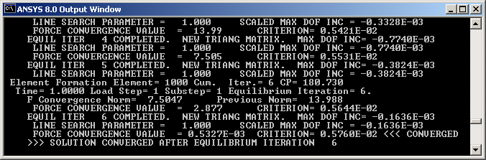
Pure Lagrange multipliers method
Use Penalty is chattering occurs
DELT=0.1
/prep7
et,1,183
et,2,169
et,3,172,,4,,2
mp,ex,1,2e5
pcir,190,200-DELT,-90,90
wpof,0,-delt
pcir,200,210,-90,90
wpof,0,delt
esiz,5
Esha,2
ames,all
lsel,s,,,1
nsll,s,1
Real,2
type,3
esurf
lsel,s,,,7
nsll,s,1
type,2
Esurf
/solu
Nsel,s,loc,x,0
D,all,ux
lsel,s,,,5
nsll,s,1
d,all,all
lsel,s,,,3
nsll,s,1
*get,nn,node,,count
f,all,fy,200/nn
alls
Solv
Penalty
FKN=1

Slide 19
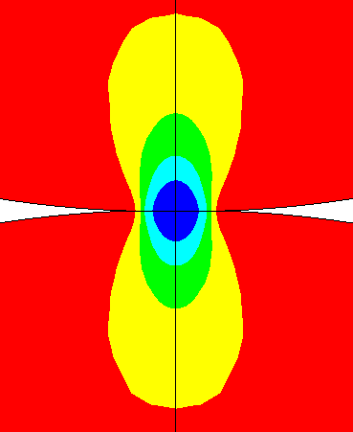
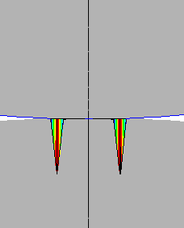
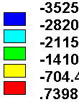
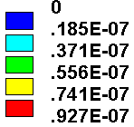
Pure Lagrange multipliers method
No need to define contact stiffness
Accuracy - constraint is satisfied exactly, there are no matrix conditioning problems
Sy
Pene
Sy
Pene
Sy
Pene
Pure Lagrange
Iter=13
Pure Penalty(FKN=1)
Iter=8
Pure Penalty(FKN=1e4)
Iter=39

Slide 20
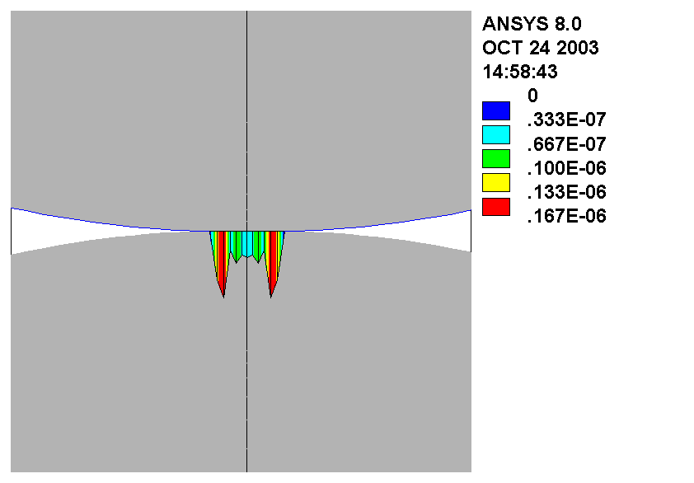
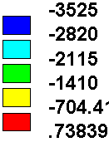
Pure Lagrange multipliers method
No need to define contact stiffness
Accuracy - constraint is satisfied exactly, there are no matrix conditioning problems
Sy
Pene
Sy
Pene
Sy
Pene
Pure Lagrange
Iter=13
Pure Penalty(FKN=1e4)
Iter=39
Augmented Lagrange
FKN=1, TOL=-3e-7
Iter=1327

Slide 21
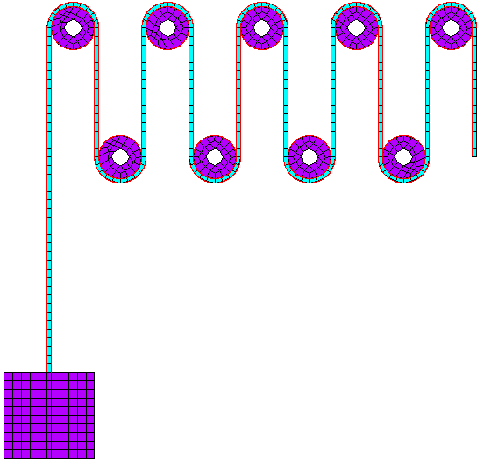
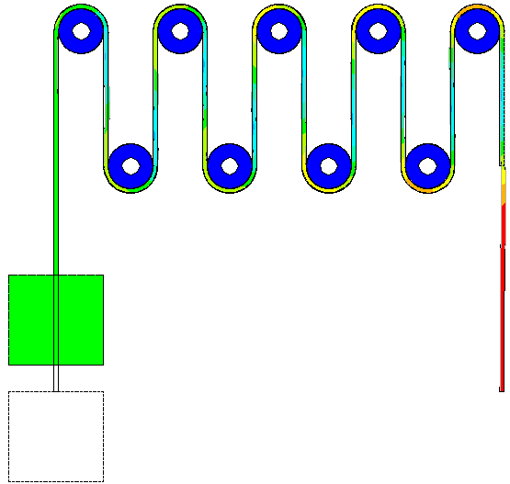
Pure Lagrange multipliers method
example-1
Element: Plane183
Material: Neo-Hookean
Contact: Pure Lagrange
Load: Displacement

Slide 22
Pure Lagrange multipliers method
/prep7
et,1,183
et,2,169
et,3,172,,3,,2
tb,hyper,1,,,neo
tbdata,1,.3,0.001
mp,ex,2,2e5
mp,dens,2,7.8e-9
r,2,,,,,,5
r,3,,,,,,5
pcir,2,5
agen,5,1,1,,22
agen,2,1,1,,11,-30
agen,4,6,6,,22
rect,-6,-5,-80,0
rect,5,6,-30,0
agen,9,11,11,,11
pcir,5,6,0,180
agen,5,20,20,,22
wpof,11,-30
pcir,5,6,180,360
agen,4,25,25,,22
wpcs,-1
rect,-16,-6,-100,-80
rect,-6,-5,-100,-80
rect,-5,5,-100,-80
asel,s,,,10,31,1,1
numm,kp
esha,2
esiz,2
ames,1,28
esha
alls
mat,2
ames,all
lsel,s,,,74,106,8
lsel,a,,,80,112,8
lsel,a,,,115,131,4
lsel,a,,,133,145,4
nsll,s,1
type,2
real,2
mat,3
esurf
lsel,s,,,1,4
lsel,a,,,9,12
lsel,a,,,17,20
lsel,a,,,25,28
lsel,a,,,33,36
cm,l1,line
nsll,s,1
type,3
esurf
lsel,s,,,76,108,8
lsel,a,,,78,102,8
lsel,a,,,113,129,4
lsel,a,,,135,147,4
nsll,s,1
type,2
real,3
esurf
lsel,s,,,41,44
lsel,a,,,49,52
lsel,a,,,57,60
lsel,a,,,65,68
cm,l2,line
nsll,s,1
type,3
esurf
/solu
nlgeo,on
acel,,9810
asel,s,,,1,9,1,1
cmsel,u,l1
cmsel,u,l2
nsll,s,1
d,all,all
asel,s,,,29,31,1
nsla,s,1
d,all,ux
nsub,5,15,1
lsel,s,,,109,,,1
d,all,ux
d,all,uy,0
alls
cnvt,f,,.01
nsub,100,10000,1
solv
lsel,s,,,109,,,1
d,all,uy,-50
nsub,100,10000,1
outres,all,all
alls
solv
Tip:
For large sliding problem,
Use Lagrange method, the convergence behavior is very good and stable

Slide 23
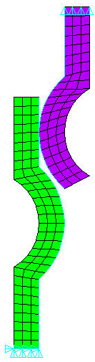
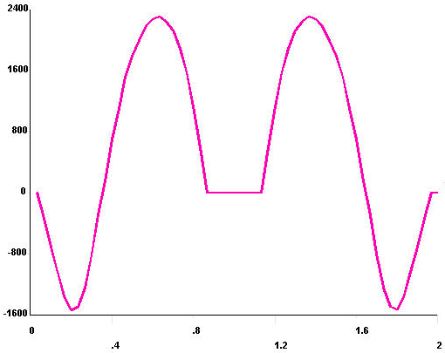



Pure Lagrange multipliers method
Lagrange:
110 Iterations
CPU:
14 Sec.
Penalty:
218 Iterations
CPU:
24 Sec.

Slide 24


Pure Lagrange multipliers method
Bending example
Lagrange:
10 Iterations
2 Sec.
Bending stress
Penalty Key(10)=1:
54 Iterations
12 Sec.
Contact penetration

Slide 25

Pure Lagrange multipliers method
/prep7
et,1,183,,,1
et,2,183,,,1,,,1
et,3,169
et,4,172,,4,,2
mp,ex,1,2e5
tb,hyper,2,1,2,moon
tbdata,1,1,.2,2e-3
Mp,mu,2,0.3
rect,1,5,0,3
rect,2,5,1.5,4
asba,1,2
rect,2.1,5,2.5,3.5
wpof,3,2
pcir,.501
esiz,.3
ames,1,3,2
esiz,.1
type,2
mat,2
ames,2
lsel,s,,,2
nsll,s,1
type,3
real,3
esurf
lsel,s,,,8,12,4
nsll,s,1
type,4
esurf
lsel,s,,,5
nsll,s,1
type,3
real,4
esurf
lsel,s,,,13,14,1
nsll,s,1
type,4
esurf
/solu
nlgeo,on
solcon,,,,1e-2
nsel,s,loc,y,0
d,all,uy
nsel,s,loc,y,3.5
sf,all,pres,2
alls
nsub,10,100,1
solv
Rubber example
Element: Plane183
Material: Mooney
Contact: Pure Lagrange&Friction
Load: Pressure
Lagrange:
32 Iterations
13 Sec.
Penalty Key(10)=2:
63 Iterations
20 Sec.

Slide 26

Pure Lagrange multipliers method
/prep7
et,1,181
et,2,170
et,3,173,,3,,2
keyopt,3,11,1
mp,ex,1,2e5
r,1,.5
r,2,,,.1
r,3,,,.1
rect,0,10,0,5
agen,3,1,1,,,,0.5
esiz,1
esha,2
ames,all
type,3
real,2
asel,s,,,1,,,1
esurf,,top
type,2
asel,s,,,2,,,1
esurf,,bottom
type,3
real,3
asel,s,,,2,,,1
esurf,,top
type,2
asel,s,,,3,,,1
esurf,,bottom
/solu
nlgeo,on
nsel,s,loc,x,0
d,all,all
nsel,s,loc,x,10
nsel,r,loc,y,5
nsel,r,loc,z,0
f,all,fz,1000
alls
nsub,1,1,1
solv
Shell example
Element: Shell181
Material: elastic
Contact: Pure Lagrange
Load: Force
Lagrange:
15 Iterations
8 Sec.
Penalty Key(10)=2:
18 Iterations
10 Sec.

Slide 27
Let us talk about convergence

Slide 28





Suggestion
One reason for convergence difficulties could be the following:
FE Model is not modeled correctly in a physical sense
1) If you use a point load to do a plastic analysis, you will never get the converged solution. Because of the singularity at the node, on which the concentrated force is applied, the stress is infinite. The local singularity can destroy the whole system convergence behavior. The same thing holds for the contact analysis. If you simplify the geometry or use a too coarse mesh (with the consequence that the contact region is just a point contact instead of an area contact) you most likely will end up with some problems in convergence.
point load
Geometry
Mesh
plastic analysis
contact analysis

Slide 29



Suggestion
One reason for convergence difficulties could be the following:
FE Model is not modeled correctly in a numerical sense
2) A possible rigid body motion is quite often the reason which causes divergence in a contact analysis. This could be the result of the following: We always believe, that if we model the gap size as zero from geometry, it should also be zero in the FE model. But due to the mathematical approximation and discretization, it does not have necessarily to be zero anymore. Exactly, this can kill the convergence. If possible, use KEYOPT(5) to close the gap. You can also use KEYOPT(9)=1 to ignore 1% penetration, if it is modeled.
KEYOPT(5)=0
KEYOPT(5)=1

Slide 30



Suggestion
Caution:
If the gap physically exists, you should not use KEYOP(5)=1 to close it,instead, you should used the weak spring method.
DELT=0.1
/prep7
et,1,183
et,2,169
et,3,172
mp,ex,1,2e5
pcir,1,2-DELT,-90,90
pcir,2,3,-90,90
rect,0,1,-7,-2.5
aadd,2,3
esiz,.3
ames,all
Psprng,48,tran,1,0,0.5
lsel,s,,,1
nsll,s,1
Real,2
type,3
esurf
lsel,s,,,7
nsll,s,1
type,2
Esurf
R,2,,,,,,-1
/solu
Nsel,s,loc,x,0
D,all,ux
nsel,s,loc,y,-7
d,all,all
Alls
F,42,fy,0.11
Solv
F,42,fy,2000
Solv
Fdel,all,all
F,48,fy,-.11
Solv
F,48,fy,-3000
solv
LS1: F1=0.11
K=1, DELT=0.1
F=K*U
To close the gap:
F1=1*0.1+0.1=0.11
LS2: F1=3000

Slide 31
Suggestion
One reason for convergence difficulties could be the following:
Numerically bad conditioned FE Model
4) ANSYS uses the penalty method as a basis to solve the contact problem and the convergence behavior largely depends on the penalty stiffness itself. A semi-default value
for the penalty stiffness is used, which usually works fine for a bulky model, but might not be suitable for a bending dominated problem or a sliding problem. A sign for bad conditioning is that the convergence curve runs parallel to the the convergence norm. Choosing a smaller value for FKN always makes the problem easier to converge. If the analysis is not converging, because of the too much penetration, turn off the Lagrange multiplier.
The result is usually not as bad as you would believe.
FKN=1
FKN=0.01

Slide 32



Suggestion
One reason for convergence difficulties could be the following:
FKN=1: KEY(10)=0 Divergence
FKN=0.01, KEY(10)=0
FKN=0.01, KEY(10)=1
FKN=1: KEY(10)=1

Slide 33




Suggestion
One reason for convergence difficulties could be the following:
Quads instead of triads → Error in element formulation or element is turned inside out
6) If some elements are locally distorted you might get an error in the element formulation or the element is even turned inside out. Try to use a coarser mesh in this region to avoid those problems. You can also use NCNV,0 to continue the analysis and ignore those local problems if they do not effect the global equilibrium. In general, try to use triangular, tetrahedral or hexahedral elements (linear). Do not use quadratic hexahedral elements.
Error in element formulation
Linear quads
Mid-side triads

Slide 34





Suggestion
One reason for convergence difficulties could be the following:
The parts have no unique minimum potential energy position.
7) If the max. DOF increment is not getting smaller and the force convergence norm keeps almost constant, probably some parts in the model are oscillating. Here, introducing a small friction coefficient is usually better than using a weak spring, not knowing exactly where to place it. Friction can be applied to all contact elements (try MU=0.01 or 0.1)
MU=0
MU=0.1

Slide 35



Suggestion
Some times, if you define the contact and target properly, the analysis convergences much faster, and the result is also better.
Target
Contact
Target
F
Contact
Contact
Target
Target
Contact

Slide 36


Suggestion
One reason for convergence difficulties could be the following:
Unreasonable defined plastic material
11) It is not always a good idea to define the tangential stiffness to be zero using a plastic material law. If the yield stress is reached all over the whole cross section, there is no material resistance anymore to carry the load. There will be a plastic hinge and so the solution will never converge. In this case, input the correct tangential stiffness.
Plastic strain
Stress strain curve with tangential slope zero

Slide 37



Suggestion
One reason for convergence difficulties could be the following:
Unreasonable defined plastic material
Plastic strain
Stress strain curve with tangential slope 10000
Contact region
Stress distribution

Slide 38





Suggestion
Good mesh will generally make problem easier to converge.
The fine mesh and similar mesh are always good for the contact simulation:
Normal stress
Geometry
Sphere influence
Mesh
Contact Pressure

Slide 39



Suggestion
Good mesh will generally make problem easier to converge.
The fine mesh and similar are always good the contact simulation:
Geometry
Contact region
Contact mesh

Slide 40


Suggestion
Good mesh will generally make problem easier to converge.
The fine mesh and similar are always good the contact simulation:
Normal stress
Contact pressure

Slide 41
How can I make the problem converge?
Trust yourself: I’m able to make it converge!
Consider the problem as idealized real world problem:
20%- Mechanics expertise, 20%- Engineer expertise
30%- FEA expertise, 30%- Software expertise
Use the magic KEYOPTIONS
KEYOPT(5)=1: To eliminate the rigid body motion
KEYOPT(9)=1: To eliminate the geometric noise
KEYOPT(10)=2: To make ANSYS think

Slide 42

Thanks

