Slide 2
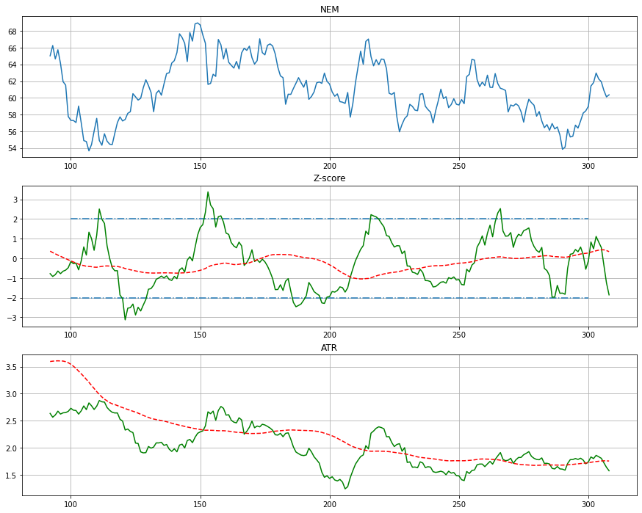
Z-score(30) from ATR(14)
Buy when cross -2 down and
Sell when cross +2 up
Code:

Slide 3
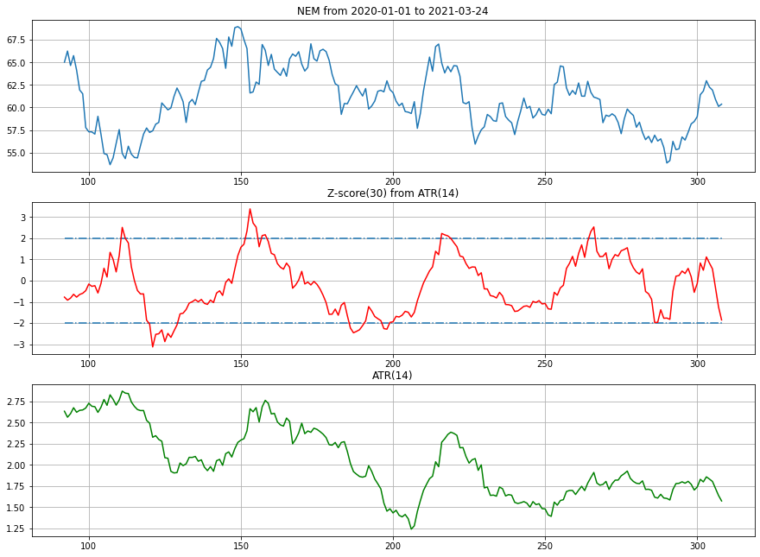

Slide 4
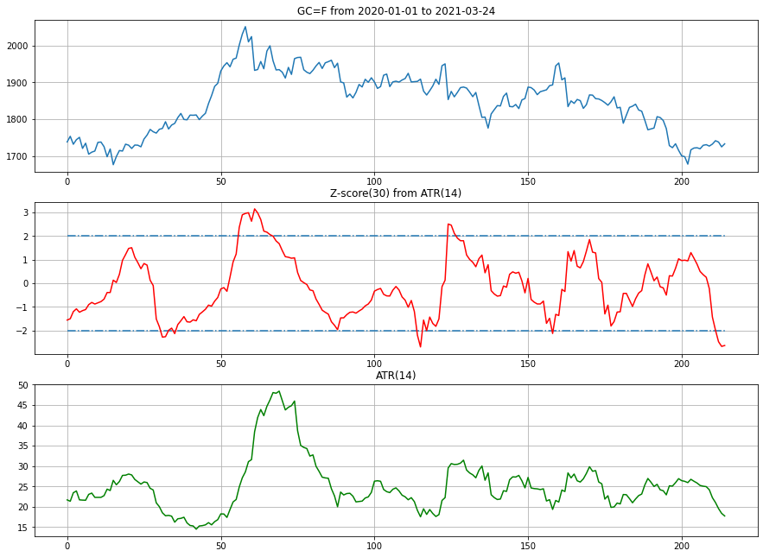

Slide 5
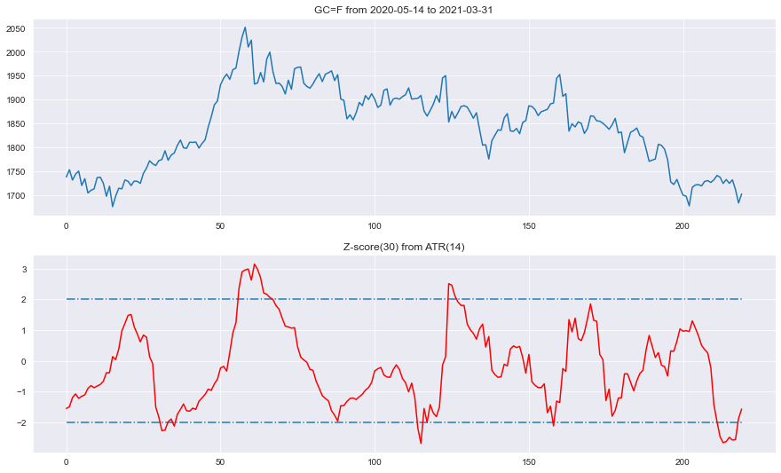

Slide 6
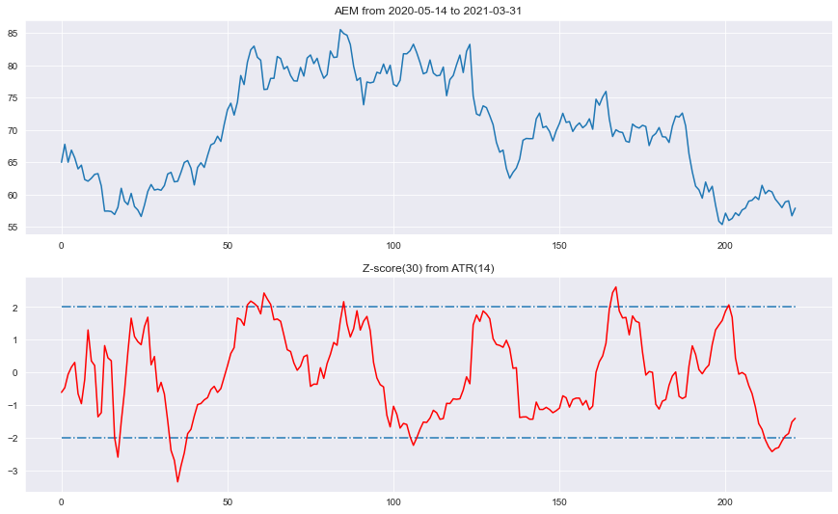

Slide 7
