Slide 1
Diagnose me
Collaborators: ramon, pauline, jessica

Slide 2
“Diagnose me” web application
Diagnose Me is a web application designed to be a simple symptoms checker.
The premises of the application is to take in a users input of zip code and primary symptom. This in return displays the top three conditions the symptom is related to. It also will display how many people in your area based on zip code have searched the same symptoms in the past 7 days. This gives an idea of how common a condition could be in your area or If something is going around.

Slide 3
Front End
Pauline

Slide 4
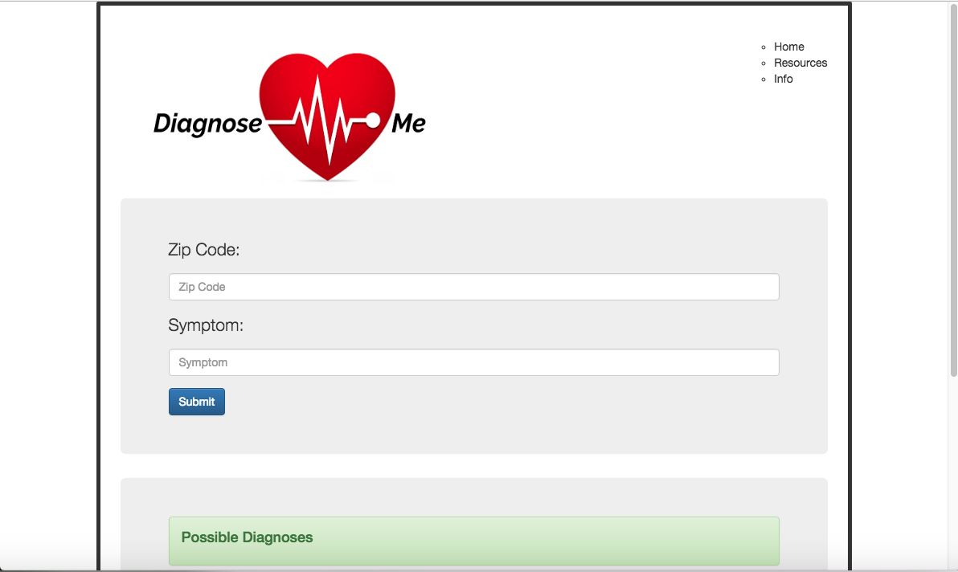

Slide 5
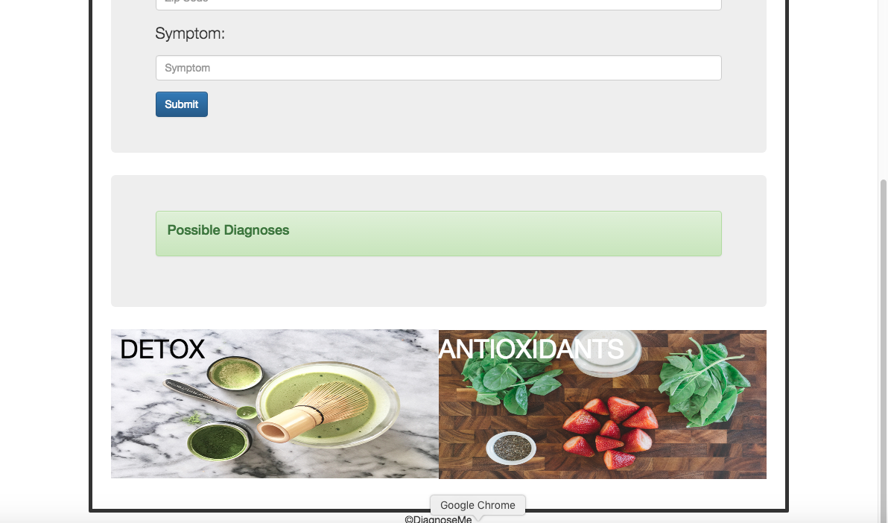

Slide 6
Technology used
Handlebars
Bootstrap
Html
CSS

Slide 7
Back end
Ramon and jessica

Slide 8
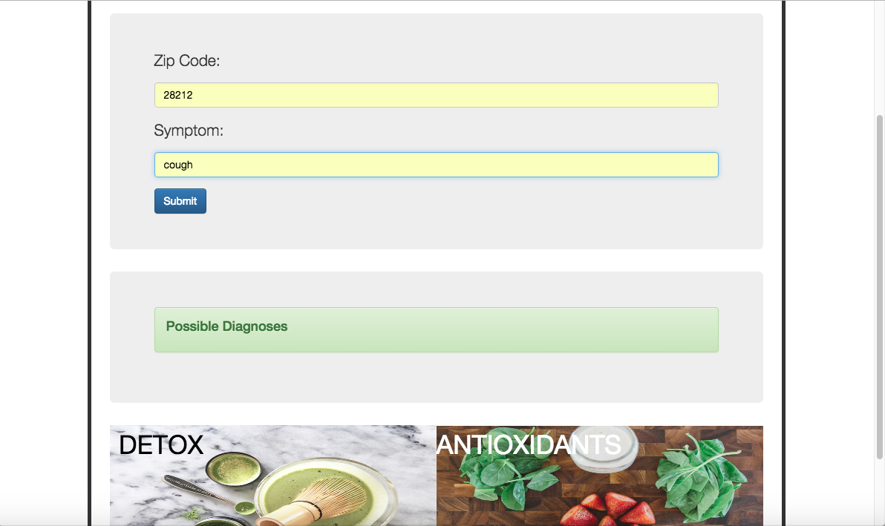

Slide 9
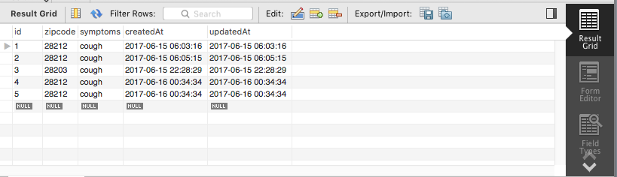

Slide 10
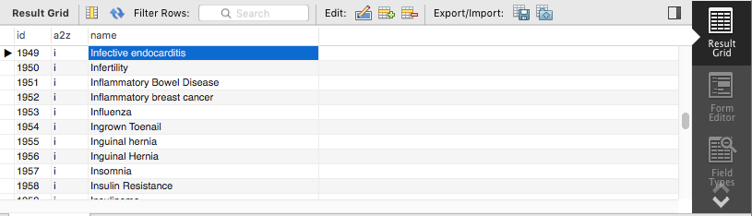
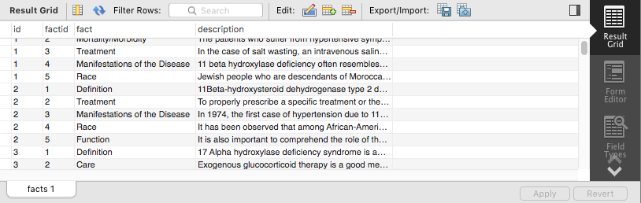

Slide 11
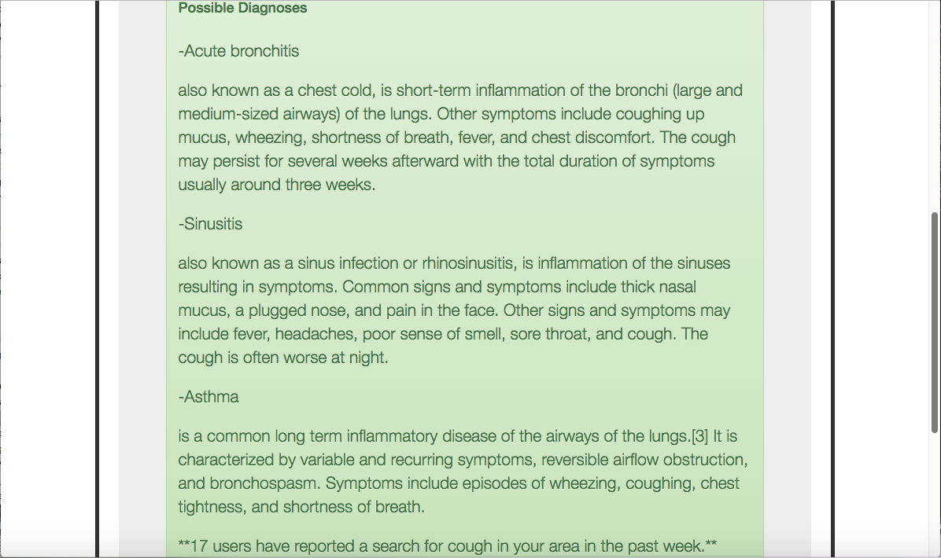

Slide 12
Technology used
Node.js
Javascript
Mysql
Sequelize
Express.js

Slide 13
Future development
omdo
User profiles to save long term diseases and provide a quick reference.
Up to 5 symptoms input for better accuracy on results.
Sex input to narrow down results to gender rated conditions
Age input to narrow down conditions more common in a certain age group
Separate page to display a list of clinics and hospitals in the area.
Separate pages for remedies and recipes that correspond to users input
to promote better health.

