Slide 1
Identification of variants in the evolution of novel aerobic citrate metabolism in Escheria coli
Richard Tillett
Midterm example, BCH 709
Fall 2018

Slide 2
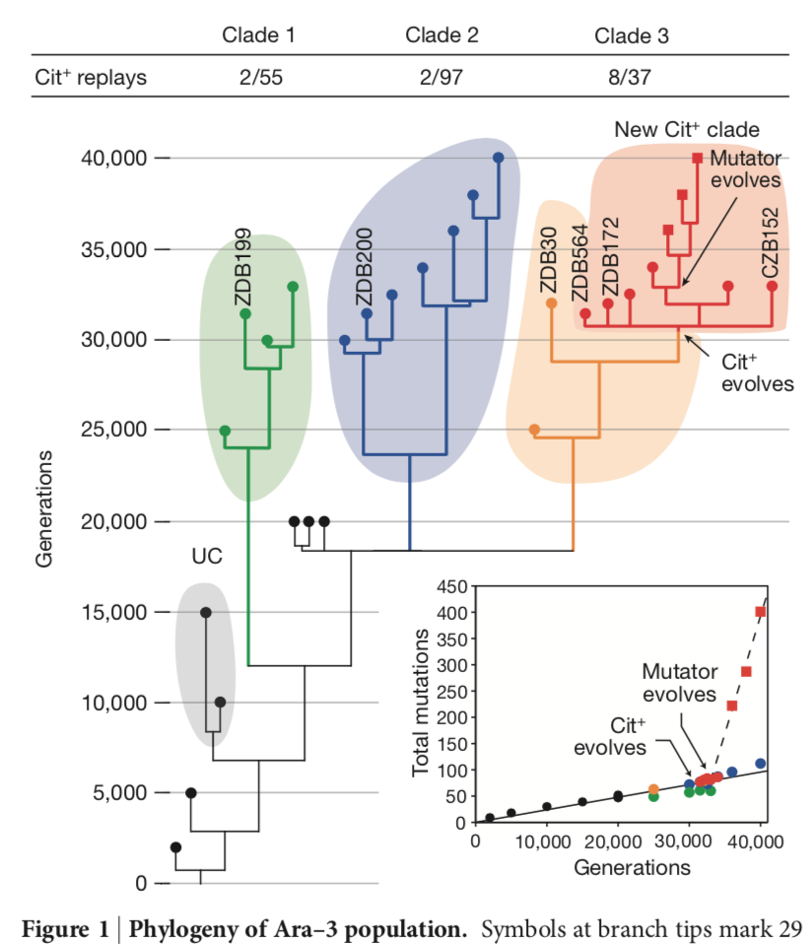
Background
Blount et al 2012 tracked E. coli for 40k generations under low glucose, high citrate medium
They detected the evolution of citrate metabolism Cit+ in this span of time
Sequenced various generations before and after Cit+ emerged
Identified numerous potentiating mutations pre-emergence of Cit+
Can I find them using the Data Carpentry tools?
Blount et al 2012, Fig 1

Slide 3
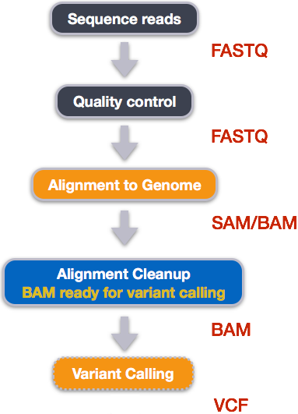
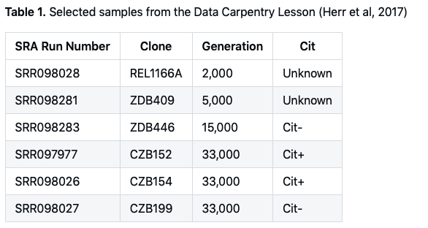
Aim 1: Identify variants in six samples from Blount et al 2012, using the tools from Data Carpentry
Data Carpentry Wrangling Genomics Schema

Slide 4
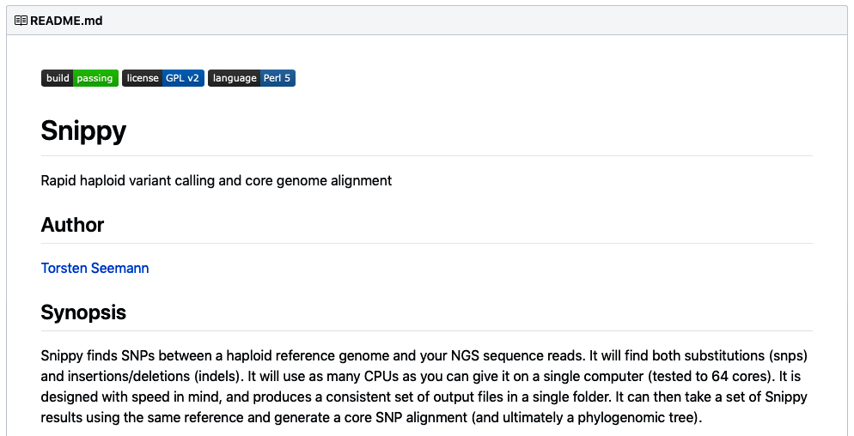
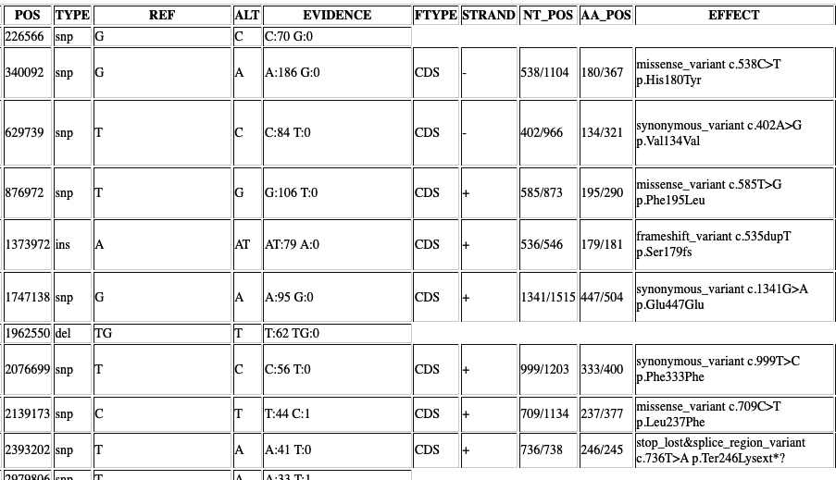
Aim 2: Comparison of variants with Blount et al.
To generate a compact list of variants and compare, I have to go beyond the tools described in the DC lessons
I will install and use Snippy to call and report variants with tools and settings appropriate for haploid genomes
https://github.com/tseemann/snippy
Snippy uses bwa, samtools, freebayes, snpeff, more
Snippy README Seermann, et al
Example Snippy Report

Slide 5
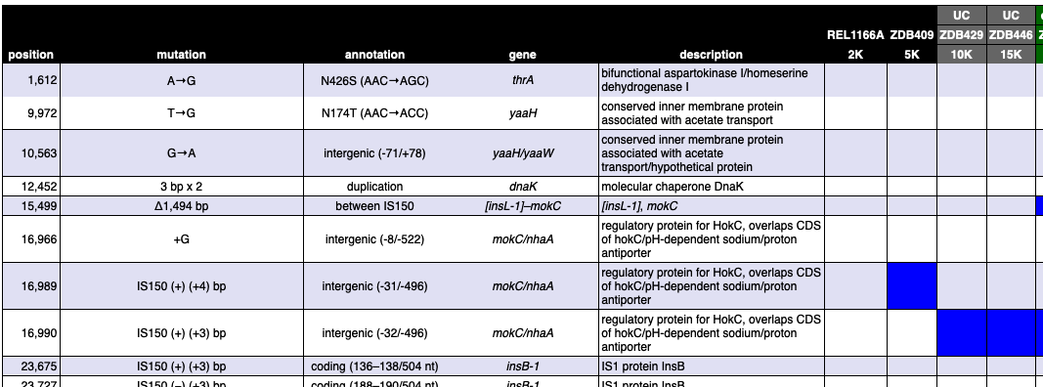
Aim 2: Comparison of variants with Blount et al.
How many of the variants reported in Blount will I also find using the DC tools and Snippy?
Blount et al, Supplemental table
Example Snippy Report

