Slide 1
DIY Bioinformatics: BLAST & friends
Richard Tillett
NV INBRE Bioinformatics Core
Feb 24, 2017

Slide 2
Today’s goal
My goal today is to help you answer one question…

Slide 3
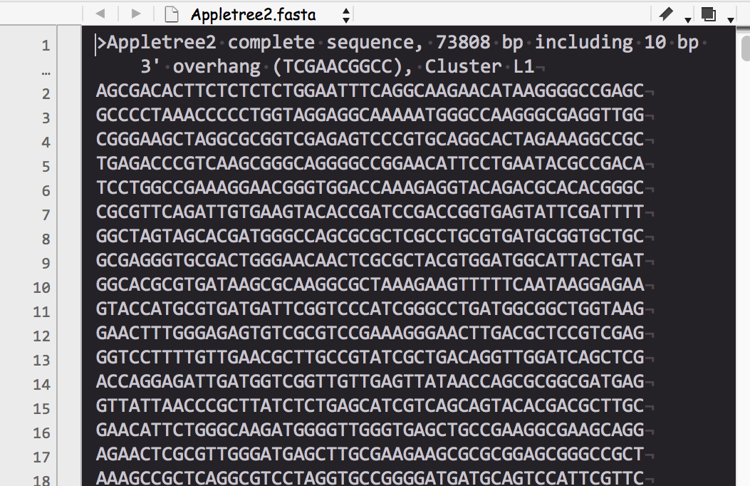
“What am I going to do with this!?”

Slide 4
We’ll make some sense of it (starting with BLAST)!

Slide 5
How will we do make sense of it?
Using the Basic Local Alignment Search Tool (BLAST)
What is BLAST?
BLAST is a set of tools used to identify imperfect matches (similarity) between a query nucleotide/protein sequence with sequences stored in a database. For a given query sequence, BLAST reports sequences with aligned regions of similarity.

Slide 6
BLAST
Basic Local Alignment Search Tool
based on Smith-Waterman (SW) local alignment
SW alignment employs a type of math called dynamic programming
BLAST uses a heuristic (shortcut) called word method

Slide 7
Global vs Local Alignment
Seq 1
Seq 2
Global alignment
Seq 1
Seq 2
Local alignment
Tao Tao, NLM, NIH, Bethesda, MD

Slide 8
BLAST basics
BLAST needs two things:
A query
Nucleotide or protein sequence
Typically in FASTA format text
A database to search
On web-based blasts, this will be a dropdown menu

Slide 9
FASTA
>gi|5524211|gb|AAD44166.1| cytochrome b [Elephas maximus maximus]
LCLYTHIGRNIYYGSYLYSETWNTGIMLLLITMATAFMGYVLPWGQMSFWGATVITN
LFSAIPYIGTNLVEWIWGGFSVDKATLNRFFAFHFILPFTMVALAGVHLTFLHETGSN
NPLGLTSDSDKIPFHPYYTIKDFLGLLILILLLLLLALLSPDMLGDPDNHMPADPLNTPLHI
KPEWYFLFAYAILRSVPNKLGGVLALFLSIVILGLMPFLHTSKHRSMMLRPLSQALFWTL
TMDLLTLTWIGSQPVEYPYTIIGQMASILYFSIILAFLPIAGXIENY
>SEQUENCE_2
MTEITAAMVKELRESTGAGMMDCKNALSETNGDFDKAVQLLREKGLGKAAKKADRLA
AEGLVSVKVSDDFTIAAMRPSYLSYEDLDMTFVENEYKALVAELEKENEERRRLKDPNKP
EHKIPQFASRKQLSDAILKEAEEKIKEELKAQGKPEKIWDNIIPGKMNSFIADNSQLDS
KLTLMGQFYVMDDKKTVEQVIAEKEKEFGGKIKIVEFICFEVGEGLEKKTEDFAAEVAA
QL
>SEQUENCE_3
SATVSEINSETDFVAKNDQFIALTKDTTAHIQSNSLQSVEELHSSTINGVKFEEYLKS
QIATIGENLVVRRFATLKAGANGVVNGYIHTNGRVGVVIAAACDSAEVASKSRDLLRQ
ICMH
A very basic specification consisting of:
>Definition line
One or more lines of sequence
Nucleotide OR protein
File named as .fasta, .fa, .fna, .faa, .txt
Schlauch BCH709

Slide 10
Why use BLAST?
“What is my sequence and what does it do?”
You obtained DNA sequence from an experiment and need to know more about it
Comparing the novel sequence to known protein sequences to hypothesize gene function
Comparing a partial sequence to whole genome sequences
Finding homologs to interesting genes in your favorite species
Specialized BLASTs
Make gene-specific primers for PCR (Primer-BLAST)
Screen a sequence for vectors (VecScreen)
Comparing two sequences (bl2seq)

Slide 11
Types of BLASTing
BLASTN: DNA query vs DNA database
BLASTP: protein query vs protein database
BLASTX: DNA query translated into all six reading frames to produce translated protein sequences, which are the used to query a protein seq database
TBLASTN: protein query vs a DNA sequence database with seqs translated into all 6 reading frames
TBLASTX: DNA query sequence translated into all 6 reading frames against DNA seq db translated into all 6 reading frames
Schlauch BCH709

Slide 12
Database Similarity Searching
general goal
submit a sequence of interest (query)
find most similar sequences from XX databases
the most similar sequences may have the most similar function to query sequence
Schlauch BCH709

Slide 13
E-Values
rules of thumb
E < 10⁻⁵⁰ → high confidence of homologous relationships
10⁻⁵⁰ < E < .01 → result of homology
.01 < E < 10 → no significance, perhaps remote homology
E > 10 → two sequences are randomly related
Nota Bene: as E is directly dependent on the length of the
database, as the database(s) increase in length, E will
increase, which likely will yield less hits
Schlauch BCH709 Fall 2016

Slide 14
How BLAST Works
Make lookup table of “words” for query
Scan database for hits (word match/seed)
Extend alignment both directions
Ungapped extensions of hits (initial HSPs)
Gapped extensions (no traceback)
Gapped extensions (traceback + alignment details)
Tao Tao, NLM, NIH, Bethesda, MD
Notes:
-X X dropoff value for gapped alignment (in bits) (zero invokes default
behavior) blastn 30, megablast 20, tblastx 0, all others 15 [Integer]
default = 0
=X2 (in output)
-y X dropoff value for ungapped extensions in bits (0.0 invokes default
behavior) blastn 20, megablast 10, all others 7 [Real]
default = 0.0
=X1 (in output)
-Z X dropoff value for final gapped alignment in bits (0.0 invokes default
behavior) blastn/megablast 50, tblastx 0, all others 25 [Integer]
default = 0
=X3 (in output)

Slide 15
Nucleotide Words
Make a lookup table based on the word size.
11-mer
ATGCTGCTAGTCGATGACGTAGCTACCGATAT
ATGCTGCTAGT
ATGCTGCTAGTCGATGACGTAGCTACC
TGCTGCTAGTC
GCTGCTAGTCG
CTGCTAGTCGA
TGCTAGTCGATGACGTAGCTACCGATA
. . .
Tao Tao, NLM, NIH, Bethesda, MD

Slide 16
Word Hits & Extensions
Nucleotide: one exact match
ATGCTGCTAGTCGATGACGTAGCTA
TAGTCGATGA
Protein: two matches within 40 residues
PHAIEKCYTGCTLAQEADDTA
IDK EAD
Tao Tao, NLM, NIH, Bethesda, MD

Slide 17
Global vs Local Alignment
Seq 1
Seq 2
Global alignment
Seq 1
Seq 2
Local alignment
Tao Tao, NLM, NIH, Bethesda, MD

Slide 18
BLAST Parameters
Max target sequences: how many possible
alignments you want to BLAST to return
Automatically adjust parameters for short sequences:
defaults: BLOSUM62, for short sequences, PAM30
shorter sequences = 50 bases,
Expect threshold: how many matches from the database
should be due to chance alone?
Word size: the length of the word that the BLAST
algorithm first uses between the query and database
sequences (and then extends left and right)
defaults: 3 or 6 AA’s; 11 bases, smaller values are more
sensitive
Schlauch BCH709 Fall 2016

Slide 19
BLAST Parameters
Max matches in a query range: you can limit the number
of matches to a particular part of a sequence
Match/Mismatch Scores: select from pull-down menu
Gap Costs: choose from specifics or use a linear function
Filter: you can filter out low-complexity regions
or known repeat regions based on organism
Mask: you can highlight parts of your sequence to be
filtered by the filter above
Schlauch BCH709 Fall 2016

Slide 20
BLAST Parameters
before aligning, you may want to exclude regions of
low complexity ~ regions containing short repeats
they make up ~15% of all protein sequence data
may artificially increase the similarity score
alignment software allows you to mask these
regions
- hard masking: excludes the regions completely
- soft masking: excludes the regions in first step
but uses them for the extension step
Schlauch BCH709 Fall 2016

Slide 21
Test drive time!
Go to
https://github.com/rltillett/diy-blast/
& click “diy_blast.md”

