Slide 1
Modeling Bivariate Change Processes of Health and Well-being in the NHATS
By Bill

Slide 2
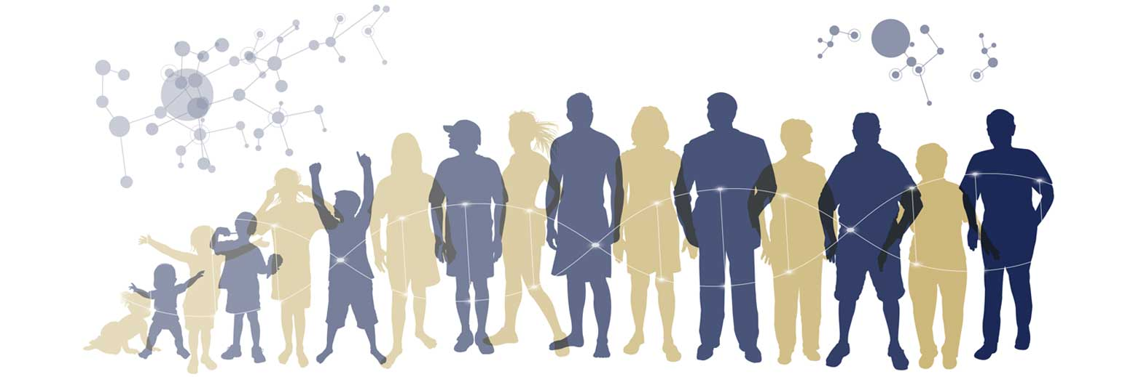

Slide 3


Slide 4
Pillars of Successful Aging
Several models have been used to characterize how individuals age and experience older adulthood (e.g., Antonucci et al., 2011; Baltes & Baltes, 1990; Carstensen, 1999; Charles, 2010; Heckhausen, 2011; Learner et al., 2011).
One of the most successful models is the framework of Successful Aging (Rowe & Kahn, 1997/2015).
Engagement with Life*
High Cognitive* and Physical Function
Avoiding Disease* and Disability
Out of this initial framework comes a lot of additional work on how these pillars are best conceptualized and what predicts someone who is “successfully aging.”

Slide 5
Interrelations among Successful Aging Pillars
There is likely cross-disciplinary consensus that health and well-being are associated with each other for some reason.
Compromised health provides some clear mechanisms for why it would impact well-being—it creates various restrictions and psychological changes that affect well-being.
The reverse has fewer clear links, although it has been advocated for by a staunch group of people who study subjective well-being (see Diener et al., 2018).
Well-being is associated with more positive health behaviors, adaptation to stress (self-reports and HRV), immune functioning, less chronic disease, recovery from illness, and lower mortality.
However, there haven’t been many studies examining the interrelation between health and well-being over longer durations of time and among those who are more likely to have compromised health. Plus, there’s even some disagreement over the normative trajectory of these characteristics over time.

Slide 6
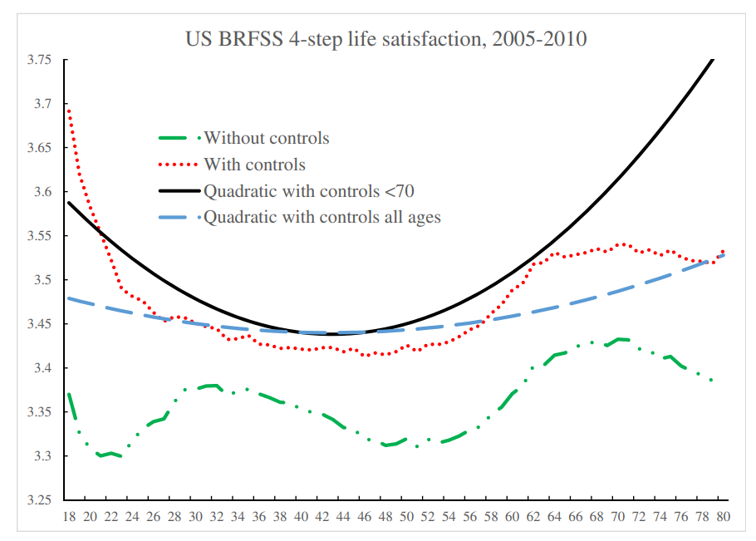

Slide 7
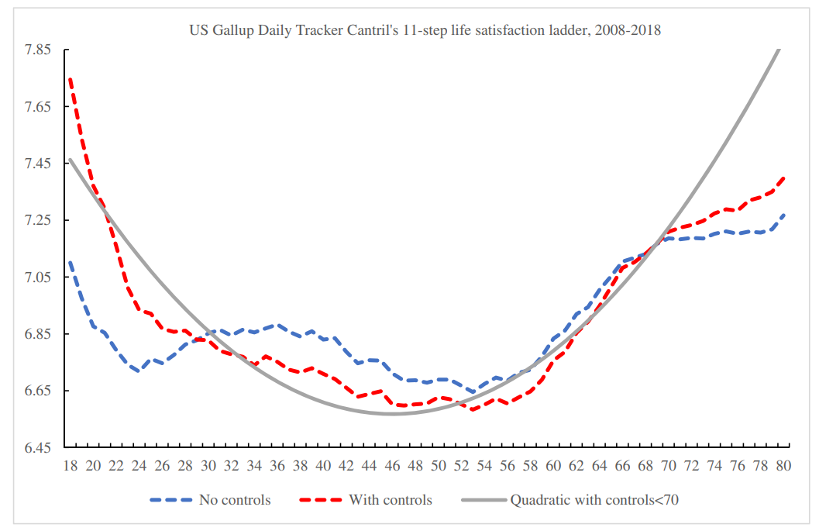
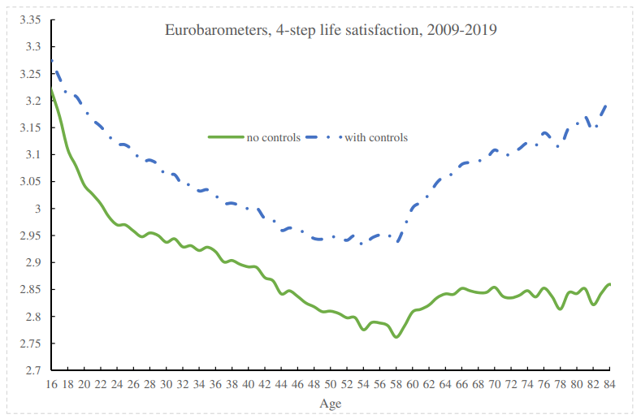
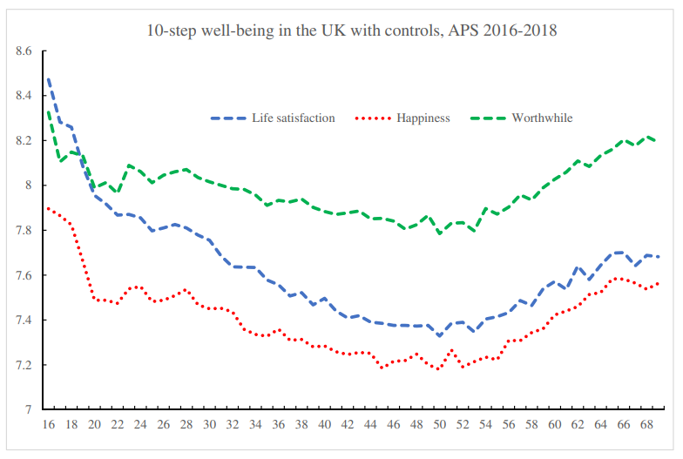
Blanchflower et al., 2021

Slide 8
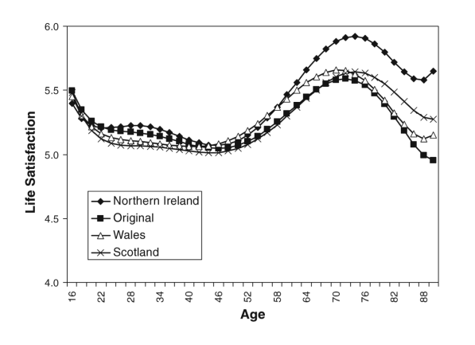
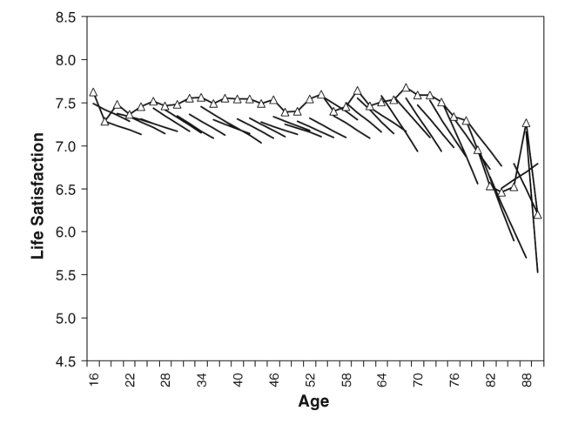
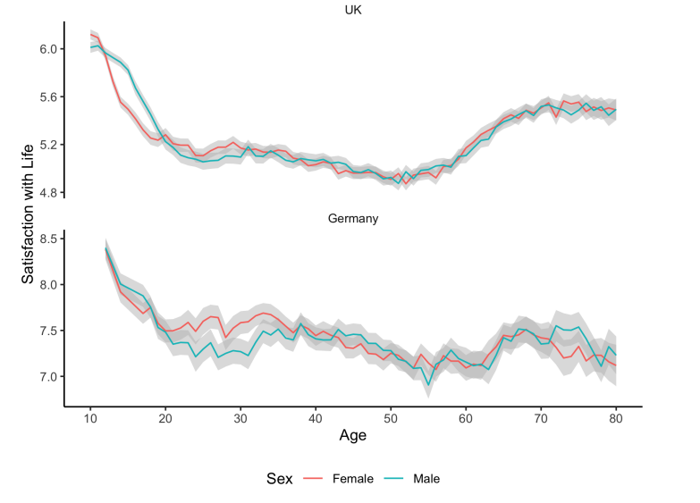
Baird et al., 2010; Orben et al., 2018

Slide 9
Ambiguity about Developmental Trajectories
Life satisfaction increases with age (Lucas & Gohm, 2000; Prenda & Lachman, 2001; Vaux & Meddin, 1987)
Well-being decreases with age (Freund & Baltes, 1998; Mroczek & Spiro, 2005)
Well-being doesn’t change with age (Diener & Suh, 1998; Hamarat, Thompson, Steele, Matheny, & Simons, 2002)
Well-being has a U-shape with age
Although the exact “nadir” is a bit debated (see Hudson, Lucas, & Donnellan, 2019)

Slide 10
Broadening out well-being
Even more variability is present in less studied constructs that are conceptually related but empirically distinct constructs
Purpose in life (declines or no changes at all; Hill et al., 2015; Pinquart, 2002; Springer et al., 2011)
Positive emotionality (Chi, Almeida et al., 2021; Stawski et al. 2019).
Statistical controls might confound age-related processes.
How closely linked are things like well-being, health, and cognition? Has implications for models of successful aging.
What is needed is a large sample of heterogeneous older adults followed over extended periods of time with consistent measures of well-being, health, and cognition.

Slide 11
National Health & Aging Trends Study
Combined waves 1 through 10 to maximize the sample size.
N = 12,427 SPs contributing at least one wave of data (59.7% female)
65-69: 19.7%
70-74: 19.9%
75-79: 19.1%
80-84: 18.5%
85-89: 12.7%
90+: 10.2%
68.6% white, 21.8% black, 5.7% Hispanic, 2.8% other, 1.1% don’t know/refused
I modeled bivariate changes in purpose in life, self-rated health, and cognition (word recall tasks). These analyses controlled for age, gender, and education.
I’ll ask you a few questions later about modeling more complicated processes! And weighting. ☺

Slide 12
A brief (measurement) aside…
Well-being Questions Group #1 (3-point scales; analyzed separately and together)
My life has meaning and purpose.
I feel confident and good about myself.
I gave up trying to improve my life a long time ago.
I like my living situation very much.
Other people determine most of what I can and cannot do.
When I really want to do something, I usually find a way to do it.
I have an easy time adjusting to change.
Well-being Questions Group #2 (5-point scales; last month feeling)
Cheerful
Bored
Full of life
Upset

Slide 13
Item | Factor 1 | Factor 2
My life has meaning and purpose. | 0.67 | 0.21
I feel confident and good about myself. | 0.75 | 0.17
I gave up trying to improve my life a long time ago. | 0.10 | 0.78
I like my living situation very much. | 0.66 | 0.03
Other people determine most of what I can and cannot do. | 0.09 | 0.79
When I really want to do something, I usually find a way to do it. | 0.49 | 0.24
I have an easy time adjusting to change. | 0.56 | -0.08

Slide 14
Item | Factor 1 | Factor 2
My life has meaning and purpose. | 0.67 | 0.21
I feel confident and good about myself. | 0.75 | 0.17
I gave up trying to improve my life a long time ago. | 0.10 | 0.78
I like my living situation very much. | 0.66 | 0.03
Other people determine most of what I can and cannot do. | 0.09 | 0.79
When I really want to do something, I usually find a way to do it. | 0.49 | 0.24
I have an easy time adjusting to change. | 0.56 | -0.08

Slide 15
Item | Factor 1
Cheerful | 0.80
Bored (R) | 0.69
Full of Life | 0.78
Tired (R) | 0.66

Slide 16
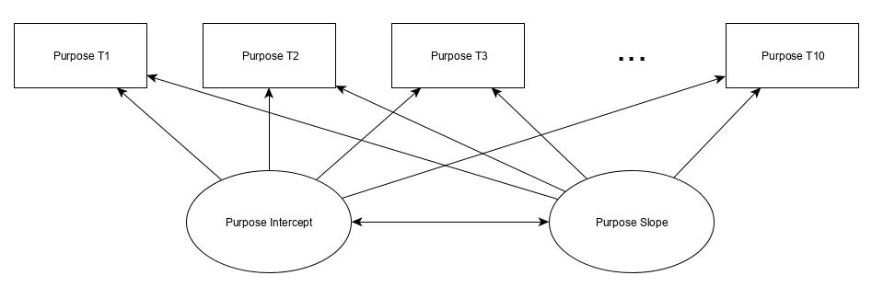

Slide 32
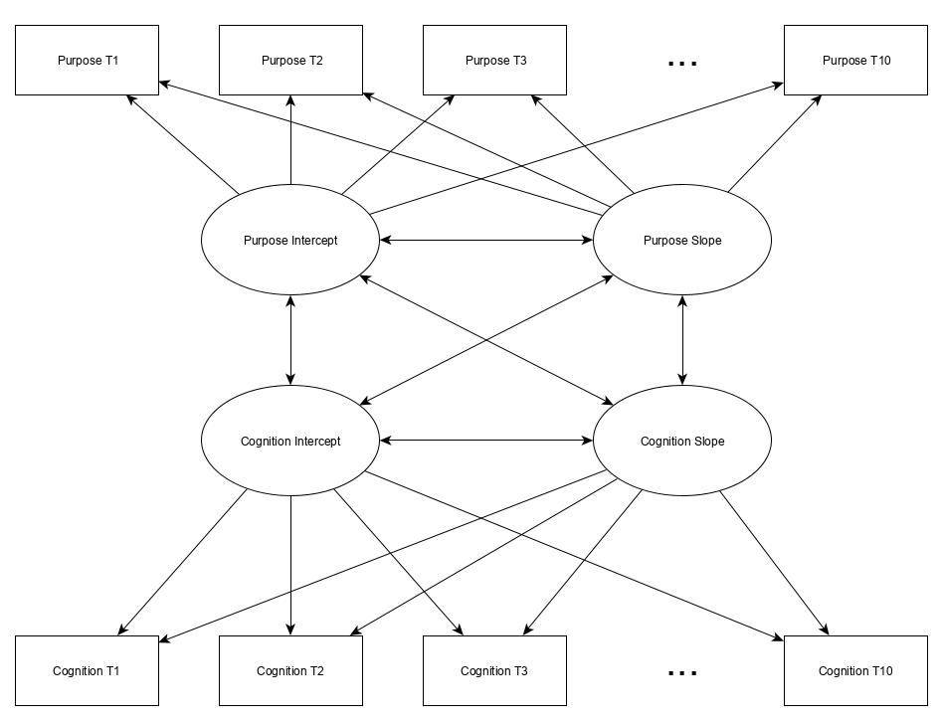

Slide 37
Results(adjusted p < .001; xy standardization shown)
Did people who started off with worse health/cognition change differently in their well-being over time?
Rarely. It doesn’t affect their changes in purpose at all (ps > .60). People with worse overall health declined in positive emotions over time (bst = -.44, p < .001) but their cognition was unrelated to their changes in positive emotions (bst = -.07, p = .03).

Slide 39
Results(adjusted p < .001; xy standardization shown)
Did people who started off with worse health/cognition change differently in their well-being over time?
Rarely. It doesn’t affect their changes in purpose at all (ps > .60). People with worse overall health declined in positive emotions over time (bst = -.44, p < .001) but their cognition was unrelated to their changes in positive emotions (bst = -.07, p = .03).
Did people who started off with lower well-being experience more dramatic declines in health/cognition over time?
Yes, but only for health. People who had lower levels of purpose experienced steeper declines in health (bst = -.12, p < .001); people with lower positive emotions also had steeper declines in health (bst = -.26, p < .001).
Purpose (p = .27) and positive emotions (p = .14) were unrelated to changes in cognition.

Slide 41
Results(adjusted p < .001; xy standardization shown)
Are people coordinated in how their well-being and health/cognitions change over time?
Yes, for ALL scenarios. Changes in purpose were correlated with changes in health (bst = .23, p < .001) and changes in cognition (bst = .31, p < .001).
Changes in positive emotions were correlated with changes in health (bst = .59, p < .001) and changes in cognition (bst = .19, p < .001).

Slide 42
Interim Conclusions
People’s well-being and their health/cognition were correlated in how they changed over time. How your well-being changed was associated with changes in health/cognition.
As your health or cognition got worse, you experienced simultaneous changes in well-being.
Some evidence for a unidirectional effect: purpose and positive emotions at the start of NHATS predicted changes in health over time but not cognition.
The reverse wasn’t true.

Slide 43
How can we further disentangle the associations between health/cognition and well-being?

Slide 44
Modeling predictions of health and well-being
People traditionally approach this question by employing cross-lagged panel models.
Way harder and more complicated than you think…

Slide 45
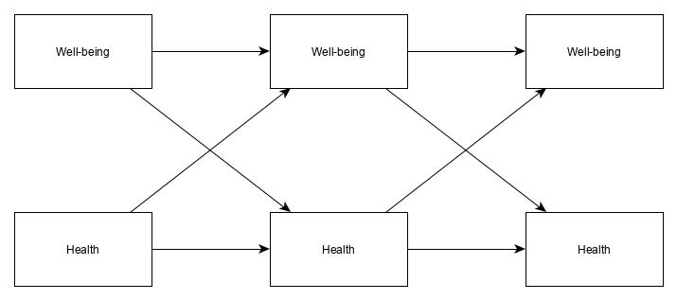

Slide 46
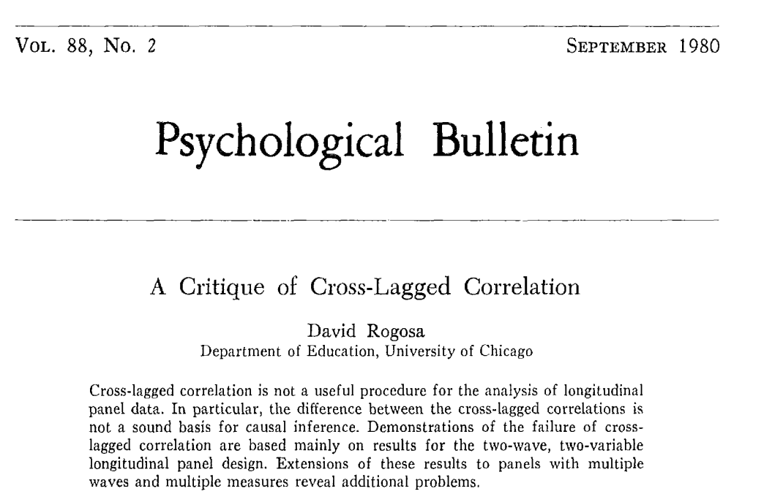
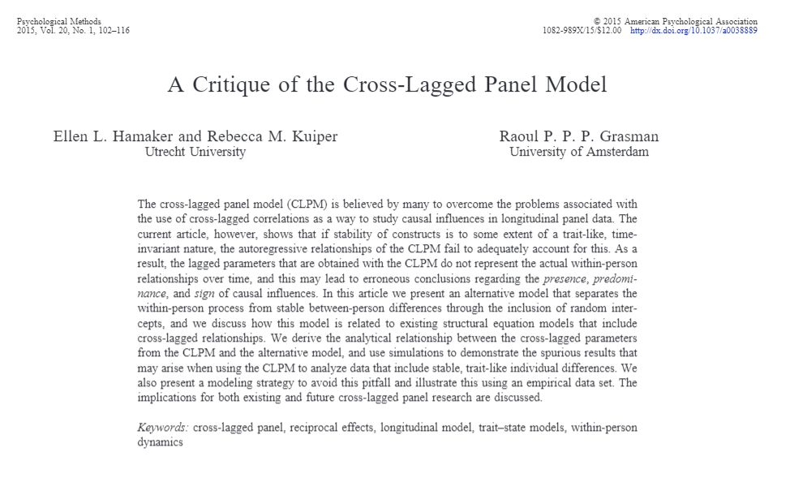

Slide 47
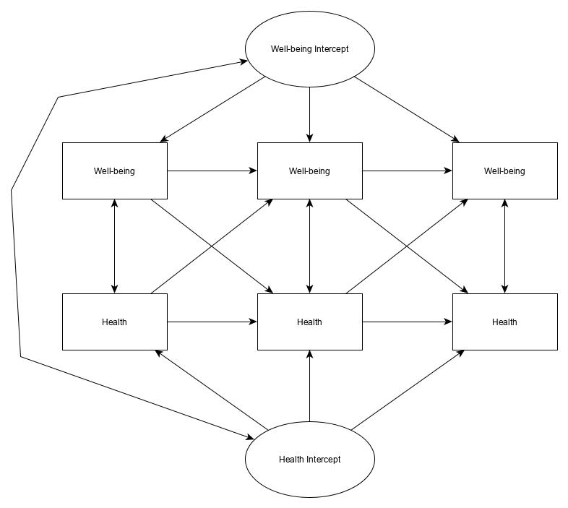

Slide 48
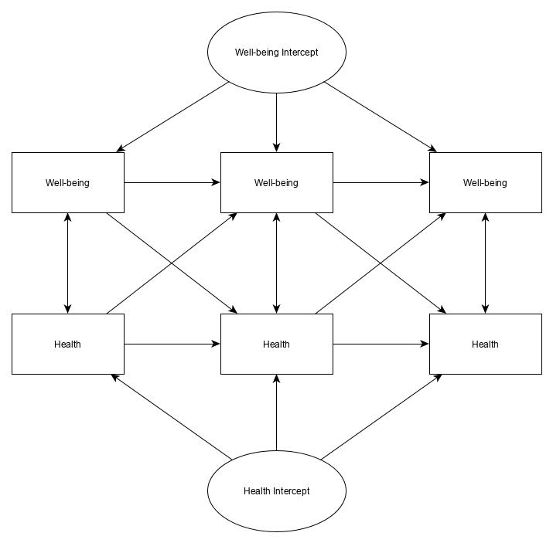
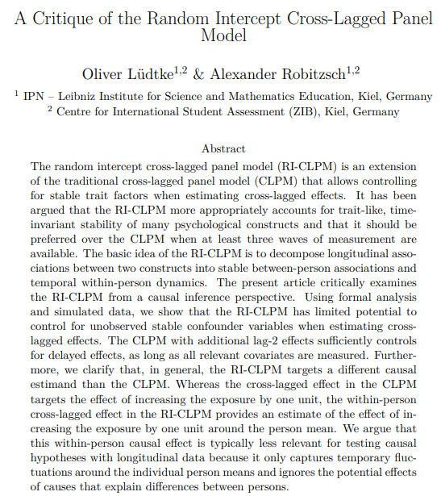
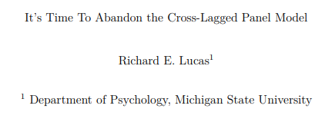

Slide 49
Modeling predictions of health and well-being
People traditionally approach this question by employing cross-lagged panel models.
Way harder and more complicated than you think
It’s currently being debated; not sure how to proceed (might hold off on those analyses).
There are likely “intermediary” processes (i.e., mediators/mechanisms) linking simultaneous changes in health/cognition and well-being).
I’d love to hear your thoughts on what these variables might be.

Slide 50
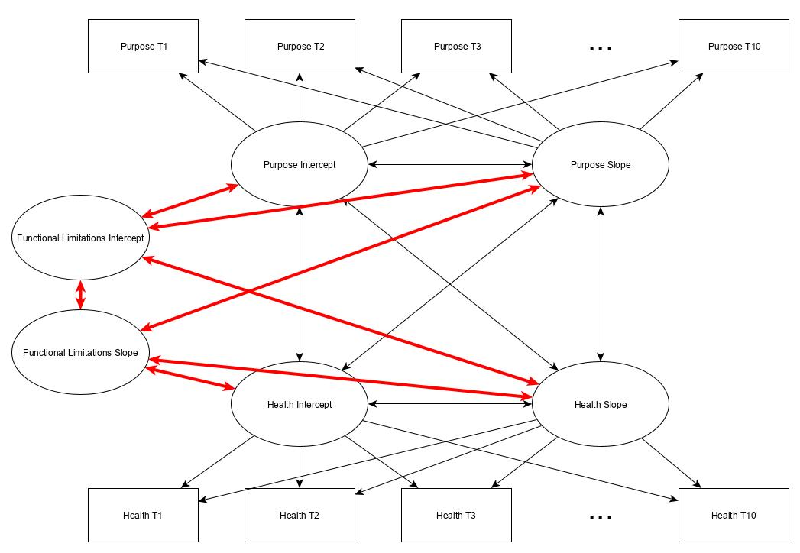

Slide 52
Thanks Everyone!
Next immediate steps
There are likely “intermediary” processes (i.e., mediators/mechanisms) linking simultaneous changes in health/cognition and well-being).
This model could be extended to examine subgroup analyses, disparities, and other contextual variables.
Happy to answer any questions!

