Slide 1
Machine learning for linear solvers
By: Wes Ludwig + Max Oellien

Slide 2
What is Machine Learning?
Field of CS where statistical methods are used to “teach” computers with data
Started in 1959, applied to many tasks, such as spam filtration, cybersecurity, and computer vision
Main task to generate classification rules, hypotheses h which map an Instance Space X to a Label Space Y . Denoted as h : X -> Y
Minimize generalization error: err(h) = P(h(x) =! y)

Slide 3
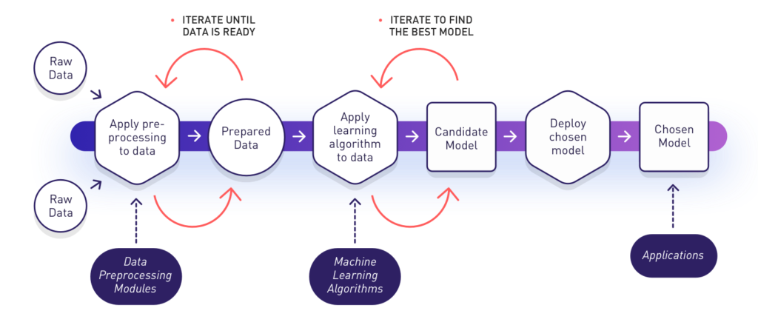
How does it work?

Slide 4
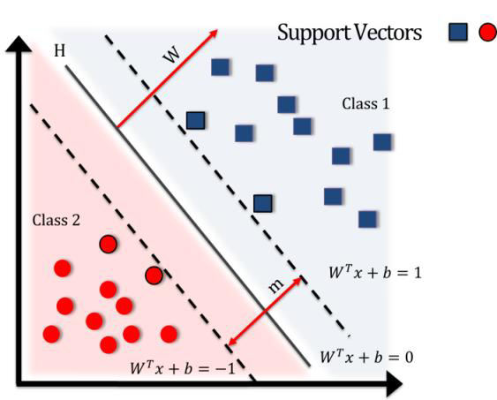
How does it work? - Support Vector Machine
Data Source: Distribution D on X
(x1, x2, …,xm)
Labelling: c* : X -> Y ((x1,c*(x1)),...,(xm,c*(xm)))
Algorithm learns from labeled examples and outputs: h : X -> Y

Slide 5
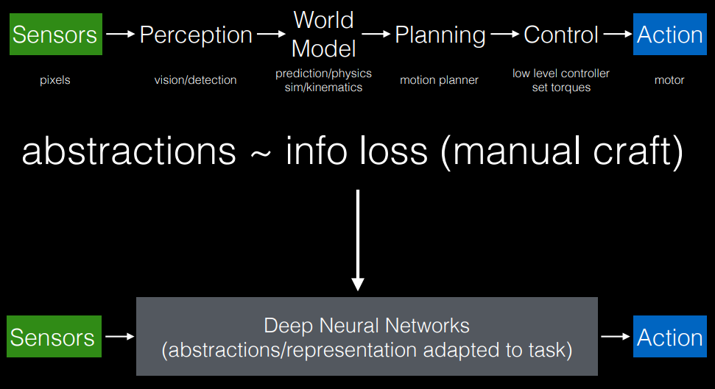
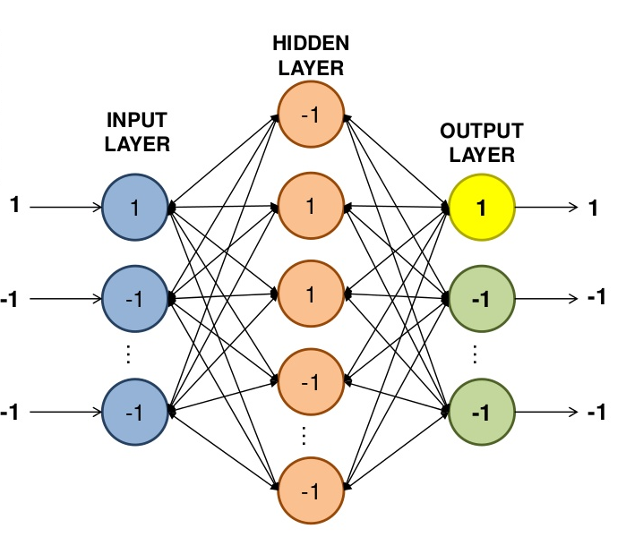
Deep Learning
https://pdfs.semanticscholar.org/presentation/3c1a/e7e3e3594081a1b21cdf79175e832add3af6.pdf

Slide 6
Application: Choosing Sparse Linear Solvers
- Solving sparse linear systems is a fundamental problem in scientific computing and often comprises the majority of computing time.
- The problem of maximizing performance of solvers on linear systems is PAC learnable. => h : X -> Y
- An example distribution D over example space XxY can be assumed to be representative of the full space.
-A learning algorithm can be made to generate h by being trained on a subset of D.

Slide 7
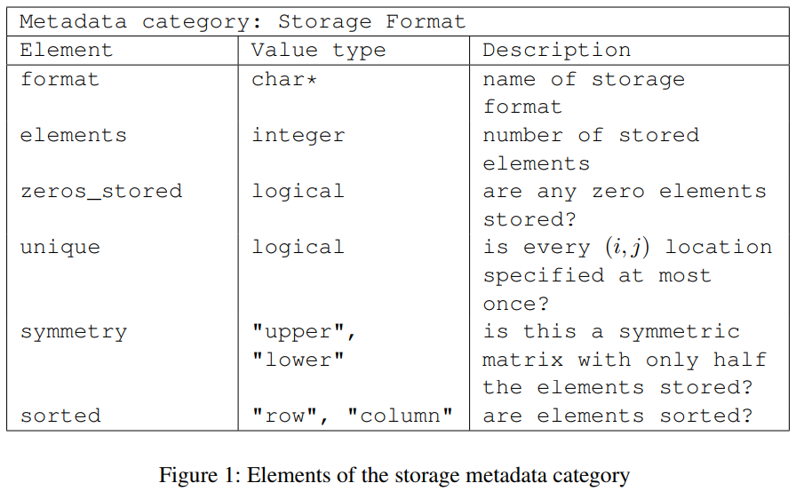
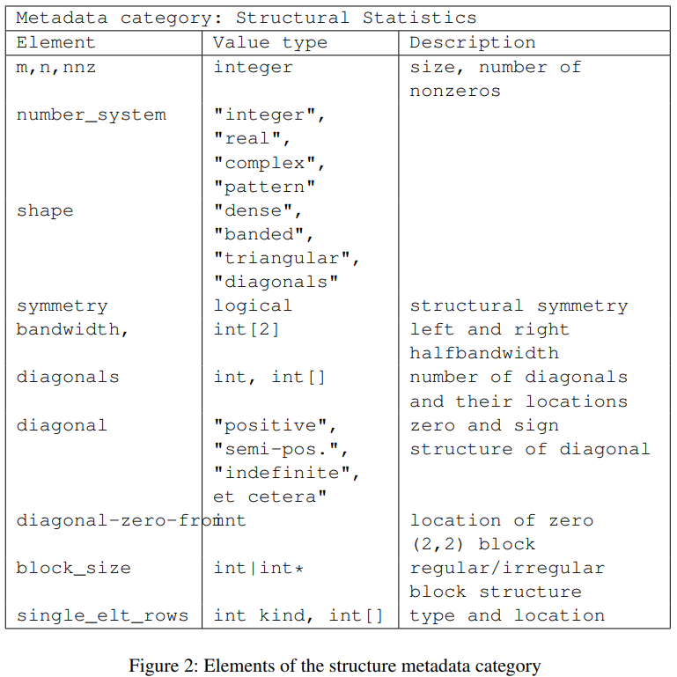
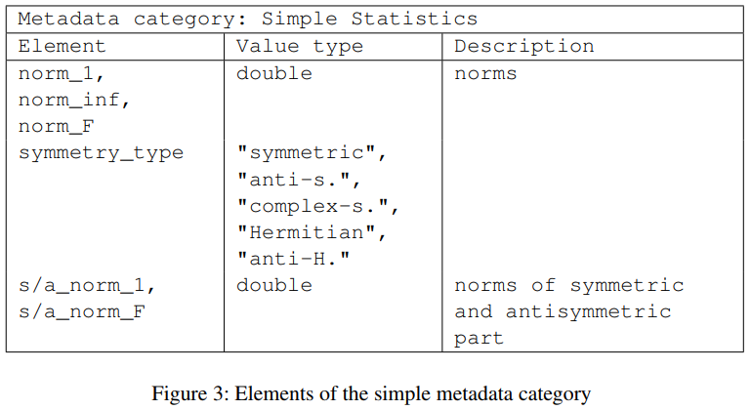
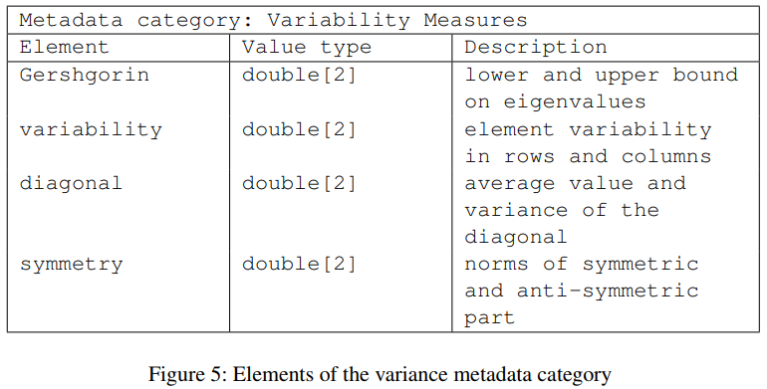
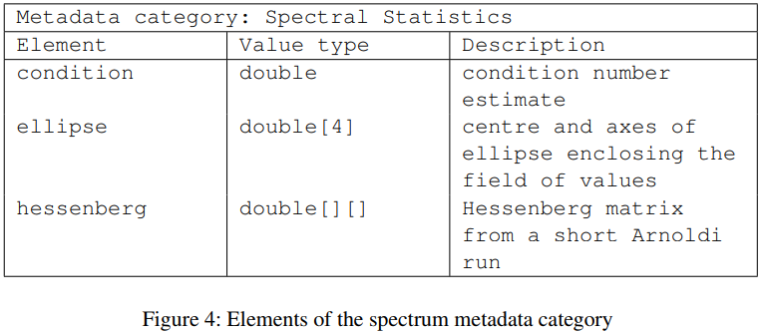
Characterizing Linear Systems
A Standard and Software for Numerical Metadata. ACM TOMS (2007)

Slide 8
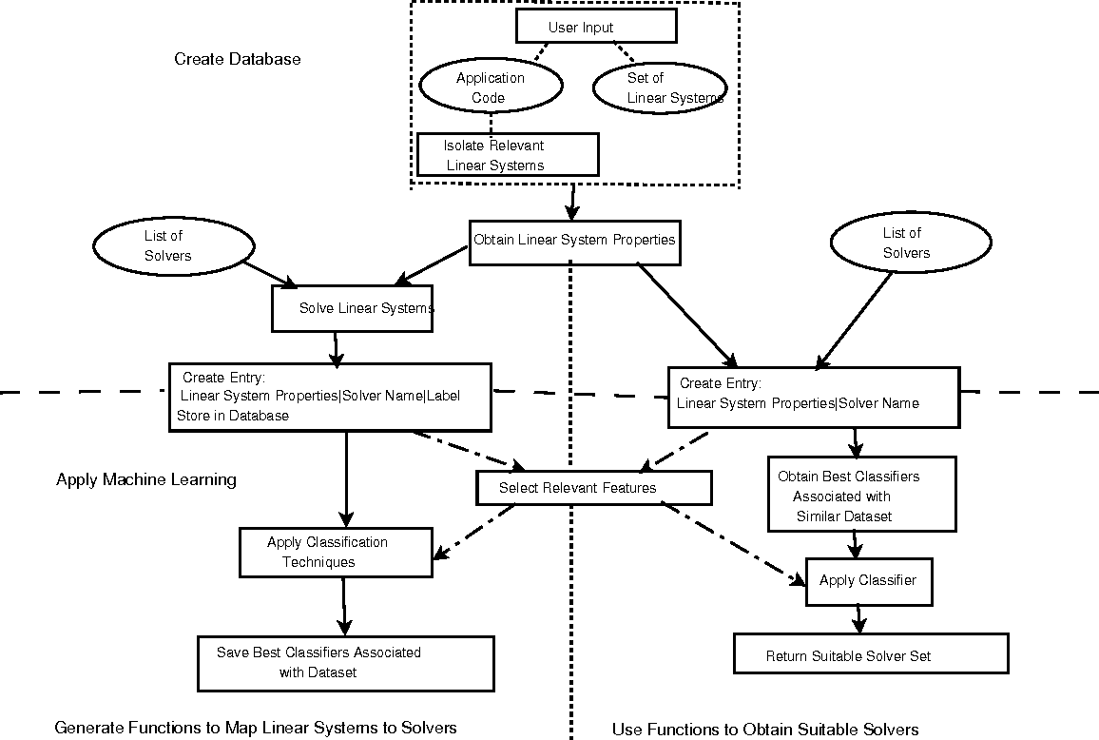
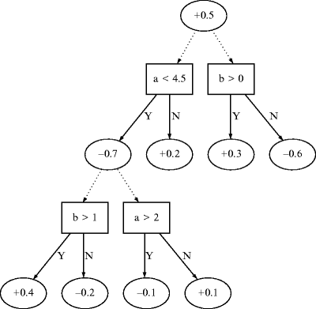
M.L. for choosing Linear Solvers

Slide 9
Proposed Work
We propose to replicate the method laid out in the 2010 paper for a novel set of linear systems.
-Label a subset of linear systems for training and testing using NMD AnaMod
-Solve training systems with PETSc solvers to develop performance characteristic labels
-Implement boosting in MLJava to generate a classifier ADT which could be used to decrease computing time for the full set of linear systems.
Though we have not chosen an example set of linear systems, the later tutorials and matrix examples of the PETSc library present numerous possibilities

Slide 10
References
Bhowmick, S., Eijkhout, V., Freund, Y., Fuentes, E., & Keyes, D. (2006). Application of Machine Learning in Selecting Sparse Linear Solvers. Retrieved from http://pages.tacc.utexas.edu/~eijkhout/Articles/2006-bhowmick.pdf
Bhowmick, S., Eijkhout, V., Freund, Y., Fuentes, E., & Keyes, D. (2010). Application of Alternating Decision Trees in Selecting Sparse Linear Solvers. Software Automatic Tuning, 153-173. doi:10.1007/978-1-4419-6935-4_10. Retrieved from
https://link.springer.com/chapter/10.1007%2F978-1-4419-6935-4_10
Bhowmick, S., Toth, B., & Raghavan, P. (2009). Towards Low-Cost, High-Accuracy Classifiers for Linear Solver Selection. Lecture Notes in Computer Science Computational Science – ICCS 2009, 5544, 463-472. doi:10.1007/978-3-642-01970-8_45. Retrieved from https://link.springer.com/chapter/10.1007/978-3-642-01970-8_45
Eijkhout, V., & Fuentes, E. (2009). A Standard and Software for Numerical Metadata. ACM Transactions on Mathematical Software, 35(4), 1-20. doi:10.1145/1462173.1462174. Retrieved from
https://pdfs.semanticscholar.org/1d0b/051b34ce43c77bdf07eb5db7f460894946f8.pdf
Eijkhout, V., & Fuentes, E. (2010). Machine Learning for Multi-stage Selection of Numerical Methods. New Advances in Machine Learning. doi:10.5772/9376. Retrieved from
http://pages.tacc.utexas.edu/~eijkhout/Articles/2010-intech.pdf
Eijkhout, V. (2008, August 19). NMD: Numerical Metadata library Reference Manual. Retrieved from https://www.icl.utk.edu/files/publications/2007/icl-utk-183-2007.pdf

