Slide 1
6356 Final Project
Jonathan Jackson, Sriram Arjula, Ryan Luna

Slide 2
Presentation outline
Paper Overview
Project Overview
Implementation
Results
Future Work

Slide 3


Paper Overview
Parallel Implementation of Cryptographic Algorithm:
AES using OpenCL on GPUs
Govardhana Rao Inampudi
Prof. Shyamala K
Prof. S. Ramachandram

Slide 4
High-level Overview
Motivation: Protecting information through cryptographic algorithms
Problem: Cryptographic algorithms are computationally intense. The computational time required increases exponentially as data gets larger.
Solution: Implement a parallel version of a cryptography algorithm (AES) on GPUs to realize a speedup in execution time.
Results: Showed an improvement up to 99.8% in comparison to a sequential implementation of the encryption algorithm.

Slide 5
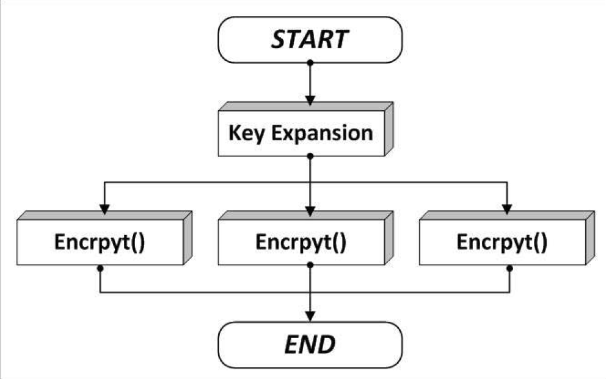
Paper discussion (Method)
Data decomposition is used to divide the input-data into 256 work-items.
The size of each work item is 24 bits
What the work-items are specifically isn't specified.
Data is data and the algorithm will work all the same
Data parallelism is achieved by assigning the groups of work-items to multiple threads and simultaneously to GPU cores.
The AES algorithm employed is of 14 rounds, indicating that AES-256 is being used.
As seen on the right, the encrypt function is executed in parallel (concurrently) whereas the key expansion stage is executed sequentially.
Flow diagram of Parallel implementation of AES algorithm

Slide 6
Paper discussion (Results)
The program was implemented using OpenCL and tested on AMD Radeon 8550M and 8570G GPUs.
The AMD APP Profiler was used for performance analysis
Parameters such as the GPU platform, global and local item sizes processed by the GPU, and the kernel occupancy of OpenCL are considered to evaluate the work.

Slide 7
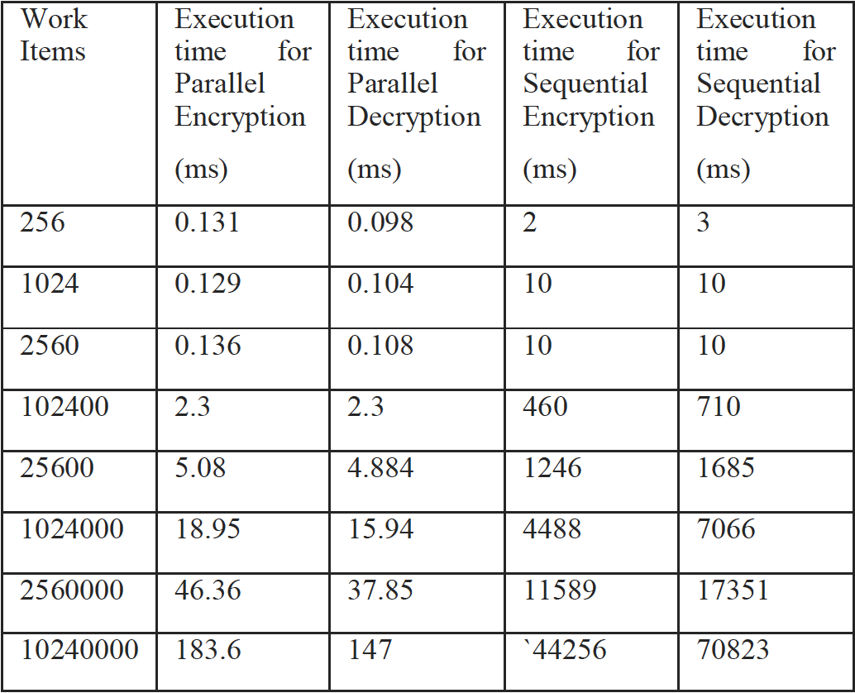
Paper discussion (results) cont.
As the number of work-items increases from 256 to 1024, the execution time can be seen rapidly decreasing.
The most optimal speedup achieved is 99.8% at 1024 work items.
Due to IPC overhead the execution time increases once the work-items exceeds 1024
However, in comparison to the sequntial implementation, even at 10240000 work-items, the speedup is 99.6%
Sequential and Parallel Execution Time of AES algorithm

Slide 8
Project overview

Slide 9
Project overview
Our project direction is in the field of Image Processing and parallel execution of cryptography algorithms (e.g. AES).
The work presented in the paper has a wide variety of potential applications. Our main goal for this project was/is to build a working example of one.
Using the Python programming language
Attempting Data Parallelization
Implementing AES on images
Fast and secure data transfer is a huge topic in the IoT and Cloud Computing era. That is our motivating factor, and we believe that parallel computing is key in achieving this.

Slide 10
Objective(s)
Expand on the work in this paper by integrating image processing and cryptography.
Develop a working implementation of an image encryption/decryption program.
Achieve a speedup from a parallelized implementation of our image encryption/decryption program on a CPU.
Implement OpenCL and execute the program on a GPU to realize a greater speedup.
GPUs can handle parallel processing at much greater efficiency than CPUs
Conclude our project with results

Slide 11
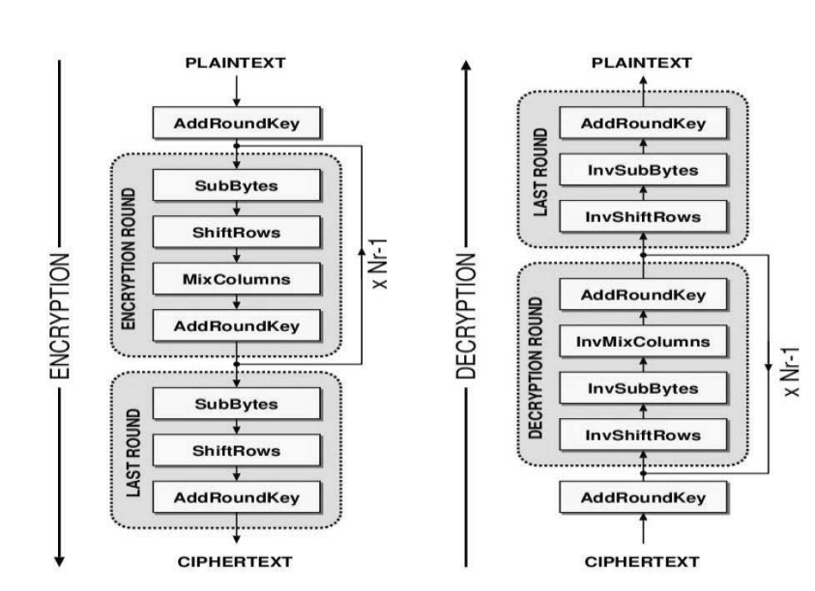
What is AES?
The Advanced Encryption Standard (AES) algorithm is a symmetric block cipher that processes image which is of blocks size 128 bits using three different cipher key size of lengths 128,192 or 256 bits. Based on the key size length used, the number of execution rounds of the algorithm is 10, 12 or 14 respectively
The algorithm has 4 rounds based on the Rijndeal cipher:
1.Key Expansion
2.Initial round
3.rounds - sub bytes, shift rows, mix colomns and add round key.
4.last round key: add round key.

Slide 12
Data parallelism
Data parallelism is parallelization across multiple processors in parallel computing environments. It focuses on distributing the data across different nodes, which operate on the data in parallel.
Examples of data parallelism were given at the beginning of the semester
Splitting input data across multiple cores to run the same computation on them in parallel (e.g. getting the min, or max of an array).

Slide 13
implementation

Slide 14
python

Slide 15
OpenCL (PyOpenCL)
OpenCL provides many benefits in the field of high-performance computing. OpenCL-coded routines, called kernels, can execute on GPUs and CPUs from manufacturers such as Intel, AMD, Nvidia, and IBM.
A single application can dispatch kernels to multiple devices at once (synchronize kernels running on both a CPU and GPU and share data between them).
PyOpenCL is an open-source package (MIT license) that enables developers to easily access the OpenCL API from Python.

Slide 16
Threading (Python Pkg.)
This module constructs higher-level threading interfaces on top of the lower-level _thread module.
Allows the creation of threads which can (normally) execute concurrently.
In CPython, due to the Global Interpreter Lock, only one thread can execute Python code at once (even though certain performance-oriented libraries might overcome this limitation).

Slide 17
Python Global Interpreter Lock (GIL)
In CPython, the global interpreter lock, or GIL, is a mutex that protects access to Python objects, preventing multiple threads from executing Python bytecodes at once.
The GIL prevents race conditions and ensures thread safety.
The GIL does not have much impact on the performance of I/O-bound multi-threaded programs as opposed to CPU-bound threads.
The lock is shared between threads while they are waiting for I/O.
A program whose threads are entirely CPU-bound (e.g. a program that processes an image in parts using threads) would not only become single-threaded due to the lock but will also see an increase in execution time due to the acquire and release overheads added by the lock.

Slide 18
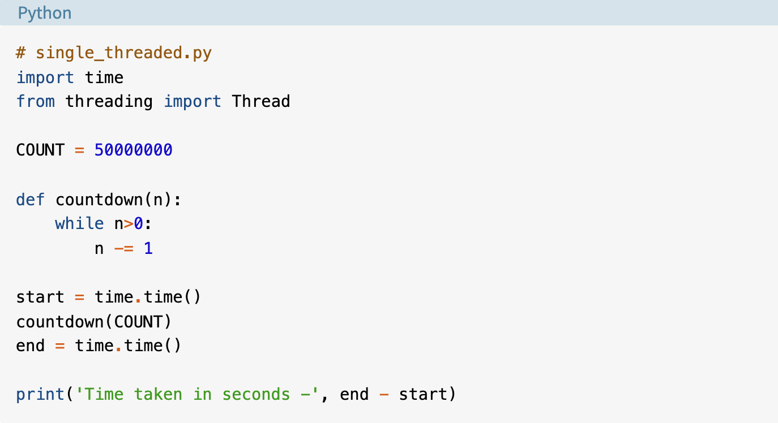
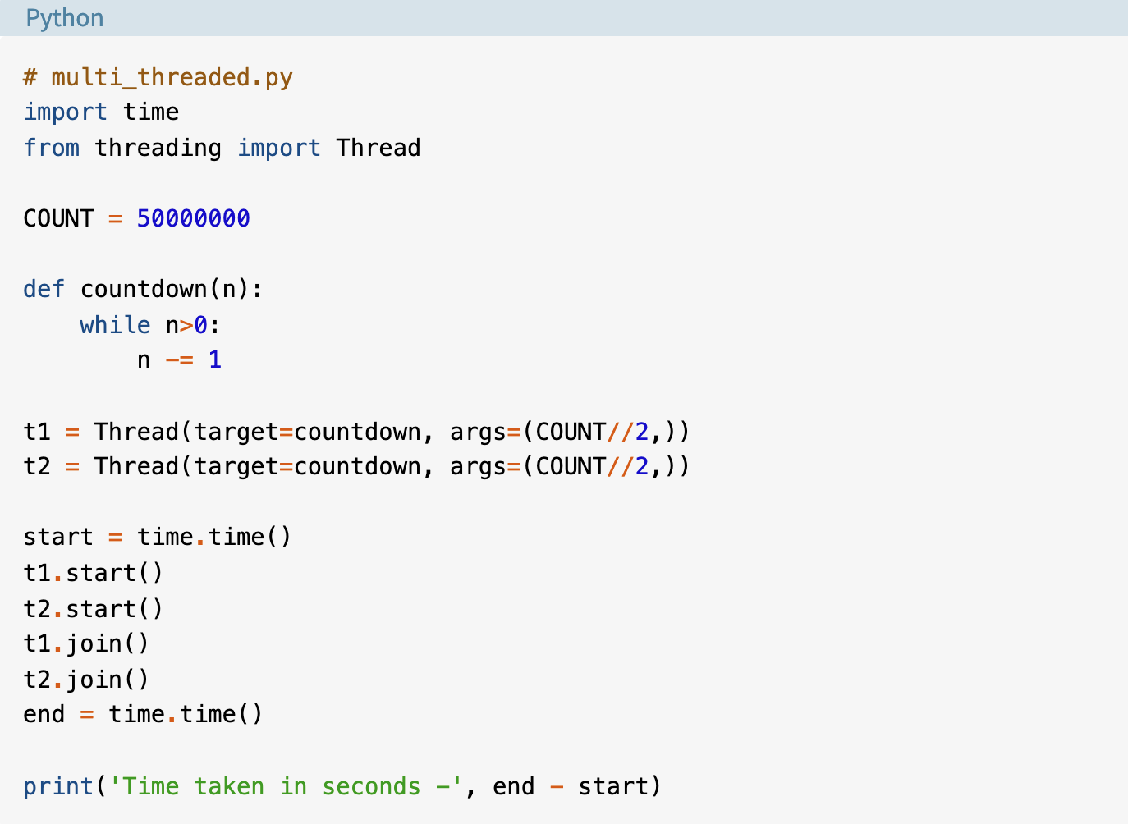
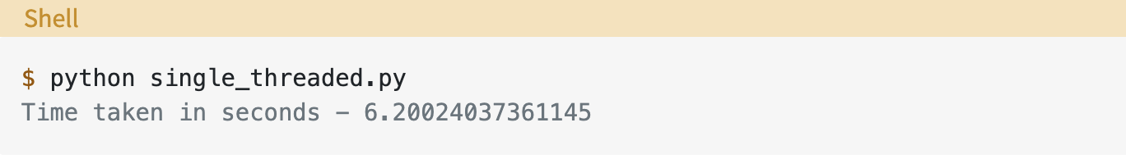
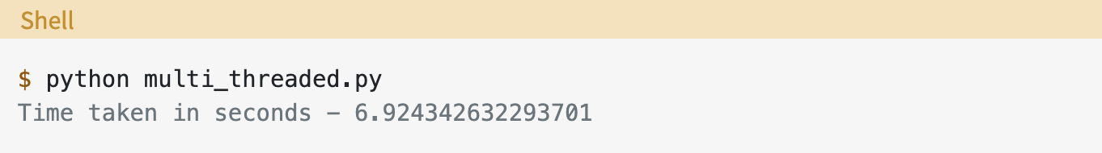
Python Global Interpreter Lock (GIL) cont.
Both versions take almost same amount of time to finish with the multi-threaded version taking slightly longer.
In the multi-threaded version, the GIL prevented the CPU-bound threads from executing in parallel.
CPU-bound program preforming a countdown
Same program using two threads in parallel

Slide 19
Multiprocessing (Python Pkg.)
Supports spawning processes using an API similar to the threading module
Offers both local and remote concurrency, effectively side-stepping the GIL by using subprocesses instead of threads.
Allows the programmer to fully leverage multiple processors on a given machine
The Pool object offers a convenient means of parallelizing the execution of a function across multiple input values, distributing the input data across processes (data parallelism).

Slide 20
Concurrent.Futures (Python Pkg.)
Provides a high-level interface for asynchronously executing callables (e.g. function definitions).
The asynchronous execution can be performed with threads, using ThreadPoolExecutor, or separate processes, using ProcessPoolExecutor.
It is essentially an easier means to implement the threading and multiprocessing packages.
Less flexibility
More optimal choice for the project given the timeframe

Slide 21
Fernet (Python Pkg.)
Fernet is an encryption spec that utilizes AES-128 under the hood.
Allows easy implementation of AES in Python.
Generate a key with static method Fernet.generate_key()
Instantiate an instance of the cryptography.fernet.Fernet class
Encrypt data with encrypt() method
Decrypt data with decrypt() method

Slide 22
Additional Python Pkgs.
Pillow
Image processing
Numpy
Array management
IO
Loading/Saving files
Glob
File/Path management
Math
Math
Time
Gather execution time measurements
Random
Generate random numbers
Image Slicer
Image processing
Pathlib
File/Path management
Shutil
File/Path management
Progressbar
Aesthetically pleasing command line progress indicator

Slide 23
design

Slide 24
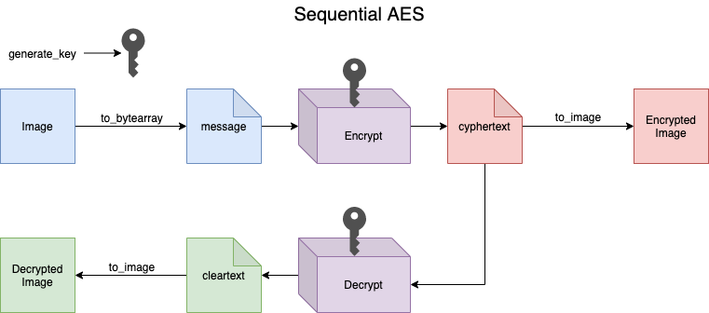
Flowchart (Sequential)

Slide 25
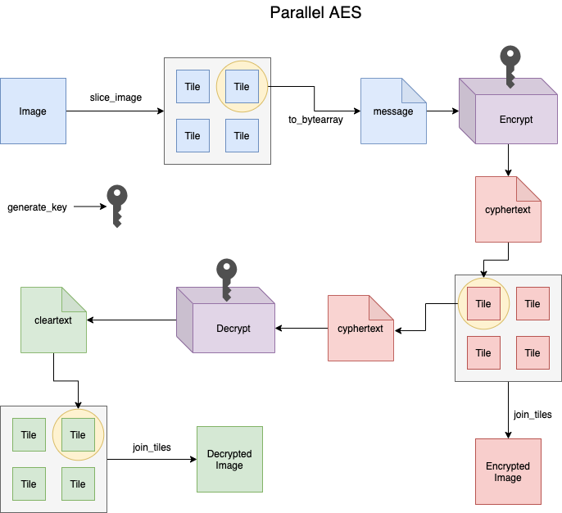
Flowchart (Data-parallelism Using Tiles)

Slide 26
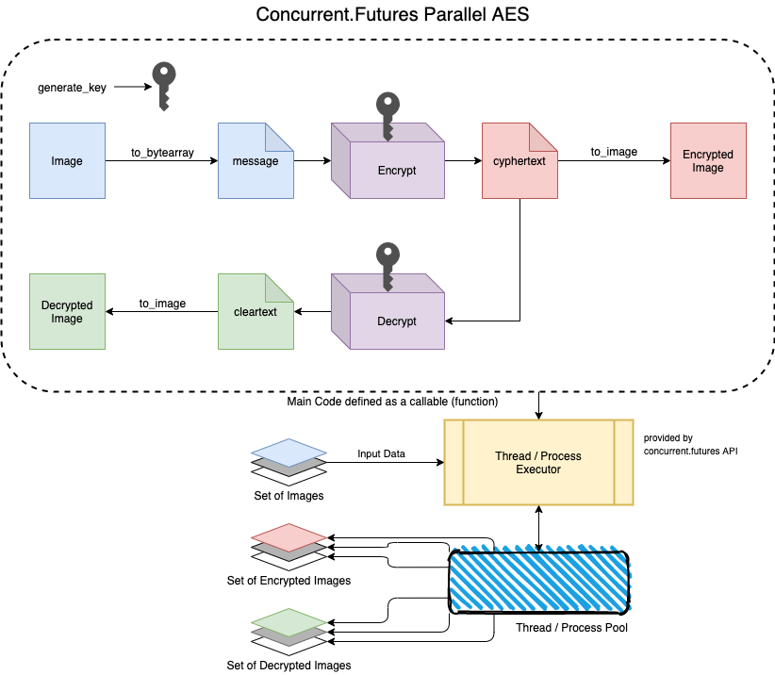
Flowchart (Parallelism Without Tiles)

Slide 27
Current status

Slide 28
accomplishments
Working program capable of encrypting/decrypting images
Achieved some speedup after sidestepping the GIL
Seemingly successful implementation of data parallelism at a high-level in v.2
Increased understanding of parallel programming in Python

Slide 29
setbacks
Unable to implement on GPU using OpenCL to realize true increase in parallel performance
Progress was hindered for about a week due to GIL
Implementing multi-processing came with a learning-curve
Some objects weren't able to be 'pickled' (e.g. image classes) as they were
Binary protocol for serializing/de-serializing Python objects
Workarounds might have induced some overhead costs
Ambitious goals with a short timeframe

Slide 30
Results

Slide 31
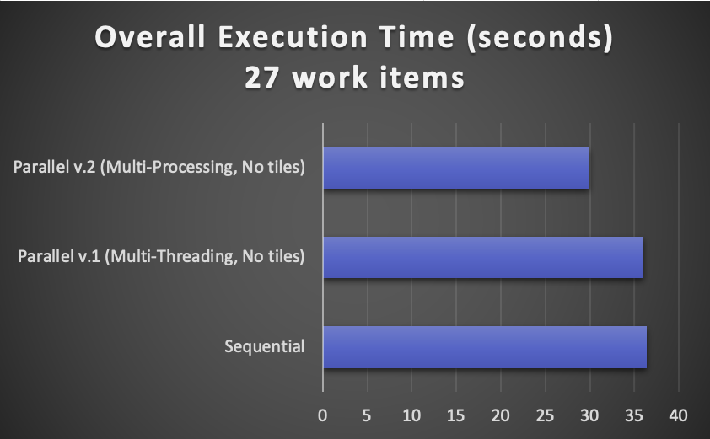
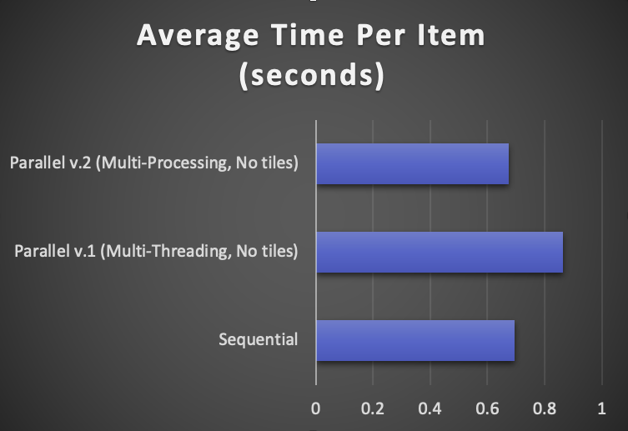
No Tiles

Slide 32
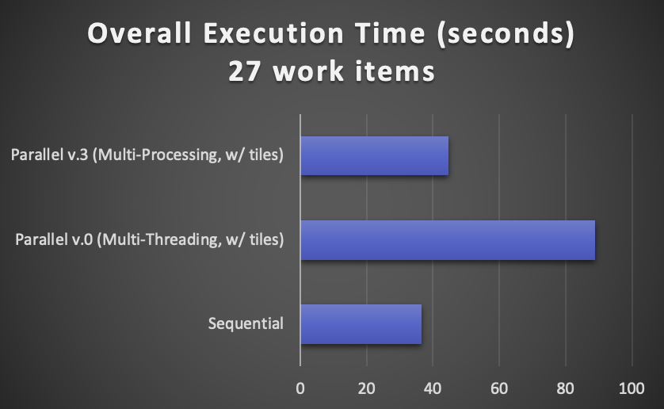
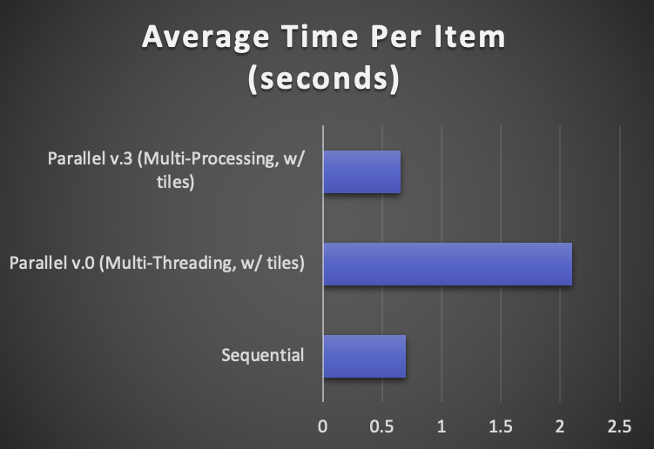
Using tiles

Slide 33
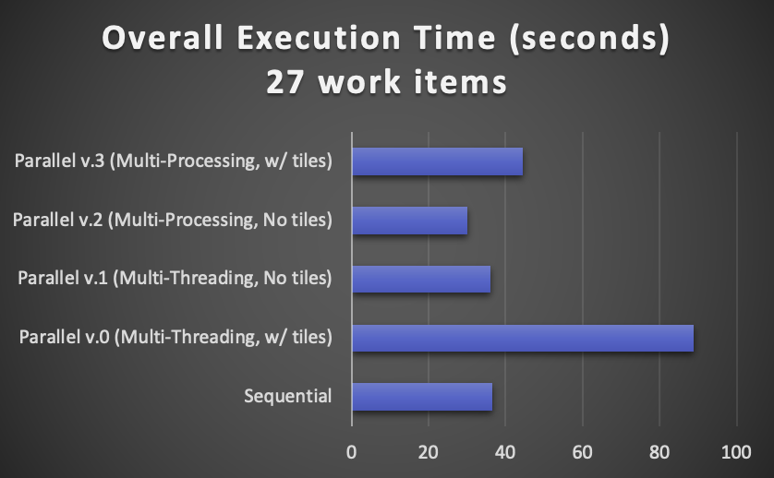
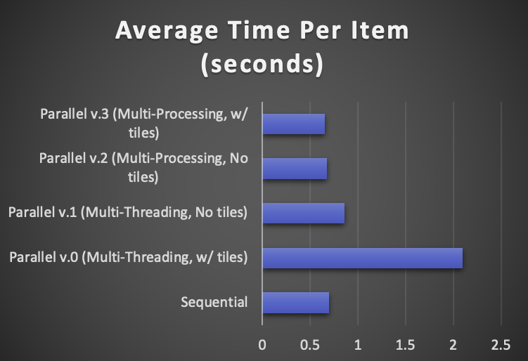
Overall

Slide 34
Future work
Fix issues with latest version using tiles
Implement OpenCL and realize speedup on GPU
Further optimize parallelism
Use threads for I/O bound tasks (Image loading/storing) and processes for CPU-bound tasks (Image processing, encryption/decryption)
Gather results with varying number of work-items to see at what point maximum speedup is achieved
Same as paper

Slide 35
Questions?

