Slide 1
WeChat
”Give us your money ☺”

Slide 2
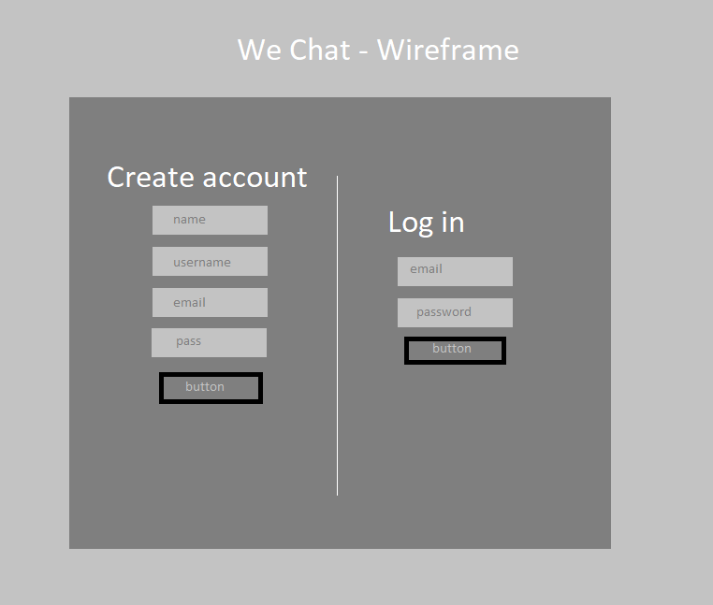
Prototype/Wireframe

Slide 3
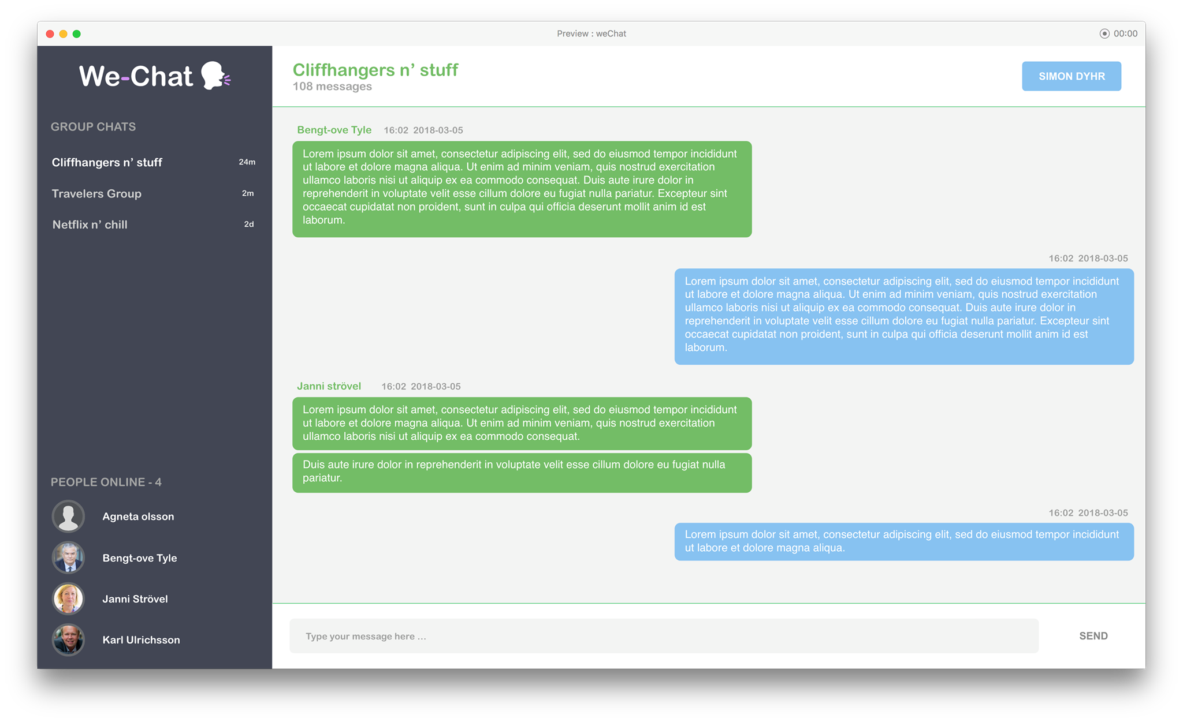
Prototype/Wireframe

Slide 4

https://trello.com/b/UYqLD6jV/chat-application

Slide 5
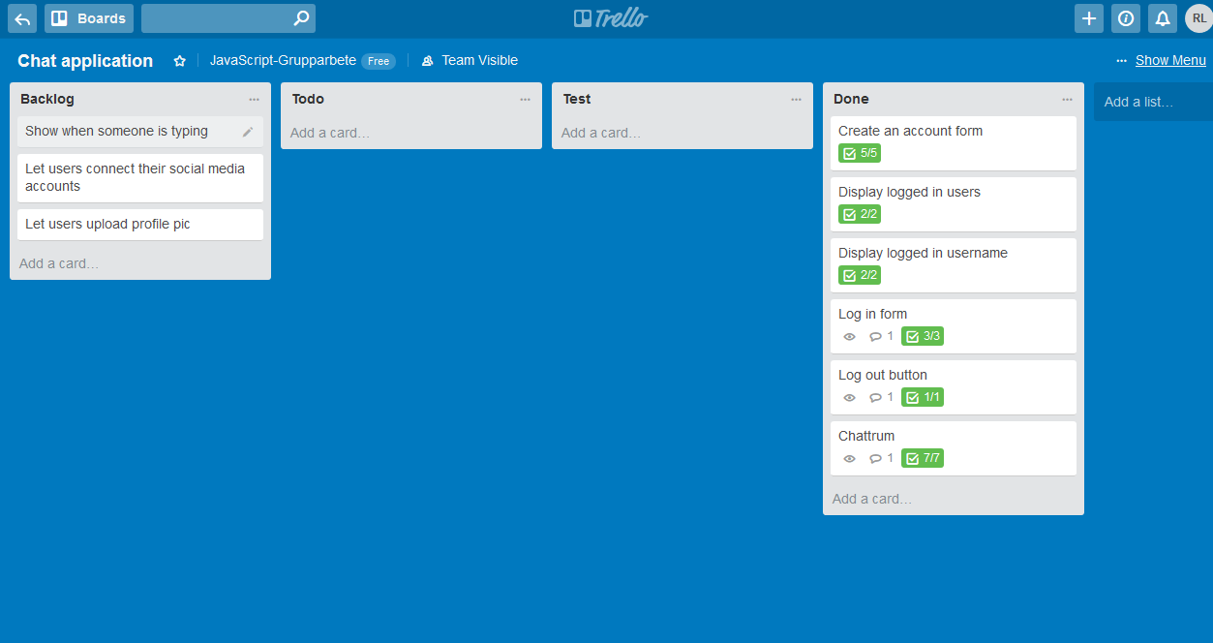

Slide 6


Slide 7
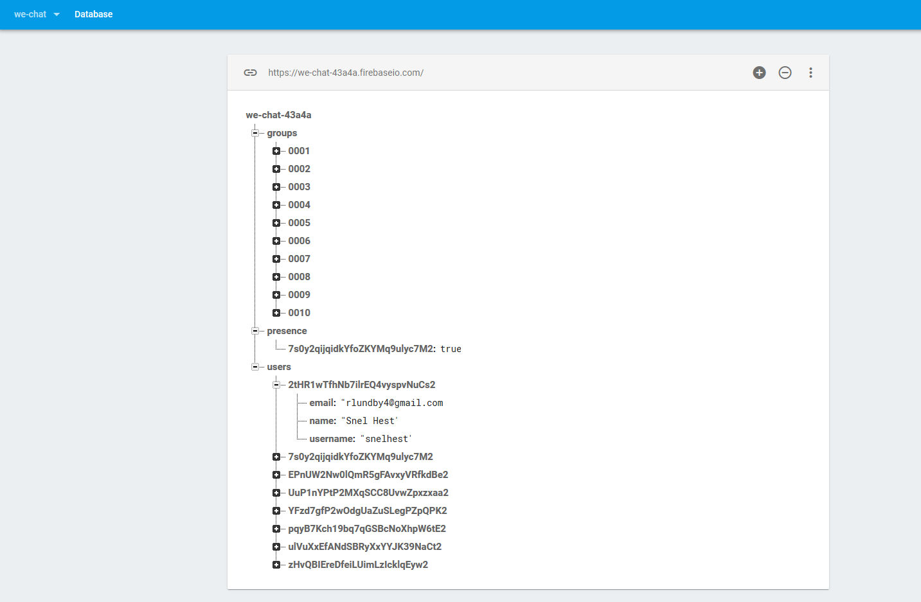
Groups: Chat rooms
Presence: Online indicator
Users: Registered users
- User Id
- email, name, username

Slide 8
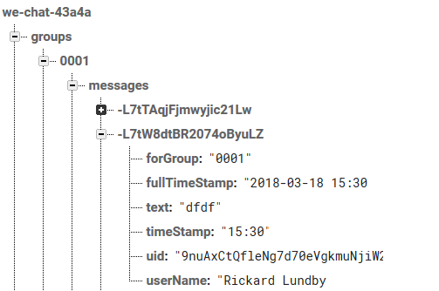
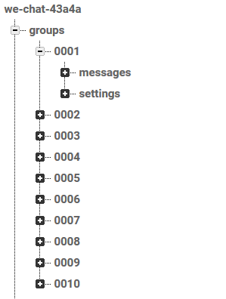
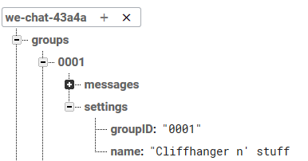
Messages
Groups
Settings

Slide 9
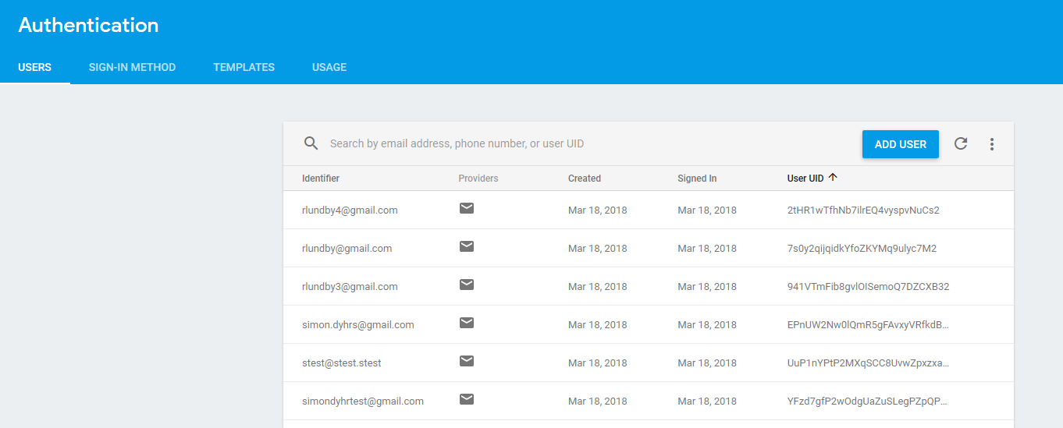
Firebase Authentication

Slide 10


https://github.com/rlundby/weChat
https://we-chat-43a4a.firebaseapp.com/

