Slide 1
Predicting the Best Italian Restaurant to Eat at While Visiting Washington, D.C.
By: Logan Walker
Coursera Data Science Applied Capstone Project

Slide 2
Background
Washington, D.C. has become one of the top destinations for tourists to not only explore some of our nation’s top historical attractions, but also to experience exciting new dining options of various cuisines
One of the popular around the area are Italian restaurants
With very limited knowledge of the city’s layout and so many neighborhoods to choose from, tourists may wonder where the best Italian restaurant to eat at would be
Factors to consider:
Distance from D.C.’s city center (where tourists typically explore attractions)
Popularity (number of likes given by users on Foursquare)
This study might appeal to tourists & potential entrepreneurs

Slide 3
Data sources
Geocoder (open-source Python library package)
Nominatim feature – identify coordinates of defined address
Foursquare API Search
API Client ID
Client Secret
Version
Limit = 50 venues
Radius = 5000 meters

Slide 4
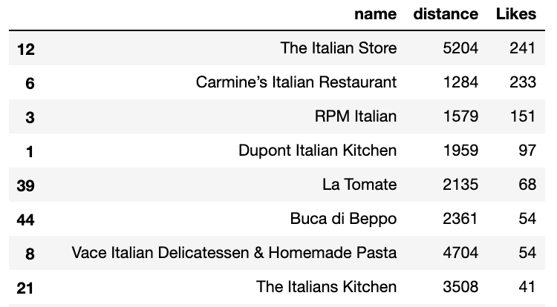
Data cleaning
Foursquare API Search Query URL converted to JSON file
Venues in JSON file combined into Pandas dataframe
Filter out columns with missing values
Preserve columns containing information about restaurant location
Total of 47 venues returned and 21 features for each venue
Use Venue ID from dataset
Create loop that extracts a list for number of likes received on Foursquare for each Italian restaurant
Create a new, simplified dataframe that contains:
Restaurant Name
Distance
Likes

Slide 5
3 Methods of Analysis
K-Means Clustering
Agglomerative Divisive Clustering
Density-Based Spatial Clustering of Applications with Noise (DBSCAN)

Slide 6
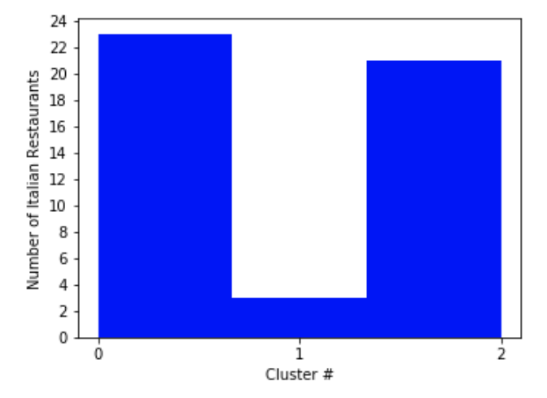
K-Means Clustering
Figure 1. Histogram visualizing the number of Italian restaurants that were delegated to each cluster based on k-means algorithm running 12 times.

Slide 7
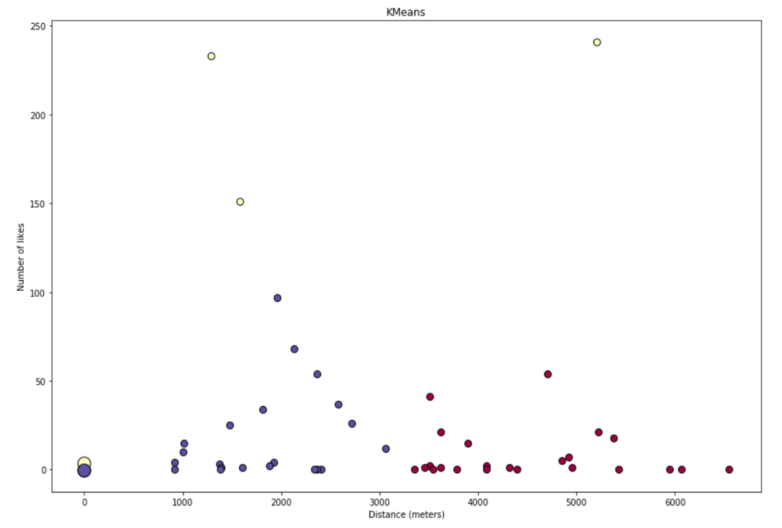
K-Means Clustering Cont’d
Figure 2. Color map depicting each Italian restaurant venue and its associated cluster label. Number of cluster centroids are depicted in the lower left-hand corner and individual datapoints were mapped based on values of features (distance and number of likes). Distance in meters is assigned to the X-axis and Number of Likes is assigned to the Y-axis.
Labels:
Red = Cluster 0
Yellow = Cluster 1
Blue = Cluster 2

Slide 8
K-Means Clustering Results
Cluster 1 had significantly fewer venues with this label than both clusters 0 and 2
The 3 Clusters generated could be categorized as such:
Cluster 0 = Far from city center, low number of likes
Cluster 1 = Close to OR far from city center, high number of likes
Cluster 2 = Close to city center, low number of likes

Slide 9
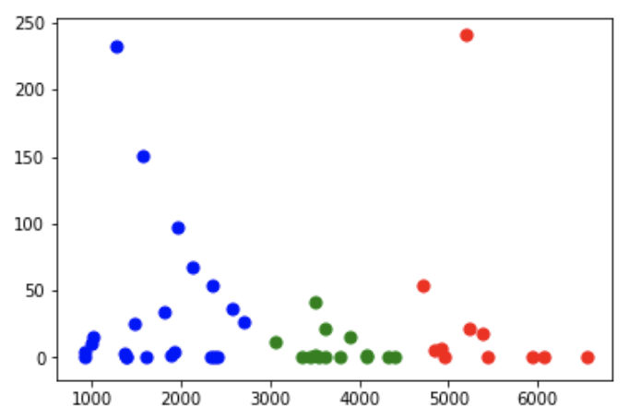
Agglomerative Divisive Clustering
Figure 4. Scatter plot of Number of Likes (Y-axis) vs. Distance from City Center (X-axis). New cluster label colors were used for agglomerative divisive clustering.
Labels:
Red = Cluster 0
Blue = Cluster 1
Green = Cluster 2

Slide 10
Agglomerative Divisive Clustering Results
These new cluster labels are more oriented towards distance as a feature opposed to the number of likes
The 3 Clusters generated could be categorized as follows:
Cluster 0 = Closest to city center
Cluster 1 = Moderately close to city center
Cluster 2 = Furthest from city center

Slide 11
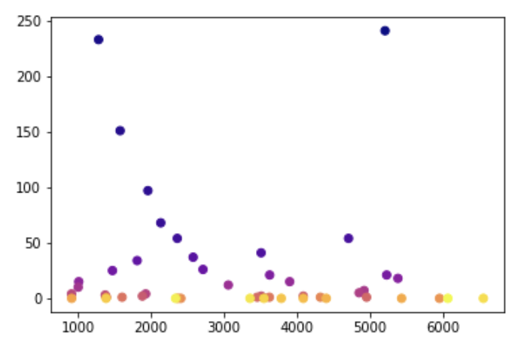
Density-Based Spatial Clustering of Applications with Noise (DBSCAN)
Figure 5. Scatter plot of Number of Likes (Y-axis) vs. Distance from City Center (X-axis) utilizing DBSCAN.

Slide 12
DBSCAN Results
Datapoints with darker colors are more indicative of restaurants that have more favorable popularity and distance to the city center.
Datapoints with lighter colors have a much larger margin for these two variables and are more difficult to interpret. These points would likely be less favorable as options to choose from

Slide 13
Conclusion and future directions
Built useful models to determine which Italian restaurants in Washington, D.C. would be the best options based on 47 venues returned
Focused specifically on distance from D.C. city center and number of likes each venue received from Foursquare users
Concluded that most favorable options tended to be located moderately distant to city center and received a much greater number of likes than other Italian restaurant venues
Both accuracy of clustering models and conclusions drawn have room for improvement.
Ideas include:
More Italian restaurant options
Filter out irrelevant venues returned by Foursquare API Search
More statistical analysis (descriptive statistics, linear regression modeling, classification modeling)
Additional independent variables to consider (e.g. neighborhoods)

