Slide 1
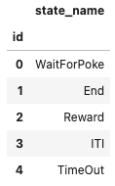
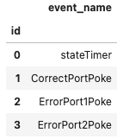
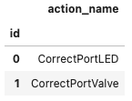
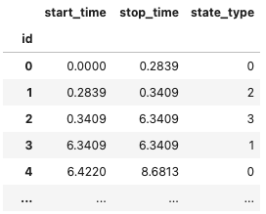
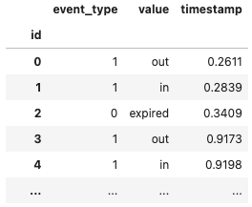
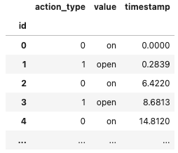
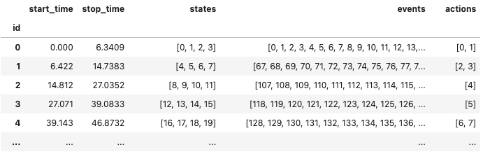
ndx-beadl
/general
Task
StateTypesTable
BEADLTaskProgram
EventTypesTable
BEADLTaskSchema
ActionTypesTable
/acquisition
StatesTable
EventsTable
ActionsTable
/intervals
TrialsTable (TimeIntervals)

