Slide 1










What makes a song popular
Stephanie Sammour Jordan Cline Bill Pezzullo

Slide 2
Goal:
Examine the top songs from the Billboard 100 spanning from 1958 to 2019
and see if there are characteristics that these songs share. Are these characteristics propelling certain songs to become hits? Through data cleaning and plotting what we find, we hope to find if there are any correlations that support the questions that follow.
Questions:
Overarching Question : What makes a top hit a top hit
1) Is there a similar attribute (i.e acousticness/valence/energy/danceability) that a large portion of the songs have?
2) Is there a particular genre that dominates the top hits playlist?
3) Is there a connection between the hits globally and what countries it ‘blows up’ in? (i.e if it ‘blows up’ in the USA, is it more likely to be a hit in the global playlist)

Slide 3
Data Sources:
https://data.world/kcmillersean/billboard-hot-100-1958-2017 - Data World Top 100 audio features (2 data files)
Data file on the top 100 taken every week from 1958 to 2019
Data file on songs with Spotify attributes associated with the songs
https://spotifycharts.com/regional - csv data on top 200
Spotify API (for playlist data / song valuations)

Slide 4
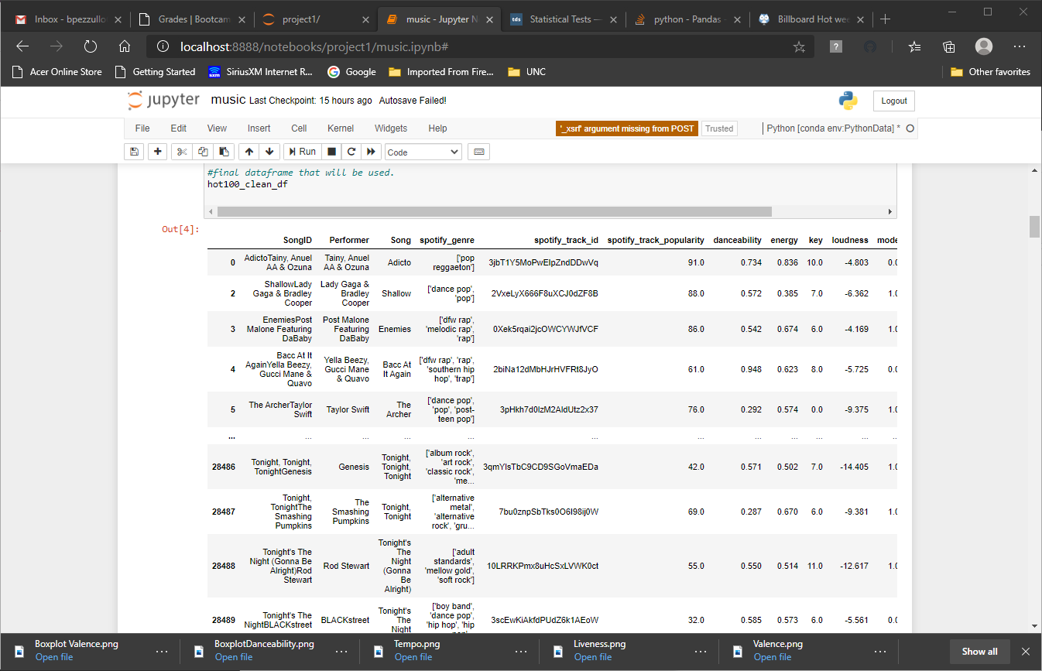
songid
performer
song
spotify_genre
spotify_track_id
spotify_track_preview_url
spotify_track_album
spotify_track_explicit
spotify_track_duration_ms
spotify_track_popularity
danceability
energy
key
loudness
mode
speechiness
acousticness
instrumentalness
liveness
valence
tempo
time_signature
23,550 songs

Slide 5
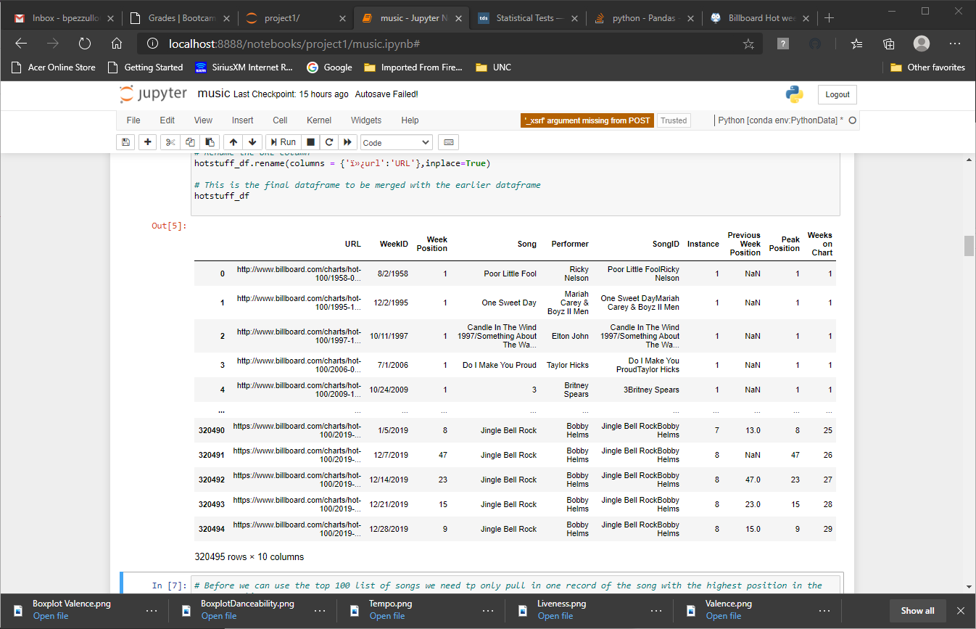
Fields
url
weekid
week_position
song
performer
songid
instance
previous_week_position
peak_position
weeks_on_chart
Over 320,000 rows

Slide 6
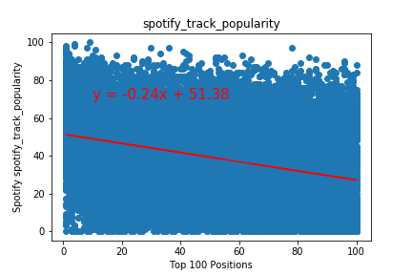
Correlation amongst the popularity Spotify attributes
Popularity:
-The correlation between both
factors is -0.33
-The p-value is 0.0

Slide 7
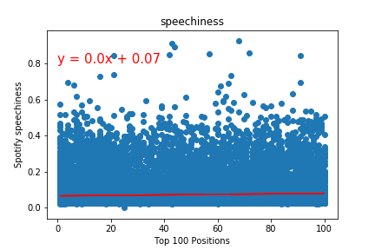
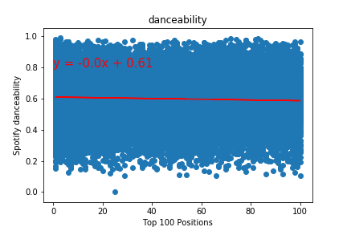
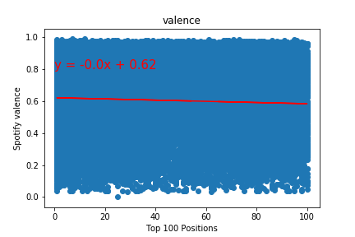
Danceability, Speechiness, and Valence
- The correlation between both factors is -0.05
- The p-value is 0.0

Slide 8
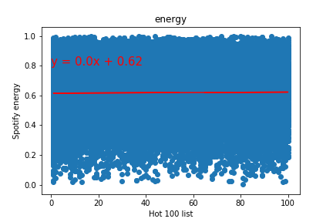
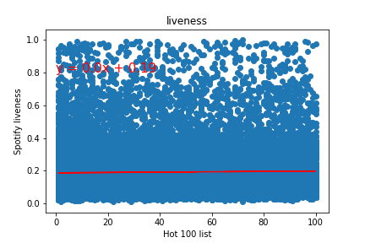
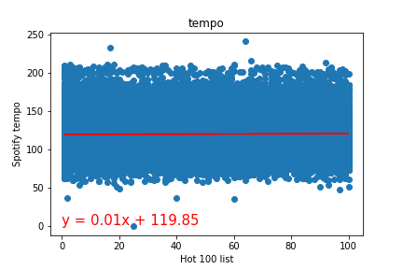
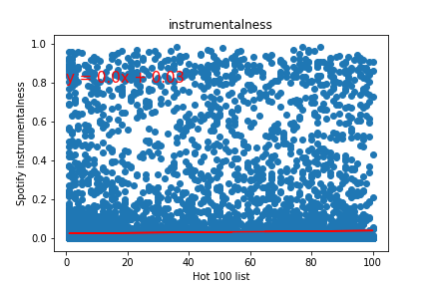
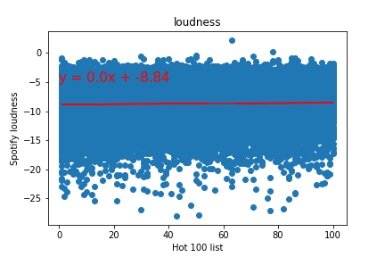
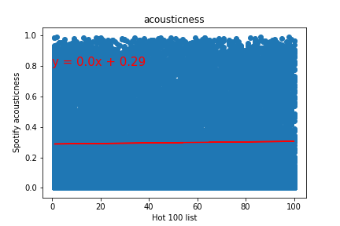
No correlation amongst the other Spotify attributes

Slide 9
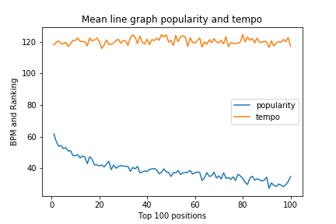
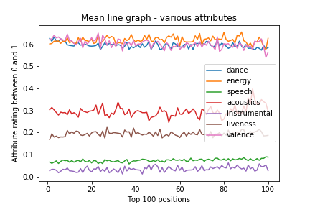
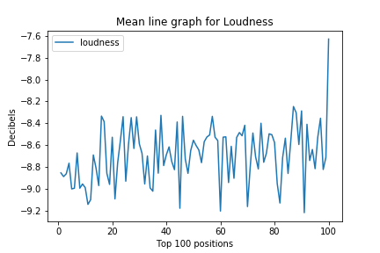

Slide 10
Trends over the Decade
While the top songs have only a small correlation with the attributes for the full 60 years, we decided to breakdown the songs using the WeekID by decade.

Slide 11
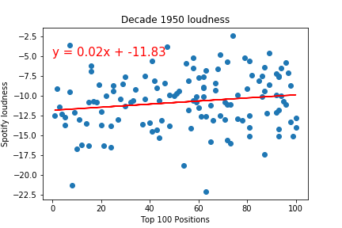
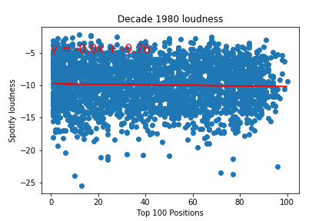
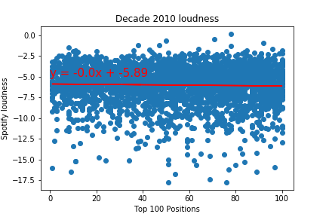
Loudness trends over the last 60+ years
Music has increased in loudness over the years

Slide 12
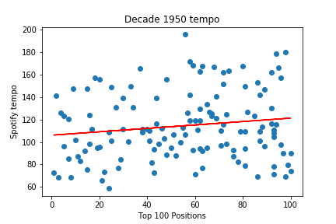
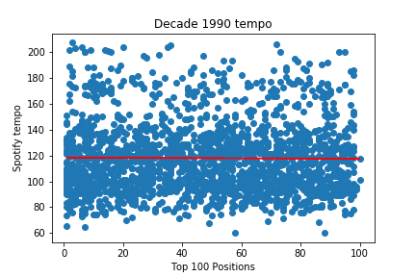
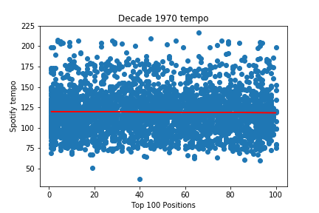
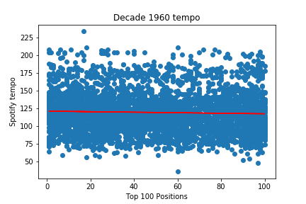
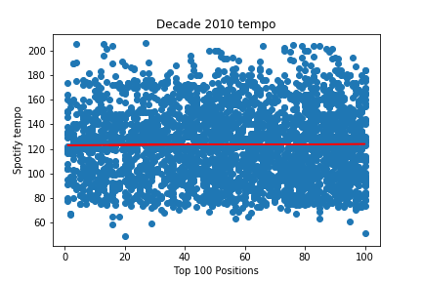
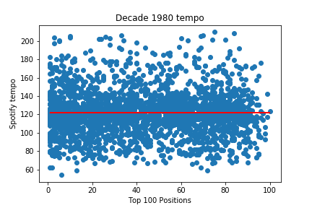
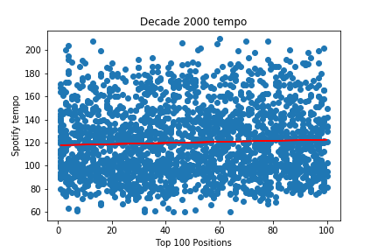
Tempo trends over the last 60+ years
Large jump from 50’s to 60’s
Slow increase for the last 60 years

Slide 13
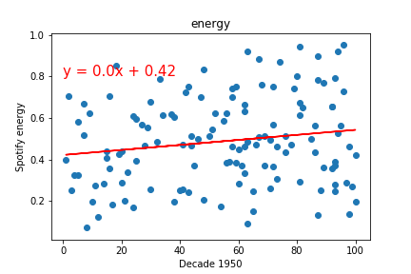
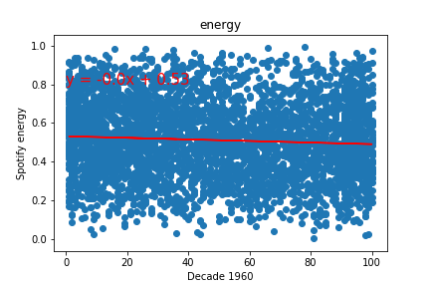
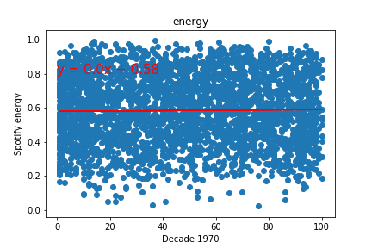
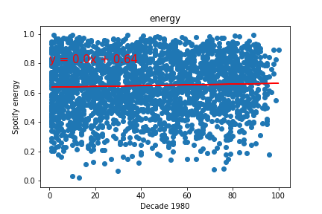
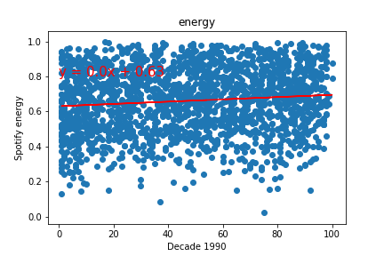
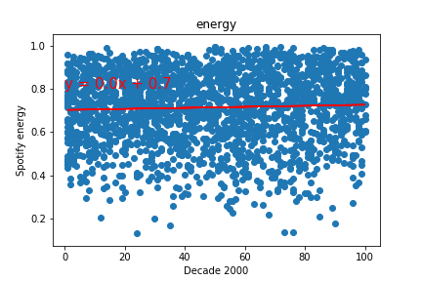
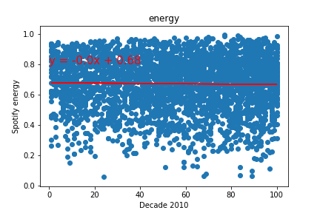
Energy level of top songs
increase by 10% between 50’s and 60’s
increase by only 5% between 60’s and 80’s
stabilizes after 1980’s
roughly over 25% over the 60+ years

Slide 14
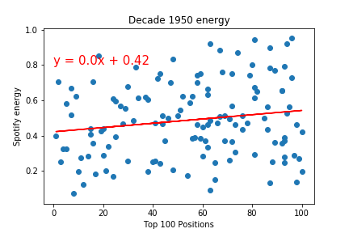
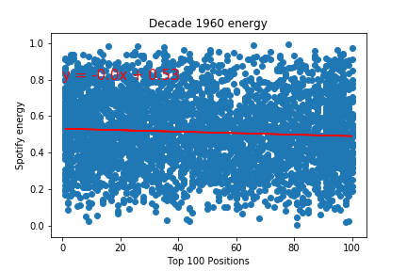
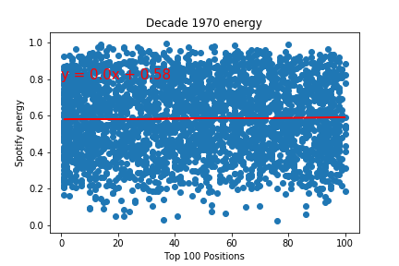
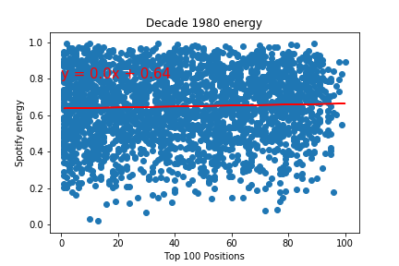
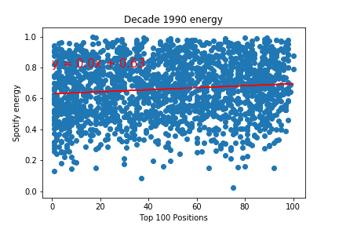

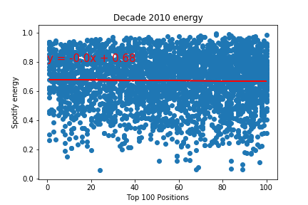
Energy level of top songs
increase by 10% between 50’s and 60’s
increase by only 5% between 60’s and 80’s
stabilizes after 1980’s
roughly over 25% over the 60+ years

Slide 15


Slide 16
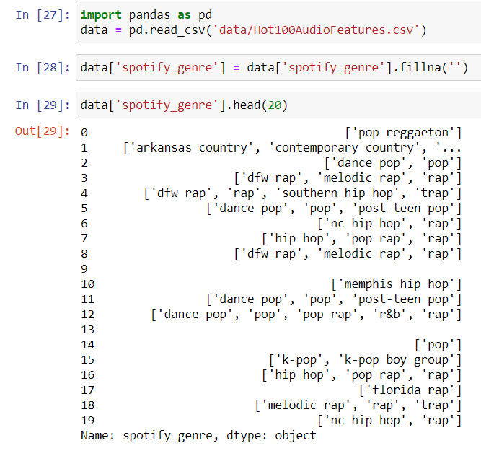

Slide 17
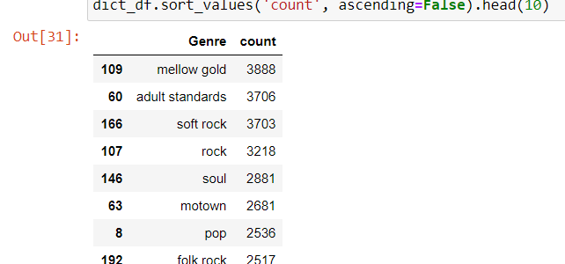

Slide 18
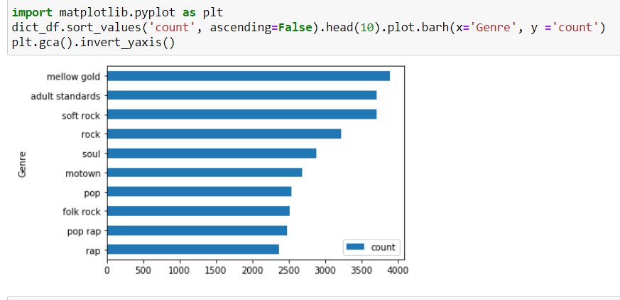

Slide 19


Slide 20
Backup

Slide 21
