Slide 1










What makes a song popular
Stephanie Sammour Jordan Cline Bill Pezzullo

Slide 2
Goal:
Examine the top songs from the Billboard 100 spanning from 1958 to 2019
and see if there are characteristics that these songs share. Are these characteristics propelling certain songs to become hits? Through data cleaning and plotting what we find, we hope to find if there are any correlations that support the questions that follow.
Questions:
Overarching Question : What makes a top hit a top hit
1) Is there a similar attribute (i.e acousticness/valence/energy/danceability) that a large portion of the songs have?
2) Is there a particular genre that dominates the top hits playlist?
3) Is there a connection between the hits globally and what countries it ‘blows up’ in? (i.e if it ‘blows up’ in the USA, is it more likely to be a hit in the global playlist)

Slide 3
Data Sources:
https://data.world/kcmillersean/billboard-hot-100-1958-2017 - Data World Top 100 audio features (2 data files)
Data file on the top 100 taken every week from 1958 to 2019
Data file on songs with Spotify attributes associated with the songs
https://spotifycharts.com/regional - csv data on top 200
Spotify API (for playlist data / song valuations)

Slide 4
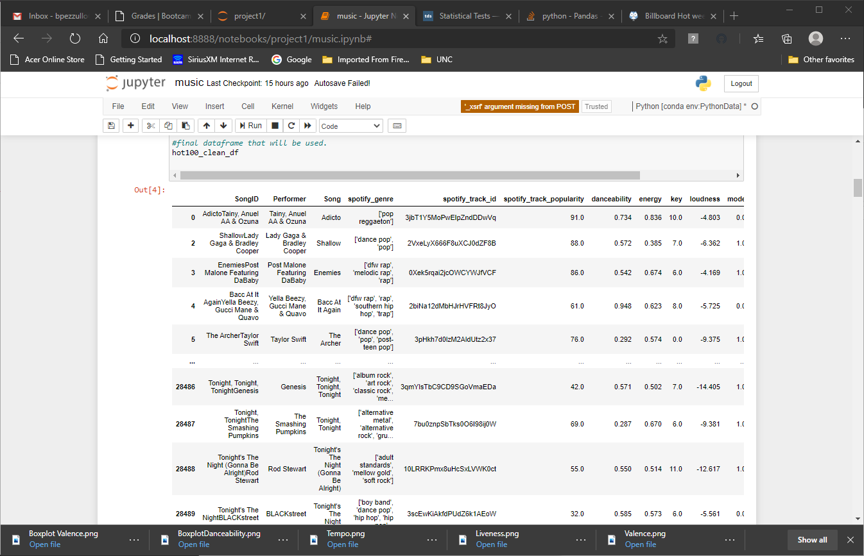
23550 songs

Slide 5
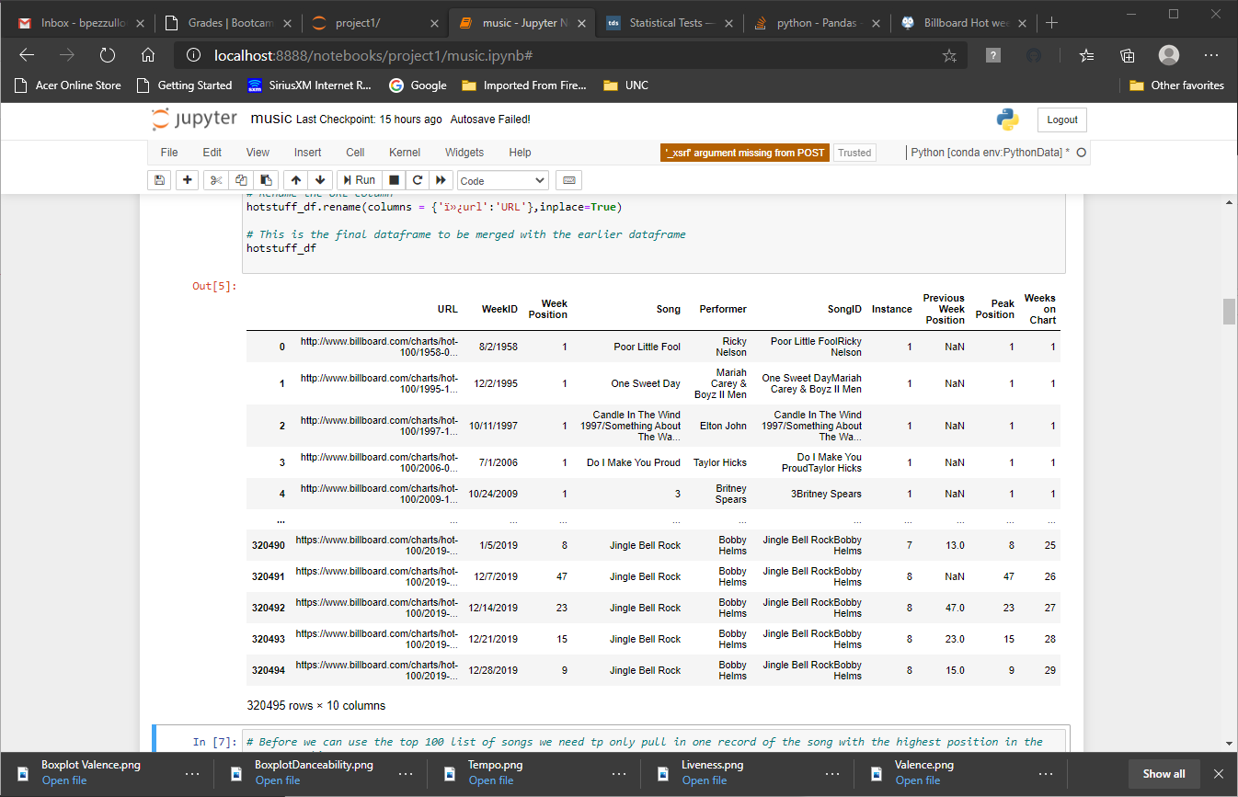
Over 320,000 rows

Slide 6
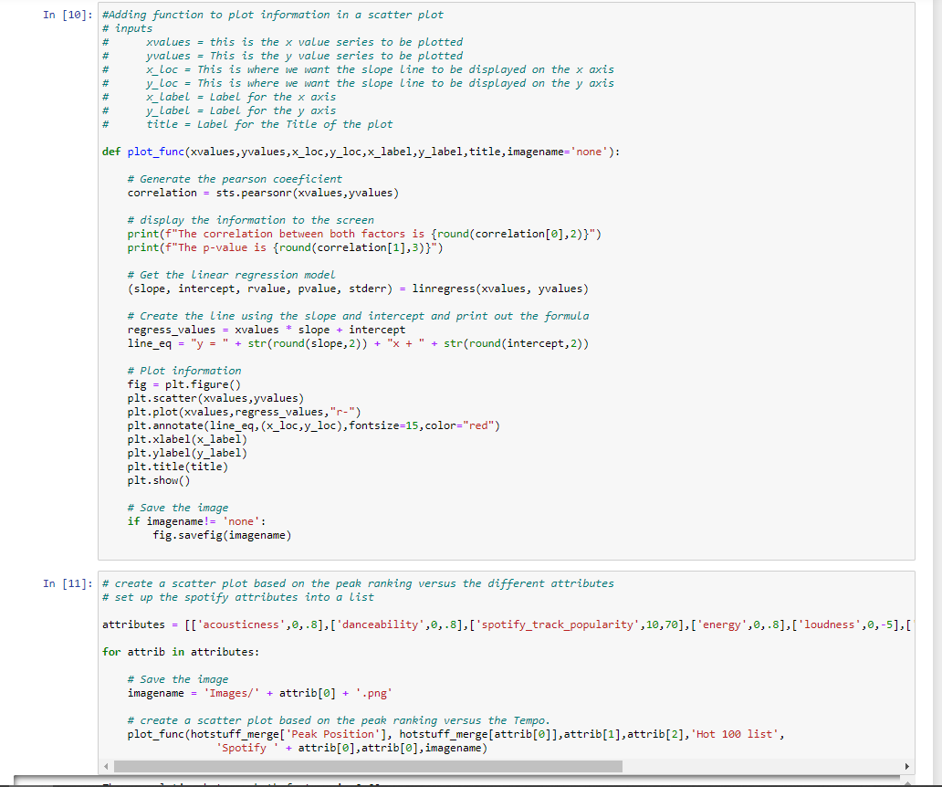

Slide 7
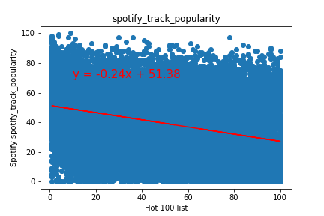
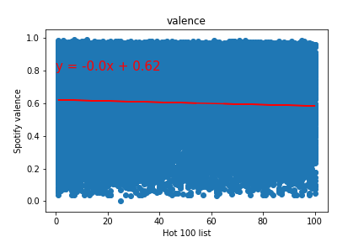
Valence:
The correlation between both factors is -0.05
The p-value is 0.0
Popularity:
The correlation between both factors is -0.33
The p-value is 0.0

Slide 8
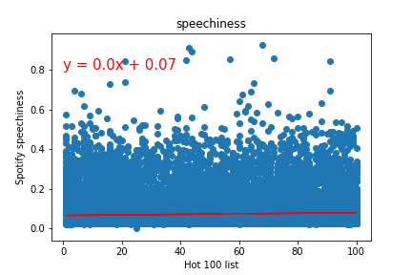
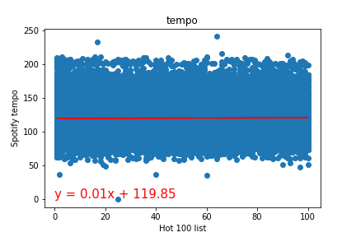
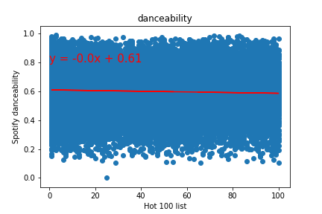
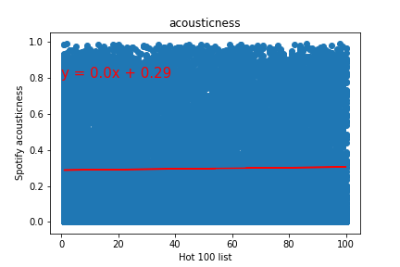

Slide 9
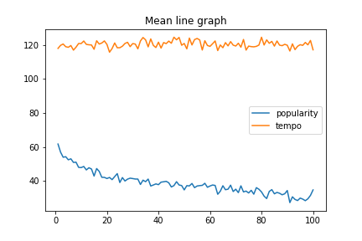
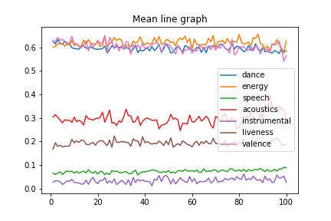
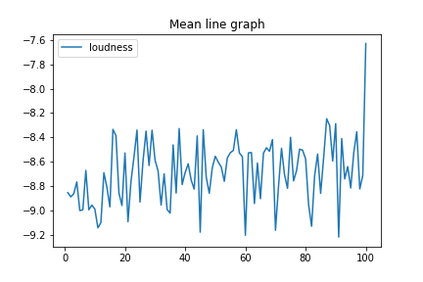

Slide 10
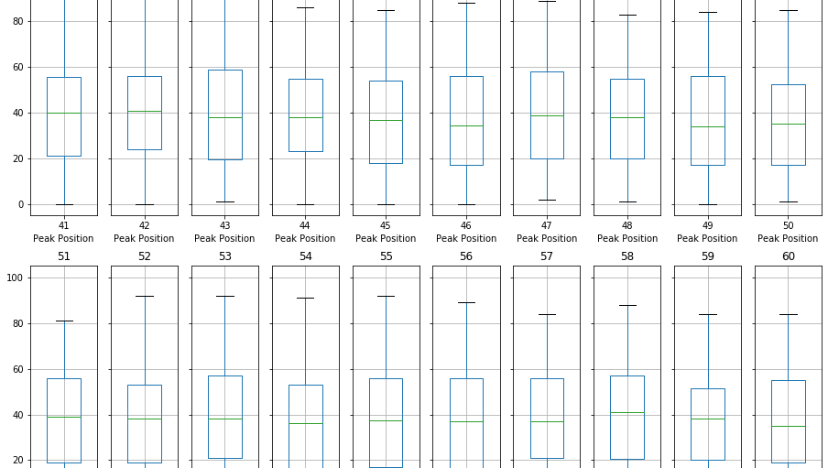

Slide 11
Trends over the Decade
Music seems to not be directly associated to an attribute captured by the Spotify system. As we can see in the next set of slides the trend changes.

Slide 12
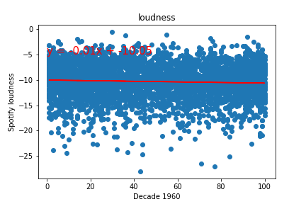
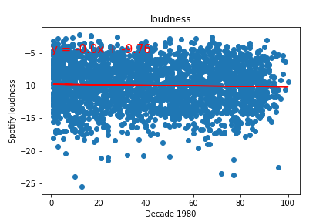
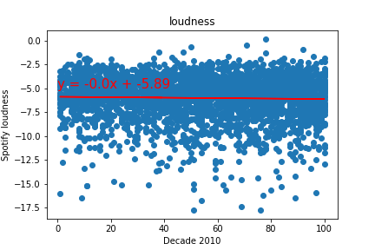
Loudness trends over the last 70 years
Music has increased in loudness over the years

Slide 13
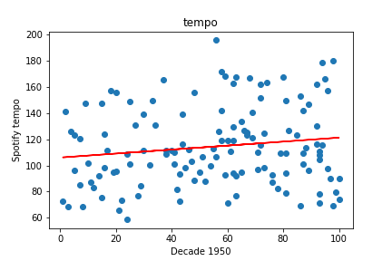
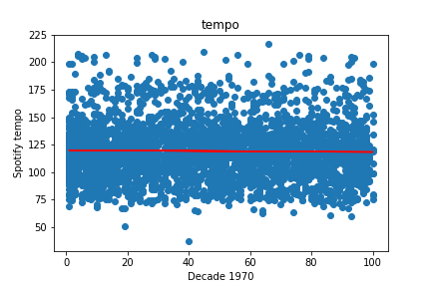
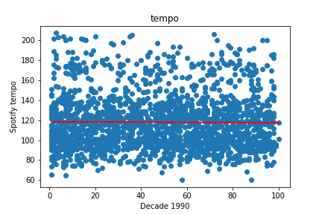
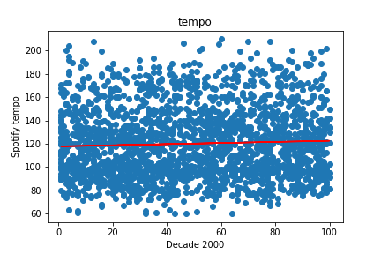
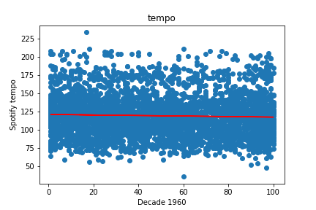
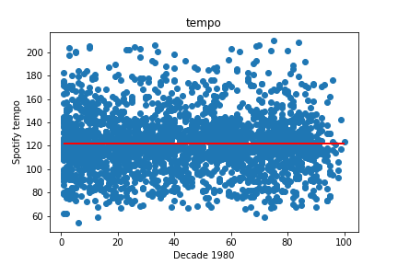
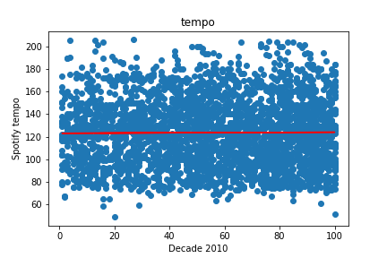
Tempo trends over the last 70 years

Slide 14
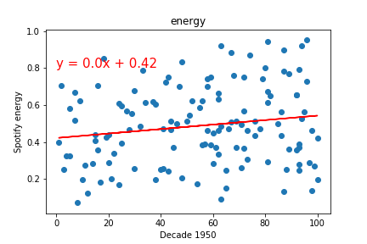
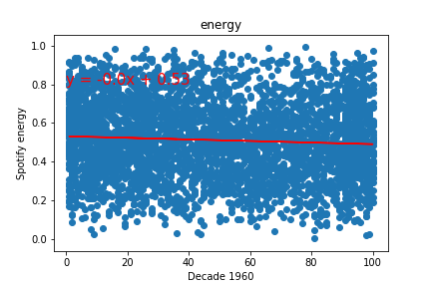
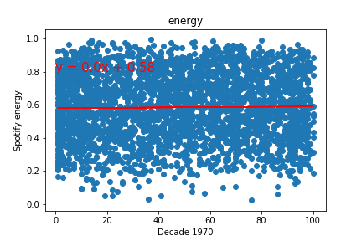
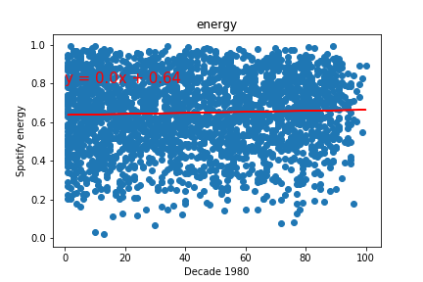
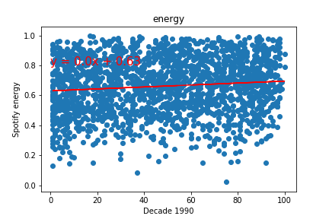
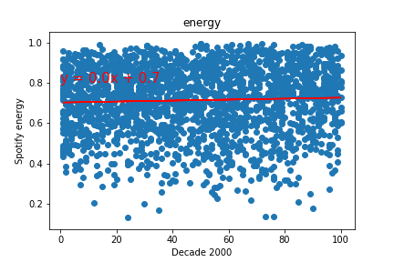
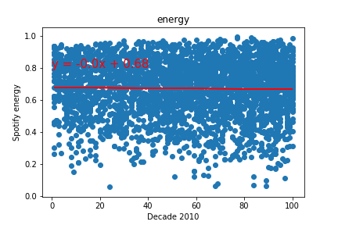
Energy level of top songs have seemed to increase over the decades

