Slide 1
Predicting IAAF World Half Marathon Championship & Training Strategy for Athlete
Ruofan Lyu
001222480

Slide 2
Introduction
IAAF(International Association of Athletics Federations) World Half Marathon Championship is a well-known sports event in the world. As a possible pre-qualification of the most famous six World Marathon Major, including Boston Marathon, it is a highly participated marathon event.
Predicting athletes’ performance is significant. It helps athletes to determine their further training strategy. For sport enthusiasts, predicting can bring more professional guidance to them and attract more public attention.

Slide 3
Approach
Web data scraping
Build a regression model based on predictor variables: age, discipline, performance, date
Provide a training strategy

Slide 4
Multiple regression
In the multivariate case, when there is more than one independent variable, the regression line cannot be visualized in the two dimensional space. We could construct a linear equation containing all those variables. In general then, multiple regression procedures will estimate a linear equation of the form:
Y = a + b₁*X₁ + b₂*X₂ + ... + b_{p}*X_{p}

Slide 5

Naive Bayes classifier
In machine learning, naive Bayes classifiers are a family of simple probabilistic classifiers based on applying Bayes' theorem with independence assumptions between the features.
Knowing the probability of x|Ck, calculate P(Ck|x): to determine the result.

Slide 6
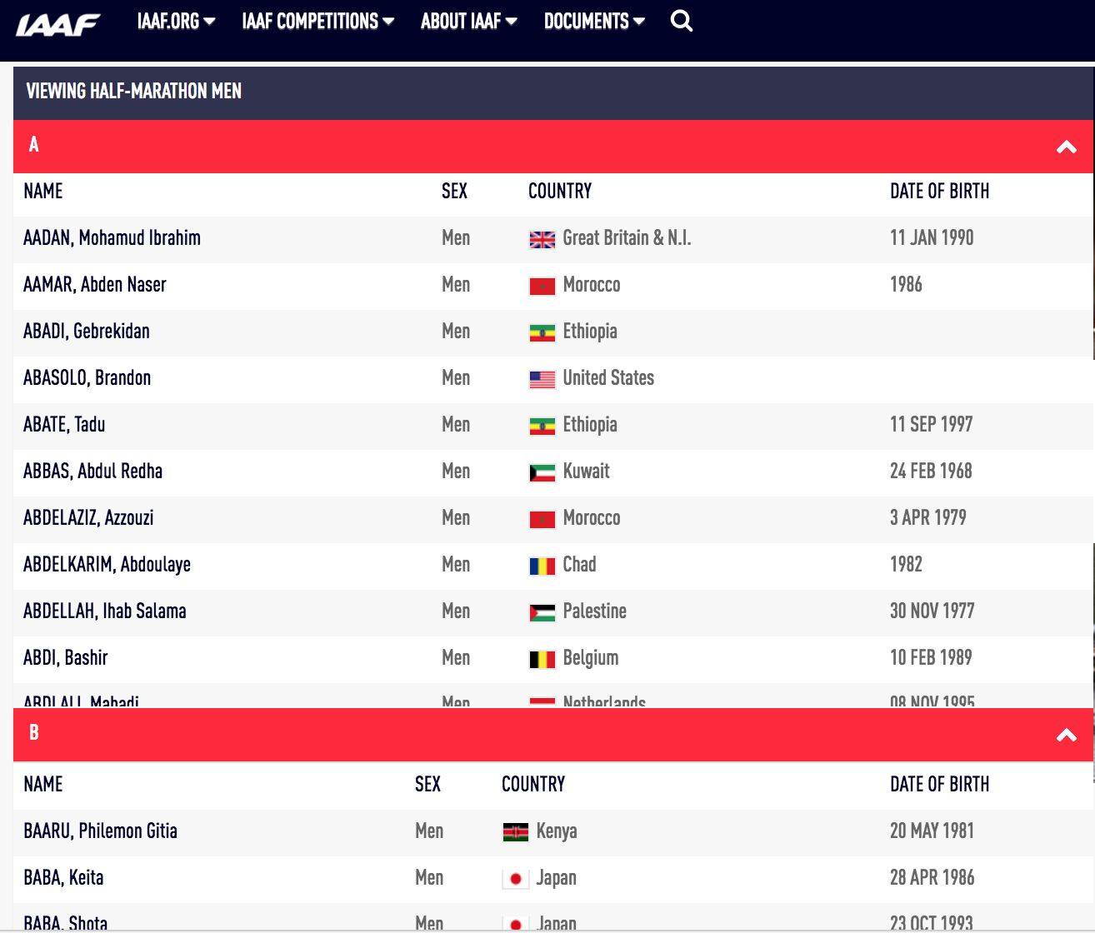
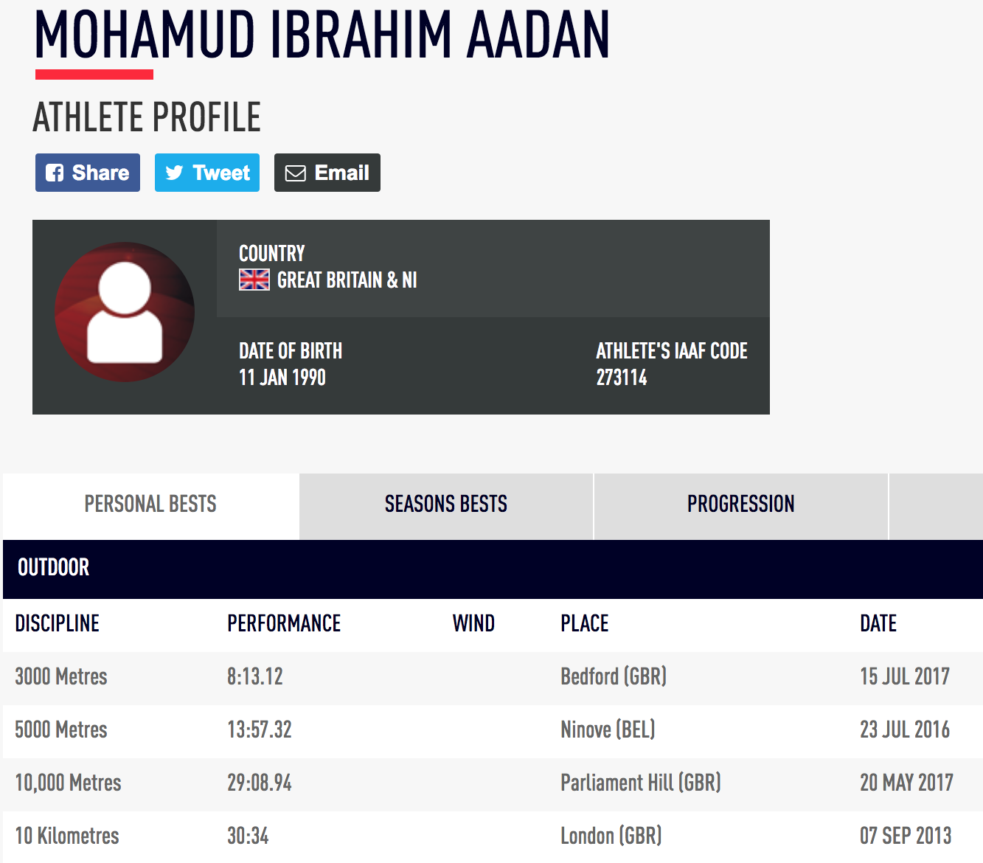
Data Source
List of athletes who has ever attend half marathon
Athlete profile

Slide 7
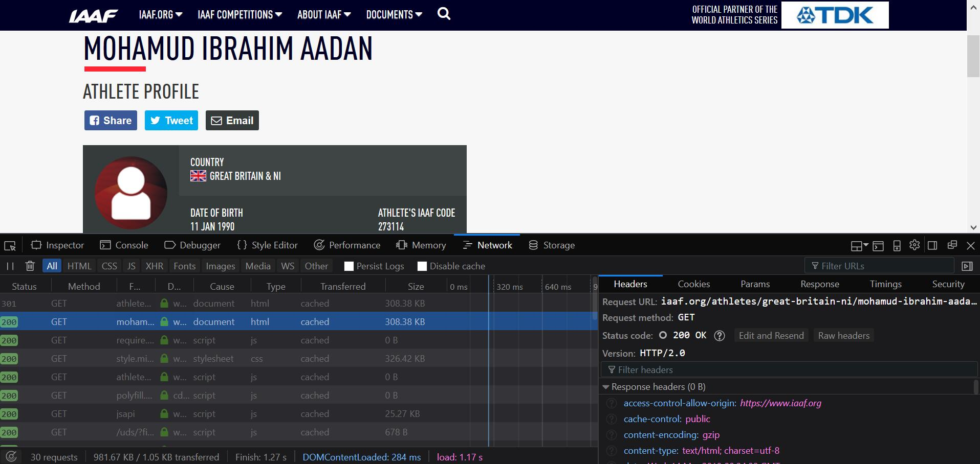
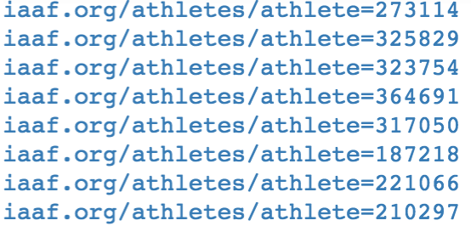
Data scraping

Slide 8
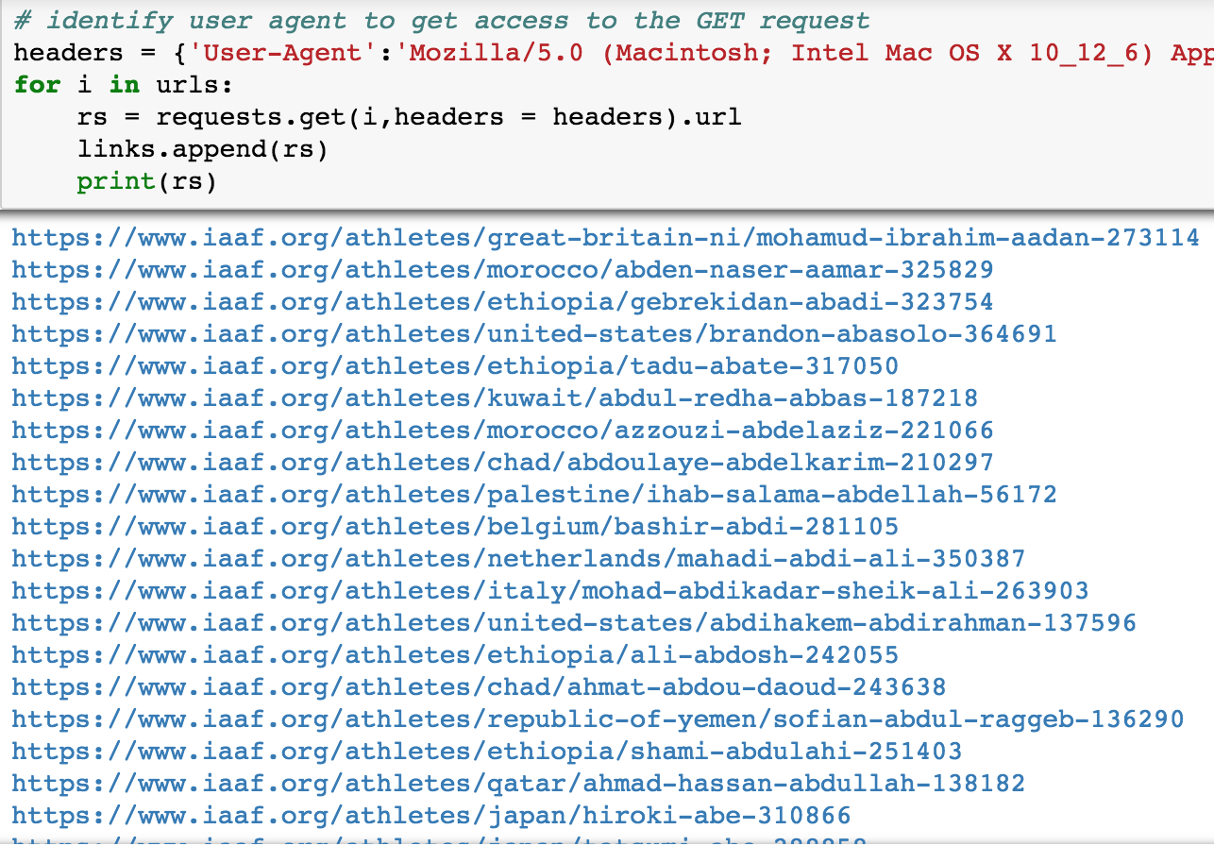
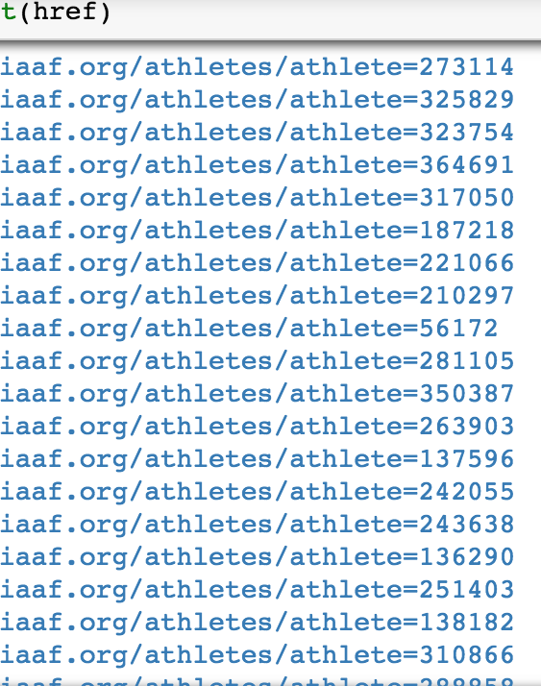
Redirected URL →
Original URL
↓

Slide 9
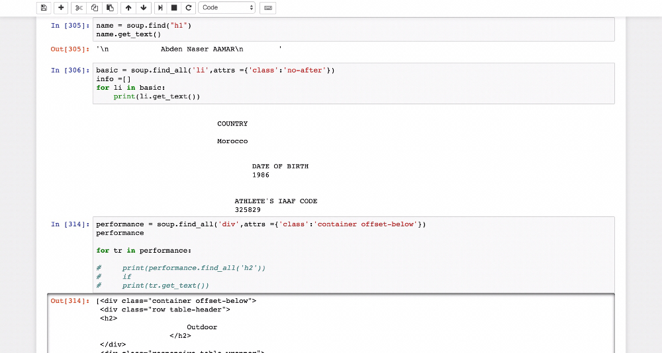

Slide 10
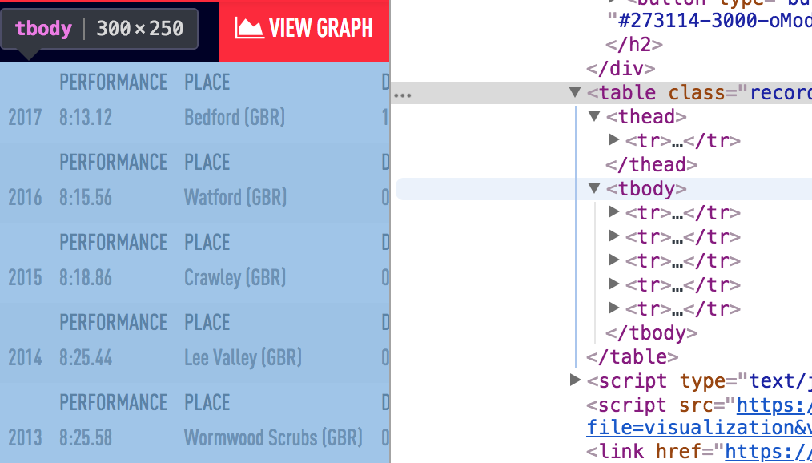
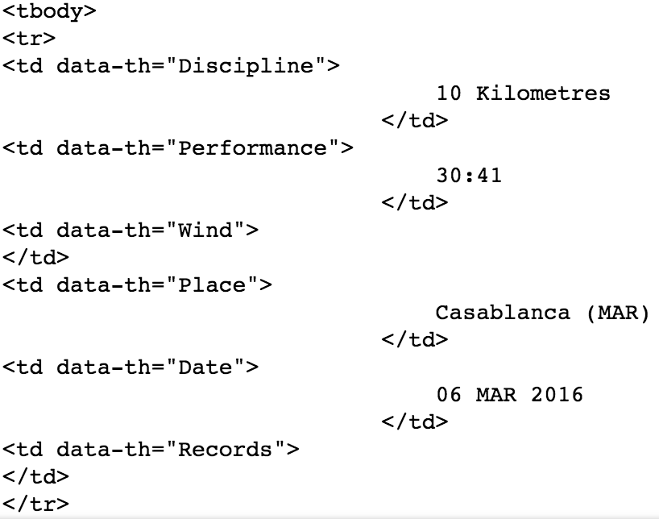

Slide 11
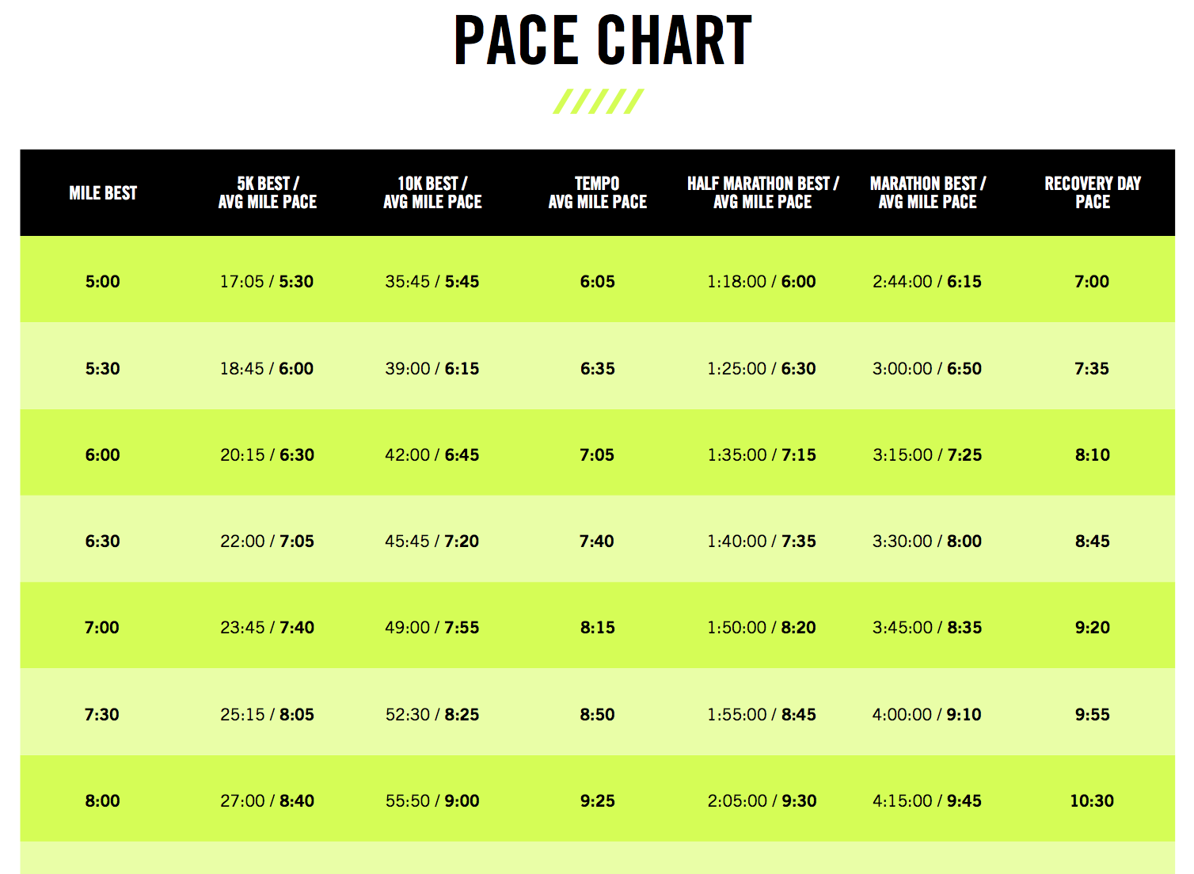
Next Steps
Build prediction model
Apply athletes’ data to the training plan
The training strategy basically refer to the Half Marathon Pace Chart

Slide 12
References
Thomas A. Severini. (2014). Analytic Methods in Sports: Using Mathematics and Statistics to Understand Data from Baseball, Football, Basketball, and Other Sports. Chapter 2.
S Tufféry. (2011). Data mining and statistics for decision making. 534 -538
Michael Bowles. (2015). Machine Learning in Python: Essential Techniques for Predictive Analysis. 122-124
Brian Hanley. Pacing profiles and pack running at the IAAF World Half Marathon Championships. (2015). https://pdfs.semanticscholar.org/819e/8db906d3673e46b6f609d1d77838f34ae1f1.pdf
https://en.wikipedia.org/wiki/Naive_Bayes_classifier

